Slide 1

INDIAN ELECTION ANALYSIS
(2014 & 2019)
Notes:
here’s my submission to codebasics resume challenge on Indian Parliament Elections 2014, 2019.

Slide 2
ANALYSIS FLOW
OVERVIEW (PLAYGROUND)
2014 ELECTION ANALYSIS
2019 ELECTION ANALYSIS
COMPARISON OF 2014 & 2019 RESULTS
CONCLUSIONS & RECOMMENDATIONS
Notes:
I begin this presentation building context on how enormous Indian democracy is and how challenging it is for both Election Commission and the parties in participation.
Then, I presnt my analysis on poll results of 2014, 2019 after which I draw comparisons and make inferences. Finally, I end with recommendations to ECI if I find any. Here, we go.

Slide 3
THE PLAYGROUND
India has 28 states & 7 Union Territories
STATES WITH HIGHEST CONSTITUENCIES
STATE | CONSTITUENCIES
UP | 80
Maharastra | 48
West Bengal | 42
Bihar | 40
Tamil Nadu | 39
STATES WITH LEAST CONSTITUENCIES
STATE | CONSTITUENCIES
Mizoram | 1
Nagaland | 1
Sikkim | 1
Meghalaya | 2
Goa | 2
Notes:
in 2014, there are 511 constituencies and in 2019, there are 543.
the problem is that data related to constituencies in odisha (21), chattisgarh (11) are missing in 2014 data, so 543-32 = 511
uts have 1 pc except delhi,

Slide 4
STATES BY ELECTORAL ROLL
STATES WITH HIGHEST ELECTORAL ROLL
STATE | ELECTORAL ROLL
UP | 138810557
Maharastra | 80798823
Bihar | 63800160
West Bengal | 62833113
Tamil Nadu | 55114867
STATES WITH HIGHEST CONSTITUENCIES
STATE | CONSTITUENCIES
UP | 1368
Maharastra | 945
Tamil Nadu | 884
Bihar | 647
West Bengal | 514
STATES WITH LEAST CONSTITUENCIES
STATE | CONSTITUENCIES
Mizoram | 4
Nagaland | 4
Daman & Diu | 5
Lakshadweep | 7
Sikkim | 7
STATES WITH LEAST ELECTORAL ROLL
STATE | ELECTORAL ROLL
Lakshadweep | 49922
Daman & Diu | 111827
Dadra & Nagar Haveli | 196597
Andaman & Nicobar Islands | 269360
Sikkim | 370770

Slide 5
CONSTITUENCIES BY ELECTORAL ROLL
TOP 5 CONSTITUENCIES BY ELECTORAL ROLL
PC_NAME | STATE | ELECTORS_TOT
Malkajgiri | Telangana | 3150313
Bangalore North | Karnataka | 2849250
Ghaziabad | Uttar Pradesh | 2728978
Bangalore Rural | Karnataka | 2497458
Chevella | Telangana | 2443112
BOTTOM 5 CONSTITUENCIES BY ELECTORAL ROLL
PC_NAME | STATE | ELECTORS_TOT
Lakshadweep | Lakshadweep | 55189
Daman & Diu | Daman & diu | 121740
Jammu & Kashmir | Ladakh | 179232
Dadra & Nagar Haveli | Dadra And Nagar Haveli | 250029
Andaman & Nicobar Islands | Andaman & Nicobar Islands | 318471
Notes:
Notice that range or difference between largest & smallest constituency is
in 2014 among constituencies in top 5 electoral roll stands 4th is NCT OF Delhi NORTH WEST DELHI 2194343.0.

Slide 6
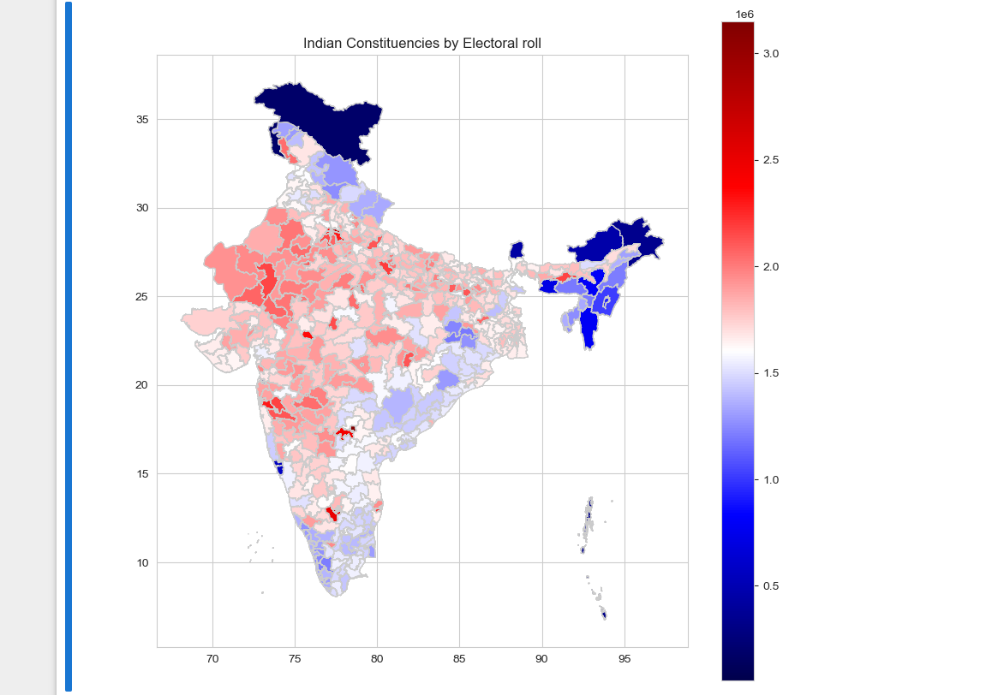
india map
Notes:
display the table in previous 2 slides on indian map. can also add details like area or population

Slide 7
2014 ELECTION ANALYSIS
Notes:
non party analysis 2014:
voter turnout & nota - (correlation with social parameters - gdp, gender,age distribution, employment, crime rate, poverty & nutrition etc)

Slide 8
CONSTITUENCIES BY VOTER TURNOUT RATIO
TOP 5 CONSTITUENCIES IN VOTER TURNOUT RATIO
PC_NAME | STATE | RATIO
Dhubri | Assam | 88
Tamluk | West Bengal | 87
Nagaland | Nagaland | 87
Kanthi | West Bengal | 86
Lakshadweep | Lakshadweep | 86
BOTTOM 5 CONSTITUENCIES BY VOTER TURNOUT RATIO
PC_NAME | STATE | RATIO
Srinagar | Jammu & Kashmir | 25
Anantnag | Jammu & Kashmir | 28
Baramulla | Jammu & Kashmir | 39
Kalyan | Maharastra | 42
Patna Sahib | Bihar | 45
Notes:
VOTER TURNOUT RATIO = VOTED/ ELECTORS
J&K

Slide 9
STATES BY VOTER TURNOUT RATIO
TOP 5 STATES IN VOTER TURNOUT RATIO
STATE | RATIO
NAGALAND | 87
LAKSHADWEEP | 86
TRIPURA | 84
DADRA & NAGAR HAVELI | 84
SIKKIM | 83
BOTTOM 5 STATES BY VOTER TURNOUT RATIO
STATE | RATIO
JAMMU & KASHMIR | 49
BIHAR | 56
UTTAR PRADESH | 58
MAHARASTRA | 60
MIZORAM | 61
Notes:
VOTER TURNOUT RATIO = VOTED/ ELECTORS
J&K

Slide 10
TOP 5 CANDIDATES BY WINNING MARGIN
CANDIDATE | PC_NAME | STATE | MARGIN
NARENDRA MODI | VADODARA | GUJARAT | 570128
VIJAY KUMAR SINGH | GHAZIABAD | UTTAR PRADESH | 567260
C.R. PATIL | NAVSARI | GUJARAT | 558116
RAMCHARAN BOHRA | JAIPUR | RAJASTHAN | 539345
DARSHANA VIKRAM JARDOSH | SURAT | GUJARAT | 533190

Slide 11
TOP 5 CONSTITUENCIES BY NOTA PERCENT
PC_NAME | STATE | NOTA PERENT
TURA | MEGHALAYA | 3
NILGRIS | TAMIL NADU | 3
PUDUCHERRY | PUDUCHEERY | 2
BANSWARA | RAJASTHAN | 2
KHUNTI | JHARKHAND | 2
Notes:
pc_name
Tura Meghalaya 19185 586501 3.0
Nilgiris Tamil Nadu 46559 1269173 3.0
Puducherry Puducherry 22268 901357 2.0
Banswara Rajasthan 34404 1698244 2.0
Khunti Jharkhand 23816 1111856 2.0

Slide 12
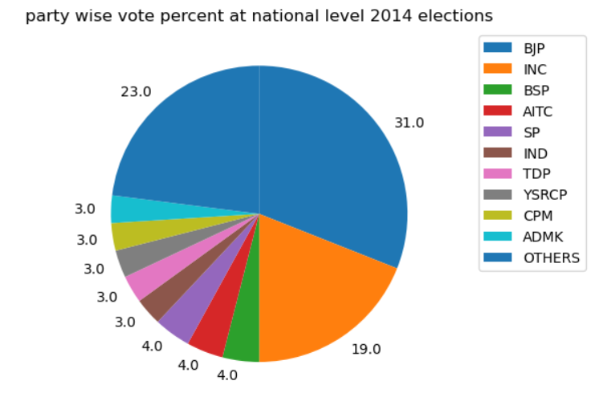
NATIONAL LEVEL VOTE SPLIT BETWEEEN PARTIES IN 2014
Notes:
party wise analysis 2014
party wise vote split

Slide 13
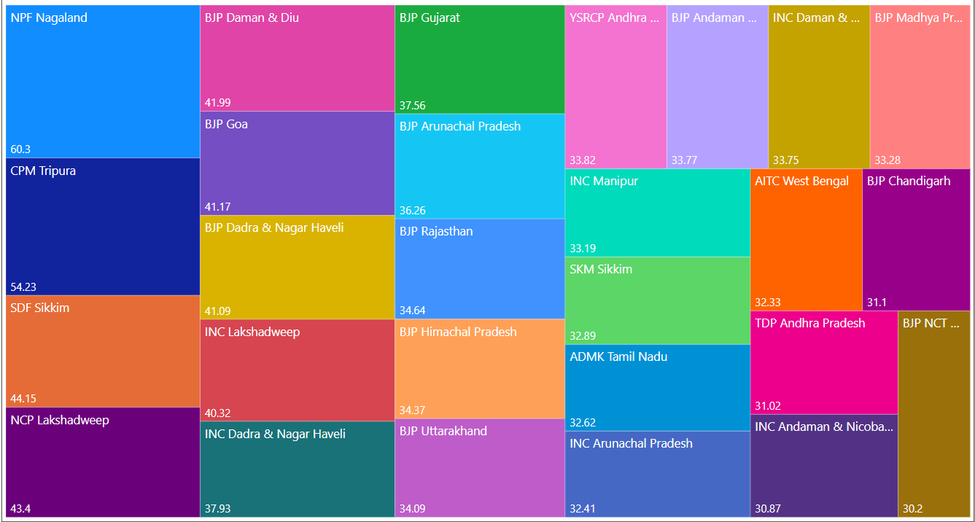
STATE LEVEL VOTE SPLIT BETWEEEN PARTIES IN 2014

Slide 14
2019 ELECTION ANALYSIS
Notes:
non party analysis 2014:
voter turnout & nota - (correlation with social parameters - gdp, gender,age distribution, employment, crime rate, poverty & nutrition etc)

Slide 15
CONSTITUENCIES BY VOTER TURNOUT RATIO
TOP 5 CONSTITUENCIES IN VOTER TURNOUT RATIO
PC_NAME | STATE | RATIO
Dhubri | Assam | 90
Bishnupur | West Bengal | 87
Ongole | Andhra Pradesh | 86
Narasaraopet | Andhra Pradesh | 86
Bapatla | Andhra Pradesh | 86
BOTTOM 5 CONSTITUENCIES BY VOTER TURNOUT RATIO
PC_NAME | STATE | RATIO
Anantnag | Jammu & Kashmir | 8
Srinagar | Jammu & Kashmir | 14
Baramulla | Jammu & Kashmir | 34
Hyderabad | Telangana | 44
Patna Sahib | Bihar | 45
Notes:
VOTER TURNOUT RATIO = VOTED/ ELECTORS

Slide 16
STATES BY VOTER TURNOUT RATIO
TOP 5 STATES IN VOTER TURNOUT RATIO
STATE | RATIO
LAKSHADWEEP | 85
MANIPUR | 82
NAGALAND | 82
TRIPURA | 82
WEST BENGAL | 81
BOTTOM 5 STATES BY VOTER TURNOUT RATIO
STATE | RATIO
JAMMU & KASHMIR | 44
BIHAR | 57
UTTAR PRADESH | 59
NCT OF DELHI | 60
MAHARASTRA | 60
Notes:
VOTER TURNOUT RATIO = VOTED/ ELECTORS

Slide 17
TOP 5 CANDIDATES BY WINNING MARGIN
CANDIDATE | PC_NAME | STATE | MARGIN
C.R. PATIL | NAVSARI | GUJARAT | 689668
SANJAY BHATIA | KARNAL | HARYANA | 656142
KRISHNA PAL | FARIABAD | HARYANA | 638239
SUBASH CHANDRA BAHERIA | BHILWARA | RAJASTHAN | 612000
RANJANBEN BHATT | VADODDARA | GUJARAT | 589177
Notes:
state/UT pc_name candidate margin
114 Gujarat Navsari C. R. Patil 689668
129 Haryana Karnal Sanjay Bhatia 656142
126 Haryana Faridabad KRISHAN PAL 638239
337 Rajasthan Bhilwara SUBHASH CHANDRA BAHERIA 612000
122 Gujarat Vadodara RANJANBEN BHATT 589177

Slide 18
TOP 5 CONSTITUENCIES BY NOTA PERCENT
PC_NAME | STATE | NOTA PERENT
ARUKU | ANDHRA PRADESH | 3
BASTAR | CHHATTISGARH | 3
NABARANGPUR | ODISHA | 3
PASCHIM CHAMPARAN | BIHAR | 2
KORATPUR | ODISHA | 2
Notes:
state total_votes total_electors nota_percent
pc_name
Aruku Andhra Pradesh 47977 1451418 3.0
BASTAR Chhattisgarh 41667 1379122 3.0
Nabarangpur Odisha 44582 1461004 3.0
Paschim Champaran Bihar 45699 1633824 2.0
Koraput Odisha 36561 1434384 2.0

Slide 19
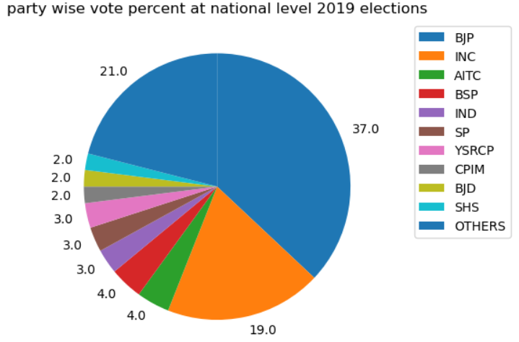
NATIONAL LEVEL VOTE SPLIT BETWEEEN PARTIES IN 2019
Notes:
party wise analysis 2014
party wise vote split

Slide 20
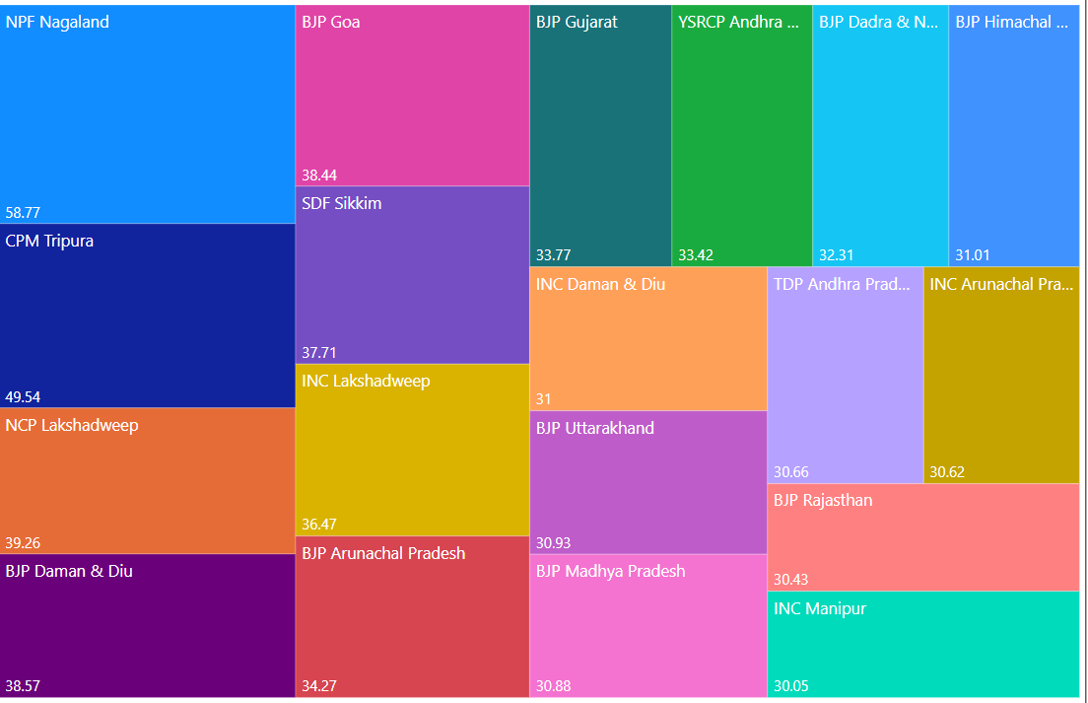
STATE LEVEL VOTE SPLIT BETWEEEN PARTIES IN 2019

Slide 21
COMPARISON BETWEEN 2014 & 2019 POLLS
Notes:
non party analysis 2014:
voter turnout & nota - (correlation with social parameters - gdp, gender,age distribution, employment, crime rate, poverty & nutrition etc)

Slide 22
ABSOLUTE NUMBERS
2014
2019
overall vote percent 66.45%
nota percent 1.05%
BJP won the mandate with 271 (53%) seats and 31% vote share
INC is second with 43 (8%) seats and 19% vote share
overall vote percent 67.73%
nota percent 1.06%
BJP won the mandate with 303(59%) seats and 37% vote share
INC stands second with 52(10%) seats and 19% vote share.
Notes:
non party analysis 2014:
voter turnout & nota - (correlation with social parameters - gdp, gender,age distribution, employment, crime rate, poverty & nutrition etc)

Slide 23
RELATIVE NUMBERS - RETAINED
PC_NAME | STATE | PARTY | VOTE%14 | VOTE%19 | +/-
WAYANAD | KERALA | INC | 30.18 | 51.95 | +21.77
HOSHANGABAD | MADHYA PRADESH | BJP | 42.67 | 51.46 | +8.79
KANGRA | HIMACHAL PRADESH | BJP | 36.24 | 50.81 | +14.57
UTTARA KANNADA | KARNATAKA | BJP | 37.70 | 50.50 | +12.80
MANDI | HIMACHAL PRADESH | BJP | 31.54 | 50.50 | +18.96
Notes:
state pc_name party_14 votepercent_14 party_19 votepercent_19
193 Kerala Wayanad INC 30.18 INC 51.95
205 Madhya Pradesh HOSHANGABAD BJP 42.67 BJP 51.46
123 Himachal Pradesh Kangra BJP 36.24 BJP 50.81
173 Karnataka Uttara Kannada BJP 37.70 BJP 50.50
124 Himachal Pradesh Mandi BJP 31.54 BJP 50.50

Slide 24
RELATIVE NUMBERS - LOST
PC_NAME | STATE | PARTY | VOTE%14 | PARTY | VOTE%19 | +/-
ALIPURDUARS | WEST BENGAL | AITC | 24.64 | BJP | 45.55 | +20.91
AUTONOMOUS DISTRICT | ASSAM | INC | 30.35 | BJP | 47.91 | 17.56
PUDUCHERRY | PUDUCHERRY | AINRC | 28.38 | INC | 45.71 | +17.33
KANYAKUMARI | TAMIL NADU | BJP | 25.41 | INC | 41.78 | +16.37
CHIKKBALLAPUR | KARNATAKA | INC | 25.61 | BJP | 41.24 | +15.63
Notes:
West Bengal Alipurduars AITC 24.64 BJP 45.55 20.91
28 Assam Autonomous District INC 30.35 BJP 47.91 17.56
285 Puducherry Puducherry AINRC 28.38 INC 45.71 17.33
337 Tamil Nadu Kanniyakumari BJP 25.41 INC 41.78 16.37
156 Karnataka Chikkballapur INC 25.61 BJP 41.24 15.63

Slide 25
TOP 5 CONSTITUENCIES WHERE BJP INCREASED ITS VOTE SHARE IN 2019
PC_NAME | STATE | VOTE%14 | VOTE%19 | GAIN
KODARMA | JHARKHAND | 22.29 | 41.51 | +19.22
MANDI | HIMACHAL PRADESH | 31.54 | 50.50 | +18.96
BHIWANI-MAHENDRAGARH | HARYANA | 27.45 | 44.53 | +17.08
HAZARIBAGH | JHARKHAND | 26.79 | 43.71 | +16.92
KHAJURAHO | MADHYA PRADESH | 27.89 | 44.03 | +16.14
Notes:
Jharkhand Kodarma 22.29 41.51 19.22
124 Himachal Pradesh Mandi 31.54 50.50 18.96
113 Haryana Bhiwani-Mahendragarh 27.45 44.53 17.08
137 Jharkhand Hazaribagh 26.79 43.71 16.92
208 Madhya Pradesh KHAJURAHO 27.89 44.03 16.14

Slide 26
TOP 5 CONSTITUENCIES WHERE BJP LOST ITS VOTE SHARE IN 2019
PC_NAME | STATE | VOTE%14 | VOTE%19 | GAIN
DAMAN & DIU | DAMAN & DIU | 41.99 | 30.88 | -11.11
SANGLI | MAHARASTRA | 37.08 | 28.14 | -8.94
MUZAFFARNAGAR | UTTAR PRADESH | 41.13 | 33.79 | -7.34
GADCHORLI-CHIMUR | MAHARASTRA | 36.50 | 32.88 | -3.62
SECUNDRABAD | TELANGANA | 23.14 | 19.55 | -3.59
Notes:
Telangana Secundrabad 23.14 19.55 -3.59
236 Maharashtra Gadchiroli-Chimur 36.50 32.88 -3.62
443 Uttar Pradesh Muzaffarnagar 41.13 33.79 -7.34
264 Maharashtra Sangli 37.08 28.14 -8.94
83 Daman & Diu Daman & diu 41.99 30.88 -11.11

Slide 27
TOP 5 CONSTITUENCIES WHERE INC GAINED ITS VOTE SHARE IN 2019
PC_NAME | STATE | VOTE%14 | VOTE%19 | GAIN
WAYANAD | KERALA | 30.18 | 51.95 | +21.77
KALIABOR | ASSAM | 30.42 | 45.31 | +14.89
SHILLONG | MEGHALAYA | 21.35 | 35.04 | +13.69
ERNAKULAM | KERALA | 30.60 | 39.43 | +8.83
THIRUVANANTHAPURAM | KERALA | 23.40 | 30.34 | +6.94
Notes:
Kerala Wayanad 30.18 51.95 21.77
34 Assam Kaliabor 30.42 45.31 14.89
274 Meghalaya Shillong 21.35 35.04 13.69
178 Kerala Ernakulam 30.60 39.43 8.83
190 Kerala Thiruvananthapuram 23.40 30.34 6.94

Slide 28
TOP 5 CONSTITUENCIES WHERE INC LOST ITS VOTE SHARE IN 2019
PC_NAME | STATE | VOTE%14 | VOTE%19 | GAIN
KISHANGANJ | BIHAR | 34.29 | 22.11 | -12.18
BAHARAMPUR | WEST BENGAL | 40.14 | 36.08 | -4.06
AMRITSAR | PUNJAB | 32.69 | 29.51 | -3.18
RAE BARELI | UTTAR PRADESH | 33.01 | 31.42 | -1.59
CHHINDWARA | MADHYA PRADESH | 39.92 | 38.77 | -1.15
Notes:
Madhya Pradesh CHHINDWARA 39.92 38.77 -1.15
448 Uttar Pradesh Rae Bareli 33.01 31.42 -1.59
286 Punjab Amritsar 32.69 29.51 -3.18
469 West Bengal Baharampur 40.14 36.08 -4.06
59 Bihar Kishanganj 34.29 22.11 -12.18

Slide 29
CONCLUSIONS & RECOMMENDATIONS
Efforts to create awareness and inclusivity in Jammu & Kashmir are strongly recommended.
Correlation between largely amassed states and poor voter turnout ratio needs to be assessed.
Urban cities appearing in bottom 5 positions in voter turnout ratio is a concern
Strengthening NOTA might increase voter turnout ratio
Notes:
LET’S NOW FOCUS ON TWO PRIMARY NATIONAL PARTIES AND COMPARE THEIR PERFORMANCE IN 2014 & 2019

