Slide 1
Discrimination of Objects Mounted on
Optical Bench Using Ultrasonic Sensing
and Machine Learning
Presented by:
[Romana Rashid - 1428733] · [Mithila Maruti Prabhu- 1567111]
Supervisor:
Dr. Andreas Pech
Machine Learning Project | Winter Semester 2025–2026
4
3
2
26
Material Classes
ML Models
Recording Sessions
Distances (5–30 cm)
Object Boundary Network (OBN) — Material Classification via Ultrasound

Slide 2
Project Overview
Identifying material types by analysing reflected ultrasound signals
1
→
2
→
3
→
4
→
5
→
6
Raw Signals
Feature Extraction
ML Models
Day 1 Training
Day 2 Evaluation
Results
ADC recordings from ultrasound sensor
15 time + frequency domain features
RF · SVM · KNN
80/20 stratified split
Cross-session test
Accuracy, F1, drift
Objective
Approach
Classify 4 materials from ultrasound reflections
Collect ADC signals at 5–30 cm (26 positions)
Train ML models on time & frequency features
Extract 15 statistical & spectral features
Evaluate cross-session generalisation
Train RF, SVM, KNN — evaluate on Day 2 data
Motivation
Non-invasive material ID for robotics & logistics
Ultrasound: cost-effective, works in low-visibility
Benchmark temporal drift on model reliability
Object Boundary Network (OBN) — Material Classification via Ultrasound

Slide 3
Data Collection & Setup
Two recording sessions — 4 material classes at 26 distance positions
4
26
2
~2600
Material Classes
Distances (5–30 cm)
Recording Sessions
Measurements / Session
Laptop
PB w/ Foam
PB w/o Foam
Steel
Smooth flat metallic-plastic surface, moderate reflectivity
Dampened box — foam absorbs partial signal energy
Hollow plastic shell — stronger internal echoes
High-density smooth reflector, strongest signal amplitude
Day 1 — Training Session
Day 2 — Evaluation Session
Used for training all ML models (80/20 stratified split)
Recorded independently — tests temporal drift & robustness
Data: /data/raw/ — 26 distances × 4 classes
Data: /data/raw_day2/ — same structure as Day 1
Signal Format: Each .txt file contains multiple ADC rows. Header encodes sample rate (32768 Hz), buffer size, sensitivity (84), measurements, frequency (512 Hz). Each row provides tab-separated ADC values forming a full waveform.
Object Boundary Network (OBN) — Material Classification via Ultrasound

Slide 4
Feature Engineering
15 hand-crafted features per measurement from time & frequency domain
⏱ Time-Domain Features (10)
📈 Frequency-Domain Features (5)
Feature | Description
mean | Average signal amplitude
std | Amplitude variability
max / min | Peak positive/negative values
ptp | Peak-to-peak range
rms | Root mean square energy
energy | Total signal power (∑ x²)
abs_mean | Mean of absolute values
argmax / argmin | Sample indices of peaks
Feature | Description
fft_mean | Average spectral magnitude
fft_std | Frequency content spread
fft_max | Dominant frequency amplitude
fft_peak_bin | Index of dominant frequency bin
fft_energy | Total spectral energy (∑|X|²)
Distance (cm) is included as an explicit numeric feature
FFT features computed via scipy.fft.rfft on the raw ADC signal
Normalisation via StandardScaler inside SVM & KNN pipelines
Total dataset: ~2600 rows × 16 columns (15 features + distance)
Two feature sets: Full range (26 distances) and 4-distance subset (10, 15, 20, 25 cm)
Object Boundary Network (OBN) — Material Classification via Ultrasound

Slide 5
Machine Learning Models
Three classifiers compared — trained on Day 1, tested on Day 2
Random Forest
SVM (RBF Kernel)
K-Nearest Neighbours
Hyperparameters
Hyperparameters
Hyperparameters
n_estimators = 500
kernel = RBF
n_neighbors = 7
max_depth = None
C = 10
weights = distance
min_samples_split = 2
gamma = scale
StandardScaler pre-processing
random_state = 42
StandardScaler pre-processing
✓ Strengths
✓ Strengths
✓ Strengths
Handles non-linear boundaries naturally
Effective in high-dimensional spaces
Non-parametric, no training phase
Robust to outliers
Strong generalisation (kernel trick)
Naturally multi-class
Provides feature importance
Works well with clear margins
Interpretable predictions
⚠ Limitations
⚠ Limitations
⚠ Limitations
Slower inference for large forests
Slow training on large datasets
Slow at inference (all training distances)
Memory-intensive
No native probability output
Sensitive to feature scaling
Object Boundary Network (OBN) — Material Classification via Ultrasound

Slide 6
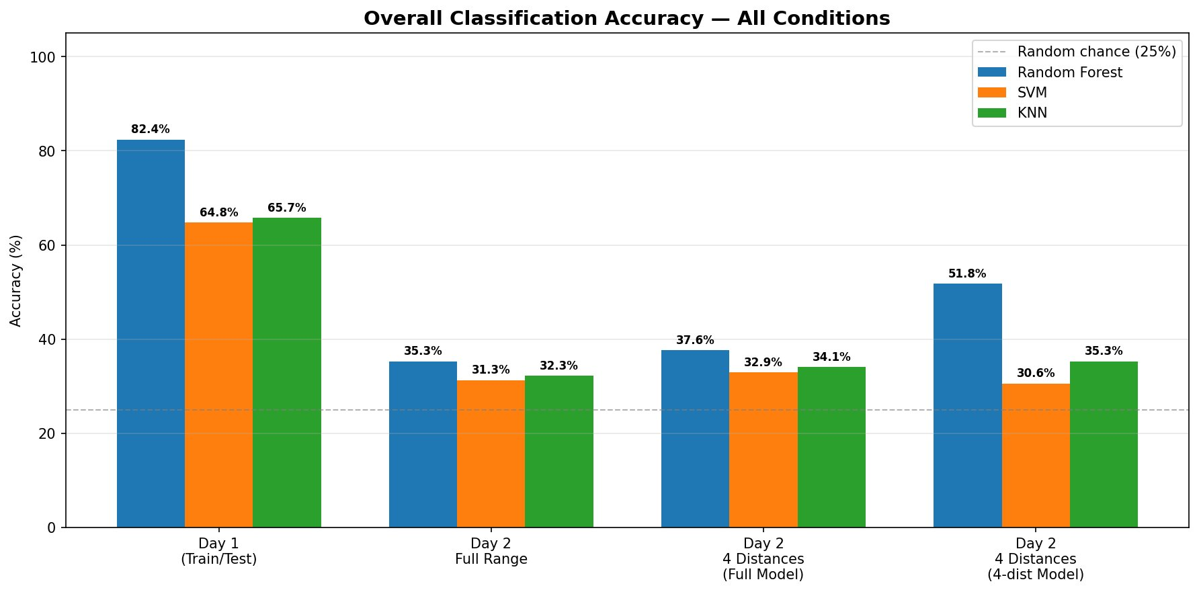
Model Performance — Overall Accuracy
Day 1 training vs Day 2 cross-session evaluation
RF dominates Day 1 with 82.4% — large advantage over SVM/KNN
All models degrade heavily on Day 2 full range (~35%) — temporal drift is significant
4-distance RF model recovers to 51.8% by limiting to well-characterised distances
SVM and KNN show less benefit from 4-distance restriction
Object Boundary Network (OBN) — Material Classification via Ultrasound

Slide 7
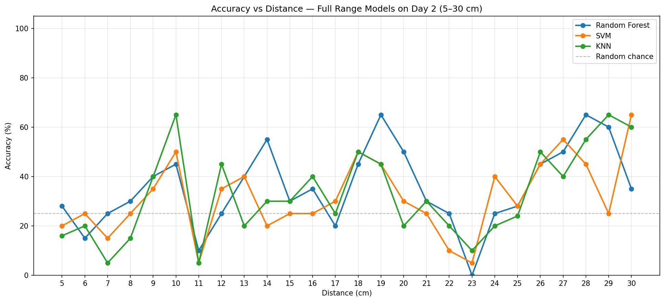
Accuracy vs. Distance — Full Range
How model performance varies across the 26 measurement distances on Day 2 (5–30 cm)
RF maintains highest accuracy at most distances on Day 2
Performance is highly variable and distance-dependent for all models
Middle range (15–20 cm) generally shows better classification
Short distances (≤10 cm) and very long distances (≥25 cm) tend to be harder
Object Boundary Network (OBN) — Material Classification via Ultrasound

Slide 8
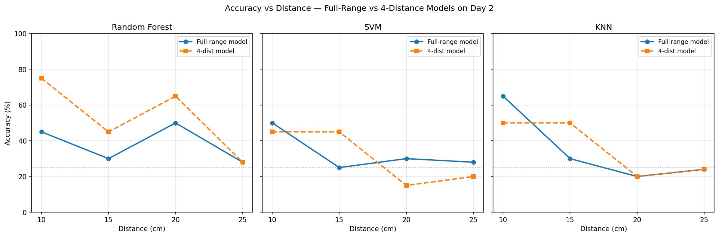
4-Distance Subset Analysis
Restricted training at 10, 15, 20, 25 cm — Full-Range vs 4-dist model comparison on Day 2
RF 4-dist model: 51.8% on 4-dist Day 2 — significant +16 pp gain over full-range
Restricting distances reduces noise from outlier positions
SVM/KNN do not benefit as much — limited feature separability
Distance-selective training is a viable strategy to mitigate temporal drift
Object Boundary Network (OBN) — Material Classification via Ultrasound

Slide 9
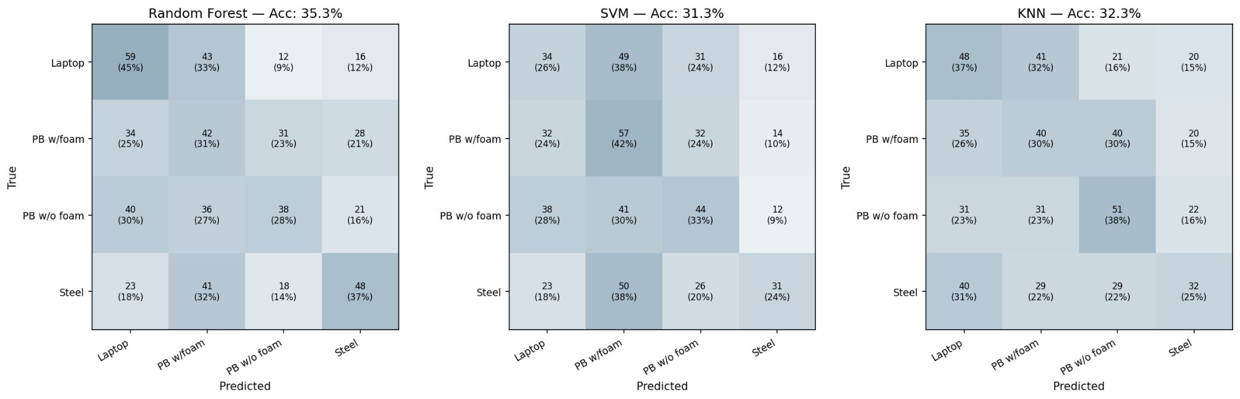
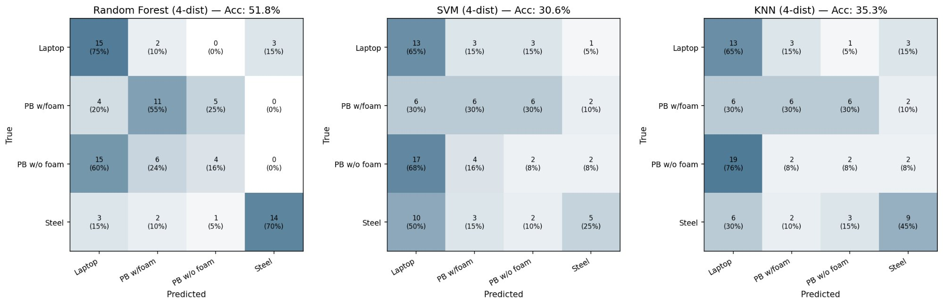
Confusion Matrices — Day 2 Evaluation
Which classes are misclassified and why
Full Range — Day 2
4-Distance Model — Day 2
Steel best classified by RF 4-dist (70%) — high acoustic impedance contrast
PB w/o foam most confused — hollow echo varies with distance
4-dist RF shows clear diagonal dominance vs diffuse full-range patterns
Object Boundary Network (OBN) — Material Classification via Ultrasound

Slide 10
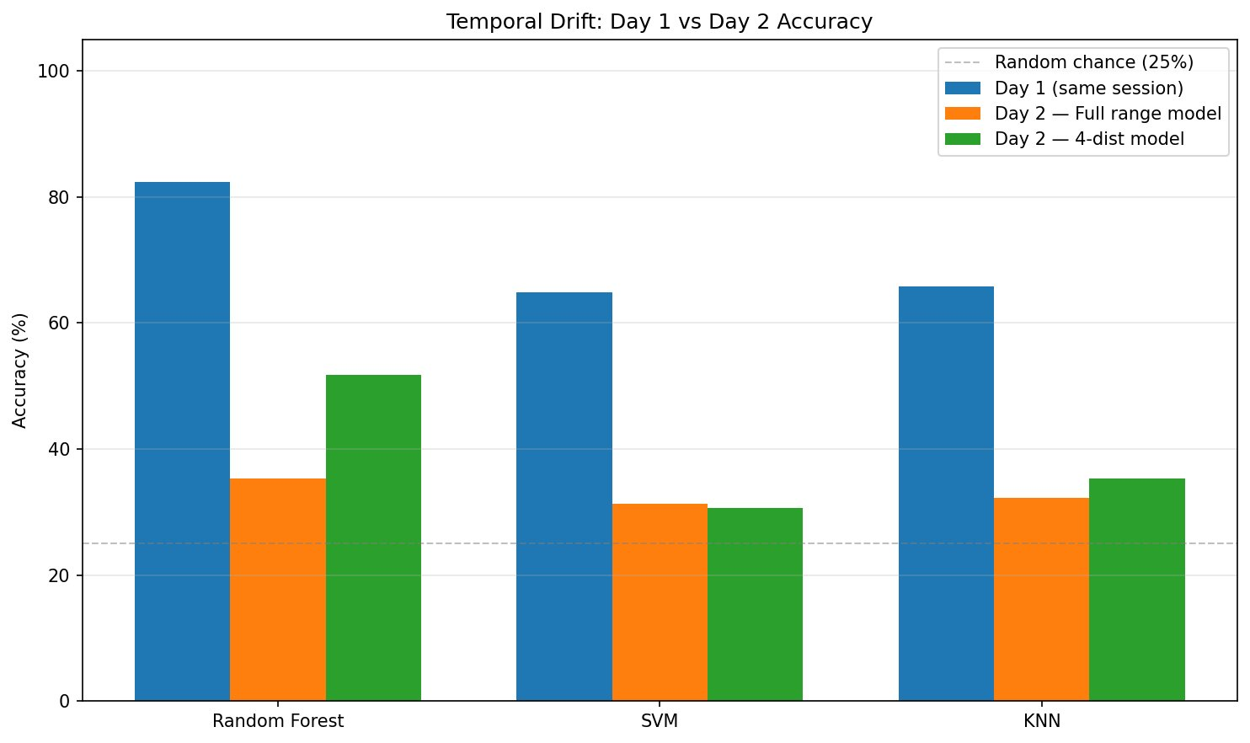
Temporal Drift Analysis
Signal characteristics shift between recording sessions
Systematic shift in signal statistics between Day 1 and Day 2 due to environmental changes
RF drops from 82.4% (Day 1) to 35.3% (Day 2 full range) — a loss of ~47 pp
Mitigation: restrict training distances, domain adaptation, or periodic re-training
4-dist RF partially recovers to 51.8%, confirming curated data helps cross-session robustness
Object Boundary Network (OBN) — Material Classification via Ultrasound

Slide 11
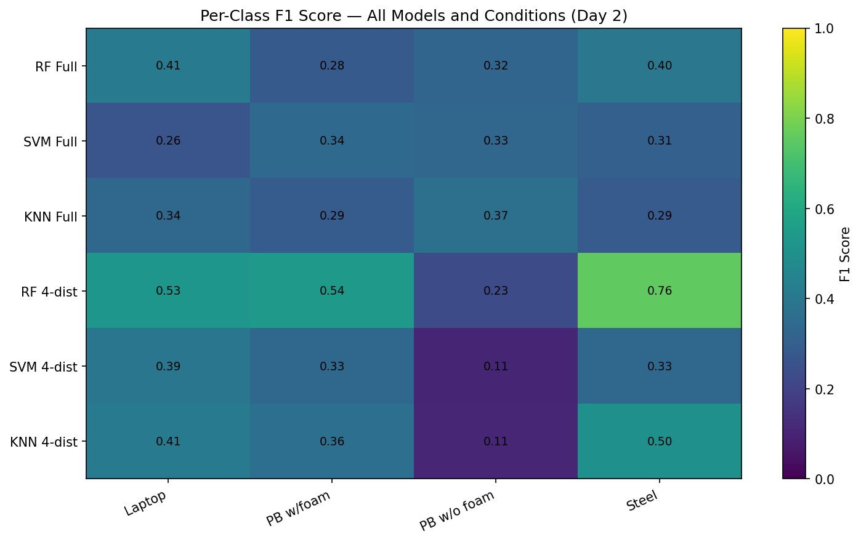
F1-Score Heatmap by Class
Per-class performance reveals which materials are hardest to identify (Day 2)
RF 4-dist achieves F1=0.76 for Steel — highest score across all configurations
PB w/o foam is consistently the hardest class (F1 as low as 0.11 in 4-dist SVM/KNN)
Steel is most reliably classified; foam-padded plastic box is hardest across all models
Object Boundary Network (OBN) — Material Classification via Ultrasound

Slide 12
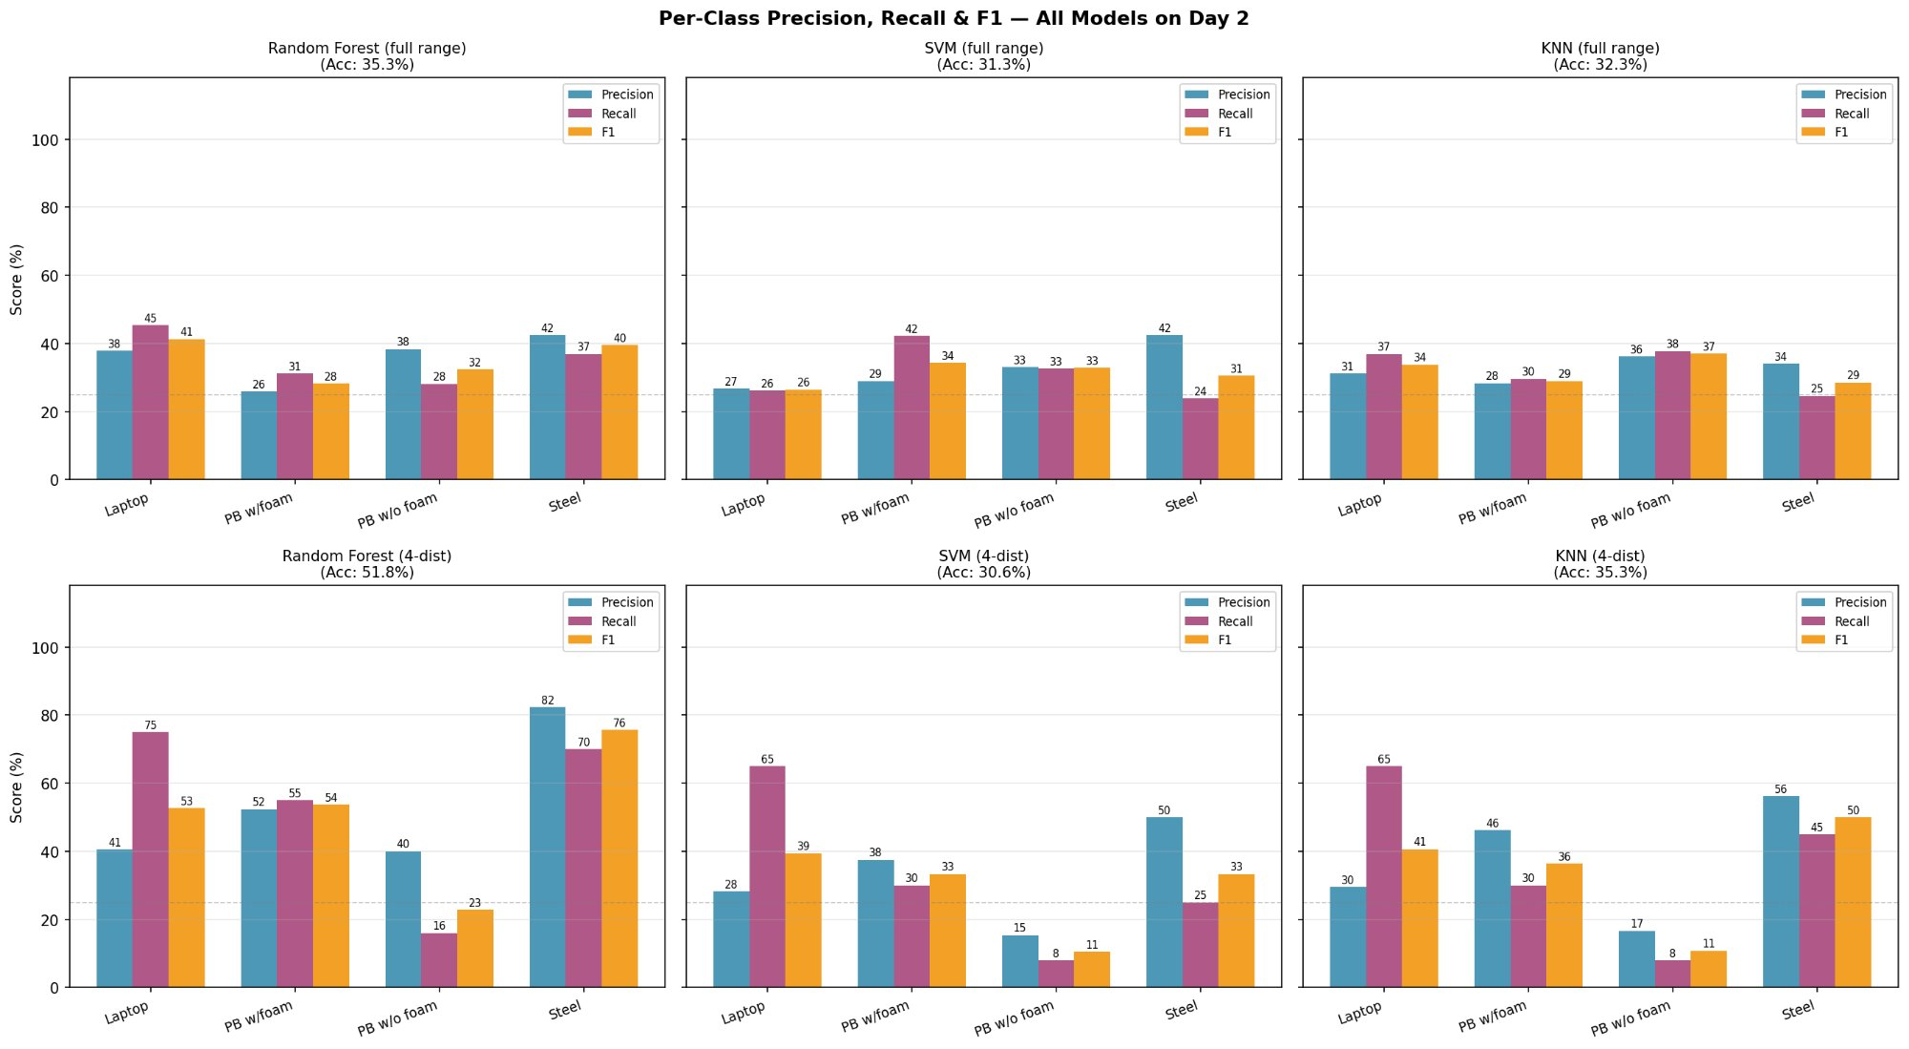
Per-Class Precision, Recall & F1
Detailed breakdown for all 6 model configurations on Day 2 ★ NOT IN ORIGINAL PRESENTATION
RF 4-dist achieves best Steel precision (82%) and recall (70%) — strong class-specific detection
PB w/o foam suffers low recall in 4-dist models (SVM: 8%, KNN: 8%) — many missed detections
PB w/ foam: balanced precision/recall in full-range models; recall drops sharply in 4-dist SVM/KNN
Full-range models show flatter, more balanced profiles — no single class dominates
Object Boundary Network (OBN) — Material Classification via Ultrasound

Slide 13
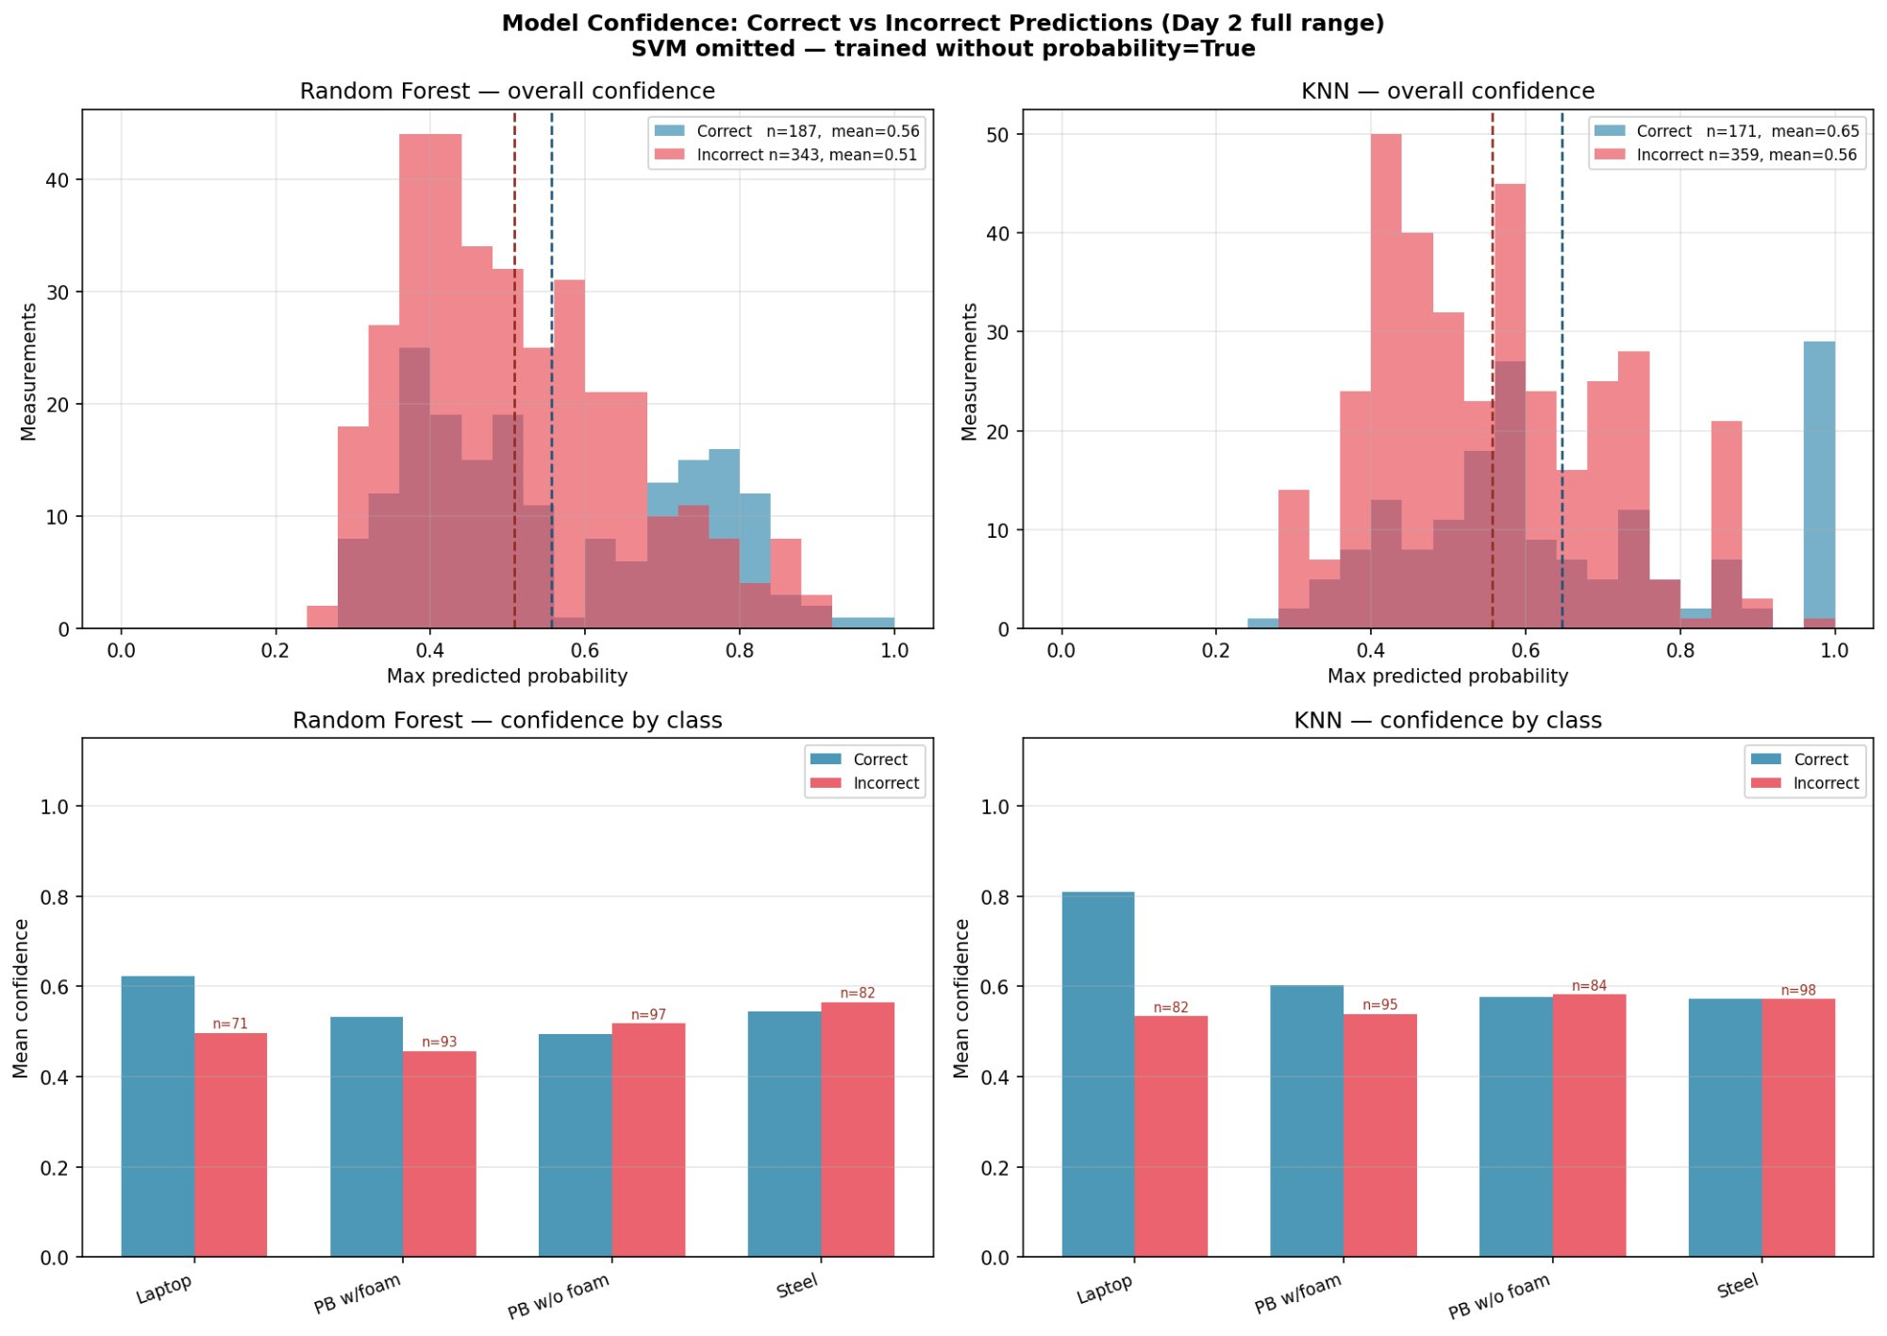
Model Confidence Analysis
Correct vs. Incorrect prediction confidence — Day 2 full range ★ NOT IN ORIGINAL PRESENTATION
RF: correct predictions (mean=0.56) only slightly more confident than incorrect (mean=0.51)
KNN: correct predictions (mean=0.65) show better separation from incorrect (mean=0.56)
Models are often near-equally confident in wrong predictions — limited self-awareness of errors
KNN confidence by class: Laptop correct predictions hit 0.80 mean — most distinctive signal class
Object Boundary Network (OBN) — Material Classification via Ultrasound

Slide 14
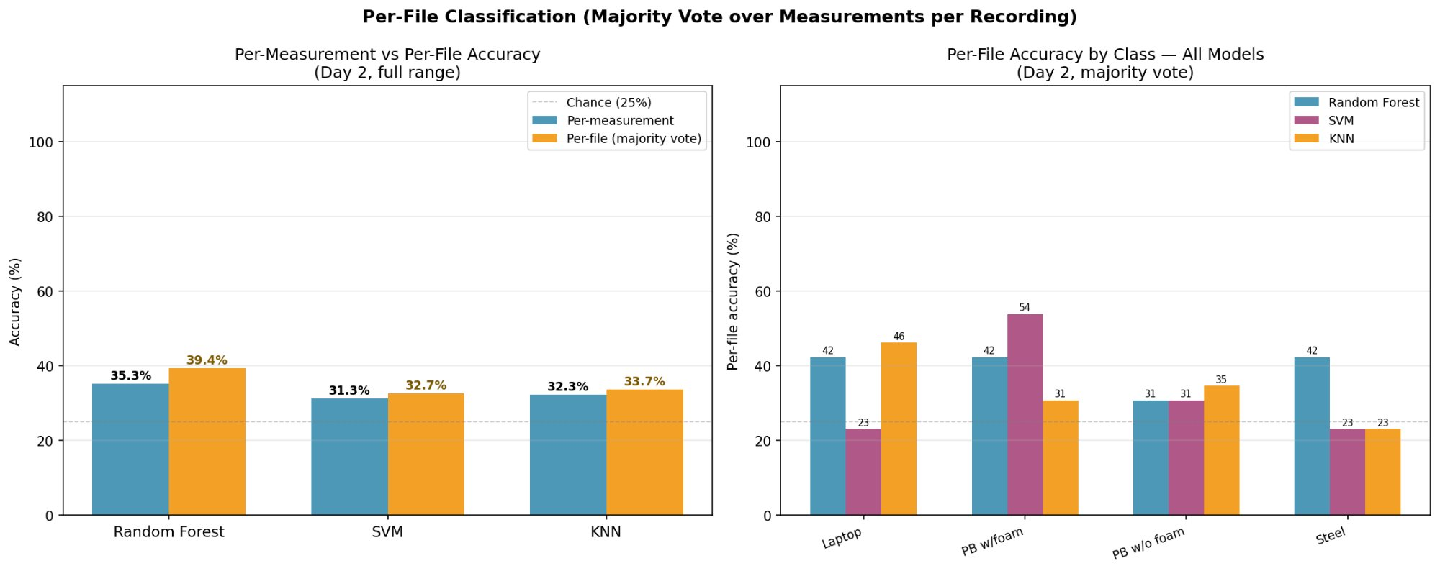
Per-File Classification (Majority Vote)
Aggregating per-measurement votes per recording — Day 2 full range ★ NOT IN ORIGINAL PRESENTATION
Majority vote improves RF: 35.3% → 39.4%; SVM: 31.3% → 32.7%; KNN: 32.3% → 33.7%
Aggregating predictions per file provides marginal but consistent accuracy gains
SVM achieves 54% per-file accuracy on PB w/ foam — best single-class result in majority vote
Steel and PB w/o foam remain the hardest classes even with majority voting aggregation
Object Boundary Network (OBN) — Material Classification via Ultrasound

Slide 15
Results Summary
Comprehensive comparison of all model–evaluation configurations
Configuration | Model | Accuracy | Notes
Day 1 (train=test) | Random Forest | 82.4% | Strong in-session performance
Day 1 (train=test) | SVM | 64.8% | Competitive but lower than RF
Day 1 (train=test) | KNN | 65.7% | Similar to SVM
Day 2 Full (full model) | Random Forest | 35.3% | Significant drift drop
Day 2 Full (full model) | SVM | 31.3% | Near-chance performance
Day 2 Full (full model) | KNN | 32.3% | Near-chance performance
Day 2 4-dist (full model) | Random Forest | 37.6% | Slight improvement
Day 2 4-dist (4d model) | Random Forest | 51.8% ✓ | Best cross-session result
Day 2 4-dist (4d model) | SVM | 30.6% | No improvement with 4d model
Day 2 4-dist (4d model) | KNN | 35.3% | Minor improvement
Object Boundary Network (OBN) — Material Classification via Ultrasound

Slide 16
Conclusions & Future Work
82.4%
51.8%
4
15
Best Day 1
Accuracy (RF)
Best Day 2
Accuracy (RF 4d)
Materials
Classified
Features
Extracted
Key Findings
Future Work
Random Forest (82.4%) outperforms SVM (64.8%) and KNN (65.7%) on Day 1
Apply domain adaptation / transfer learning for cross-session robustness
Cross-session performance degrades substantially — temporal drift is a critical challenge
Explore deep learning (1D CNN, LSTM) directly on raw ADC signals
4-distance restricted RF model achieves 51.8% — best Day 2 result (+16 pp over full-range RF)
Automated distance selection to find optimal measurement windows
Steel is the easiest material to classify; foam-padded plastic box is the hardest
Expand material classes — wood, glass, composite materials
Distance is an important feature — models trained on near-field distances generalise better
Real-time classification on embedded hardware (Raspberry Pi / Arduino)
SVM & KNN show limited benefit from 4-distance restriction strategy
Collect additional sessions to build a longitudinal drift model
Object Boundary Network (OBN) — Material Classification via Ultrasound

