Slide 1

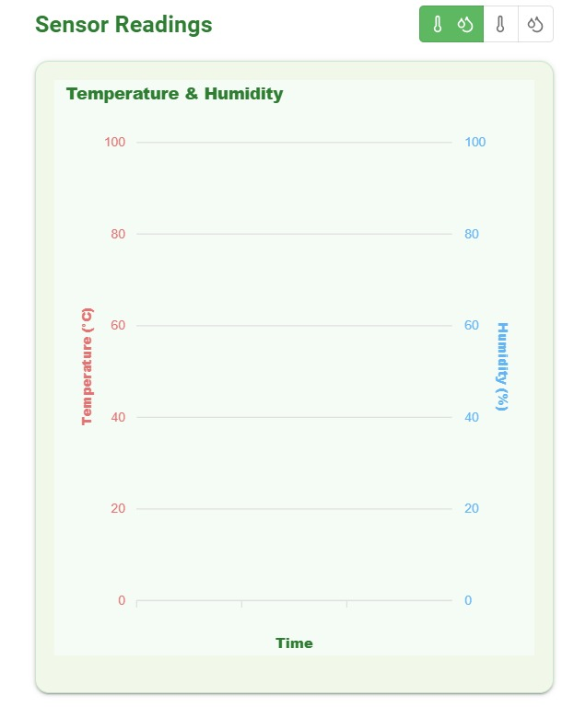
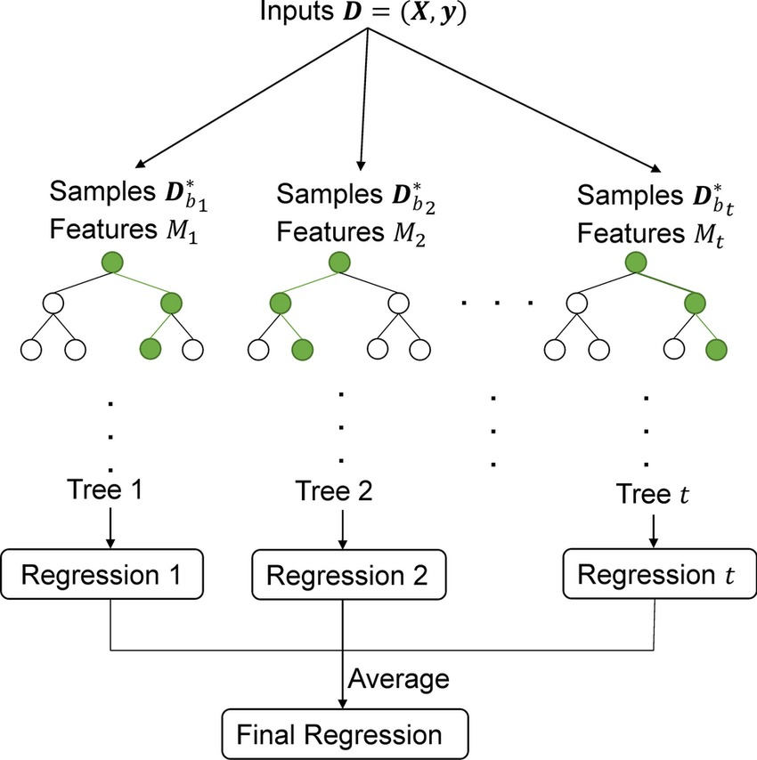
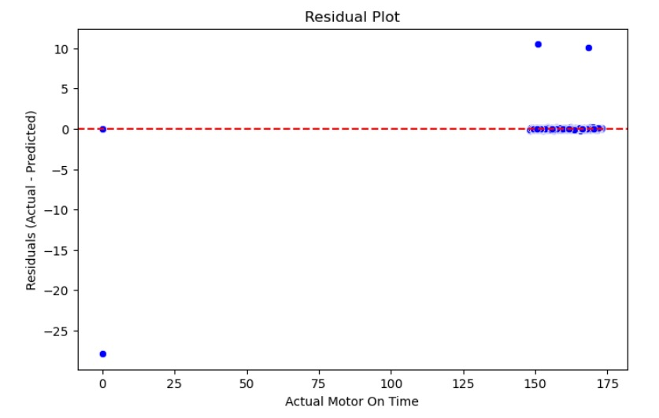
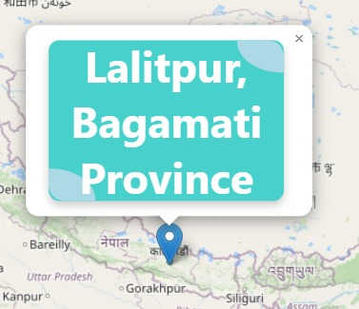
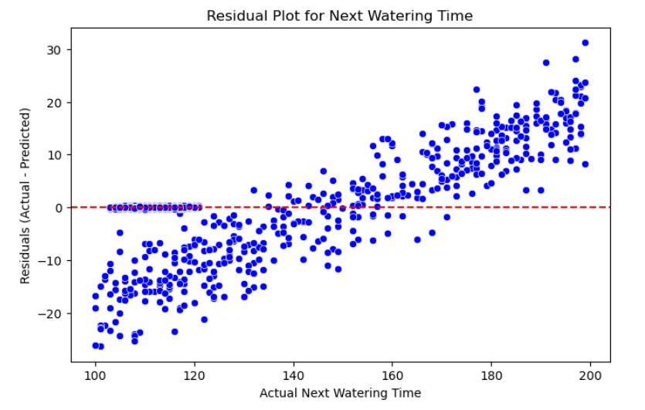
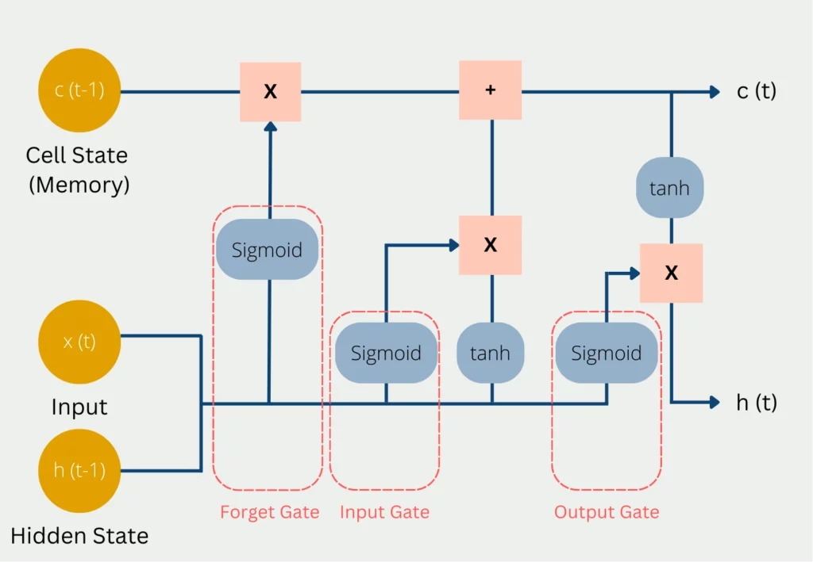
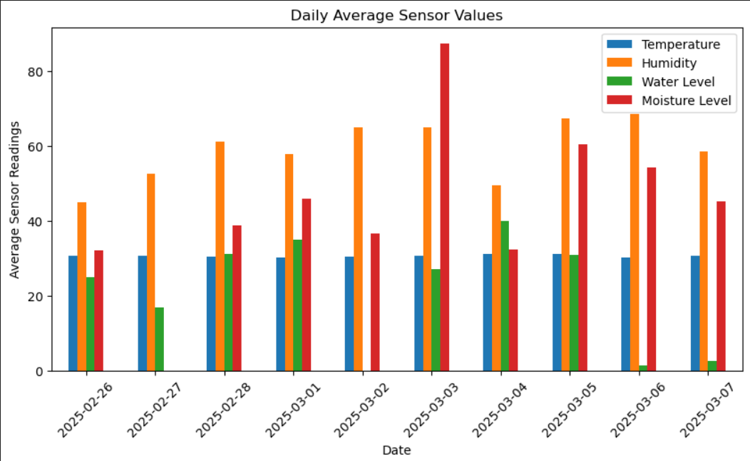
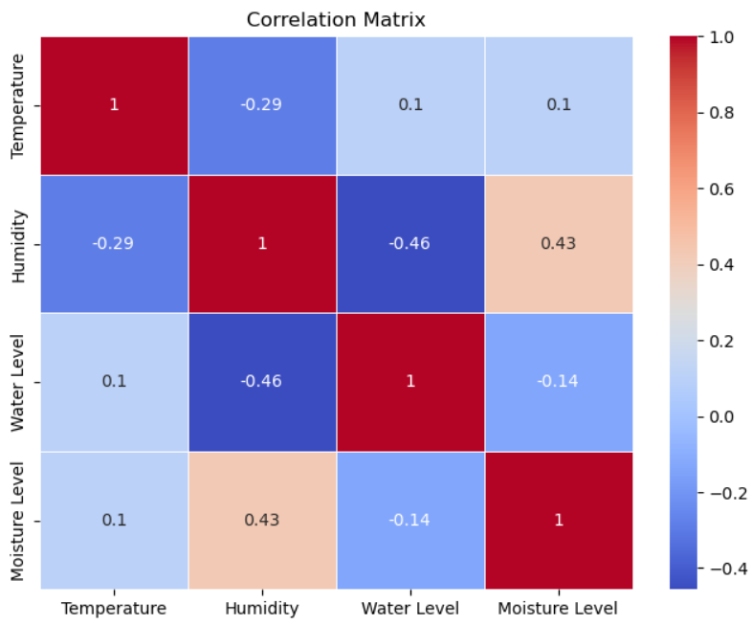
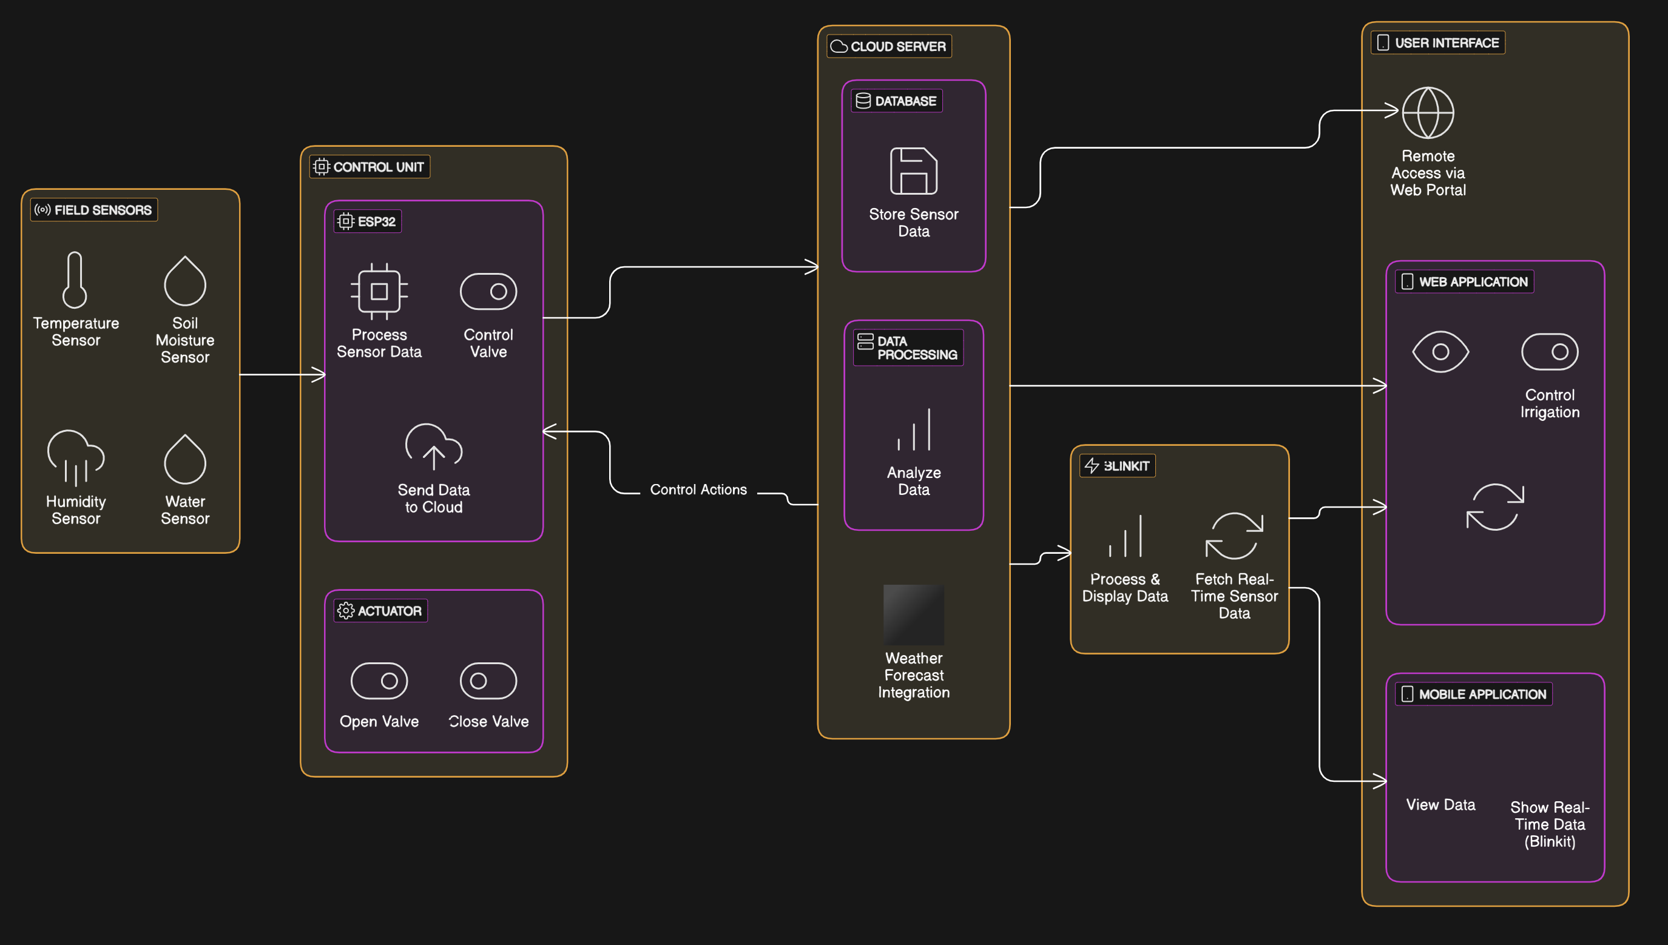
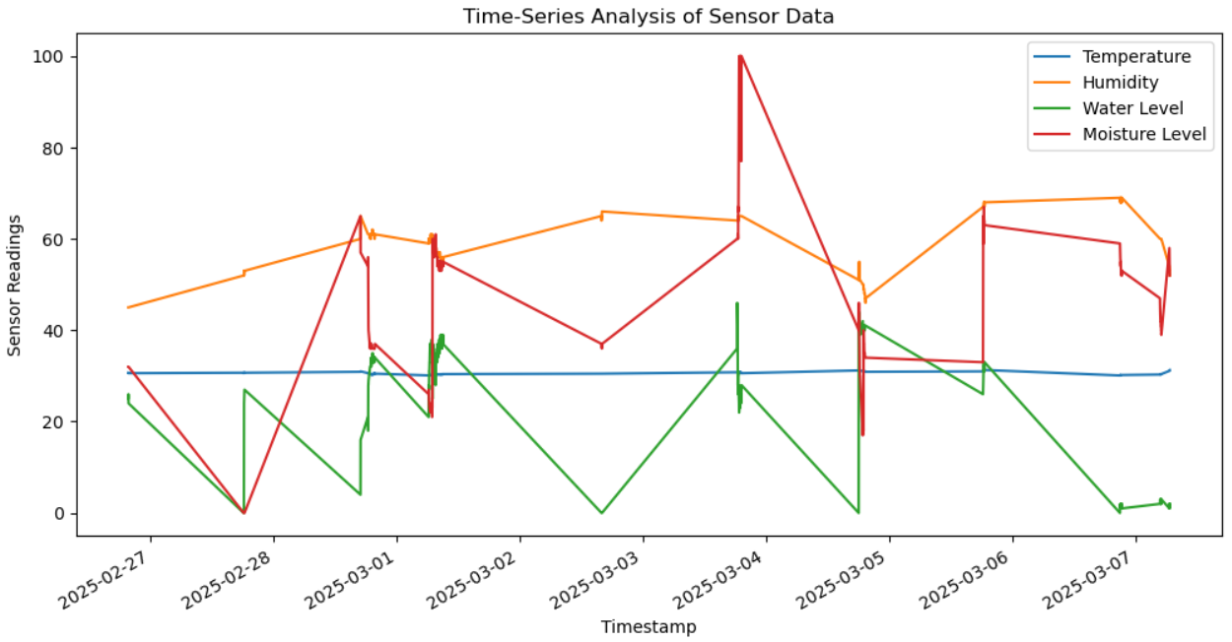
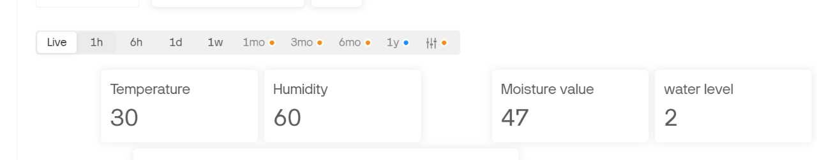
SMART IOT BASED IRRIGATION DECISIVE SYSTEM
MPS AKHIL,I HEMA VARDHAN REDDY,PADIGALA NANDINI, Amrita Viswa Vidyapeetham
(A) GOAL & CONTRIBUTIONS
(E) Web Dashboard
Goal: Develop a smart IoT-based irrigation system to optimize water usage and improve crop health through automated, data-driven irrigation.
Contributions:
Automated irrigation based on real-time soil moisture levels.
Remote monitoring and control via Blynk and web dashboard.
Machine learning models for predicting motor on and next motor on time.
Residual plot analysis for model accuracy evaluation.
By using real-time data and predictive models, the system reduces water wastage by optimizing irrigation schedules, ensuring efficient resource utilization.
The web dashboard for the IoT Smart Irrigation System offers an interactive interface for monitoring and controlling the irrigation process. It displays real-time data on temperature, humidity, soil moisture, and water levels.
The dashboard includes a live status panel with LED indicators for power state, pump activity, and sensor connectivity. Users can remotely control the pump manually or set it to automatic mode based on soil moisture levels.
It also features historical data tracking, allowing farmers to analyze trends and export data in Excel format. ML-powered predictions for weather and pump runtime are shown through charts, enabling data-driven irrigation decisions.
The responsive design ensures easy access from desktops, tablets, and mobile devices, allowing farmers to manage irrigation remotely.
(B) Random Forest and LSTM
A Random Forest is a powerful ensemble learning algorithm that combines multiple decision trees to improve accuracy and reduce overfitting. It is widely used for both classification and regression tasks. The model aggregates the predictions of multiple trees, resulting in a more stable and reliable outcome
(F) Real-Time Weather Tracking
Interactive Map Display:
Uses Leaflet.js to render a detailed, interactive map.
Displays the current location of the irrigation system.
Real-Time Location Tracking:
Automatically retrieves and updates the system's GPS coordinates.
Shows live location details with markers on the map.
Location Details Popup:
Clicking on the marker displays location-specific details, such as:
Latitude and longitude coordinates.
Nearby landmarks or geographical information.
Responsive Map Controls:
Zoom, pan, and navigation features for easy exploration.
Fully accessible on desktops, tablets, and mobile devices.
Residual Plot Analysis
The residual plot shows the difference between the actual and predicted values.
Residuals close to zero indicate a good fit.
Random scatter of residuals around zero shows that the model makes unbiased predictions.
Patterns or trends in the residual plot indicate potential model bias or non-linearity in the data.
LSTM Model for Time Series Prediction
Model Type: Long Short-Term Memory (LSTM), a recurrent neural network (RNN) designed for sequential data.
Forecasting Capability: Captures long-term dependencies and temporal patterns, making it effective for time series prediction.
Memory Structure:
Uses memory cells to store information.
Employs gates (input, forget, and output) to regulate data flow.
Functionality:
Retains relevant historical data while discarding irrelevant information.
Input & Output:
Takes the last 24 hours of weather data as input.
Predicts the next 6 hours of values.
(G) DATA ANALYSIS
The bar chart displays the daily average sensor values for temperature, humidity, water level, and moisture level over a series of dates. It provides a visual comparison of these environmental parameters, helping monitor variations over time.
(C) Architecture Diagram
Color Representation:
Red: Strong positive correlation (value close to 1).
Blue: Negative correlation (value close to -1).
Key Correlations:
Humidity and moisture level have a moderate positive correlation (0.43).
Correlation Matrix Overview: Visualizes the relationship between temperature, humidity, water level, and moisture level.
Humidity and water level show a weak negative correlation (-0.46).
Time-Series Analysis: The graph shows the variations in temperature
humidity, water level, and moisture level over time.
Trend Observation: Humidity and moisture levels fluctuate significantly, while temperature remains relatively stable.
System Architecture Overview
The Smart IoT-Based Agricultural Decision Support System uses field sensors to measure temperature, humidity, soil moisture, and water levels. An ESP32 microcontroller processes the data, controls irrigation valves, and sends it to the cloud. Real-time data is displayed via Blynk on web and mobile apps, enabling remote monitoring and efficient irrigation management.
(D) Mobile Access
(H) TECHNICAL STACK
Hardware: ESP32, DHT11, Soil Moisture Sensor, Water Level Sensor, 4G-GSM.
Cloud & IoT: HiveMQ Cloud, Firebase Realtime Database.
Frontend: React-based web application.
Backend: Node.js server with Firebase Admin SDK.
ML Models: TensorFlow, scikit-learn, Flask.
(I)REFERENCES
The Blynk integration in the IoT Smart Irrigation System enables remote monitoring and control through a mobile app, enhancing accessibility and convenience for farmers. The Blynk platform displays real-time sensor data, including temperature, humidity, soil moisture, and water levels. The app provides live status updates on the irrigation system, including the pump’s operational state and error alerts, through LED status indicators.
Farmers can remotely control the water pump based on moisture levels or manually override it. The app also offers historical data visualization, predictive maintenance alerts, and weather forecasts using ML-powered LSTM models, ensuring data-driven irrigation scheduling for optimal water usage and improved crop health.
Tzounis , A., Katsoulas , N., Bartzanas , T., & Kittas , C. (2017). Internet of Things in agriculture, recent advances, and future challenges. Biosystems Engineering, 164, 31-48. [DOI: 10.1016/j.biosystemseng.2017.09.007]
Patil, S., & Kale, N. (2016). A model for smart agriculture using IoT. 2016 International Conference on Global Trends in Signal Processing, Information Computing, and Communication, 543-545. [DOI: 10.1109/ICGTSPICC.2016.7955370]
Rathod, P., Maheshwari, R., & Patil, M. (2018). IoT-based smart irrigation system. International Journal of Computer Science and Network, 7(6), 273-277.

