Slide 1
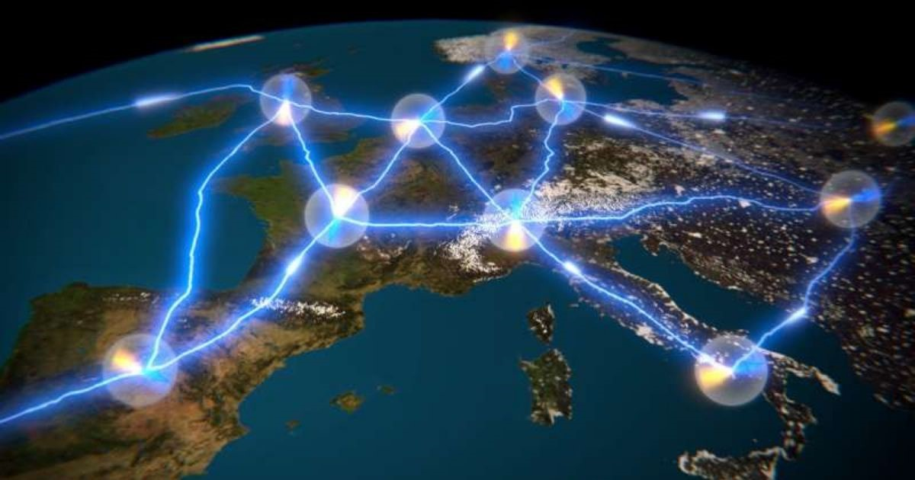
Anonymous communication of quantum messages
Matteo Gianvenuti

Slide 2
Project goal
Through QNE implement the paper
“Unnikrishnan, A., MacFarlane, I. J., Yi, R., Diamanti, E., Markham, D., & Kerenidis, I. (2019). Anonymity for practical quantum networks. Physical review letters, 122(24), 240501.”
Notes:
It consits of…

Slide 3
The context
Roles
Protocol inputs
Protocol variation
Notes:
Step 2.
Honest agents. -> perfect anonymity of the protocol.
Sender as source for the GHZ.
QNE limitation: sync issue, to many sockets, variation, -> broadcast

Slide 4
Quantum Network Explorer (QNE)
QNE-ADK
NetQASM
Notes:
QNE advantages: python (netqasm lang). Low cost, no need qc, network.
QNE Limitations: ubuntu linux
pip install squidasm --extra-index-url=….

Slide 5
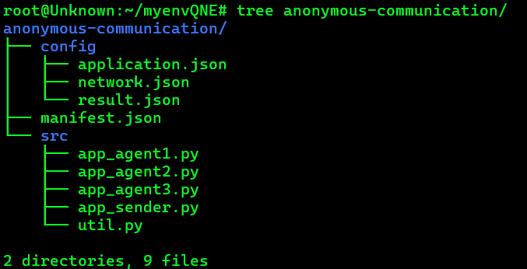
QNE Application
Application
Experiment
Notes:
Qne application create myapp role1 role2
Qne experiment create exp myapp europe
Qne experiment run exp
Netqasm simulate (directly from NetQASM tools)

Slide 6
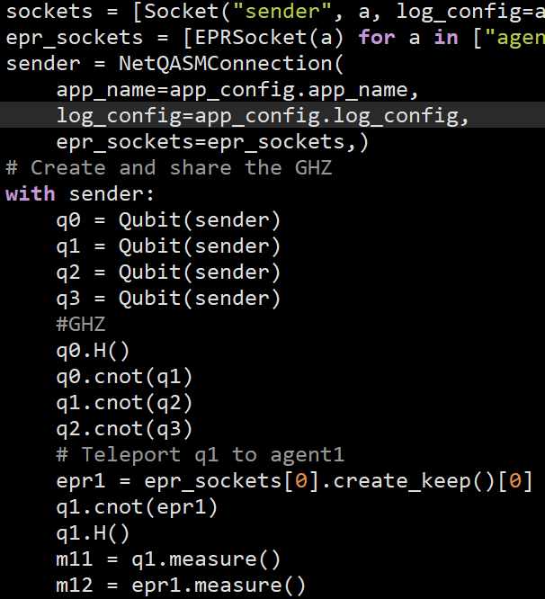
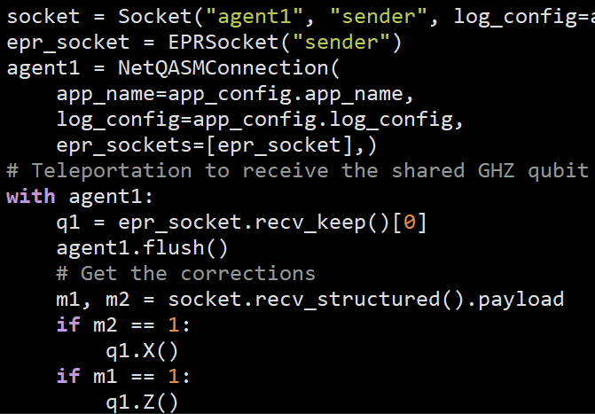
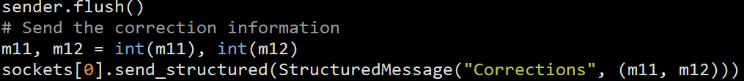
Practical example
EPRSocket
NetQASMConnection
flush
measure
Notes:
QNE advanrage: Create keep, recv keep, give a qubit or more (list) already entangled! Btw 2 roles.
Quantum hardwar -> connection -> QNodeOS.
BaseNetQASMConnection instance provides an interface for Host programs to interact with a quantum node controller.
A QNodeController represents a physical quantum node controller that handles messages coming from the Host, lets the Executor execute subroutines, and sends results back to the Host.

Slide 7
Limitations of QNE
Qubits quantity
Documentation (netqasm)
Notes:
Doc forward to netqasm sdk.
Advantages, here!

Slide 8
Conclusion
Problem solving
Projects
Notes:
Motive of choice.
If you have QCs non need simulator.

