Slide 1
GP types comparison
Project presentation for ML
Matteo Gianvenuti

Slide 2
Project objective
Compare the «modified» GP with the «normal» GP in terms of:
Performance
Effective solution’s size
Speed of convergence

Slide 3
Workflow
Understand previous work
Act for the objective

Slide 4
Improvements
data_loader.py: direct use of scikit-learn functions
utils.py:
training_rf: direct use of scikit-learn functions and removing unnecessary operations
extraction_tree: optimized!
extraction_list: rewritten. Some terminals were considered as internal nodes by the logic
generalization of similar functions and removing useless functions

Slide 5
Improvements
gp_types.py:
generalization of similar functions and removing useless operations
added calculation of equivalent nodes
div operator fix
evolution correction
dinamic probability calculation fix
pset update fix

Slide 6
Improvements
user_interface.py: added support for multiprocessing, possibility to configure more parameters and structured data saving
terminal_interface.py: created to speed up the performances (same of user interface but with no gui)
user_interface_charts.py: shows/analyses the run data
best_ind_f1.py: removing unecessary operations

Slide 7
Representation complexity analysis
extraction_tree: O(n)
get_modules: O(p*e)
extraction_list: O(n)
n = string individual’s size
p = population’s size
e = complexity of the extraction method

Slide 8
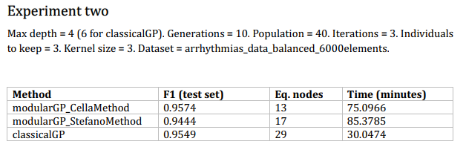
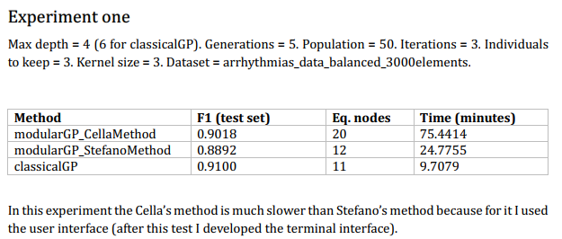
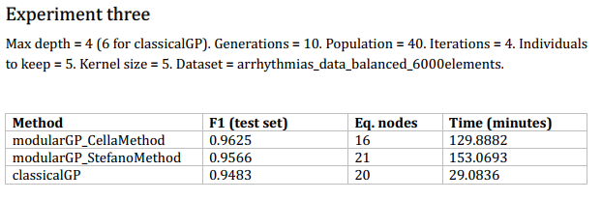
Results

Slide 9
Conclusion
The «modified» GP lead to better performances but with a higher overhead respect the «normal» GP. A really high max depth could make false this sentence.

