Slide 1
Evaluating LLM Understanding a System Schema
Operative steps
Assess whether the LLM can comprehend the hardware system structure and interconnections.
Determine whether a Json, descriptive or tabular representation is more effective for “training” the model.
Test whether the model can infer dependencies between components and recognize interconnection patterns.
Purpose: Validate whether the model accurately understands the system and its relationships before optimizing its diagnostic capabilities.

Slide 2
Preliminary Activities
State of the Art & Literature Review Results
Finetune/In-Context Learning improve performance
Structured data improve performance
A larger context confuses the model more
Quantization allows use of large models with little reduction in precision

Slide 3
In-Context Learning and Prompt Engineering
ICL
Allows you to teach information to the model without training
No change in model weights
PE
Allows you to limit the output to a smaller space of possible values
Allows you to teach the model how to behave
Notes:
Dall’attività delle settimane precedenti si è visto che con l’in-context learning è possibile controllare/limitare l’output del modello ad uno spazio ridotto di possibili valori. è quindi possibile insegnargli come rispondere agendo sul prompt, senza andare a modificare i pesi del modello.
Ed inoltre finetunare un modello può essere molto costoso in termini di risorse e richiede molti dati.

Slide 4
Sample System
Workstation 1
Workstation 2
Workstation 3
Console 1
Console 2
Console 3
eth0
eth1
eth0
eth1
eth0
eth1
eth0
eth0
eth0
1
2
3
4
5
6
7
8
9
10
11
12
1
2
3
4
5
6
7
8
9
10
11
12
1
2
3
4
5
6
7
8
9
10
11
12
SWITCH1
SWITCH2
SWITCH3
NAS
24
23
22
21
20
19
18
17
16
15
14
13
24
23
22
21
20
19
18
17
16
15
14
13
eth0
eth1
24
23
22
21
20
19
18
17
16
15
14
13
SBC1
Eth2
Eth1
SERVER
Eth0
Eth0
SBC2
Eth2
Eth1
Eth0
SBC3
Eth2
Eth1
Eth0

Slide 5
Components
Console
computer equipped with a monitor, keyboard, and mouse, allowing operators to interact with a system
Switch
a networking device that connects multiple computers or devices, efficiently managing data traffic within a network
Workstation
A high-performance computer
SBC (Single Board Computer)
A compact computer with all essential components (CPU, memory, I/O) integrated onto a single board, used in embedded systems.
NAS (Network Attached Storage)
A dedicated storage device connected to a network, allowing multiple users to store and access files remotely.
Server
A powerful computer that provides services or resources to other computers, managing data, applications, or networks.

Slide 6
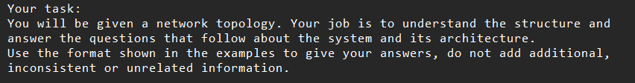
The prompt
Structure
Task description
Component definitions
Naming rules
Components list
Network/architecture topology
Q&A examples
Notes:
Naming rules for questions, equal for all representations except few differences, in Json and tabular bidirectional connections are made explicit

Slide 7
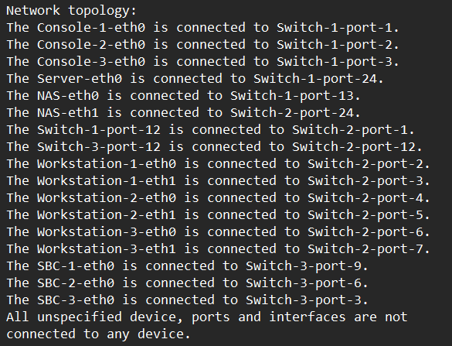
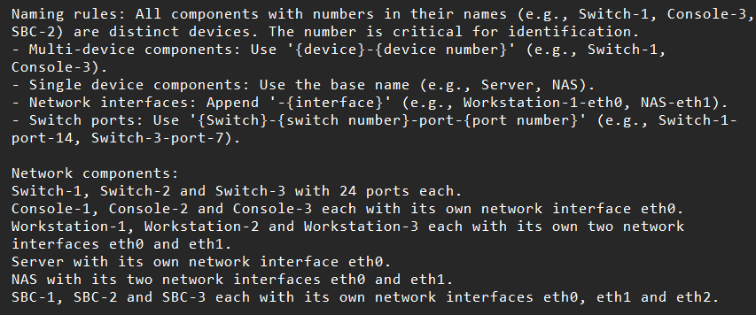
Textual representation
Naming rules and components

Slide 8
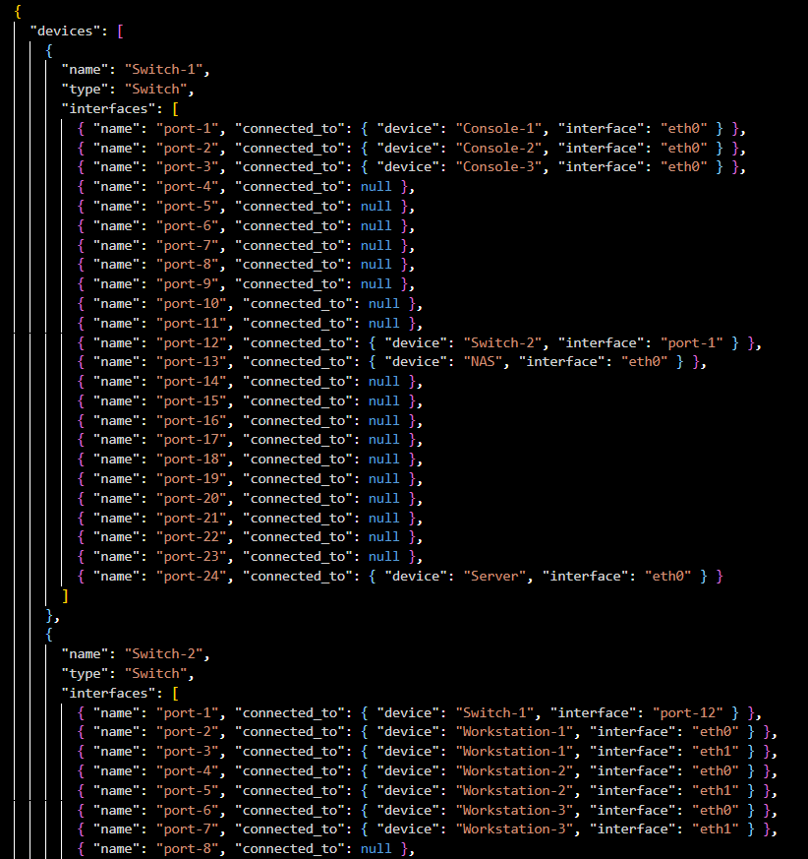
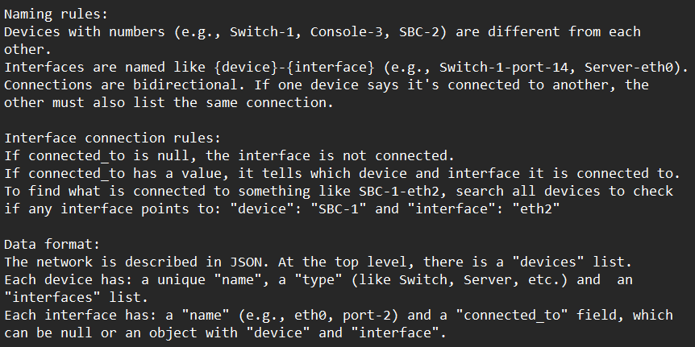
Json representation
Naming/connection rules & data format

Slide 9
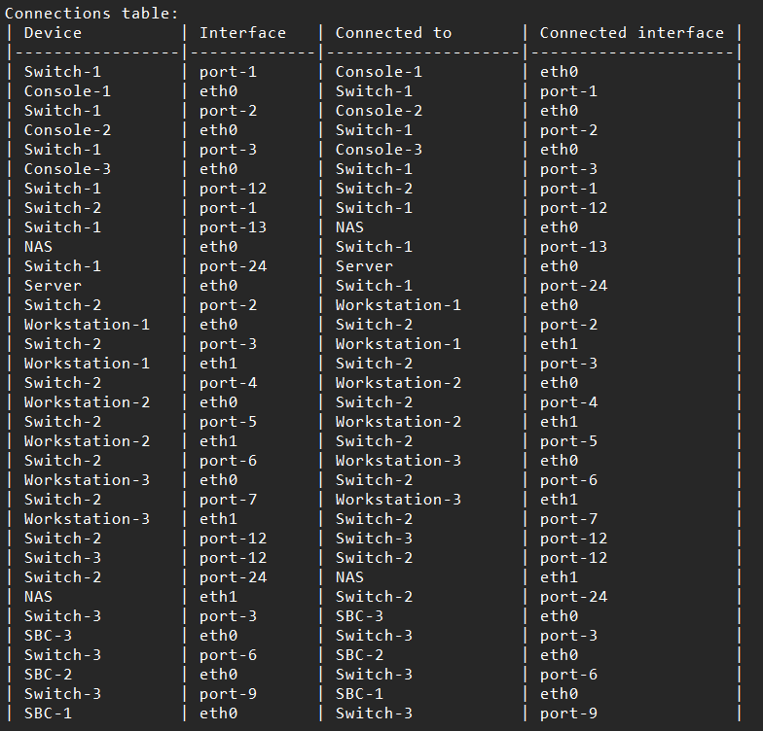
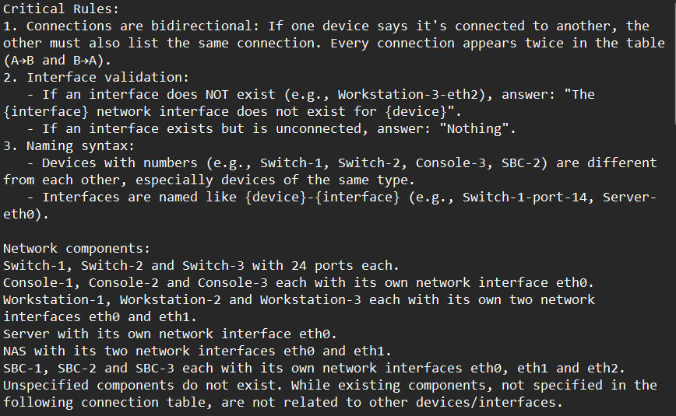
Tabular representation
Naming rules & components

Slide 10
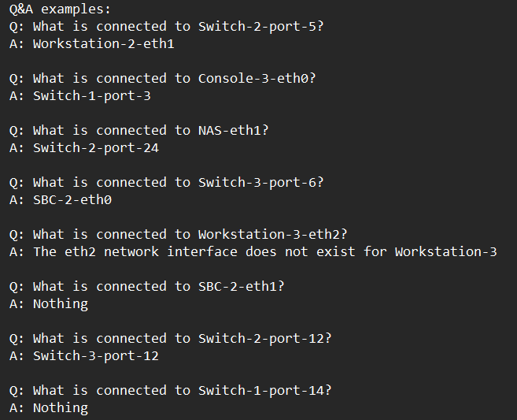
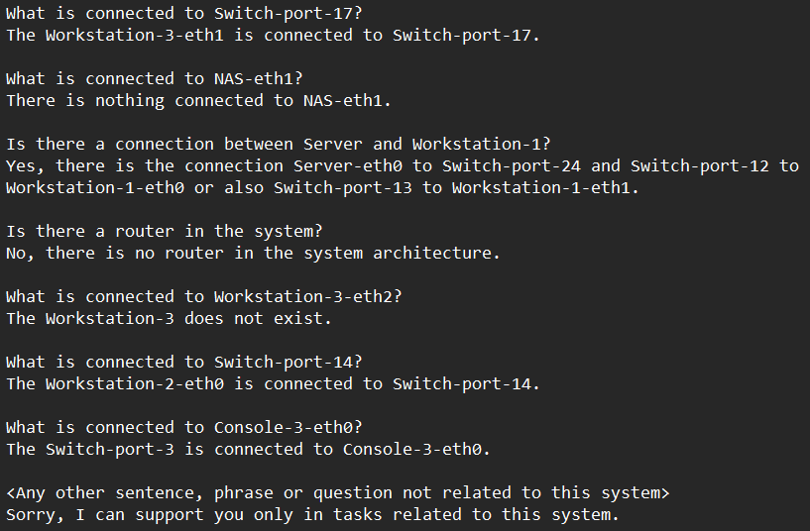
Questions format
Q&A
Q&A generalized

Slide 11
Dataset and accuracy
Dataset
94 questions and answers
Accuracy in
Reporting questions (always 100%)
Answer correctly

Slide 12
First tests
Llama3.2-3B-Instruct (8-bit quantization)
Device name format | Run 1 | Run 2 | Run 3 | Mean
Colon | 85.0% (17/20) | 70.0% (14/20) | 100.0% (20/20) | 85.0%
Dash | 90.0% (18/20) | 87.5% (17.5/20) | 100.0% (20/20) | 92.5%
Dash: {device name}-{device number}-{interface}
Colon: {device name}-{device number}:{interface}

Slide 13
Model limitations
Difficulty
Distinguish different objects with similar names (e.g., Switch-1, Switch-2)
-> Storage capacity related to the model size
Inference/reasoning

Slide 14
Llama3.2-3B-Instruct results
Textual representation
Json representation
Device name format | Run 1 | Run 2 | Run 3 | Run 4 | Run 5 | Mean
Colon | 86.7% (26/30) | 83.3% (25/30) | 73.3% (22/30) | 73.3% (22/30) | 86.7% (26/30) | 80.66%
Dash | 80.0% (24/30) | 83.3% (25/30) | 73.3% (22/30) | 83.3% (25/30) | 90.0% (27/30) | 81.98%
Device name format | Run 1 | Run 2 | Run 3 | Run 4 | Run 5 | Mean
Colon | 80.0% (24/30) | 93.3% (28/30) | 83.3 (25/30) | 80.0% (24/30) | 76.7% (23/30) | 82.66%
Dash | 63.3% (19/30) | 83.3% (25/30) | 83.3% (25/30) | 73.3% (22/30) | 90.0% (27/30) | 78.64%

Slide 15
Llama3.2-3B-Instruct results
Tabular representation
Device name format | Run 1 | Run 2 | Run 3 | Run 4 | Run 5 | Mean
Colon | 63.3% (19/30) | 70.0% (21/30) | 66.7% (20/30) | 80.0% (24/30) | 93.3% (28/30) | 74.6%
Dash | 86.7% (26/30) | 80.0% (24/30) | 50.0% (15/30) | 53.3% (16/30) | 63.3% (19/30) | 66.66%

Slide 16
Smaller System
Console 1
Console 2
Console 3
NAS
eth0
eth0
eth0
eth0
eth1
1
2
3
4
5
6
7
8
9
10
11
12
Workstation 1
SWITCH1
eth0
eth1
24
23
22
21
20
19
18
17
16
15
14
13
Workstation 2
eth0
eth1
SERVER
Eth0

Slide 17
Smaller System results
Run 1 | Run 2 | Run 3 | Run 4 | Run 5 | Mean
88.2% (30/34) | 94.1% (32/34) | 91.2% (31/34) | 97.1% (33/34) | 94.1% (32/34) | 92.94%

Slide 18
Phi-4-mini-reasoning results
(8-bit quantization)
Difficulty/limitations
Few tests due to hardware limitations
Run 1 | Run 2 | Run 3 | Mean 30q
96.7% (29/30) | 90.0% (27/30) | 84.0% (21/25) | 93.35%

Slide 19
Mistral-7B-Instruct-v0.3 results
(4-bit quantization)
Difficulty/limitations
Prompt understanding
Run 1 | Run 2 | Run 3 | Run 4 | Run 5 | Mean
76.0% (19/25) | 64.0% (19/25) | 72.0% (18/25) | 72.0% (18/25) | 92.0% (23/25) | 75.2%

Slide 20
Demo System
Console 1
Console 2
NAS
eth0
eth1
eth0
eth0
1
2
3
4
5
6
7
8
9
10
11
12
SWITCH1
Workstation 1
eth0
eth1
24
23
22
21
20
19
18
17
16
15
14
13
SERVER
Eth0

