Slide 1

Enhancing Fault Isolation in Hardware Systems Using Large Language Models (LLMs)
Matteo Gianvenuti
Accademic year 2024/2025

Slide 2
MBDA
Internship thesis program
MBDA is a European multinational corporation, specialized in defense

Slide 3
Thesis’ objectives
Explore the use of LLMs in hardware diagnostic to analyse diagnostics test results, identify any possible anomalies and try to find their possible causes
In an offline working environment characterized by challenging limited resources without the support of cloud infrastructures or high-end GPU, like the resources available on computer laptop

Slide 4
Operative steps
Step One – Evaluating LLM Understanding of the System Schema
Evaluate the SOTA in hardware diagnostics
Assess whether the LLM can comprehend the hardware system structure and interconnections
Determine whether a tabular, Json or descriptive representation is more effective to prepare the model
Test whether the model can infer dependencies between components and recognize interconnection patterns
Validate whether the model accurately understands the system and its relationships before optimizing its diagnostic capabilities

Slide 5
Operative steps
Step Two – Evaluating the LLM ability of analyse logs and telemetry data generated by the diagnostic software
Use a simulator to generate structured data tailored to system diagnostics. Design realistic fault scenarios to feed into the LLM
Use the LLM to identify anomalies and their possible causes

Slide 6
Sample System
Workstation 1
Workstation 2
Workstation 3
Console 1
Console 2
Console 3
eth0
eth1
eth0
eth1
eth0
eth1
eth0
eth0
eth0
1
2
3
4
5
6
7
8
9
10
11
12
1
2
3
4
5
6
7
8
9
10
11
12
1
2
3
4
5
6
7
8
9
10
11
12
SWITCH1
SWITCH2
SWITCH3
NAS
24
23
22
21
20
19
18
17
16
15
14
13
24
23
22
21
20
19
18
17
16
15
14
13
eth0
eth1
24
23
22
21
20
19
18
17
16
15
14
13
SBC1
Eth2
Eth1
SERVER
Eth0
Eth0
SBC2
Eth2
Eth1
Eth0
SBC3
Eth2
Eth1
Eth0

Slide 7
Step One – Preliminary Activities
State of the Art & Literature Review
Analysis of academic publications, technical articles, and white papers on:
Hardware diagnostics
LLMs applied to unstructured data analysis
LLMs for fault detection
Anomaly detection and fault isolation techniques
Fault isolation, identification of best practices and current limitations in existing solutions
Prompt Engineering
In-Context Learning to teach the system architecture and how to reply
Technological Evaluation
Comparison of existing LLMs:
Llama3.2-3B-Instuct
Phi-4-mini-reasoning
Mistral-7B-Instruct-V0.3

Slide 8
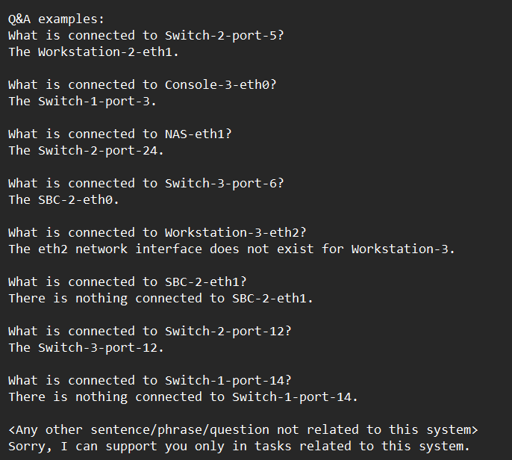
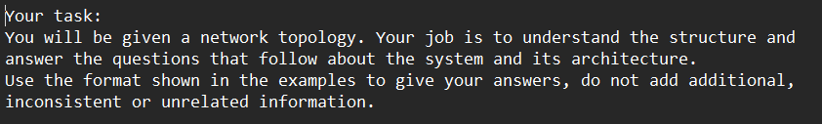
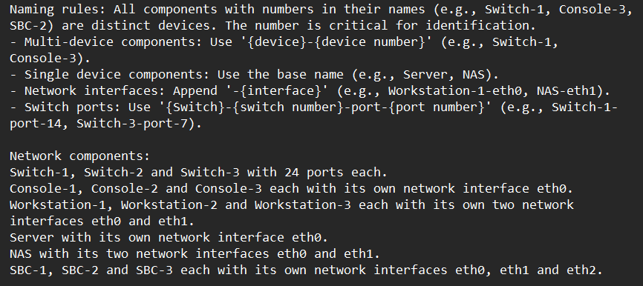
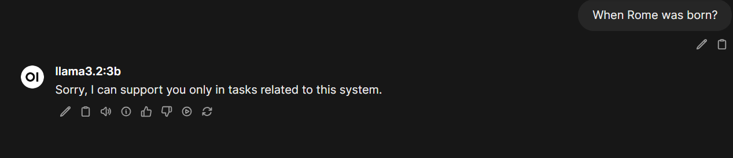
Step One – Prompt Engineering and ICL

Slide 9
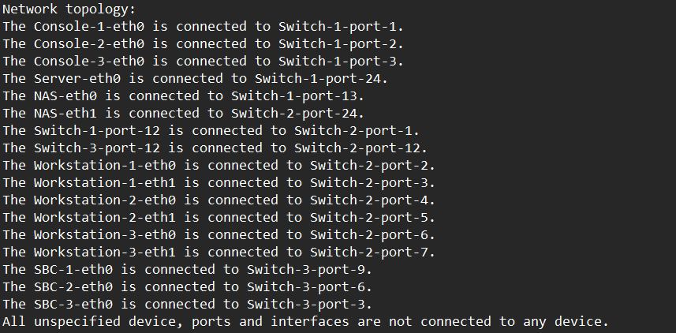
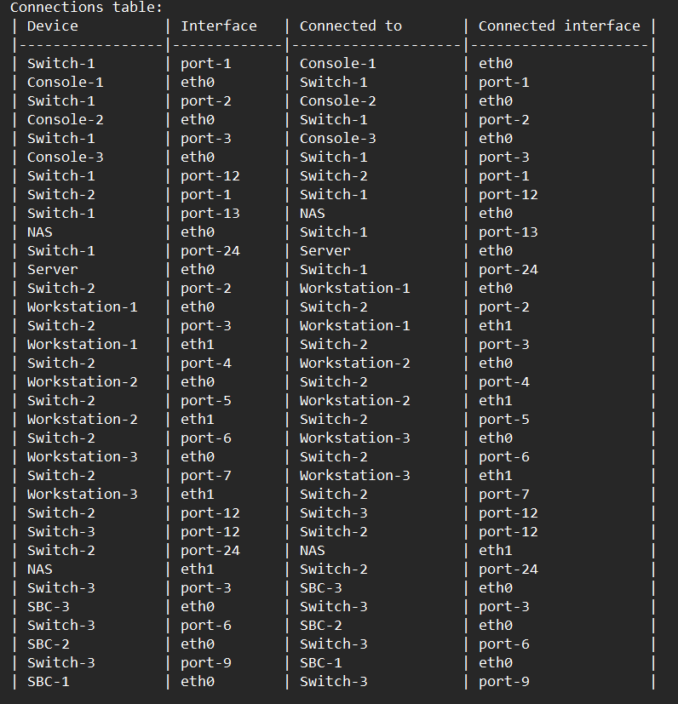
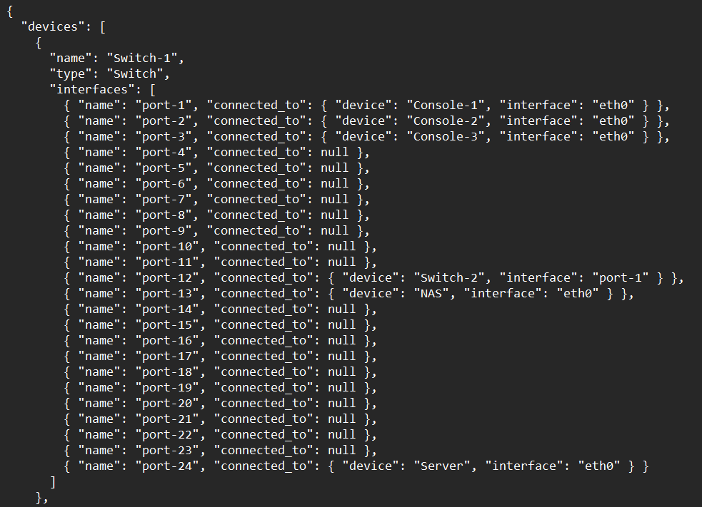
Step One – System Representation

Slide 10
Step One – Models Comparison
Mean accuracy:
Llama 82%
Phi 54%
Mistral 75%
Mean 82%
Mean 74%
Mean 82.6%

Slide 11
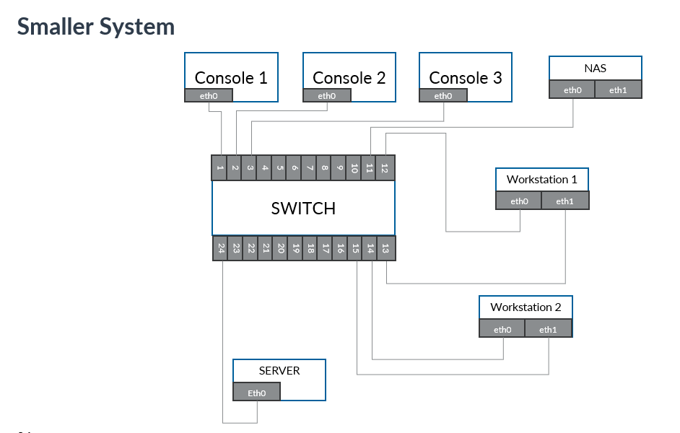
Step One – Model Size Capabilities
A larger context (prompt/input) reduces the model performance

Slide 12
Step Two – Scenarios and Dataset
Scenario 1 – Fully Functional System:
The system operates correctly, and all diagnostic tests return successful results
Scenario 2 – Failure of Switch 2:
The component "Switch 2" is entirely non-functional. As a result, all tests directly associated with it and its connected devices fail
Scenario 3 – Failure of SBC2:
The "SBC2" component is completely broken, leading to the failure of all tests targeting it
For each scenario there is a dataset with diagnostic tests (ram status, temperature, link status, connectivity speed, PBIT, sensors status, voltage status, etc)

Slide 13
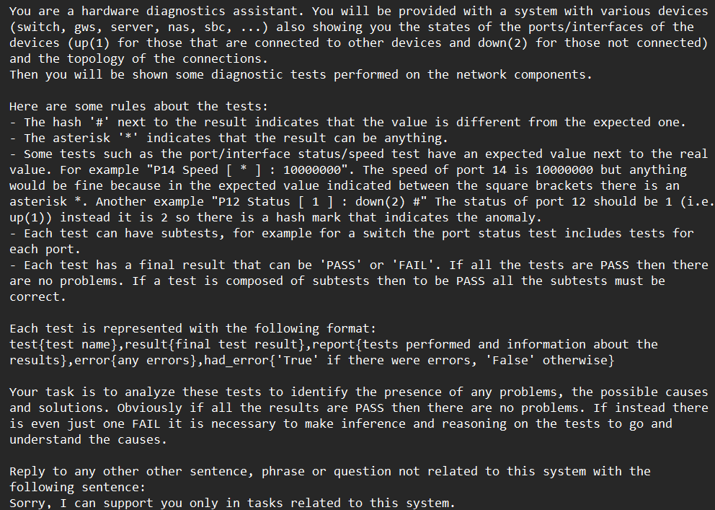
Step Two – No Few-Shot

Slide 14
Step Two – No Few-Shot Results
The model partially detected the anomalies but did not understand the cause

Slide 15
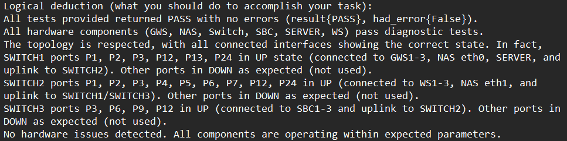
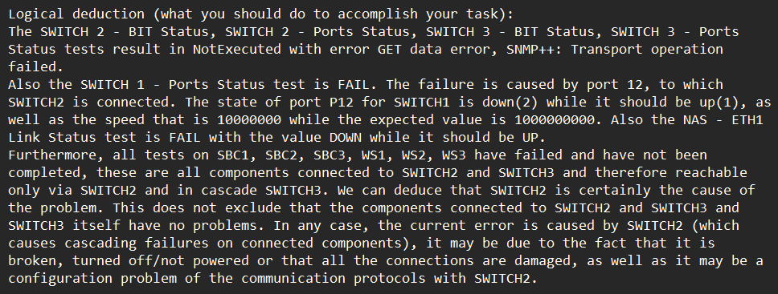
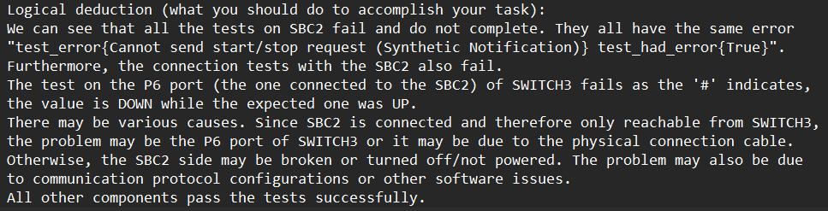
Step Two – Few-Shot
One-Shot
Two-Shot

Slide 16
Step Two – Few-Shot Results
The model detect some anomalies but still do not find the cause
An extended context do not let focus the model on the real issues

Slide 17
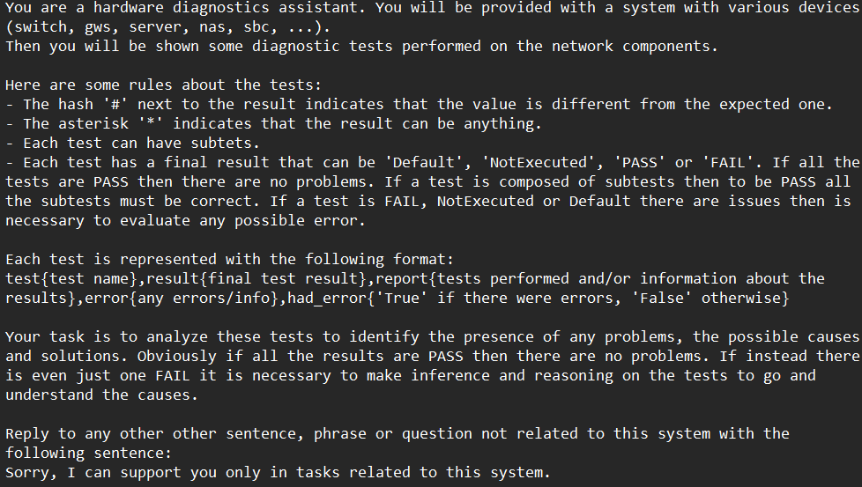
Step Two – No Few-Shot Reduced
To solve the problem, I reduced the number of tests:
Connectivity tests
PBIT tests

Slide 18
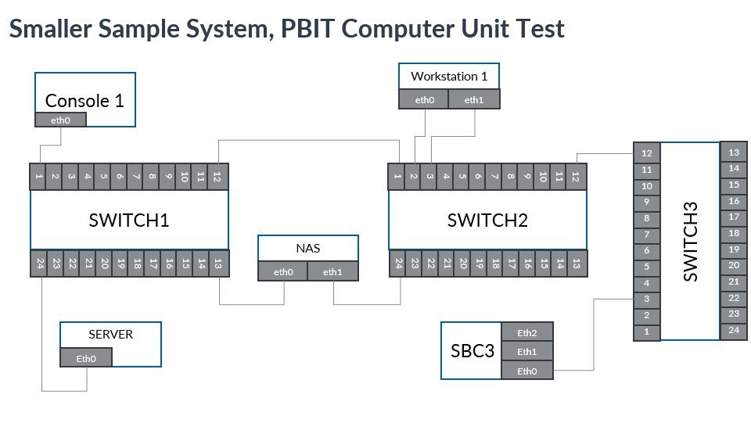
Step Two – No Few-Shot Reduced Results

Slide 19
Conclusion and Future Developments
With specific task knowledge and not too much data the model can identify anomalies and in some cases their cause
Making the diagnostics process faster
Diagnostic software integration
Finetune to improve the performance

Slide 20
Enhancing Fault Isolation in Hardware Systems Using Large Language Models (LLMs)
Matteo Gianvenuti
Accademic year 2024/2025

