Slide 1
Online security and anonymity
Matteo Gianvenuti

Slide 2

What expose you online?
IP address
Browser
Fingerprint
Cookies
Stie and cross-site tracking
Application tracking
OS and Device
Social media/networks
ISP

Slide 3





What expose you online?
Metadata
Typical behaviour
Surveliance agencies

Slide 4

VPNs
Trust
Fingerprint
Legal actions
Traffic analysis
Non-onion

Slide 5

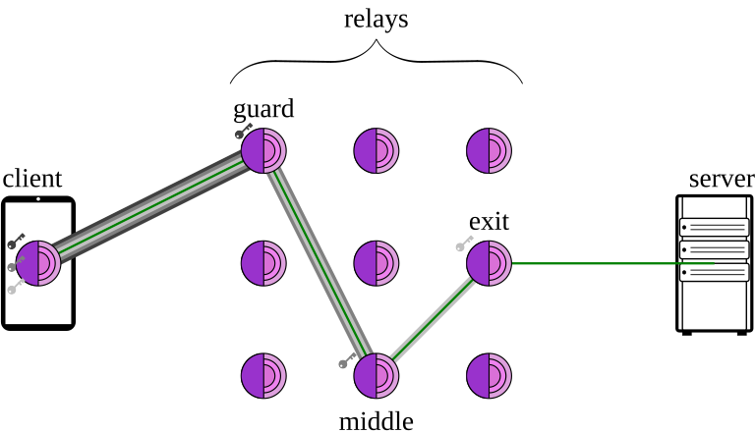
Tor
Applicative encryption
Fingerprint
Browser vulnerabilities
Network monitoring
end-to-end correlation

Slide 6

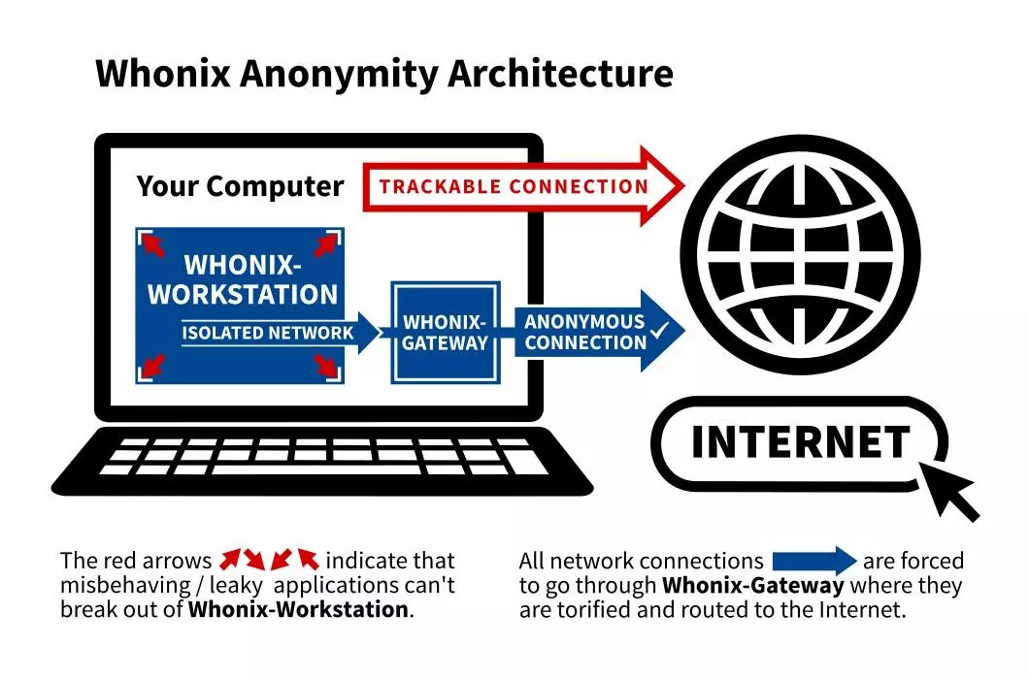
Whonix
Workstation-gateway architecture
Based on Kicksecure
Kloak
Scripting protection
Tor

Slide 7

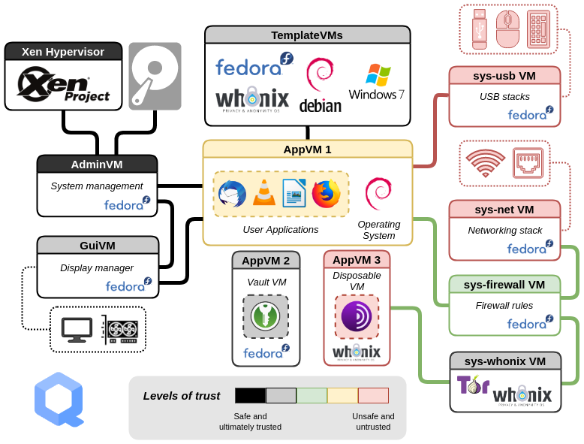

“I use Qubes and a Whonix gateway literally everyday, ...”

