Slide 1
GYM TREADMILL
RESERVATION SYSTEM
Short project README / presentation
Computer-vision-assisted treadmill occupancy monitoring and reservation workflow.
OCCUPIED
EMPTY
TRACKING
treadmill-1
treadmill-2
anchor point
Gym Treadmill Reservation System
1

Slide 2
1. Project at a glance
What the system is designed to demonstrate
Purpose
Conceptual workflow
• Monitor gym treadmills from camera feeds.
• Detect whether a treadmill is occupied or empty.
• Associate observations across camera views using an anchor point.
• Expose the current treadmill state for a reservation experience.
01
Camera input
Wide camera + bird's-eye view
02
Treadmill regions
Configured treadmill areas
03
Occupancy
Person presence determines state
04
Cross-view anchor
Point links the observation
Observed output
05
Reservation state
Available / occupied information
treadmill-1: OCCUPIED • treadmill-2: EMPTY
Gym Treadmill Reservation System
2

Slide 3
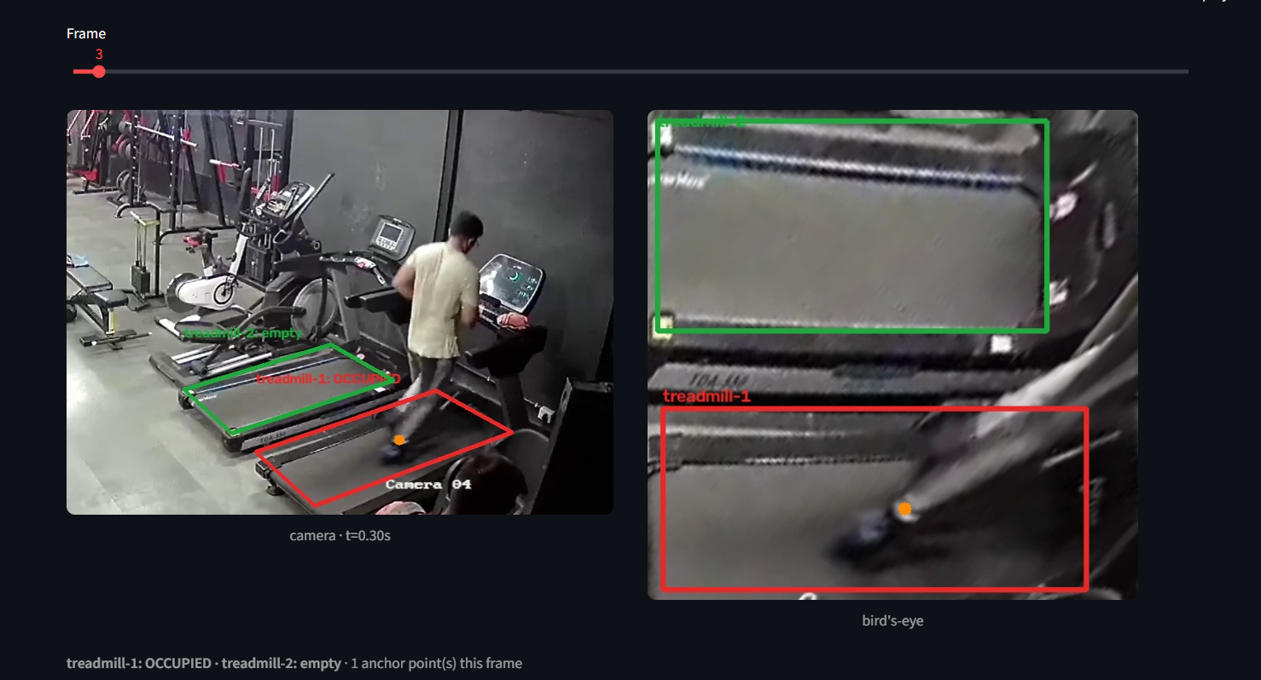
2. Detection & tracking view
The supplied screenshots show the same two treadmill regions over time
Frame 3
Initial observed state
treadmill-1
OCCUPIED
treadmill-2
EMPTY
The wide camera view provides the context while the bird's-eye panel shows the corresponding treadmill region.
Visual markers
• Red/green regions indicate treadmill state.
• Orange point marks the tracked anchor.
Gym Treadmill Reservation System
3

Slide 4
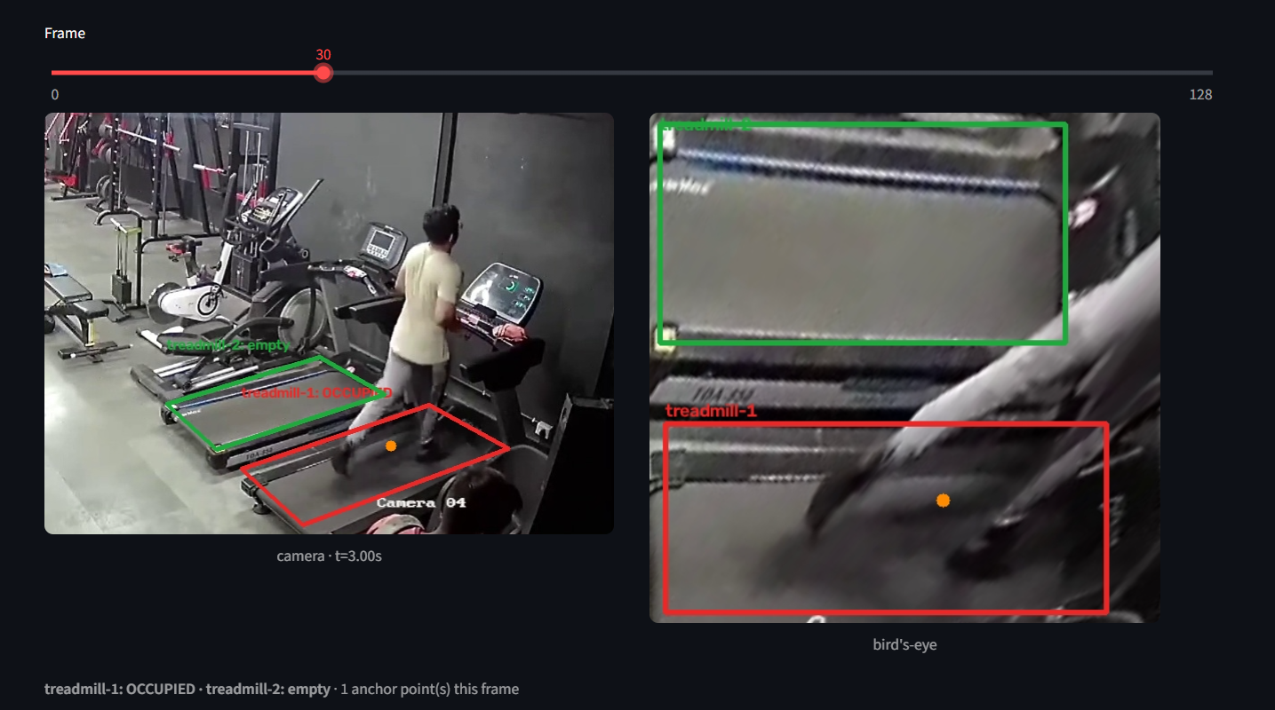
3. State change over time
The supplied frames illustrate occupancy changing during the session
Frame 30 • t ≈ 3.00 s
Observed state
treadmill-1
OCCUPIED
treadmill-2
EMPTY
Why this matters
• Reservation availability can be derived from live occupancy.
• The same visual regions persist across frames.
• The anchor point provides a compact tracked location.
Gym Treadmill Reservation System
4

Slide 5
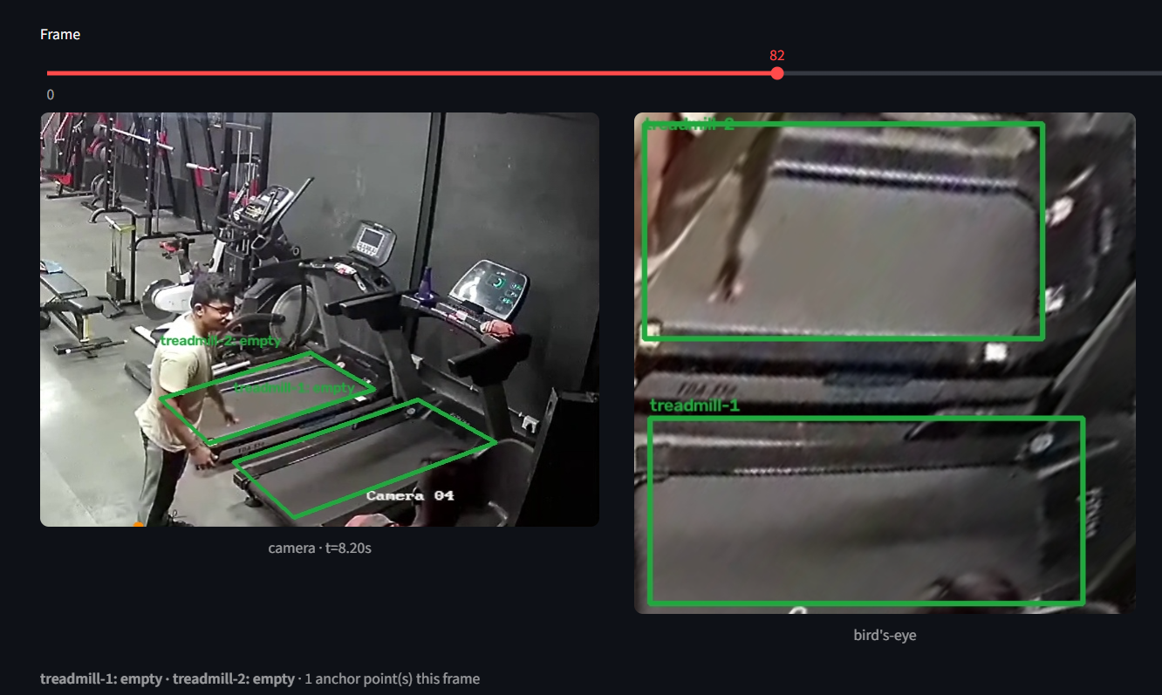
4. Empty-state example
A later frame shows both treadmill regions marked empty
Frame 82 • t ≈ 8.20 s
Observed state
treadmill-1
EMPTY
treadmill-2
EMPTY
Reservation implication
When a treadmill is detected as empty, the reservation layer can expose it as available according to the project's business rules.
Gym Treadmill Reservation System
5

Slide 6
5. README summary
Core idea, evidence, and next steps
Core idea
Evidence in demo
Reservation layer
• Use camera observations to determine treadmill occupancy.
• Represent each treadmill as a persistent region/state.
• Frames 3, 30 and 82 show state changes over time.
• Wide and bird's-eye views are presented together.
• Occupied → not available.
• Empty → candidate for reservation.
• Business rules can add booking duration, user identity and release logic.
Project demo screenshots included from the supplied frames.
End
Gym Treadmill Reservation System
6

