Slide 1
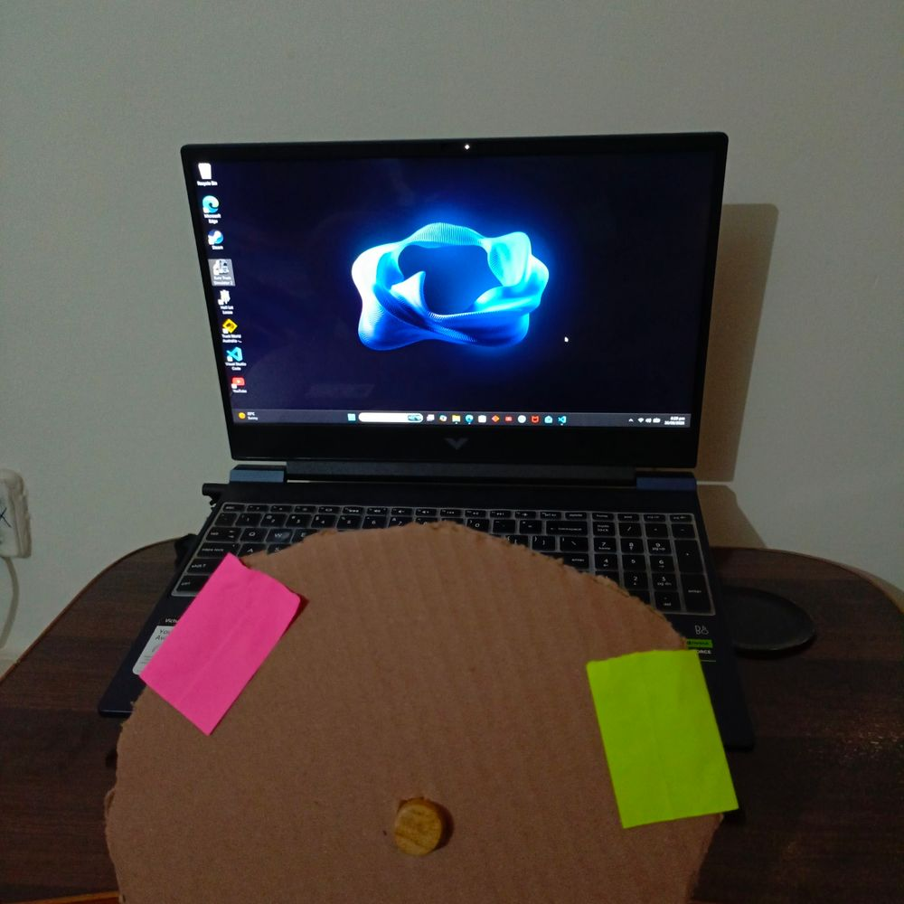
Vision-Based Steering Controller
for Driving Simulators
A webcam, a cardboard wheel and OpenCV
Muhammad Asjad

Slide 2
The idea
Play driving games with a homemade wheel and no special hardware.
1 · The prop
2 · The camera
3 · The input
A cardboard wheel on a wooden dowel, with a pink and a green sticky note as markers.
A regular webcam watches the markers while OpenCV tracks them frame by frame.
The line between the markers gives a steering angle, which becomes live keyboard presses.

Slide 3
How it works
Capture
Detect
Measure
Map
Inject
Webcam frame
Pink and green markers
Angle of the line between them
Angle to a steering key
Keystroke sent to the game
Multithreaded. Tracking and input run on separate threads, so steering stays responsive no matter which window is in focus.

Slide 4
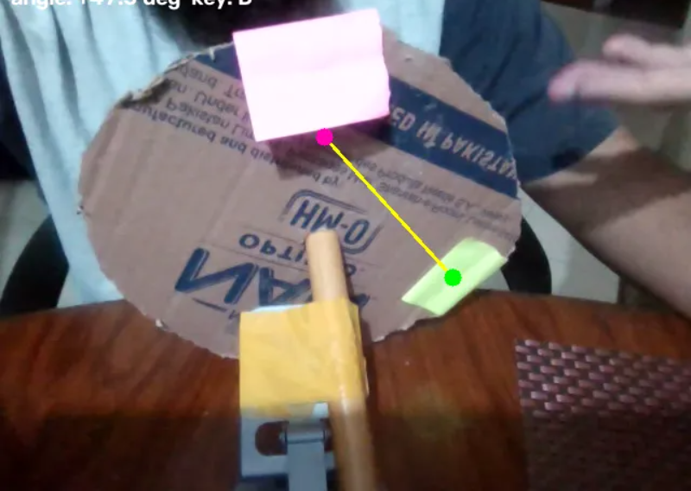
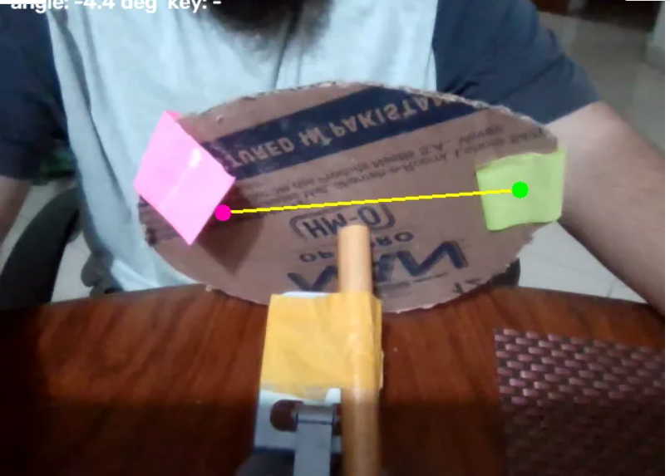
Live demo
Steering right: +47.5° sends D
Wheel centered: -4.4° sends no key

Slide 5
Design highlights
Responsive by design
A multithreaded architecture keeps input responsive independent of the active application window.
Almost no hardware
Cardboard, a wooden dowel, two sticky notes and a laptop webcam.
Live feedback
A Gradio interface shows the annotated video with status, angle and key output in real time.

Slide 6
Tech stack and next steps
Built with
Ideas to extend it
Python
OpenCV
Gradio
Multithreading
Smoothing and dead-zone tuning
Analog steering via a virtual gamepad
Pedals and gear input

