Slide 1
AURORA OPS
The IT engineer
that never sleeps
Alarms have told us something is broken for thirty years. Working out what it means, fixing it, and checking the fix held is still a person — awake at 3am.
Gourav Kumar Bathwal
Notes:
Open plainly. Do not say 'agentic' in the first minute — say what it does at 3am.

Slide 2
THE PROBLEM
It is 3am. Something just broke.
03:00
An alarm goes off
“Disk is 94% full on the main server.”
03:04
Someone wakes up and logs in
They start typing commands, one at a time, looking for what changed.
03:18
They work out what happened
A log file grew without limit because a clean-up job quietly stopped running.
03:26
They fix it and check it held
Take a backup first, clear the files, restart the job, run the check again.
Waking them up was automated in the 1990s. Everything after that is still a person typing.
Notes:
Everyone in the room recognises this, technical or not. Let it land before moving on.

Slide 3
THE PROBLEM
Three different problems get called one problem
Noticing
Understanding
Fixing
“Something is wrong.”
“Why is it wrong?”
“Make it not wrong.”
Solved. Thousands of tools do this. It is a commodity.
Still a person. Expensive, slow, and the senior engineer is the only one who is fast at it.
Still a person. Almost nobody has automated this safely.
NOT OUR FIGHT
WE DO THIS
WE DO THIS
Why the distinction decides everything
Called “monitoring”, this competes with Datadog and loses on day one. Called “what happens after the alarm”, it enters a market roughly two years old, where most products still stop at telling you the answer rather than doing anything about it.
Notes:
The room will try to collapse these three into 'IT is slow'. Keep them apart — the pitch lives here.

Slide 4
WHY NOW
We did not have too little information.
We had far too much.
For twenty years the answer to “we cannot see what is happening” was to add more monitoring. It worked, and then it went too far. People stopped being able to listen.
44%
10,000
1 in 20
of companies had an outage last year caused by
an alarm somebody had already switched off
alarms a day reaching a typical
operations team
of those alarms actually needs
a human being
Read the first number again. The outage was not caused by nobody knowing. It was caused by somebody having been told so many times that they had stopped looking. Another dashboard makes that worse, not better.
2026 State of Production Reliability report · 1,039 practitioners surveyed
Notes:
Strongest slide in the deck. Pause after 44%.

Slide 5
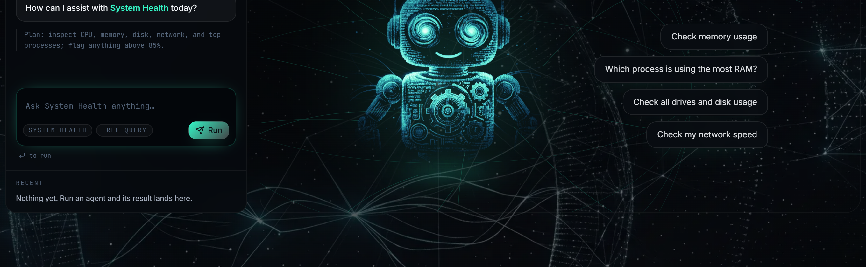
THE SOLUTION
So we gave the judgement to an assistant
You describe the problem the way you would to a colleague. It works out which checks to run, runs them on the real machine, and tells you what it found in plain language — showing every step it took.
You ask
It decides
It reports
In your own words. No commands, no syntax.
Which checks matter, and what to look at next based on what it just found.
Plain language, with a clear verdict: healthy, warning, or critical.
UNDER THE HOOD
Three ReAct agents on Groq (llama-3.3-70b, temperature 0). 33 Python tools reading the host through psutil.
Notes:
This is the live product against a running backend, not a mock-up.

Slide 6
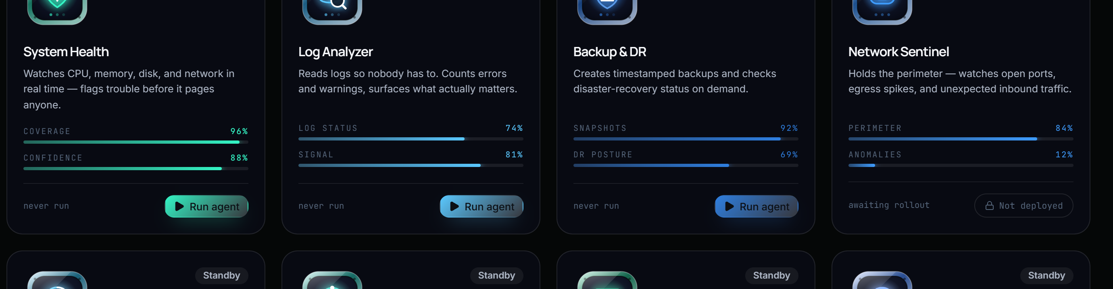
THE FLEET
Three specialists, not one know-it-all
Each one has its own narrow set of abilities and nothing else. That is a safety decision as much as an organisational one — the log reader physically cannot delete a backup, because it was never given the ability.
System Health
Log Analyzer
Backup & DR
Is the machine healthy?
What do the records say?
Is the data safe — and can we fix it?
Looks at processor, memory, disk, network, running programs, services, ports.
Reads the machine's own logs, counts the errors, finds the pattern, explains it.
Takes backups, checks they are intact, restores them, reports recovery readiness.
LOOKS ONLY
LOOKS ONLY
CAN ACT
Notes:
Say the safety line out loud: two of the three cannot change anything at all. That is deliberate.

Slide 7
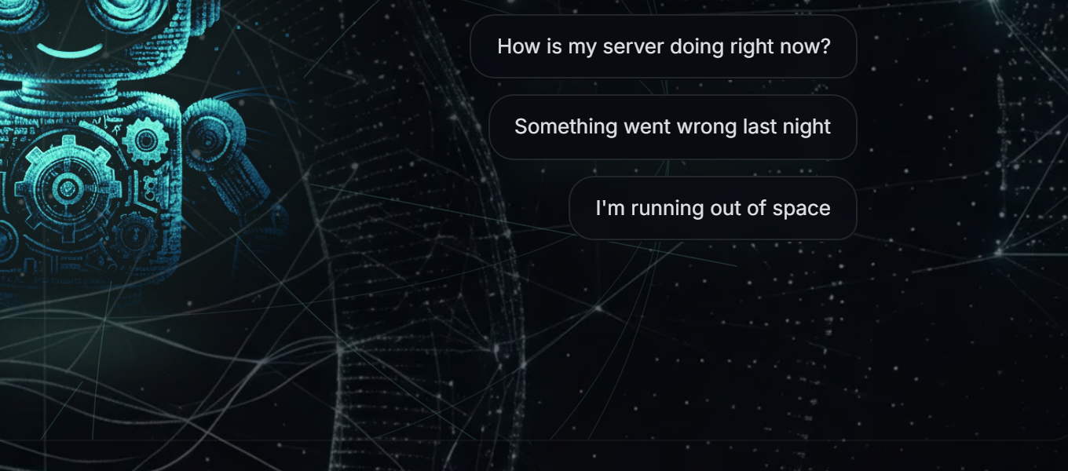
ORCHESTRATOR
You should not have to know who to ask
Nobody calling a help desk knows whether their problem belongs to the storage team or the network team. So you describe the symptom, and it works out which specialist owns it.
What you type
“How is my server doing right now?”
“Something went wrong last night”
“I'm running out of space”
Not one of those names an agent. That is the point.
And if it does not fit?
It says so, rather than forcing a wrong answer to look confident. A system with no way to say “I don't know” will always guess.
UNDER THE HOOD
One model call classifies the request into one of four routes, then a state machine hands it to that agent.
Notes:
The 'no match' branch is worth a sentence — it is a design decision, not a gap.

Slide 8
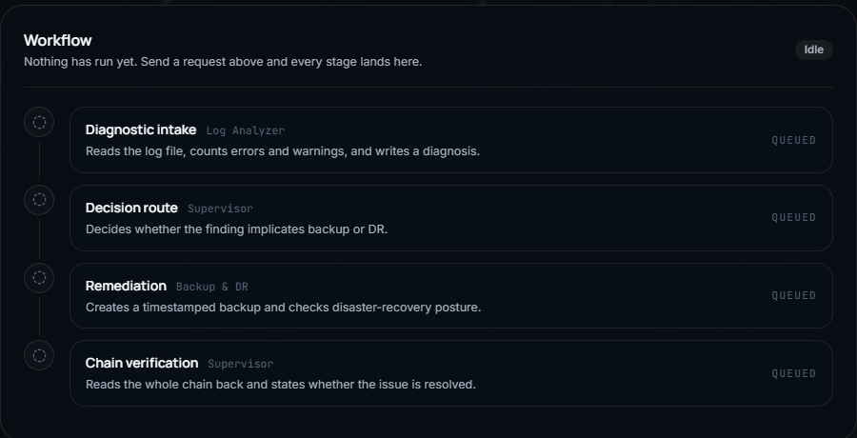
AUTO-REMEDIATION
It does not just tell you. It fixes — then checks it worked.
This is the part almost nobody else does. Most tools in this space stop at the diagnosis and hand you back the problem. Ours takes the next step, on the one kind of problem where the next step is safe to take.
1
Read the evidence
The log reader goes through the machine's records and writes down what it found.
2
Decide if action is needed
If nothing needs fixing, it skips straight to the end rather than doing something for the sake of it.
3
Act
Take the backup, verify it is intact, report the recovery position.
4
Check the work
A supervisor reads everything back and states plainly whether the issue is actually resolved.
Step 4 is the one to remember: it checks its own work.
Notes:
'An AI did something' is a demo. 'An AI did something and then verified it' is a product. Backups are the right first place to allow action — reversible, and the worst case is a little wasted disk.

Slide 9
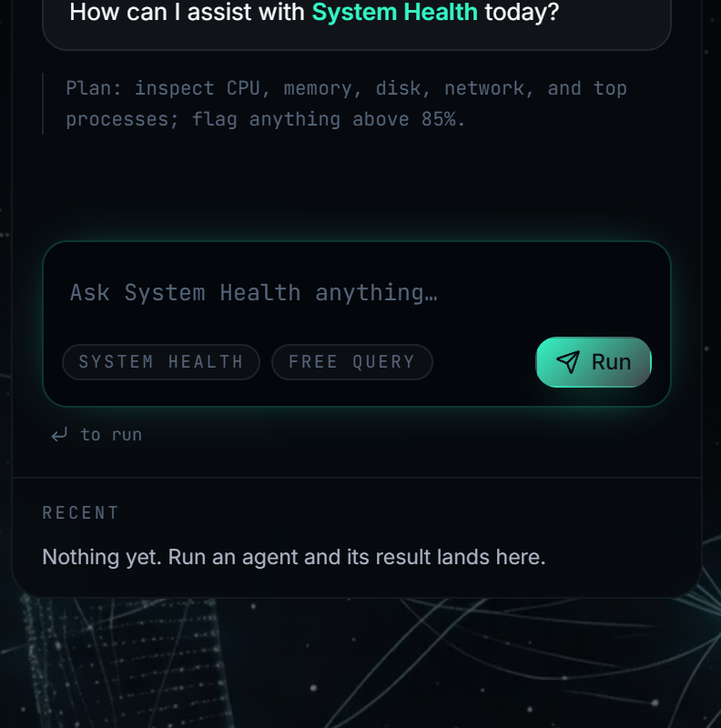
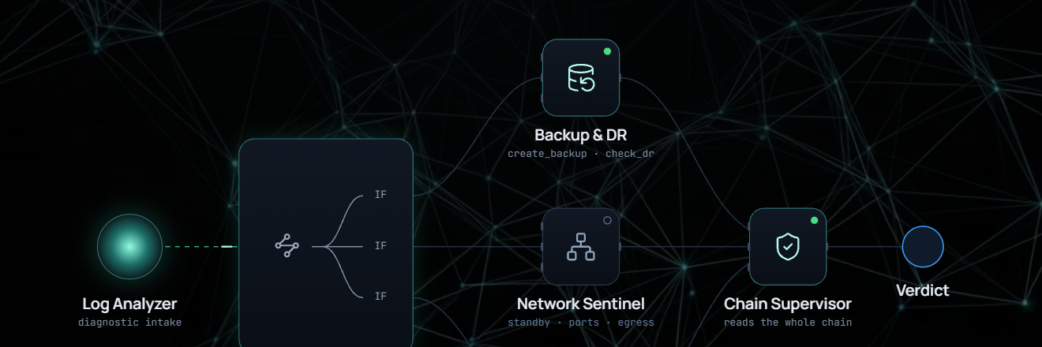
TRUST
You can see every single thing it did
The obvious objection to letting software touch your servers is “how do I know what it actually did?” So nothing is hidden: every check it ran, in order, with what came back, and the reasoning that followed.
Every step is shown
Not a summary of what it did — the actual record of what it did.
The plan is stated first
Before it runs anything, it tells you what it intends to check.
The chain, drawn live — each stage lights as the work reaches it.
The verdict is one word
Healthy, warning, or critical. No hedging, and it is colour-coded.
It admits failure
If a run breaks halfway, it says so instead of reporting a partial answer as success.
Notes:
In a category whose entire barrier is trust, showing the working is not decoration — it is the mechanism.

Slide 10
HOW IT WORKS
It chooses its own next step — inside a route we control
Two different things are happening, and keeping them apart is the whole design.
INSIDE ONE SPECIALIST
BETWEEN THE SPECIALISTS
The assistant decides
We decide
It asks for one check. Our code runs it and hands back the result. It reads that and decides what to look at next — exactly like a person troubleshooting. Nobody knows in advance how many steps it will take.
The order they work in is a fixed route we drew. It runs the same way every time and can be pointed at on a diagram. The specialists never talk to each other — they hand along a shared clipboard, in order.
Why not let them talk freely, the way some AI systems do?
Because that is unpredictable, hard to debug, and can run in circles. When software is touching production servers, unpredictable is the wrong kind of impressive.
UNDER THE HOOD
ReAct loop per agent (LangGraph prebuilt); LangGraph StateGraph with a typed shared state between them. 8–14 model calls per auto-remediation run.
Notes:
If asked about CrewAI or AutoGen: a fixed route is auditable; an emergent one is a debugging problem.

Slide 11
DEPLOYMENT
How it reaches machines it does not live on
A company's firewall blocks strangers coming in and allows staff going out — it has to, or nobody inside could load a website. So we flipped who makes the call.
Signs in once, with a pass that expires in an hour and works only once
Our server
Their machine
Pins a job to a list.
Then waits.
Never leaves the building.
“Anything for me?” — every 3 seconds, outbound
A small helper asks
“anything for me?”
every 3 seconds.
Does the work locally, sends back the answer
Every arrow points the same way. Nothing is ever opened on their side.
That single choice is why this installs in minutes instead of requiring a meeting with someone's network team. It is also how the large endpoint-management products reach a laptop sitting behind a home router.
UNDER THE HOOD
Three transports behind one interface — local (psutil), SSH (paramiko), and an outbound-polling daemon. Single-use enrolment token, 60-minute expiry, exchanged once for a long-lived key.
Notes:
Most projects at this stage assume the machine being inspected is the machine running the code. This one does not.

Slide 12
SAFETY
What stops it doing something it should not
The assistant can never run anything. It can only ask — and our code decides whether to allow it. Every limit below is enforced in code, not requested in an instruction the model could be talked out of.
It orders from a menu
For system commands there is a fixed list of 13, all read-only. Ask for anything else and it is refused by name.
Each specialist is boxed in
It holds only its own abilities. Two of the three cannot change anything at all.
Written code is inspected first
When it writes a snippet, the code is taken apart and checked before running. Anything unfamiliar is rejected rather than allowed.
It cannot read your secrets
File names that look like passwords or keys are refused outright — otherwise the assistant could simply be asked to read the password file.
Nothing is stored in the clear
Passwords, sign-in tokens and machine keys are stored as one-way fingerprints. Even we cannot read them back.
Stated openly, not hidden: three hardening gaps remain before a real deployment — they are written into the project's own documentation rather than left to be discovered.
Notes:
The secrets rule is the best story: it anticipates what the model could be talked into, not just what it is allowed to do.

Slide 13
THE MARKET
Everyone is building the diagnosis. Few will touch anything.
Who | What they sell | Where we sit
Datadog, Grafana, Zabbix | Watching and alarming | They raise the alarm. We start where they stop.
PagerDuty, BigPanda | Grouping 10,000 alarms into 12 | Useful, but still tells you nothing about the cause.
Resolve.ai, Cleric, Traversal | AI that investigates an alarm | Closest in ambition — but they need a large cloud setup we do not, and most deliberately never act.
NinjaOne, Atera | Managing company laptops and servers | Our real neighbourhood. They automate rules a human wrote. We handle the case nobody wrote a rule for.
The gap we walk into
What we need to run
The impressive new tools assume you already run Kubernetes and spend six figures a year watching it. Everyone else — a company with servers and laptops and no platform team — gets nothing.
A computer.
No cluster, no monitoring platform, no data pipeline. That is the difference between a product for a hundred companies and one for a hundred thousand.
Notes:
Names to know: Resolve.ai reached unicorn valuation in under two years. Cleric is deliberately read-only. Traversal's 90% accuracy claim is self-reported, with no independent benchmark.

Slide 14
HONEST POSITION
What we do better — and what we do not do yet
WHAT WE DO BETTER
WHAT WE DO NOT — AND THE HONEST ANSWER
We actually fix things
One machine at a time
The best-funded competitor is deliberately read-only. It investigates and hands the problem back.
It cannot yet connect a fault on one server to a cause on another. The groundwork is built; the reasoning is not.
We need almost nothing
Logs come from files
No cluster, no monitoring platform. It runs against a plain machine.
Not yet from the big logging platforms. That is a connector, not a redesign.
Built for many machines
Only one specialist can act
Three ways to reach a host behind one interface — including through a firewall, with nothing opened.
Said plainly: one area done properly beats four claimed.
Nothing is hidden
No accuracy score
Every check and every result is on screen. In a trust-limited market, that is the product.
Nor does anyone else, verifiably. Rivals' figures are their own marketing, with no independent test.
Notes:
Conceding the right column is exactly what makes the left column believable. Never claim a number you cannot defend.

Slide 15
ROADMAP
Ordered by what a real customer would hit first
Harden
Refuse to start without proper encryption configured, rather than quietly falling back. Verify a machine's identity on first contact. Retry the one failure we have actually seen in testing.
01
Connect
Plug into the logging tools companies already use. Turn a verdict into a ticket. Stream progress live instead of estimating it.
02
Connect the dots
Reason across machines, not one at a time. This is where the most valuable claim in the market sits, and where the groundwork already points.
03
Prove it
A measured accuracy score on a set of known faults, with a stated method. Being the only team in the room with a defensible number is worth more than a bigger one nobody can check.
04
Asked “what would you fix first?” — the retry. It is the one failure observed in practice, not imagined.

Slide 16
IN ONE SENTENCE
Everyone is building brilliant diagnosticians for companies that already have a platform team — and most of them stop short of touching anything.
Aurora Ops goes after the same 3am problem for everyone else. It needs nothing but the machine. It shows you every step of its reasoning. And on the one kind of problem where acting is safe, it acts — and then checks that it worked.
Thank you
Notes:
Two claims. Both defensible. Both narrow enough to survive questions. Resist widening them.

