Slide 1
Aurora Ops
Agentic IT Operations
Agents that diagnose a machine, act on what they find, and verify the fix.
Gourav Kumar Bathwal
Notes:
One line: this is software that does the part of IT operations nobody automated — the judgement between the alarm and the fix.

Slide 2
PROBLEM STATEMENT
Detection is solved. Judgement is not.
Alarms have been automated for thirty years. Working out what the alarm means, and what to do about it, is still a person.
Detect
Diagnose
Act & verify
Automated since the 1990s
Still manual
Still manual
10,000+
under 5%
44%
alerts a day reach
an average operations team
of them actually
need a human
of organisations had an outage
from an alert someone ignored
Source: 2026 State of Production Reliability survey, 1,039 practitioners.
Notes:
The point is not that IT is slow. It is that more monitoring made it worse — the outage in the third statistic happened because someone had already been told and had stopped listening.

Slide 3
SOLUTION OVERVIEW
Describe the symptom. It runs the checks.
An agent is given real tools on a real machine. It chooses which to run, reads what comes back, and decides the next step itself.
Plain-English
request
Orchestrator
Specialist
agent
Tools on the
machine
Verified
report
“disk is nearly full”
picks the specialist
chooses its own checks
real readings, not guesses
and whether it is resolved
Nobody knows which specialist owns a problem
One model call reads the request and routes it
The next check depends on what the last one found
The agent picks its own next step, every step
“Did it actually work?” is never answered
A supervisor reviews the run and states the verdict
Notes:
Left column is the problem, right column is what the agentic approach actually does about it. Do not read them out — point at the pair you want.

Slide 4
FEATURES
What it does
Three specialists
Plain-English routing
Acts, then verifies
Health, logs, backup. Each holds only its own tools.
Describe a symptom; it picks the right agent.
Takes the fix and confirms it actually worked.
Every step visible
Works behind firewalls
Read-only by default
The full record of what it ran and what came back.
The machine calls out; nothing inbound is opened.
Only one agent can change anything, and only backups.
Notes:
Six features, one line each. The last two are the ones worth pausing on: firewall traversal is why this deploys without a network conversation, and read-only-by-default is the answer to 'what if it breaks something'.

Slide 5
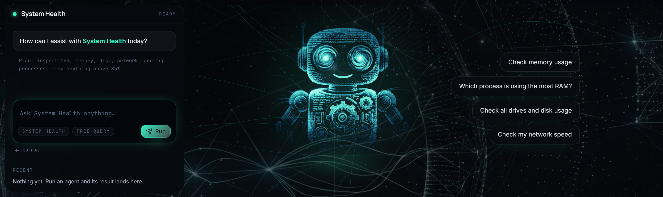
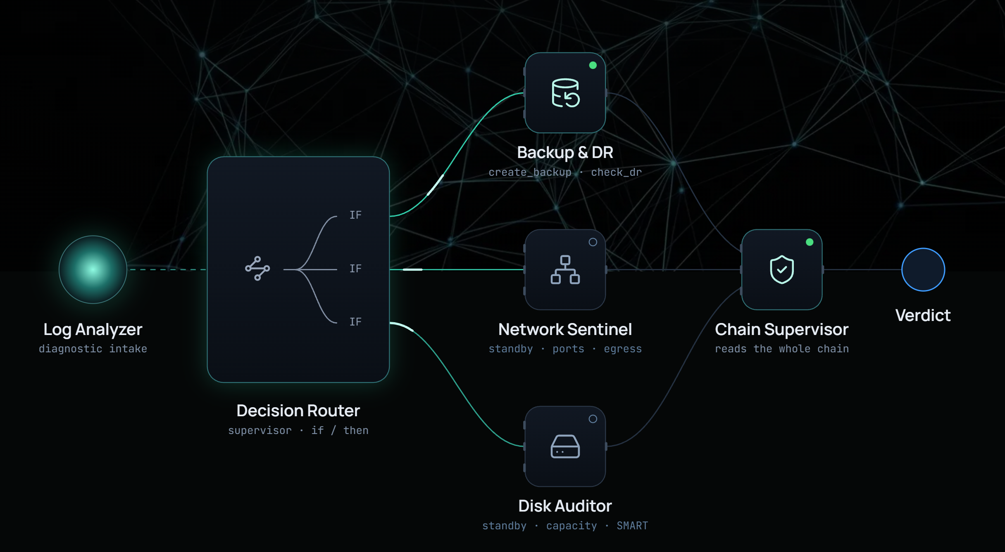
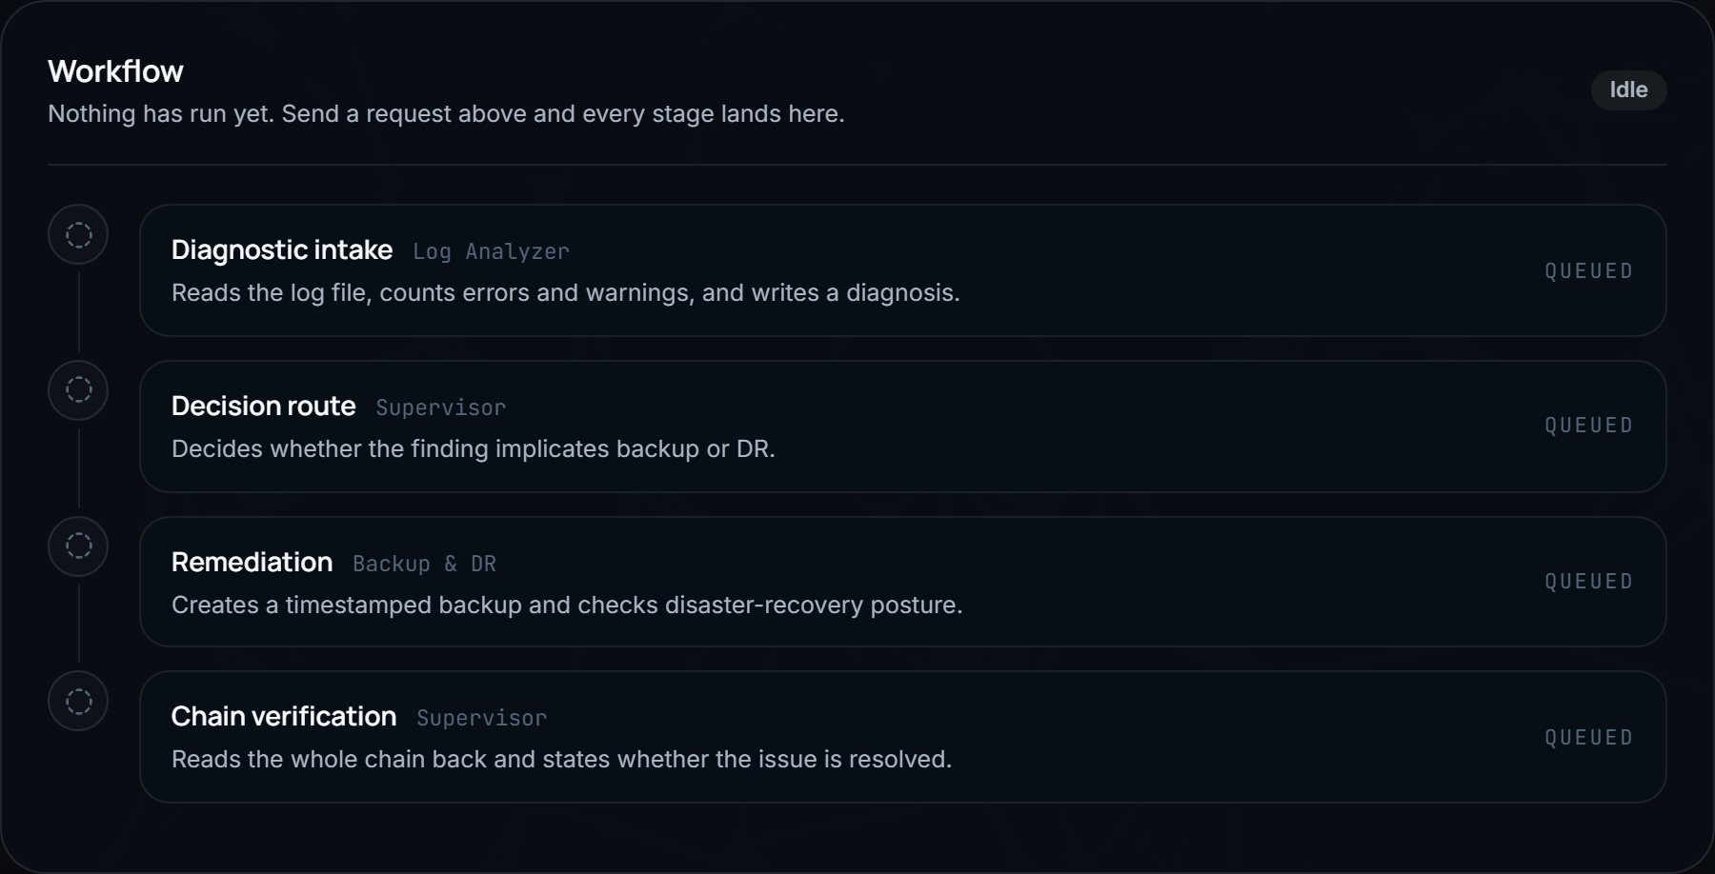
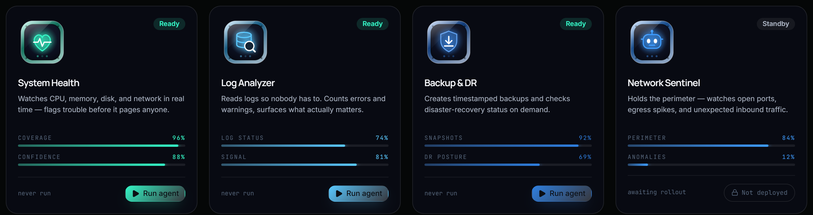
APPLICATION SNAPSHOTS
The running product
RUN AN AGENT — ASK ON THE LEFT, WATCH ON THE RIGHT
THE REMEDIATION CHAIN, DRAWN LIVE
EVERY STAGE OF A RUN, IN PLAIN LANGUAGE
THE FLEET — LIVE AND STANDBY
Notes:
Four screens, no commentary needed. If asked to demo live, open the console one and run System Health — it returns in under four seconds.

Slide 6
TECHNOLOGY STACK AND DATA FLOW
How a request becomes a verified report
Browser
API
Route
Agent
Tools
Next.js console
FastAPI
LangGraph
LLM on Groq
Python on the host
repeats until the agent has seen enough
CONSOLE
SERVICE
AGENTS
Next.js 16 · React 19
Tailwind v4
framer-motion
FastAPI · Python
SQLite
local / SSH / agent daemon
LangGraph · LangChain
Groq llama-3.3-70b
33 tools, temperature 0
Notes:
The loop is the part worth explaining: the agent is not a pipeline, it goes round between reasoning and tools until it has what it needs, then writes the report.

Slide 7
OUTCOMES AND IMPACT
What changes when judgement is automated
ALERTS
DIAGNOSES
ACTS
VERIFIES
Monitoring platforms
Yes
No
No
No
TIME TO A VERIFIED ANSWER
Manual
~35 min
RMM / endpoint tools
Yes
Rules only
Scripted
No
AI SRE tools
Yes
Yes
Rarely
No
Aurora Ops
11.8 s
Aurora Ops
Yes
Yes
Yes
Yes
~11 hrs
MEASURED ON THIS MACHINE
1.4s
3.4s
11.8s
saved per week at 20 routine
investigations
targeted question
2 tool calls
full health check
7 tool calls
diagnose, act, verify
2 agents, 4 stages
Assumes 35 minutes of manual triage per investigation.
The 11.8s figure is measured; the 35 minutes is an estimate.
Notes:
Be straight about the arithmetic: the run times are measured, the 35-minute baseline is an assumption and is printed on the slide as one. If they push, offer to re-run the model with their own number.

Slide 8
WHERE THIS GOES
Working today, and what comes next
WORKING TODAY
NEXT
Three agents on live machine data
Correlate findings across many machines
Orchestrated routing and auto-remediation
Read logs from Splunk, Loki and CloudWatch
Fleet enrolment over SSH or an agent daemon
Widen safe action beyond backup and recovery
github.com/Mr-Bathwal/aurora-ops-frontend · github.com/Mr-Bathwal/aurora-ops-hub
Notes:
Close on the 'next' column — correlation across machines is the honest gap, and naming it first is stronger than being asked about it.

