Slide 1
CogniPlay Studio
Built evidence
Truthful scope
CV host, whiteboard, games, recording, parent and teacher dashboard screens.
Implemented, semi-implemented, and roadmap features are separated.
Note: Please go through other links first. Low-cost AI smart learning wall for play-based early childhood education. Convert any wall into a smart display (touch) which can be used for play based learning to further develop cognitive and logical abilities and help identify key traits and suggest possible early intervention
Challenge: Early Childhood (3-6) | Quality of play-based early learning
AI stack
Prototype
MediaPipe, Ollama llama3, Whisper, IRT, future insights.
Clickable browser prototype maps all 10 requested features.
Hardware
Core promise
Good USB webcam + extension cable + existing display/projector/TV.
Any wall becomes a smart board for movement-based play, drawing, and teacher support.
Rubric-aligned deck created from code audit + product evidence
Prototype: /clickable-prototype/ | Local app: localhost:3000/cogniplay

Slide 2
RUBRIC 15% - PROBLEM FRAMING
Problem statement and evidence
Chosen problem
1.37M
Play
3-6
Early childhood settings often struggle to deliver high-quality, developmentally appropriate, play-based learning consistently across contexts.
Anganwadi centres
Core pedagogy
Target ages
UNICEF India
NCF Foundational Stage 2022
Challenge brief
Not just a screen problem
Continuity gap
Frontline workers need simple daily support for playful, guided, locally relevant activities.
Parents and educators rarely get plain-language visibility into strengths, growth areas, and next steps.
Evidence base used in this deck
UNICEF India: Anganwadi platform and early childhood learning. NCF Foundational Stage: guided play and learning through play. NIPUN Bharat: foundational learning and educator support. Nurturing Care Framework: early learning as a core developmental input.
The Real Need:
The real need is a low-cost, facilitator-friendly learning surface that supports movement, language, drawing, storytelling, and adaptive play.
CogniPlay Studio | Early Childhood 3-6

Slide 3
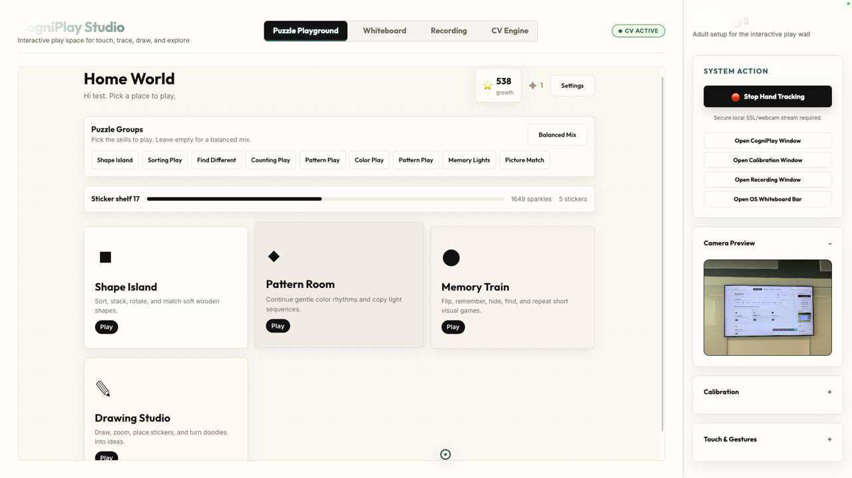
USER UNDERSTANDING
Target users and context
Children 3-6
Anganwadi workers
ECCE educators
Parents
Vulnerable learners
Need visual, tactile, forgiving, low-text play.
Need ready-to-use activities without complex setup.
Need consistent content and classroom visibility.
Need plain-language progress and things to try at home.
Need low-cost, local-language, portable continuity.
Context constraints
Low-resource centres may have a TV/projector but not an interactive board.
Large-group teaching needs wall-scale interaction, not only individual tablets.
Frontline workers need practical facilitation support, not more dashboards.
Multilingual and low-connectivity settings require local-first design.
Insights must be supportive and non-diagnostic.
Product context: Home World activity selection is already implemented as a calm, playable child entry point.
CogniPlay Studio | Early Childhood 3-6
Problem + equity

Slide 4
SOLUTION DESIGN
Solution overview
CogniPlay Studio converts existing classroom displays into AI-assisted smart learning walls using only a webcam and software.
Webcam
CV
Wall
Play
AI
Insights
USB camera captures hand
MediaPipe hand tracking
Calibrated projected surface
Puzzles, drawing, whiteboard
Teacher support + subtitles
Parent + teacher views
Built in code
Semi-implemented
Roadmap
Clickable prototype built
Hand tracking, calibration, whiteboard, local AI assistant, puzzle loop, adaptive scoring, rewards, dashboards.
OS-wide bridge, live subtitles, recording/cloud workflow, parent/teacher analytics with prototype data.
Auth, database, real rosters, cloud sync, multilingual packs, AI recommendations, item calibration.
\
CogniPlay Studio | Early Childhood 3-6

Slide 5
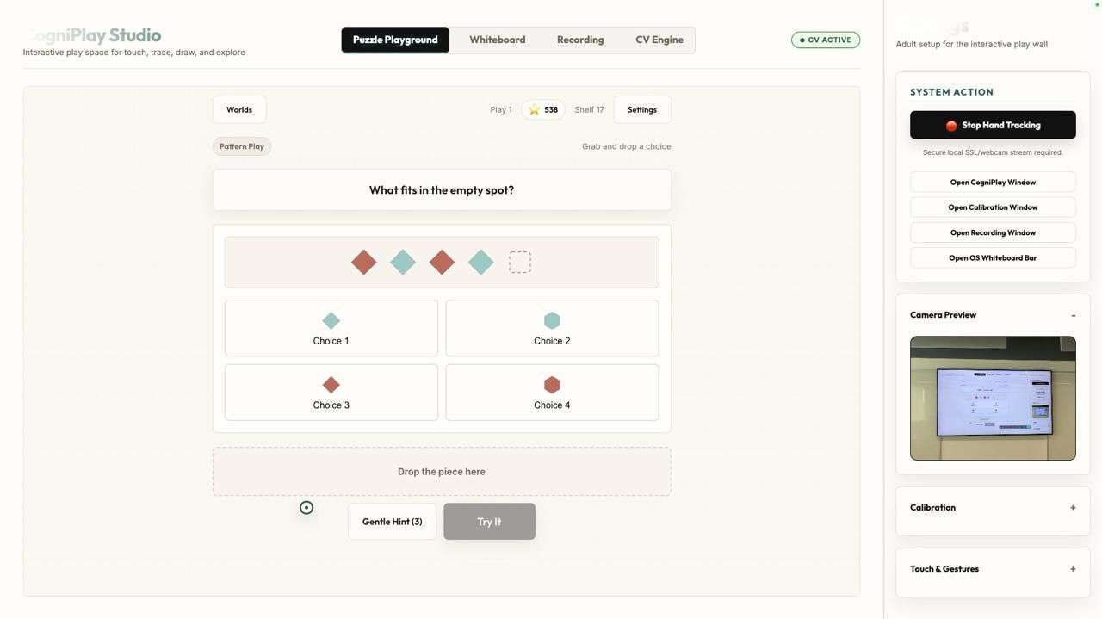
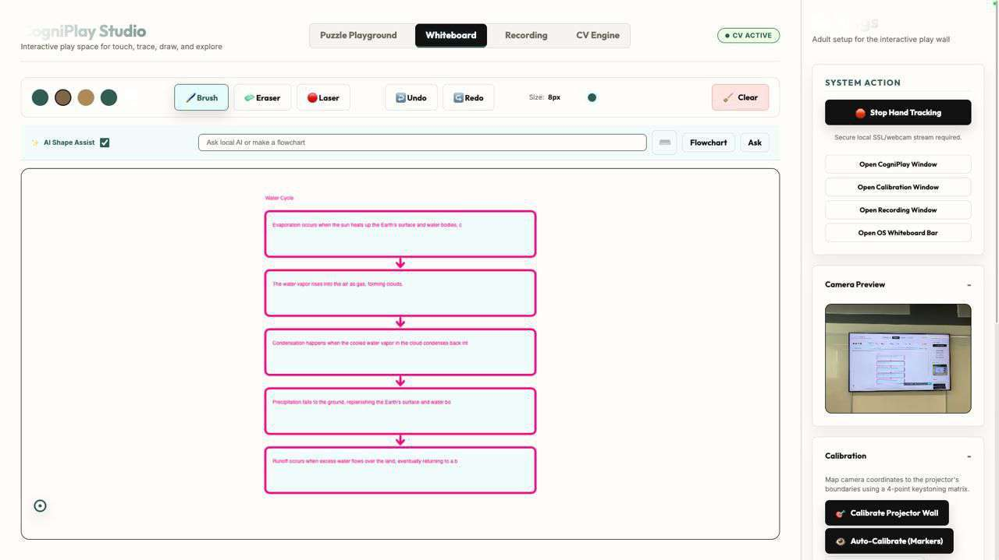
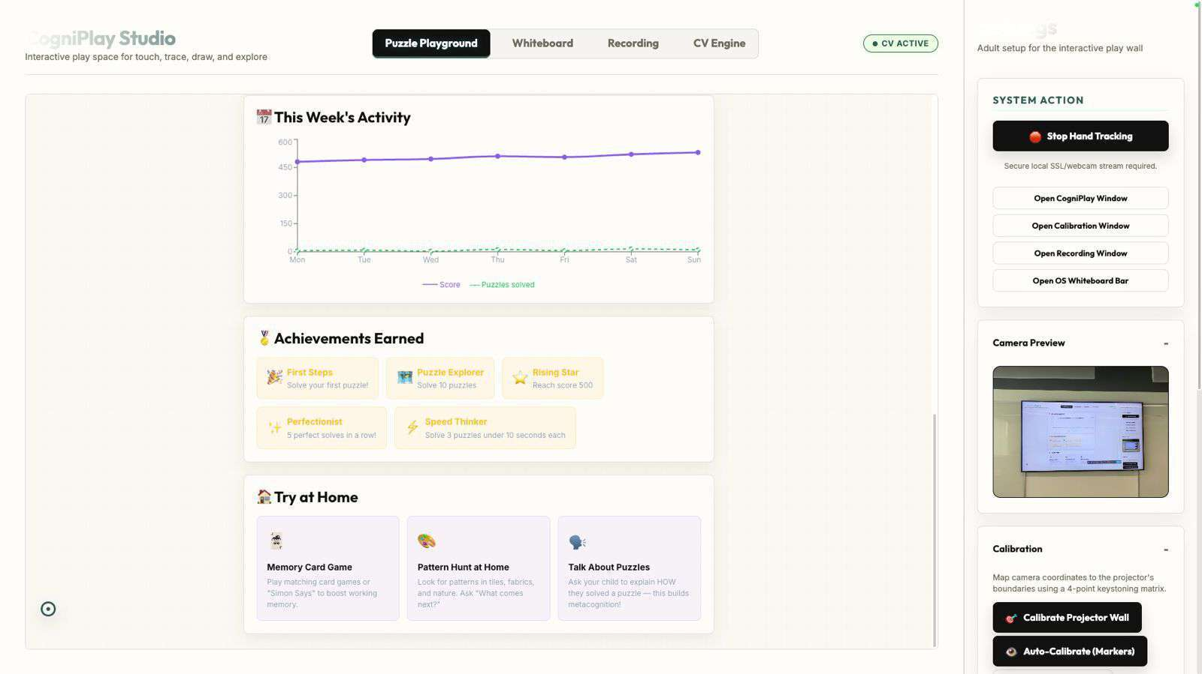
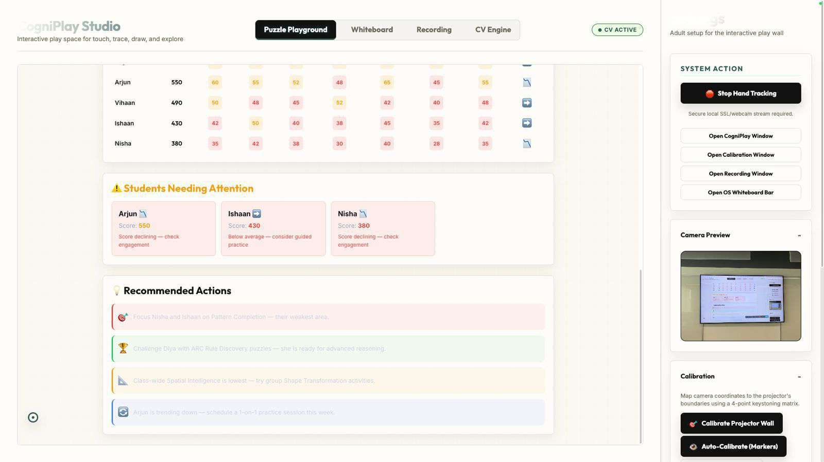
SOLUTION DESIGN
Key user flows
Teacher setup
Start tracking -> calibrate wall -> launch CogniPlay or whiteboard -> run activity
Child play
Choose world -> drag/trace/match/draw -> get feedback -> earn XP/badges -> next adaptive puzzle
Teacher support
Ask AI on whiteboard -> generate definition/flowchart -> annotate -> record/subtitle session
Parent follow-up
View score, strengths, growth areas, weekly activity, achievements, and home activities
Class intervention
Evidence screenshots: drag/drop puzzle, AI whiteboard, parent dashboard, and teacher intervention dashboard.
Review heatmap -> flag support needs -> teacher-reviewed recommended actions
CogniPlay Studio | Early Childhood 3-6

Slide 6
AI APPROACH
Why AI is necessary
Without AI or intelligent adaptation, the product collapses into a projected worksheet or a normal whiteboard.
Teaching support
Frontline workers still need to manually create explanations, diagrams, and local examples.
Ollama generates flowcharts, definitions, and Ask AI responses at the whiteboard.
Inclusion
Children with hearing barriers or absent children lose continuity.
Whisper subtitles and caption burn-in support access and review.
Personalization
One-size puzzles bore advanced learners and frustrate struggling learners.
IRT adapts difficulty from attempt history; future AI can generate validated puzzle variants.
Early support
Teachers see scores too late or not at all.
Future AI insights can summarize patterns and suggest teacher-reviewed interventions.
Important truth
Not every intelligent layer is an LLM: hand tracking is computer vision, shape assist is geometry/rules, adaptation is statistical IRT, and content support uses local LLMs.
CogniPlay Studio | Early Childhood 3-6

Slide 7
AI TECHNICAL FEASIBILITY
AI methodology: model choice, data, evaluation
Layer
Model
Data
Evaluation plan
Status
Computer vision
MediaPipe Hands
Webcam frames; 21 hand landmarks
Accuracy, latency, false pinch rate, classroom lighting robustness
Implemented
Whiteboard AI
Ollama llama3
Teacher prompt text
Age appropriateness, factuality, useful diagrams, local-language quality
Mostly built
Subtitles
Whisper / whisper.cpp
Audio chunks
Word error rate by language, delay, device performance
Semi-built
Adaptive learning
3PL IRT + procedural templates
Attempt correctness, time, hints, retries
Engagement, difficulty fit, item calibration after pilots
Built
Insights
Future local/cloud LLM with guardrails
Aggregated profile and class patterns
Explainability, teacher acceptance, non-diagnostic safety
Planned
Current data posture: local browser state for prototype profiles; real learner data, consent, retention rules, and secure backend are Phase 2.
CogniPlay Studio | Early Childhood 3-6

Slide 8
HIGH-LEVEL DIAGRAM
System architecture
User
Display
Host shell
React app
Dashboards
Child / teacher
Projector / TV
HTML/CSS/JS
CogniPlay
Parent / teacher
Webcam
CV layer
Gesture layer
OS bridge
USB camera
MediaPipe + filters
Pointer / click / drag
Python + CoreGraphics
Local AI
Speech AI
Scoring
Storage
Phase 2
Ollama llama3
Whisper local
IRT + EMA
localStorage now
Auth + DB + sync
Code evidence: app.js, hand-tracker.js, server.js, ai-engine.js, CogniPlay/cogniplay/src/engine, parent/teacher dashboard pages.
CogniPlay Studio | Early Childhood 3-6

Slide 9
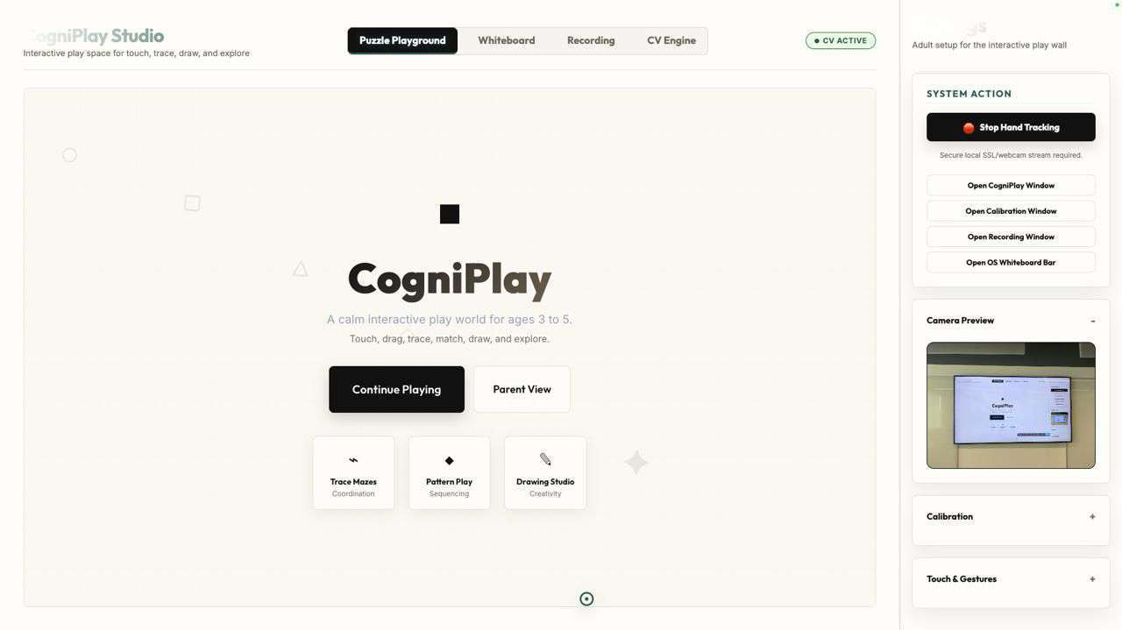
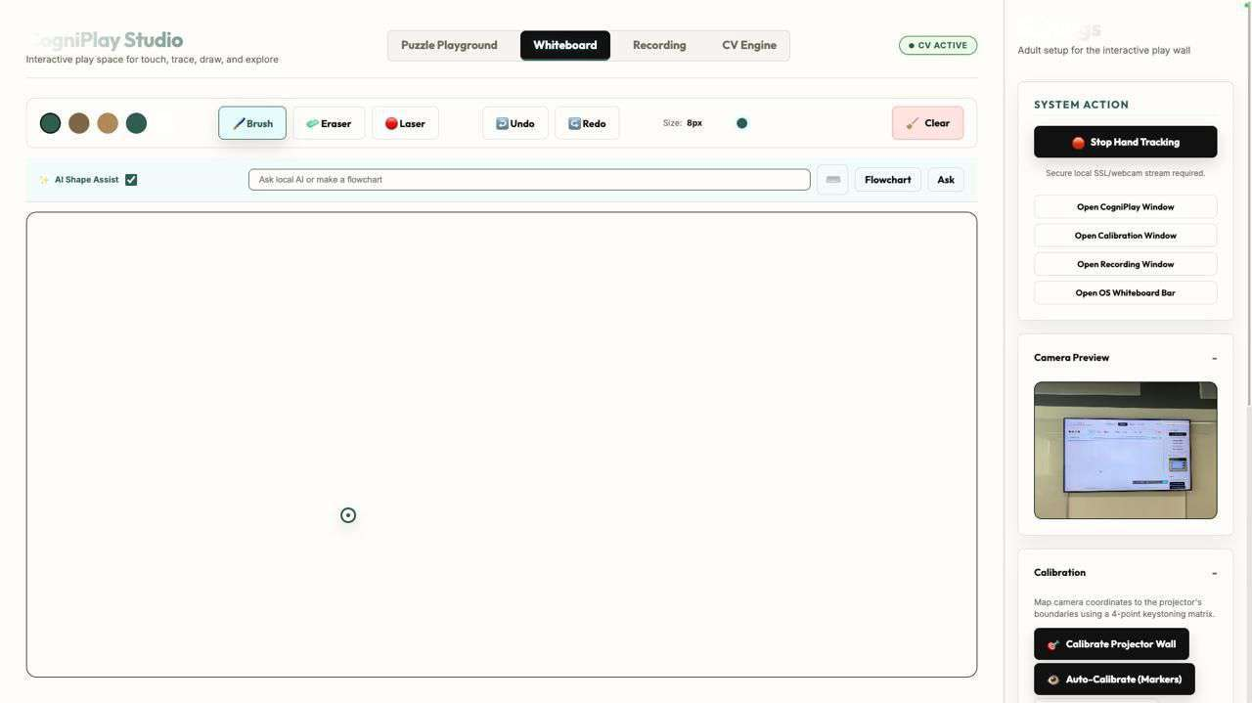
PROTOTYPE QUALITY
Clickable prototype and real product evidence
Clickable prototype
Prototype URL
Browser prototype maps all 10 features, hardware, AI used, implementation status, and code evidence.
clickable-prototype/index.html
Local server path supported.
Quality bar: the prototype is not only slides; it is a clickable feature map that judges can navigate by user journey or by feature. The current prototype can be used yourself (fully working) by going to https://github.com/Mr-Blahaj/NeoTouch Or contacting Arnav Khanna (+91 8368141018, arnav1758@outlook.com
Evidence shown: CV active shell, whiteboard/AI tools, parent dashboard, teacher mode and intervention UI.
CogniPlay Studio | Early Childhood 3-6

Slide 10
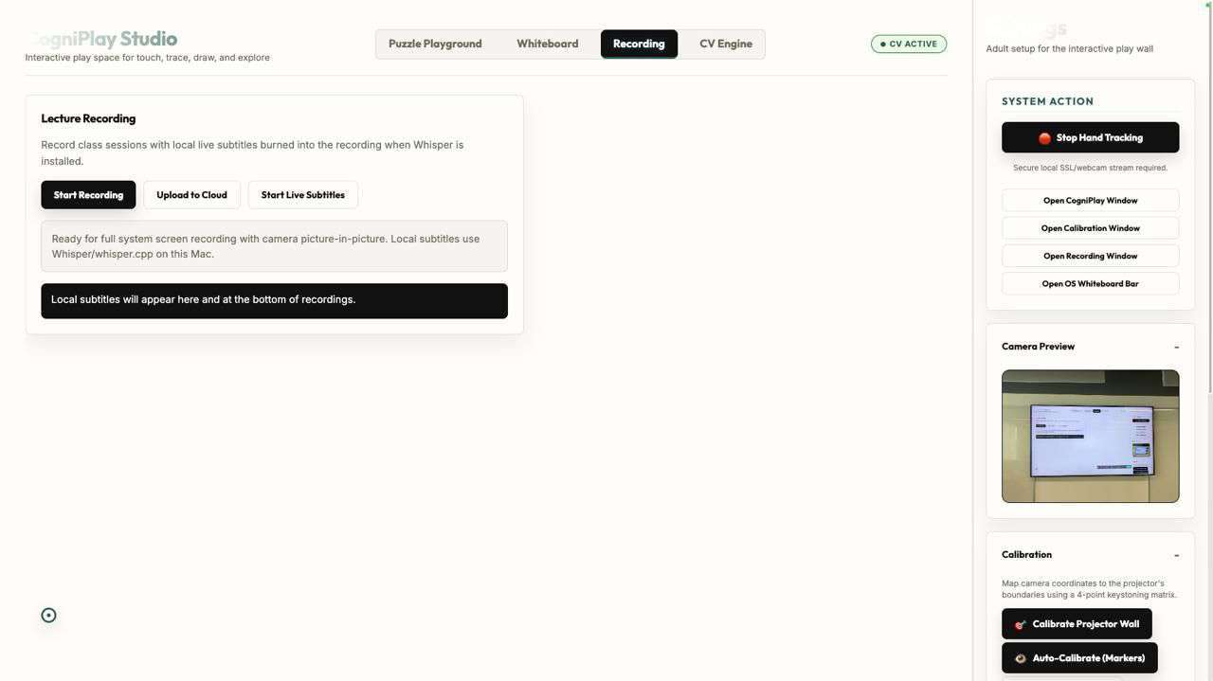
OFFLINE, LOW CONNECTIVITY, DEVICES, LANGUAGES
Real-world readiness
Offline use
Low connectivity
Host app, whiteboard, procedural puzzles, local profiles, and Ollama/Whisper options can run locally.
Core learning loop should not depend on cloud. Cloud sync becomes optional when available.
Entry-level devices
Regional languages
Needs testing on low-end laptops; use small Whisper models, model selection, and fallback modes.
Roadmap: Hindi/regional prompts, subtitle models, local examples, parent reports, and content packs.
Hardware
Good USB webcam, extension cable, and existing display/projector/TV. No dedicated smartboard required.
Implementation caveat: live subtitles depend on Whisper/whisper.cpp installation; cloud upload, auth, database, and real rosters are Phase 2.
CogniPlay Studio | Early Childhood 3-6

Slide 11
RESPONSIBLE AI
Equity, inclusion, Responsible AI and language
Inclusion
Child data
Human review
Language
Live subtitles, recording review, large shared display, low-text child UI, and future local-language content.
Prototype stores learner profile locally. Phase 2 needs consent, retention, deletion, encryption, and role-based access.
Interventions must be teacher-reviewed and non-diagnostic. AI supports educators; it does not label children.
Regional language prompts, captions, reports, and content packs are required for scale.
Guardrails to implement
Child-safe prompt templates and blocked content categories
No medical diagnosis or fixed ability labels
Teacher-facing explanations for recommendations
Opt-in recording and explicit caregiver/school consent
Local-first mode with secure cloud sync only when configured
Bias review across languages, disability, gender, and socio-economic context
Responsible AI message for judges: CogniPlay uses AI for accessibility, teacher support, and pattern recognition. Decisions remain with adults.
CogniPlay Studio | Early Childhood 3-6

Slide 12
INNOVATION + SCALE
Impact and scale potential
Impact hypothesis
Learning quality
If teachers can run engaging play activities with existing classroom hardware, more children can access quality early learning and more adults can see what support each child needs.
More daily play-based activities: shapes, patterns, memory, counting, tracing, drawing.
Teacher support
On-the-spot explanations, flowcharts, subtitles, recording, and dashboard cues.
Parent continuity
Plain-language strengths, growth areas, weekly activity, achievements, and home ideas.
Originality: wall-scale + AI + adaptive ECCE play
Not a tablet app. Not a hardware board.
Scale
Local-first, teacher-in-loop design
Software-first model can reuse existing screens and a low-cost webcam.
Access
Local-first mode supports low-connectivity centres and mobile/vulnerable communities.
CogniPlay Studio | Early Childhood 3-6

Slide 13
MILESTONES, DEPENDENCIES, RISKS, SCOPE
Implementation plan: Phase 2 milestones
0-1 week
1 – 2 week
2- 6 week (beyond hackathon phase 2)
12-16 weeks
Pilot hardening
Gesture tuning, calibration wizard, Whisper setup check, content QA, clickable prototype polish.
Secure data layer
auth, consent, role permissions, real learner and classroom rosters, along with better AI and language, teacher review, and reports
Hardening AI and language
Validated AI puzzle generation, teacher-reviewed insights, Hindi and more regional prompt packs, parent report localization.
Pilot deployment
5 pilot sites, device testing, educator training, efficacy and engagement metrics.
Dependencies
Risks and scope control
Phase 2 success metric
Webcam/display access
Do not claim diagnostic screening
A teacher can run a 20-minute play session, capture subtitles/recording, and review child/class insights with consented real data.
Local model/device capacity
Keep AI puzzle generation behind validation
School consent and child data policy
Cloud upload after consent/auth
Educator co-design partners
Teacher dashboard real data after backend
Regional language review
Pilot before impact claims
CogniPlay Studio | Early Childhood 3-6

Slide 14
TEAM
Team composition and skills
Arnav Khanna - Full-stack / product engineer & AI / ML engineer.
Arnav Mishra - Computer vision engineer
React, TypeScript, Vite, Node server, routing, clickable prototype, dashboards, Ollama, Whisper, IRT, cognitive scoring, schema validation, evaluation, Responsible AI
MediaPipe Hands, homography, calibration, filtering, gesture reliability, OS bridge
Current codebase already demonstrates the engineering spine: CV host, local server, React puzzle app, adaptive engine, AI assistant, subtitles route, recording UI, and analytics screens.
Needed for Phase 2: early childhood domain review, language reviewers, school data/privacy advisor, and pilot implementation support.
CogniPlay Studio | Early Childhood 3-6
Implementation

Slide 15
TEAM
Walk through of Features:
1. Turns any projector, TV, or display into a functional smart board using only a USB webcam and extension cable. Hand tracking enables writing, drawing, highlighting, dragging, and touch-like interaction on the wall. Implemented, needs refinement.
2. Gesture-based classroom controls for brush, eraser, laser pointer, undo, redo, clear, drag/drop, and trace interactions. Implemented.
3. AI / shape assist on the whiteboard to auto-straighten lines and improve rough shapes such as circles, rectangles, triangles, and arrows. Implemented as offline shape recognition/beautification.
4. OS-wide interaction layer through a macOS cursor bridge, allowing the hand-tracked wall to move/click/scroll outside the main web app. Semi-implemented.
5. AI whiteboard assistant using local Ollama llama3 to generate flowcharts, definitions, explanations, answers, tables, and word charts on the spot. Mostly implemented.
6. Live lecture subtitles for inclusion using local Whisper / whisper.cpp transcription. Semi-implemented; depends on local model setup.
7. Auto session recording with screen capture, teacher camera picture-in-picture, and subtitle burn-in. Implemented locally.
8. Cloud upload for recorded lectures and classroom sessions. Planned / partially scaffolded; needs full integration with school cloud storage.
9. Play-based early learning games for ages 3-6, including patterns, shapes, sorting, counting, memory, matching, tracing, pathfinding, and drawing. Implemented, needs more puzzles/categories.
10. Interactive drag-and-drop and trace-based puzzle interactions designed to build cognitive, logical, spatial, memory, attention, and reasoning skills. Implemented.
CogniPlay Studio | Early Childhood 3-6

Slide 16
TEAM
Walk through of Features:
11. Adaptive difficulty using IRT-style scoring based on correctness, time taken, hints used, and retry behavior. Implemented.
12. Local AI hints for puzzles using Ollama, with fallback hint text when AI is unavailable. Mostly implemented.
13. Learning DNA profile that tracks child progress across cognitive dimensions such as attention, working memory, spatial reasoning, pattern recognition, logical reasoning, persistence, and learning speed. Implemented as prototype.
14. Points, XP, stars, badges, achievements, and unlockable worlds to motivate children and support repeated play. Implemented.
15. Sticker shop, mentor characters, customization rewards, and in-person reward tie-ins. Not yet implemented; planned future feature.
16. Parent portal showing child score, strengths, growth areas, weekly activity, achievements, and suggested activities to try at home. Semi-implemented.
17. Teacher dashboard showing individual child statistics, Learning DNA, dimension breakdowns, progress, strengths, and areas needing support. Semi-implemented.
18. Teacher class mode showing whole-class statistics, score distribution, cognitive heatmap, students needing attention, and recommended actions. Semi-implemented with mock/demo data.
19. AI-assisted student insights and intervention recommendations for early support and teacher decision-making. Planned / semi-implemented; needs real data and responsible AI guardrails.
20. Local-first architecture so the core prototype can run without cloud dependency, supporting low-connectivity and low-resource classrooms. Implemented at prototype level.
CogniPlay Studio | Early Childhood 3-6

Slide 17
TEAM
Note to judges:
We have worked hard to create the entire platform with the hand tracking as proof of concept. The current prototype can be used yourself (fully working) by going to https://github.com/Mr-Blahaj/NeoTouch Or contacting Arnav Khanna (+91 8368141018, arnav1758@outlook.com . You will be able to see it through the video walkthrough and we would love to demonstrate it to you!
We hope to see you in the next round! With love, Team CogniPlay!
CogniPlay Studio | Early Childhood 3-6

