Slide 1
TouchWall CV Engine
CogniPlay Studio
Hand tracking · Homography · macOS bridge
CogniPlay Puzzle Engine
React 19 · IRT scoring · 15 labels
Any Wall.
Any Child.
Infinite Learning.
Local-First AI
Ollama llama3 · offline · privacy-safe
HACKATHON PITCH · 2026
Local demo: localhost:3000/cogniplay · hello@cogniplay.io
Adaptive Cognitive Profiling
7 dimensions · EMA · parent dashboard
© 2026 CogniPlay Studio. Confidential.

Slide 2
THE PROBLEM
Smart classrooms cost a fortune.
Learning analytics are an afterthought.
₹90,000 - ₹1,50,₹000
Low visibility
Average SMART Board cost
Child learning after school
Dedicated boards remain costly; many schools already have a display or projector.
Static worksheets, zero analytics. Parents and teachers get no real cognitive insight.
1-size
0 APIs
Fits all apps
Between tools in classrooms
Rigid difficulty. Fast learners are bored; struggling kids disengage and drop off.
Whiteboard, game, analytics, and parent report live in disconnected silos.

Slide 3
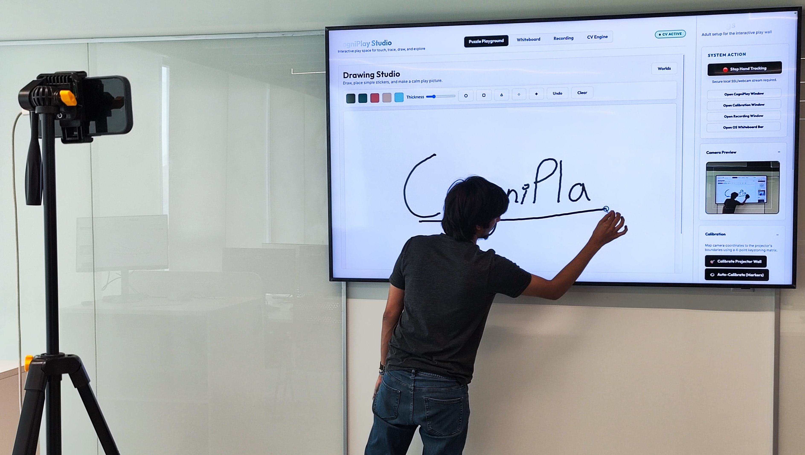
THE SOLUTION
A webcam + projector + our software = adaptive smart classroom.
TouchWall
Webcam + MediaPipe turns any projected wall into a gesture-controlled surface. No smartboard hardware required.
CogniPlay
React puzzle engine with 3PL-IRT adaptive scoring, 7-dimension cognitive profiling, and 15 category labels.
Local AI
Ollama llama3 runs on-device. Powers whiteboard flowcharts and puzzle hints with local/private inference.
Live product — CV Active, wall host running

Slide 4
HOW IT WORKS
Quick guided setup. No specialist knowledge required.
01
02
03
04
05
Point webcam at wall
4-tap perspective calibration
CogniPlay loads on projector
Child gestures to interact
IRT adapts difficulty live
USB or built-in webcam plus existing display/projector.
Touch wall corners. Homography computed instantly.
Full app streams into the iframe host.
Pinch, drag, trace — tracked by MediaPipe Hands.
3PL-IRT updates ability estimate each attempt.
Home World — activity selection
Shape sorting — drag & drop

Slide 5
TOUCHWALL — CV ENGINE
Hand Tracker v3 — rebuilt from scratch for production reliability.
OneEuroFilter1D smoothing
v3
Per-landmark (21 × {x,y,z}) filters eliminate jitter at the source.
Velocity-gated pinch
v3
Accidental triggers while moving are blocked. Real pinch occurs nearly stationary.
Temporal pinch hysteresis
v3
Confirmed across multiple consecutive frames. Eliminates single-frame glitch triggers.
Full hand-plane depth (Z)
v3
Uses entire hand plane — not a single fingertip — for accurate push-forward depth.
distanceFromScreen scaling
v3
Scales depth thresholds for 50cm–3m from wall. Same feel at any projection range.
Frame-rate-independent
v3
Real time deltas (dt tracking): stable frequency response at 30fps, 60fps, or variable.

Slide 6
AI WHITEBOARD ENGINE
Draw, explain, generate flowcharts locally. No cloud dependency.
ShapeClassifier
Offline stroke beautification. Circle, rectangle, triangle, line, arrow — pure geometry. No GPU, no API calls.
Whiteboard Copilot
Ollama llama3 generates text, definitions, flowcharts, tables, and word-charts locally.
Whiteboard with Shape Assist
Shape Assist
Toggle on/off. Laser pointer mode. Undo/redo stack. Brush, eraser, size controls.
Generated water cycle flowchart

Slide 7
COGNIPLAY — PUZZLE ENGINE
Active play modes plus 15 category labels. Adaptive on every attempt.
—
Drag & Drop
Grab a shape choice and drop into the target zone.
—
Trace Maze
Follow the path with your hand — wall collision detected.
Pattern Play
Memory Lights
—
Pattern Play
Complete the colour/shape sequence.
—
Memory Reveal
Memorise, then recall the hidden light order.
—
Picture Match
Match item to category card.
Memory Recall
Sorting Play

Slide 8
ADAPTIVE SCORING
Designed to keep children in the zone — less boredom, less frustration.
P(θ) = c + (1 − c) / (1 + e^{−a(θ−b)})
3PL-IRT — Three Parameter Logistic Item Response Theory
θ
b
a
c
Student ability
Item difficulty
Item discrimination
Guessing parameter
Updated Bayesian after each attempt. Personalised per child.
Set by prototype parameters. Pilot calibration planned.
How sharply the item separates adjacent ability levels.
Chance-level floor. Prevents lucky streaks from inflating θ.

Slide 9
LEARNING DNA
7-dimension cognitive profile. Built live. Visible to child, parent, teacher.
Attention Control
Sustained focus across puzzle sets
Working Memory
Hold sequence then recall it
Response Time
Faster correct responses improve score
Pattern Logic
Identify rules and complete sequences
Spatial Reasoning
Rotate, mirror, fit shapes
Learning Speed
Rate of θ ascent per session
Practice Persistence
Hints, retries, and perseverance signals
Learning DNA — radar
Dimension breakdown

Slide 10
RECORDING & SUBTITLES
Capture sessions. Local Whisper can burn subtitles on-device.
Start Recording
Full system screen capture with teacher camera picture-in-picture.
Start Live Subtitles
When configured, Whisper / whisper.cpp runs locally. No cloud audio upload.
Caption Burn-in
Subtitles baked into the recording file for accessibility.
Cloud Upload (Roadmap)
Local download today; school cloud storage integration planned.
Lecture Recording — live subtitle area

Slide 11
PARENT DASHBOARD
Plain-language progress. No data science degree required.
Cognitive Score
Live IRT-derived ability estimate (0–1000 scale).
Day Streak
Consecutive play days — builds habit and retention.
Strengths
Top 3 dimensions with parent-friendly labels.
Room to Grow
Lowest dimensions with encouraging framing.
Weekly Activity
Score + puzzles-solved chart. Mock data in prototype.
Try at Home
Suggested home activities for parent reinforcement.
Strengths + score
Weekly chart + achievements

Slide 12
TEACHER DASHBOARD
Prototype class-level analytics. Identify support needs early.
Class Cognitive Profile
Demo radar chart aggregated from mock students.
Score Distribution
Demo bar chart: how students cluster across score bands.
Cognitive Heatmap
Demo per-student × per-dimension grid. Colour-coded weak spots.
Students Needing Attention
Prototype flags by declining trend or below-threshold score.
Recommended Actions
Rule-based demo suggestions; AI recommendations planned.
⚠ Prototype note: teacher dashboard currently uses hardcoded mock students. Real roster integration is the highest-priority next sprint.
Class heatmap + score distribution

Slide 13
USER EXPERIENCE
Three audiences. One platform. Each experience purpose-built.
Child (ages 3–5)
Teacher
Parent
Name + age setup
Guided TouchWall setup
View Learning DNA radar
World selection
Calibrate projection
Strengths + growth areas
Puzzle play — drag, trace, match
Run CogniPlay or Whiteboard
Weekly activity chart
Local AI hint on demand
View class heatmap
Suggested home tips
Stars · XP · badge reward
Record session + subtitles
Progress notes; logs planned
Learning DNA radar
Follow up on flagged students
Progress over time

Slide 14
TECHNOLOGY
Lean stack. No unnecessary dependencies. Built to ship.
Host Shell
HTML / CSS / JS
Zero npm dependencies on host
CV Tracking
MediaPipe Hands
21 landmarks · OneEuroFilter
OS Bridge
Python + CoreGraphics
macOS now · Windows port planned
Animation
Framer Motion
CogniPlay transitions + rewards
Game App
React 19 + Vite 8 + TS
CogniPlay puzzle prototype
State
Zustand + localStorage
Prototype-grade persistence
AI (local)
Ollama llama3
Offline · no cloud dependency
Backend / Auth
— not yet built —
Supabase / Firebase · Sprint 1
Database
— not yet built —
Priority roadmap item

Slide 15
BUILD STATUS
Honest assessment — impressive prototype, clear roadmap.
✓ Built
⚡ Roadmap
Hand tracking v3 with OneEuroFilter smoothing
Backend + database (Supabase/Firebase)
4-point homography calibration
Role-based auth (teacher / parent / student)
Python macOS cursor bridge
Real classroom roster and student linking
CogniPlay full puzzle play loop (React 19 / Vite 8)
Enable AI puzzle generation after validation
3PL-IRT adaptive difficulty engine
Windows cursor bridge (win32api)
7-dim cognitive profiler with EMA scoring
Cloud sync and multi-device support
Shape classifier — offline stroke beautification
WCAG 2.1 accessibility audit
Ollama whiteboard: text, flowcharts, tables, sketches
Content authoring tool for teachers
Screen + camera PiP recording with caption burn-in
Parent dashboard (local profile data)
Efficacy study + item calibration data

Slide 16
MARKET OPPORTUNITY
Massive market. Underserved with software-first, adaptive solutions.
$187B
$54B
3–6
Low-cost
Global EdTech 2025
Interactive Display Market
Early Childhood focus
Uses existing display + webcam
Grand View Research
Fortune Business Insights
UN / World Bank
avoids dedicated smartboard hardware
UN Sustainable Development Goals alignment
SDG 4
Quality Education
SDG 10
Reduced Inequalities
SDG 17
Partnerships for Goals
Adaptive personalised learning for every child regardless of budget.
Software-only removes hardware cost as a barrier to smart classrooms.
Partnership model lets schools, NGOs, and EdTechs build on it.

Slide 17
COMPETITIVE LANDSCAPE
A software-first, offline-capable, cognitively adaptive interactive wall.
No smartboard hardware
Local AI
Adaptive scoring
Cognitive profiling
Entry cost
SMART Board
✗
✗
✗
✗
$5–15K
Osmo
✗
✗
Partial
✗
$100+
Kahoot
✓
✗
✗
✗
Freemium
Duolingo ABC
✓
✗
Partial
✗
Free
CogniPlay Studio ★
✓
✓
✓
✓
Low cost
CogniPlay combines software-first wall interaction, local AI, adaptive IRT, and 7-dimension cognitive profiling in one prototype.

Slide 18
BUSINESS MODEL
School SaaS at the core. Multiple growth channels.
School SaaS
Therapy Centers
Hardware Bundle
$199 / yr
$49 / mo
$299
Full platform per school · unlimited students
OT clinics · early intervention · SEND programs
Projector + webcam + guided setup + 1-year SaaS
Content Packs
Home Educator
Analytics API
$9.99 each
Free → $9.99/mo
B2B pricing
Phonics · numeracy · STEM · bilingual packs
Cloud sync + advanced reports unlocked on paid tier
License cognitive profiling engine to EdTech partners

Slide 19
GO-TO-MARKET
Community-led pilots. Monetise the SaaS and content layer.
Playbook: pilot-first community adoption, then monetise cloud sync, curriculum packs, and school support.
Phase 1 · Now
Phase 2 · M1–M3
Phase 3 · M4–M8
Phase 4 · M9–M18
Win + Pilot Proof
5 Pilot Partners
MVP Launch
Scale
— Demo live at hackathon
— Schools + therapy centres
— Backend + auth shipped
— District-level deals
— Demo feedback + community
— Co-design sessions
— App store + SaaS billing
— Hardware bundles
— Public repo/docs when ready
— Efficacy + classroom data
— 100 paying licenses
— International expansion

Slide 20
3-YEAR ARR TRAJECTORY
Illustrative ARR model: $180K → $1.2M → $5.8M over 3 years.
Year 1
Year 2
Year 3
$180K
$1.2M
$5.8M
100 schools + therapy
600 schools + packs
2,500 schools + API

Slide 21
RISKS & MITIGATIONS
We know what's missing. Here's exactly how we fix it.
HIGH
No backend / auth
Sprint 1: Supabase + JWT. 6-week implementation estimate.
HIGH
Mock teacher dashboard
Replace MOCK_STUDENTS after backend + real roster lands.
HIGH
Child data / COPPA
No cloud PII in prototype. Local browser stores learner profile; consent flow planned.
MED
Calibration reliability
Auto-cal via HSV colour markers. Wizard < 3 min. In testing.
MED
macOS-only cursor bridge
Windows bridge via win32api in development. 8-week estimate.
MED
AI puzzle gen disabled
Enable validated generation path; current puzzles are procedural.
MED
Whisper dependency
Graceful fallback — recording works without Whisper; subtitles optional.

Slide 22
TEAM
Full-stack founders. Every core discipline covered.
FE
Full-Stack Engineer
CE
CV Engineer
React · Node · Vite · TypeScript
MediaPipe · Python · OpenCV · homography
CogniPlay game engine, routing, all UI
TouchWall tracker v3, cursor bridge, calibration
A/ME
AI / ML Engineer
U/ED
UX / EdTech Designer
IRT · EMA · LLMs · Ollama
Child UX · Framer Motion · Learning Science
3PL-IRT engine, CognitiveScorer, AI hints
Game UX, age-appropriate flows, Framer animations

Slide 23
PROTOTYPE DEMO GUIDE
How to access and navigate the clickable prototype.
Access the live prototype
localhost:3000 / localhost:3000/cogniplay (run: node server.js)
Navigation walkthrough
1
Landing / CV Active
Top nav shows Puzzle Playground · Whiteboard · Recording · CV Engine. Check CV ACTIVE badge top-right.
2
Enter Home World
Click Continue Playing. See Shape Island, Pattern Room, Memory Train, Drawing Studio world cards.
3
Play a Puzzle
Select any world → Play. Try dragging a choice card to the 'Drop the piece here' zone.
4
Open Whiteboard
Top nav → Whiteboard. Type a topic in the AI box → click Flowchart. Watch it generate live.
5
View Learning DNA
During puzzle play → Settings → Parent Dashboard. Shows score, radar chart, dimension bars.
6
View Teacher Dashboard
Settings → Teacher Mode. Class cognitive profile, heatmap, students needing attention.
7
Recording tab
Top nav → Recording. Shows Start Recording, Cloud Upload roadmap, Start Live Subtitles buttons.

Slide 24
WHAT WE'RE ASKING FOR
Help us turn a strong prototype into a classroom-deployed product.
Win today
Month 1–3
6-month runway
$0 cash ask
5 pilot schools
$150K pre-seed
Validation + visibility. Turns a compelling prototype into a credible product story for investors and school buyers.
Schools or therapy centres to co-develop and stress-test before we charge. Real classroom data is everything.
Backend, auth, Windows bridge, content packs, and one teacher-designer hire. Positions us for a proper seed round.
5-year vision: 10 million children · 2026 hackathon prototype → 2026 pilots → 2027 1M child profiles → 2028 API platform → 2029 10M children global

Slide 25
CogniPlay Studio
Any Wall. Any Child. Infinite Learning.
Codebase verified locally; public repo pending
Local demo: localhost:3000/cogniplay · hello@cogniplay.io
© 2026 CogniPlay Studio. Confidential.

