Slide 1
TEAM TROJAN HORSE | JAN JEEVAN TRACK
FARMER APPOINTMENT PASS
BHARATAGRI
Smart Appointment & Digital Entry
Management for Agricultural Centres
Making agricultural centre visits more predictable, organized
and digitally verifiable.
VALID APPOINTMENT
Appointment ID
APT-2026-0417
Farmer
R. Naik
Centre
Ponda APC
Date / Time
12 Sep · 10:30 AM
Crop
Paddy — 8 Qtl
Farmer
Appointment
QR Pass
Verified Entry
01 / 06

Slide 2
THE PROBLEM
The Visit Is Simple. Planning It Isn't.
01
Uncertain Visit Planning
02
Manual Scheduling
Farmers may not have a simple way to know available visiting periods before travelling to a centre.
Centres need to organize visiting capacity across dates and time periods.
03
Capacity Constraints
04
Manual Verification
A centre needs to control both farmers per time slot and total quintals per day.
Checking appointment details manually can make entry verification slower and less convenient.
CURRENT CHALLENGE
Farmer
Travels to Centre
Unclear Availability
Manual Coordination
Entry Verification
02 / 06

Slide 3
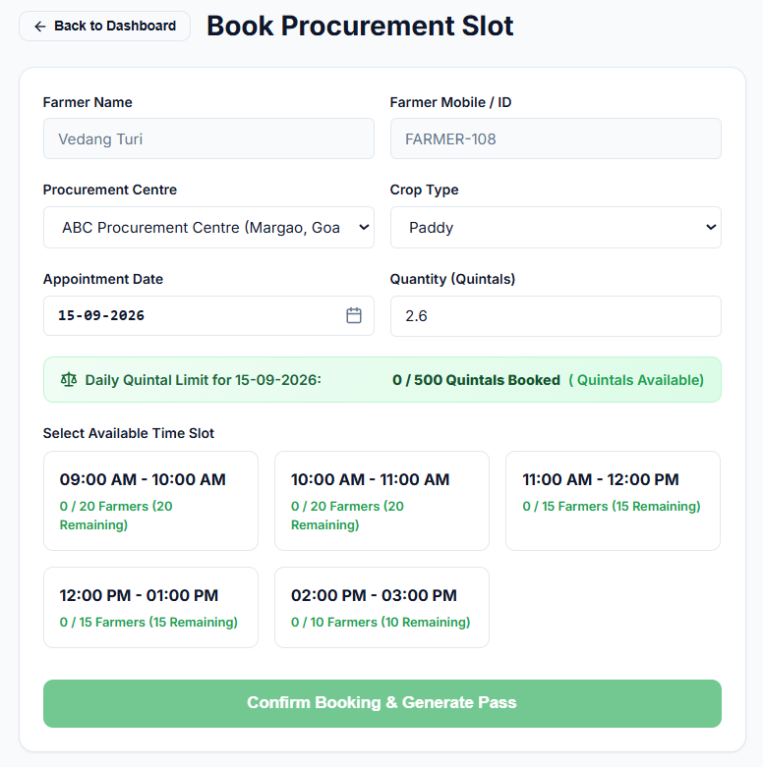
THE SOLUTION
One Platform. One Digital Visit Pass.
01
02
03
04
05
Register
Choose Centre
Book Slot
Get QR Pass
Scan & Verify
Farmer creates a basic profile.
Select the required agricultural centre.
Select date, time and crop/quantity details.
System generates a unique digital pass.
Centre scans QR — appointment validated.
Five steps. Zero paperwork. One verified visit.
03 / 06

Slide 4
ARCHITECTURE
How BHARATAGRI Works
TECH STACK
USER INTERFACES
Farmer • Procurement Centre
Layer | Technology
Frontend | React + Vite
Backend | Node.js + Express
Database | SQLite
Authentication | Custom Role-Based Authentication
QR | QRCode.react + HTML5-QRCode
API | REST API
REST API
Node.js + Express
Authentication
Booking Engine
SQLite Database.
Procurement Centre Dashboard
04 / 06

Slide 5
WHY IT WORKS
Feasible, Scalable, Impactful
FEASIBLE
SCALABLE
IMPACT
Lightweight architecture
Centre-level scheduling
For Farmers
Simple web-based system deployable without specialized hardware.
Each centre defines operational days, date ranges, time slots, farmer capacity and daily quintal capacity.
Planned visits, digital pass, less uncertainty, simple QR verification.
Digital-first
Expandable architecture
For Centres
Farmers use their phone to access appointments and their QR pass.
Same platform supports more centres and users as adoption grows.
Organized schedules, capacity control, date-wise planning, faster verification.
DATE-WISE
PLANNING
SLOT-WISE
CAPACITY
CROP-WISE
SUMMARY
05 / 06

Slide 6
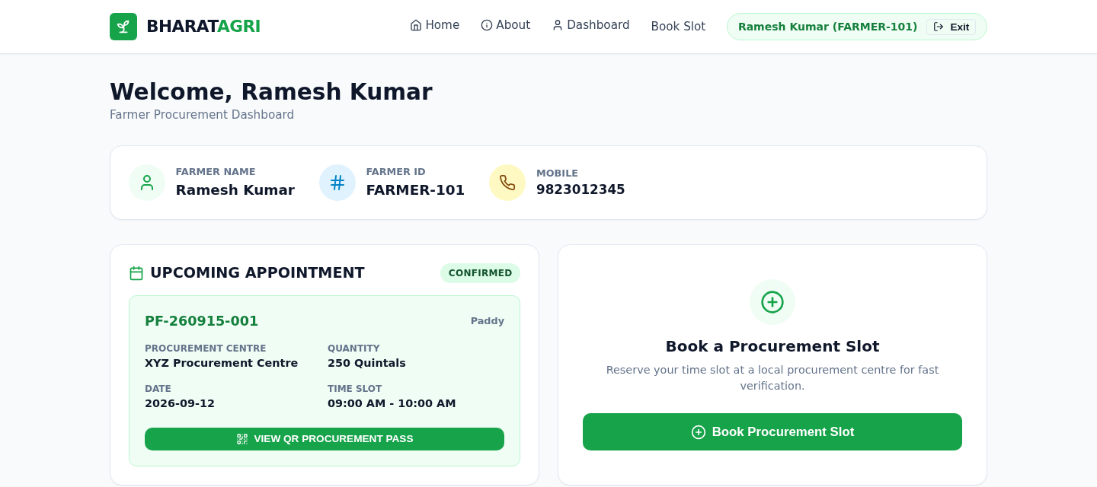
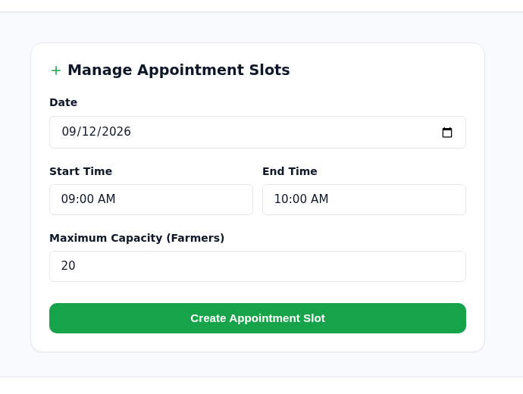
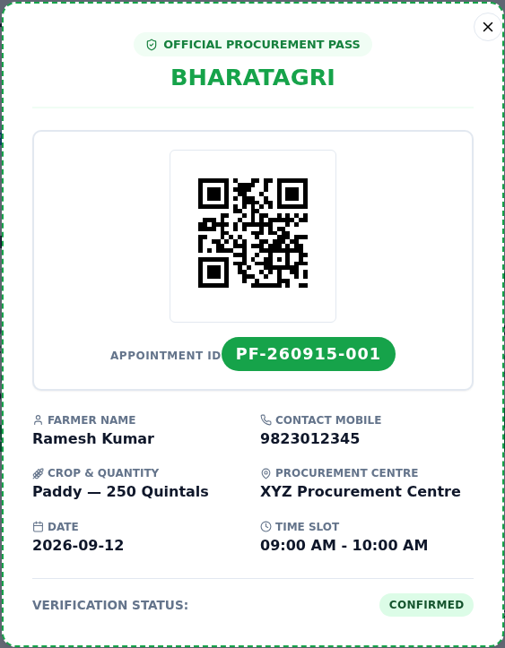
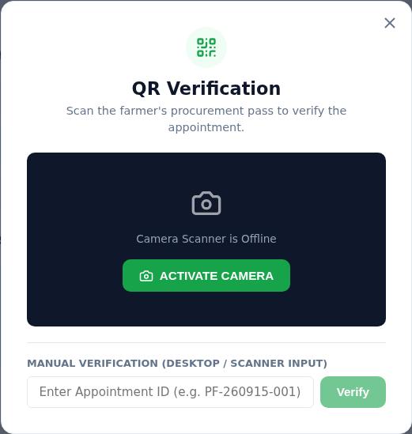
THE PROTOTYPE
From Appointment to Verified Entry
BUILT & WORKING
Live prototype — Farmer and Procurement Centre portals are fully functional end to end.
Farmer Dashboard
Slot Management
Farmer login
FARMER-101 / pass123
Centre login
CENTRE-001 / pass123
Booking ID format
PF-YYMMDD-XXX
Stack
React + Vite · Node/Express · SQLite
QR Appointment Pass
QR Verification
FUTURE SCOPE
Multilingual Support
Centre Network
Advanced Analytics
Smart Capacity Prediction
06 / 06

