Slide 1
Interactive CO₂ Emission Dashboard
Welcome to our interactive CO₂ emission dashboard, designed to make global environmental data accessible and engaging for students and educators. Our project highlights the power of data visualization and programming to empower people to understand and analyze complex environmental issues.

Slide 2
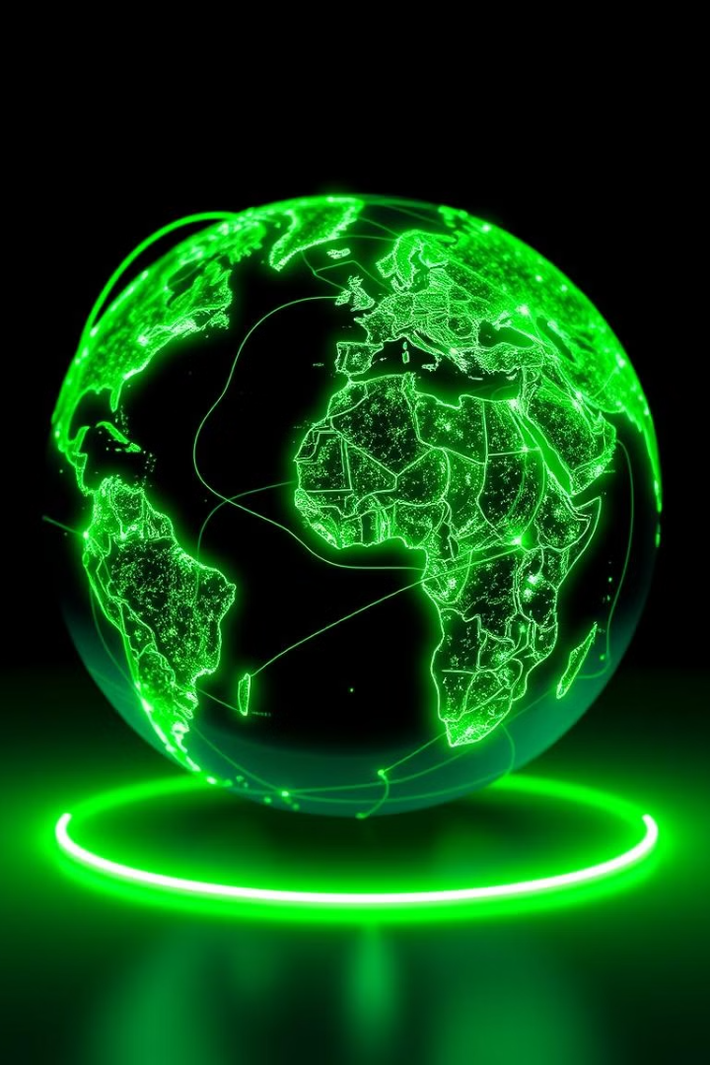
Project Objectives
Learning and Practice
Simplifying Insights
This project was a hands-on learning experience, enabling us to develop skills in Python programming, data visualization, and working with datasets.
Our interactive dashboard simplifies complex data analysis, allowing users to compare CO₂ emissions between countries without needing technical expertise.
Raising Awareness
Encouraging Exploration
We aim to encourage users to think about the global impact of CO₂ emissions and the importance of monitoring environmental data.
Interactive elements invite users to explore the data, making it a hands-on learning experience about global CO₂ emissions.

Slide 3
SETTING UP GITHUB
WHAT WE DID?
We created an root folder and created a sub-folders within it contained all our data of code and visual outputs and screen recording of our output
WHAT WE LEARNED?
We learned various things from this including how to use create,delete and modify a repository . How to commit changes in GitHub and learned how entire git works altogether

Slide 4
Tools and Libraries
Python
Matplotlib
Pandas
VS Code Notebook
Python was used for building the dashboard and data processing. It is a versatile programming language suitable for data analysis and visualization projects.
Matplotlib is a popular Python library used to create static, animated, and interactive visualizations in Python. It was used for creating graphs and charts to represent CO₂ emissions.
Pandas is a powerful Python library used for data analysis and manipulation. It helped us handle and analyze the dataset, including cleaning and transforming the data.
VS Code Notebook was our development environment, providing tools for writing and testing Python code, as well as for interacting with the dashboard.

Slide 5


Data Source and Collection
The dataset for this project was obtained from publicly available sources, including the International Energy Agency (IEA) , the World Bank, and Kaggle. The data encompasses various parameters relevant to CO₂ emissions, such as energy consumption, GDP, and population data.

Slide 6
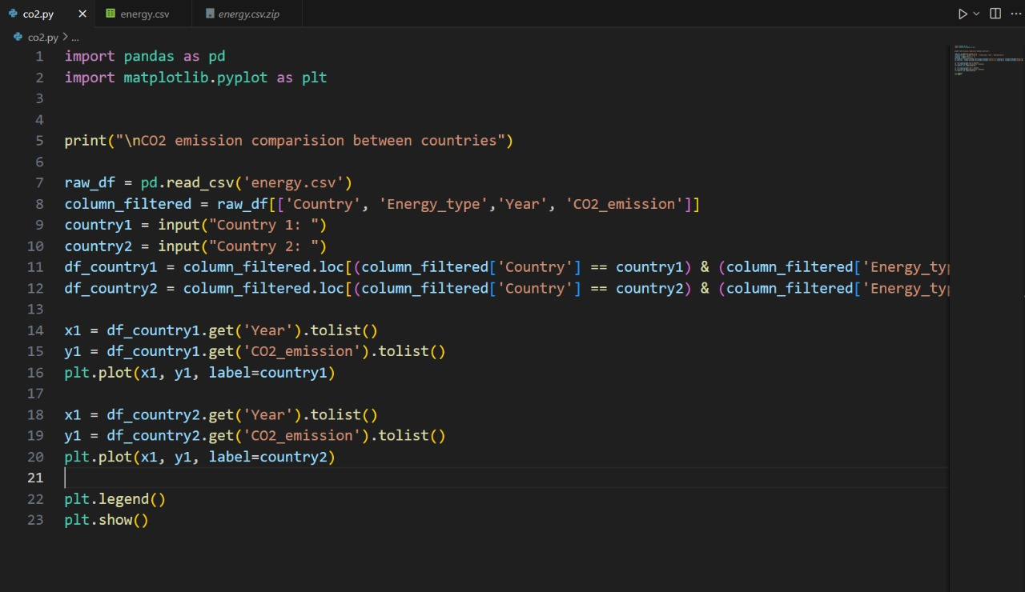

Slide 7



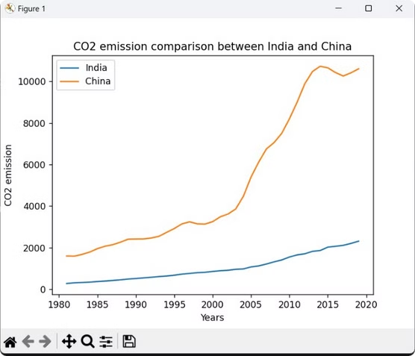


Execution and Interactivity
Install Libraries
Download Dataset
Begin by installing required libraries (matplotlib and pandas) using pip: pip install matplotlib pandas.
Obtain the dataset from our repository and place it in the same directory as the project code.
Run Script
Interact with Dashboard
Execute the Python script using your chosen development environment (e.g., VS Code Notebook).
Follow the prompts in the dashboard to select countries for comparison, view generated graphs, and analyze CO₂ emission trends.

Slide 8

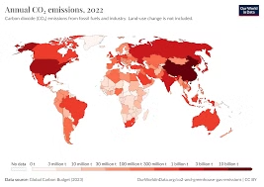
Summary of Results
The dashboard effectively visualized CO₂ emissions for given countries over user-defined inputs. Users can make meaningful comparisons between countries, leading to a better understanding of global emission patterns.

Slide 9
Challenges Faced
Data Cleaning
1
The dataset contained missing or inconsistent values, requiring extensive preprocessing to make the data usable for analysis.
Visualization Complexity
2
Balancing simplicity and readability in graphs was challenging, particularly when comparing countries and trying to make graph as simple as possible
Interactivity
3
Adding interactive elements, such as country selection required extra logic, testing, and development.
Technical Limitations
4
As a student project, the dashboard has limitations compared to professional tools, but it serves its purpose as a learning experience.

Slide 10

Key Takeaways and Next Steps
This project demonstrated the importance of data visualization and interactive tools in promoting understanding and awareness of environmental issues. Moving forward, we plan to further enhance the dashboard's functionality, incorporating more advanced features and data sources.

