Slide 1
Bank Marketing Analysis
Daniel Chang, Carolina Craus, Andrew Yule

Slide 2
TOC
Introduction
Exploratory Data Analysis (EDA)
Objective 1 Results
Objective 2 Results
Concluding Remarks

Slide 3
Introduction
“Given a large data set containing term deposit marketing success, can we better understand what effects the success rate and how to better predict it?”

Slide 4
Specific objectives
Using the bank marketing dataset, build the following:
A highly interpretable model for inference on key variables influencing term deposit subscriptions
A highly accurate model that allows for prediction of term deposit subscriptions on future clients

Slide 5
Exploratory data analysis

Slide 6
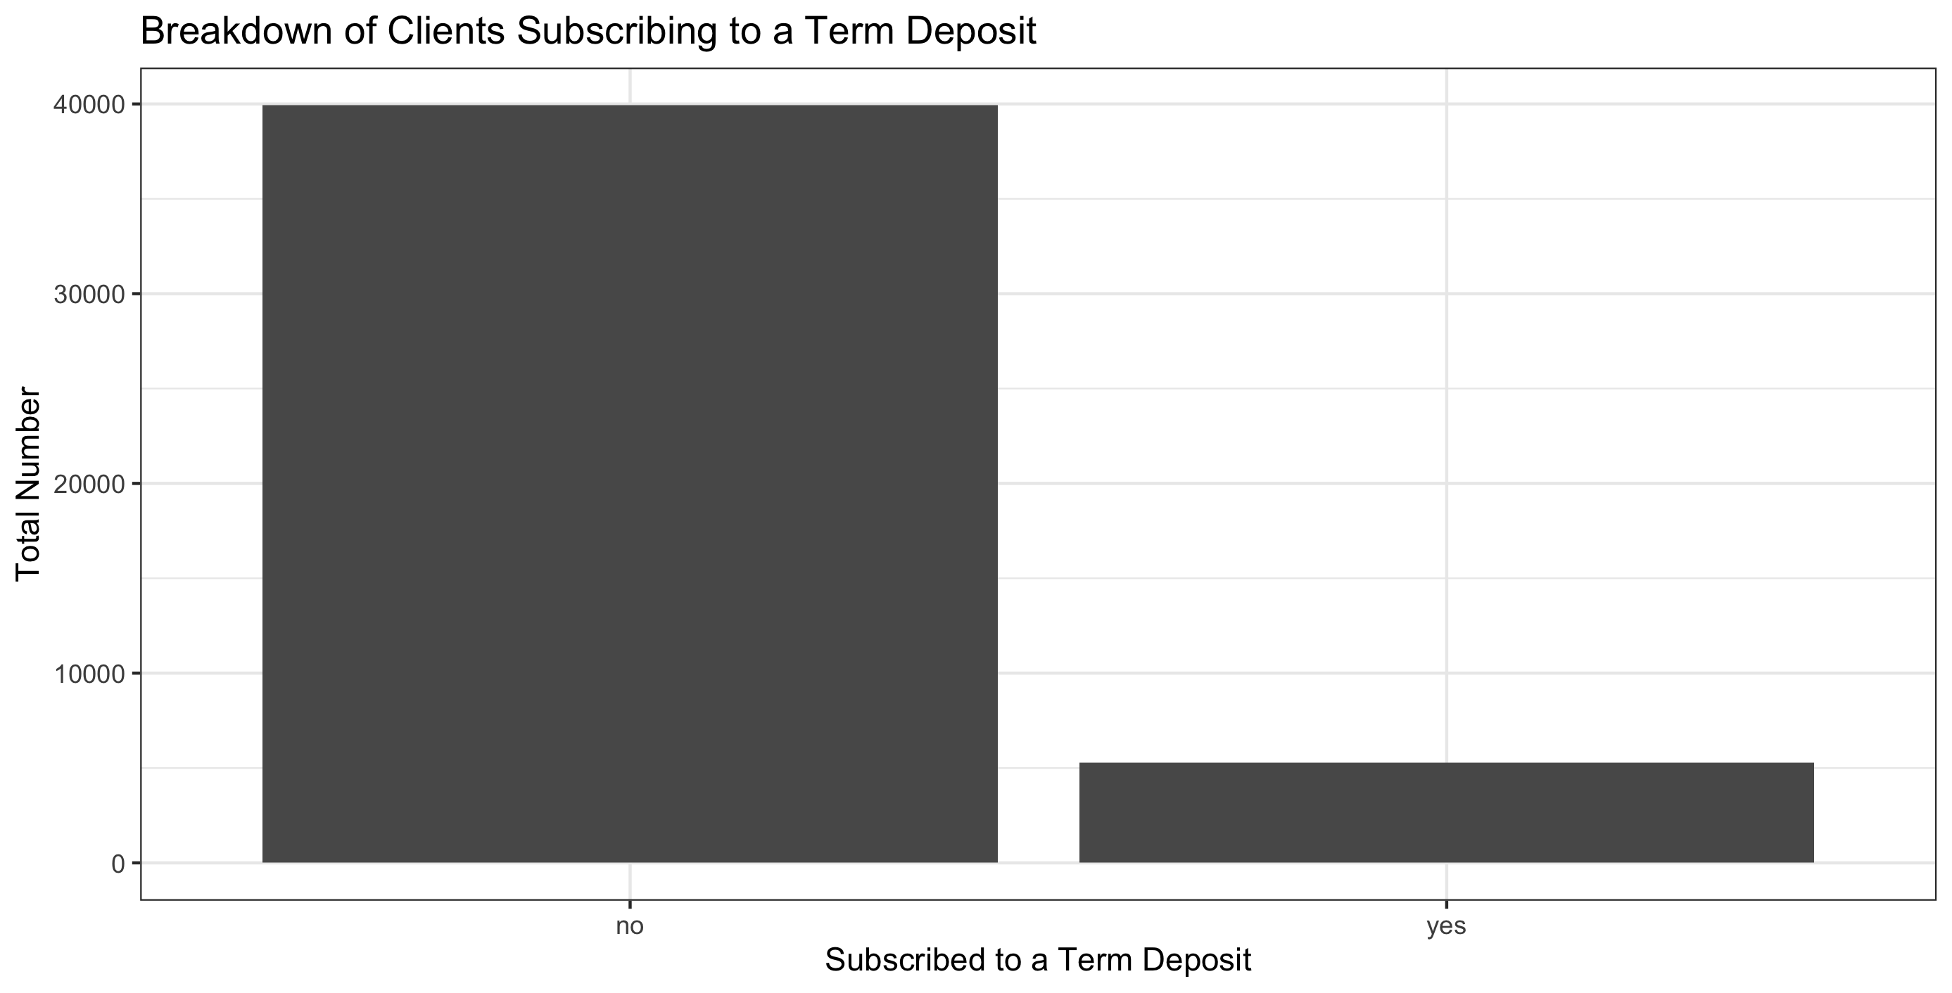
Exploratory Data Analysis
Data Introduction
Key variable of interest: Whether the client subscribed to a term deposit
The data is highly unbalanced with a success rate of ~88%

Slide 7
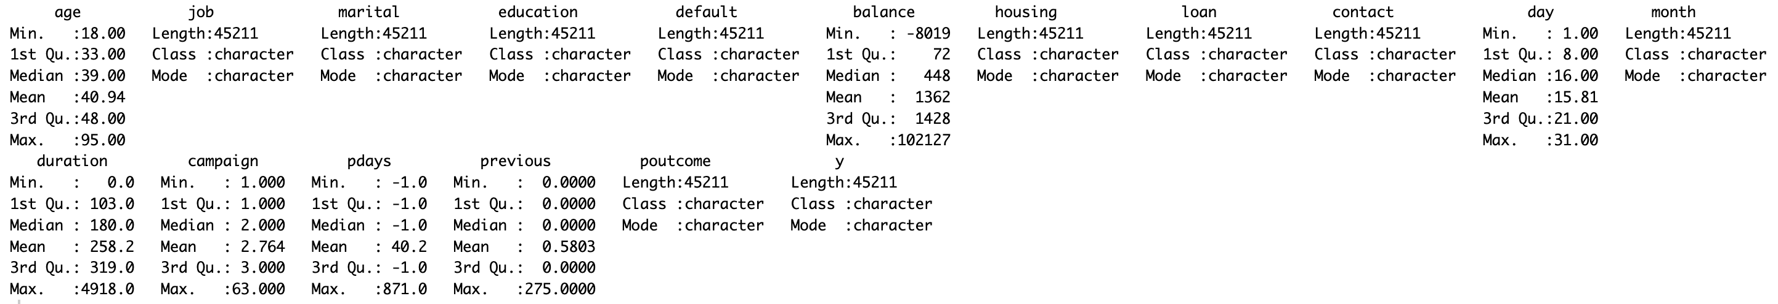
Exploratory Data Analysis
Data Introduction
Total rows: 45,211
Variable count: 18
Numerical predictors: 7
Categorical predictors: 10
No missing data was found

Slide 8
Exploratory Data Analysis
Relationship between X and Y
More EDA here on the following slides

Slide 9
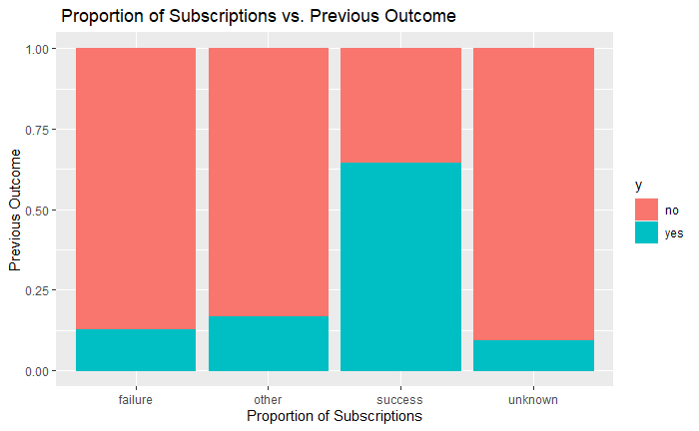
Exploratory Data Analysis
Relationship between Previous Outcome and Y
The “success” category in Previous outcome is significantly more likely to have another success
Around 65% are likely to have another success
Compared to the other categories which have less than 25% likely to have a success

Slide 10
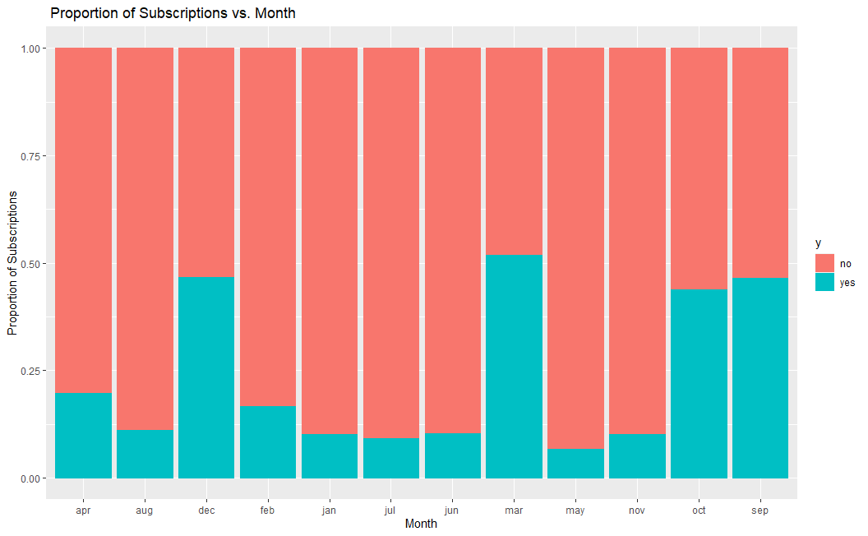
Exploratory Data Analysis
Relationship between Month and Y
Month seems to impact whether a client will resubscribe to a term deposit
September, October, December, and March seem to have almost half the clients resubscribe to a term deposit
The rest of the months have less than 25% rate of resubscribing to a term deposit

Slide 11
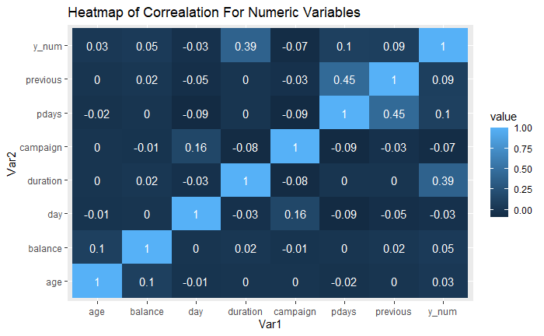
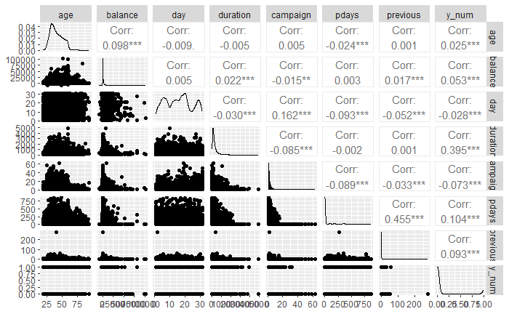
Exploratory Data Analysis
Correlation Plot and Heatmap
No very highly correlated variables or multicollinearity present

Slide 12
Objective 1

Slide 13
Objective 1
Recapping the Primary Goal
Primary goal: Can we make a highly interpretable model that helps to better gain inference on what leads to successfully signing clients to new term deposits
Note: Data was split into two datasets for training and validation using a 70/30 split
Feature Selection
17 Variables
Reduction in variables to improve interpretation

Slide 14
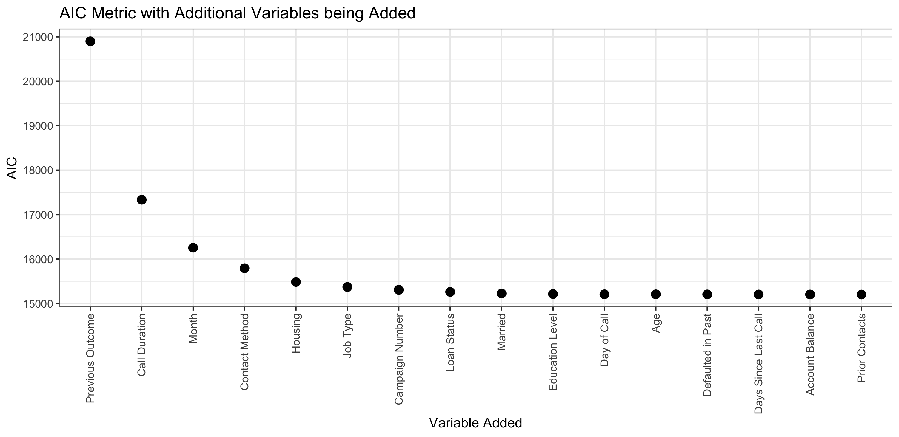
Objective 1
Feature Selection Algorithm
Main Algorithm: Stepwise logistic regression utilizing AIC as the performance metric
Diminishing returns are found after the 5th variable is included

Slide 15
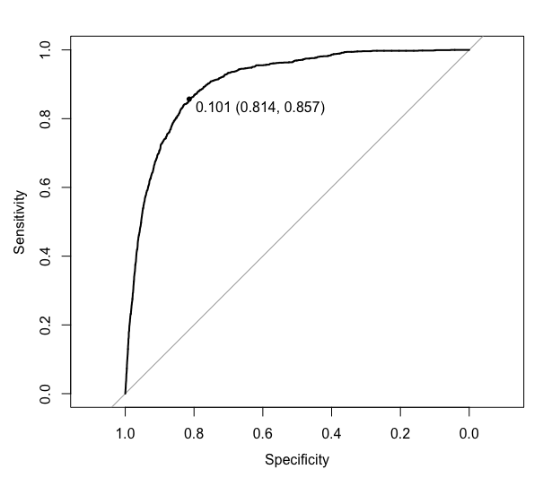
Objective 1
Model Performance
Metric | Score
AIC | 15,485
Accuracy | 81%
Sensitivity | 81%
Specificity | 86%
PPV | 97%
NPV | 38%
AUROC | 0.9045

Slide 16
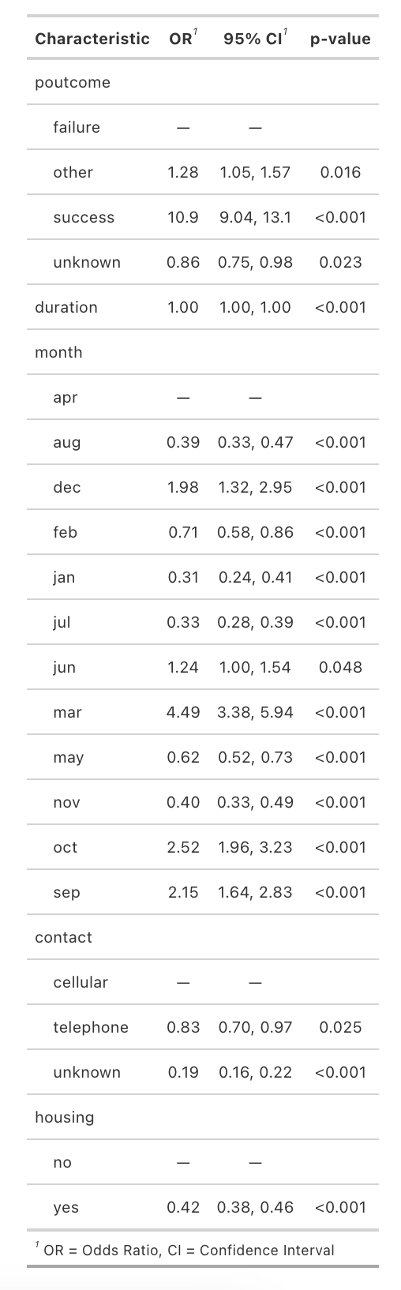
Objective 1
Model Interpretation and Inference
Note: All variables in the model were noted to have statistical significance
Relative to past failures, previous successful outcomes were associated with a ~1,000% increase in the odds of having another success¹
Relative to April, the month of March is particularly successful having an ~350% increase in the odds of having success¹
Relative to calling on a client’s cell phones, calling their telephone was associated with a ~20% reduction in the odds of having success¹
Relative to those clients without housing loans, having a housing loan was associated with a ~60% reduction in the odds of having success¹
1 Holding all other variables fixed

Slide 17
Objective 2

Slide 18
Thank you.

