Slide 1
Bank Marketing Analysis
Daniel Chang, Carolina Craus, Andrew Yule

Slide 2
TOC
Introduction
Exploratory Data Analysis (EDA)
Objective 1 Results
Objective 2 Results
Concluding Remarks

Slide 3
Introduction
“Given a large data set containing term deposit marketing success, can we better understand what effects the success rate and how to better predict it?”

Slide 4
Specific objectives
Using the bank marketing dataset, build the following:
A highly interpretable model for inference on key variables influencing term deposit subscriptions
A highly accurate model that allows for prediction of term deposit subscriptions on future clients

Slide 5
Exploratory data analysis

Slide 6
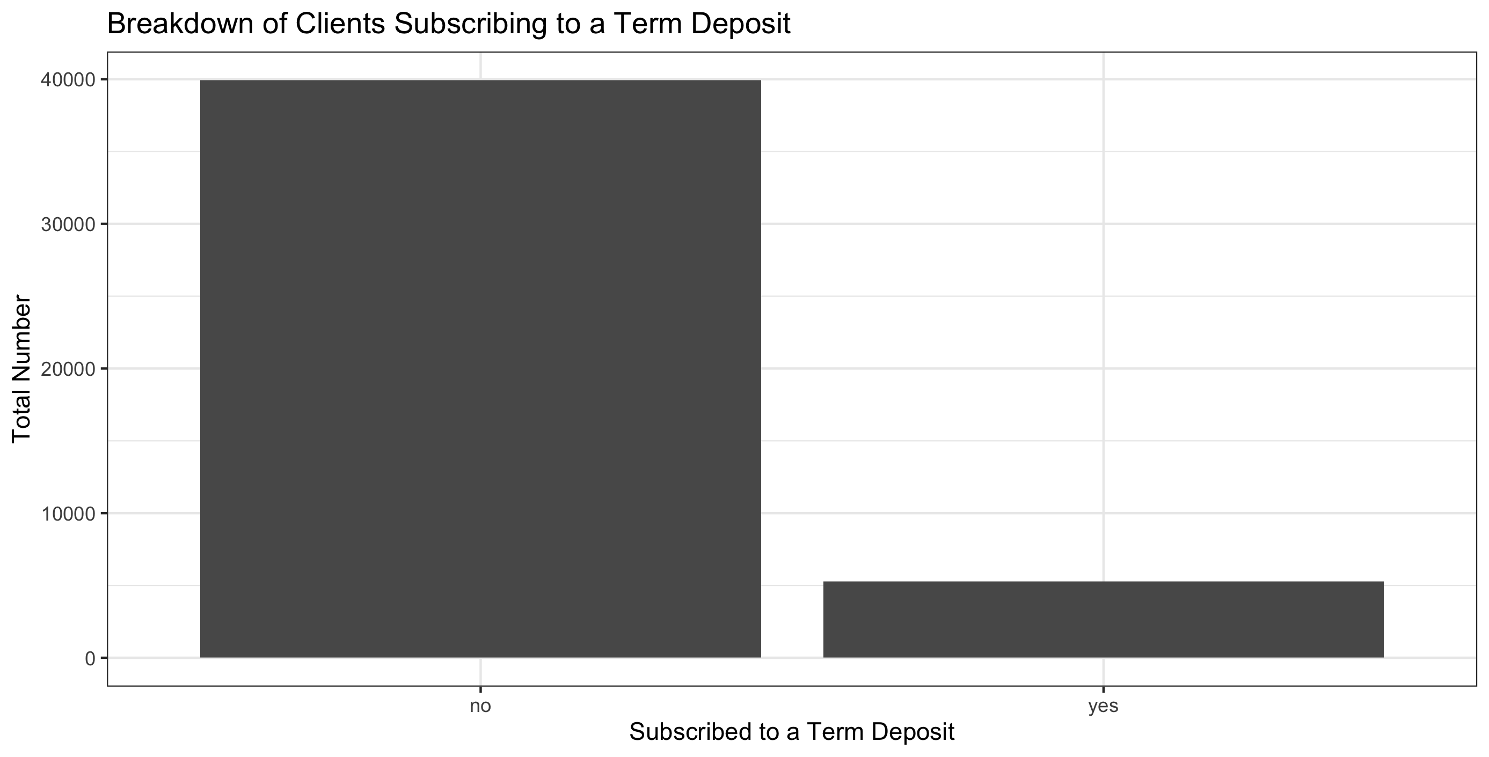
Exploratory Data Analysis
Data Introduction
Key variable of interest: Whether the client subscribed to a term deposit
The data is highly unbalanced with a success rate of ~88%

Slide 7
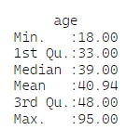
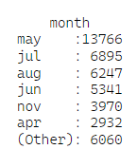

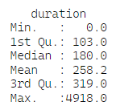
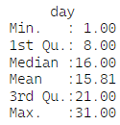
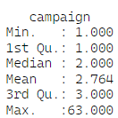
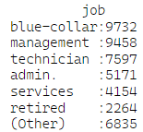



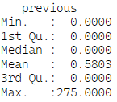
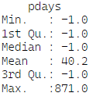
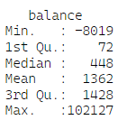



Exploratory Data Analysis
Data Introduction
Total rows: 45,211
Variable count: 18
Numerical predictors: 7
Categorical predictors: 10
No missing data was found
Numerical Variables
Categorical Variables

Slide 8
Exploratory Data Analysis
Relationship between X and Y
More EDA here on the following slides

Slide 9
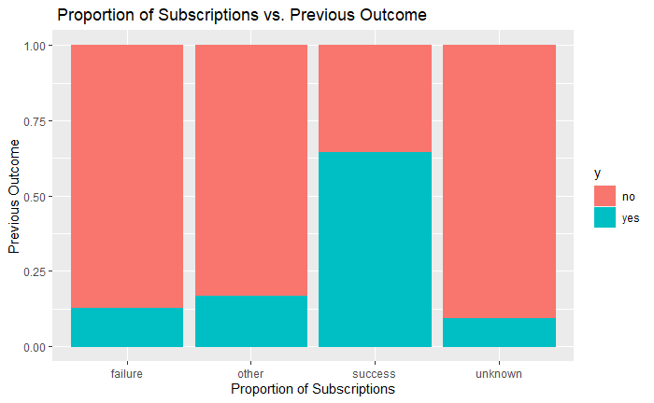
Exploratory Data Analysis
Relationship between Previous Outcome and Term Deposit Subscriptions
Previous Outcome: Outcome of the previous marketing campaign
The “success” category in Previous outcome is significantly more likely to have another success
Around 65% are likely to have another success
Compared to the other categories which have less than 25% likely to have a success

Slide 10
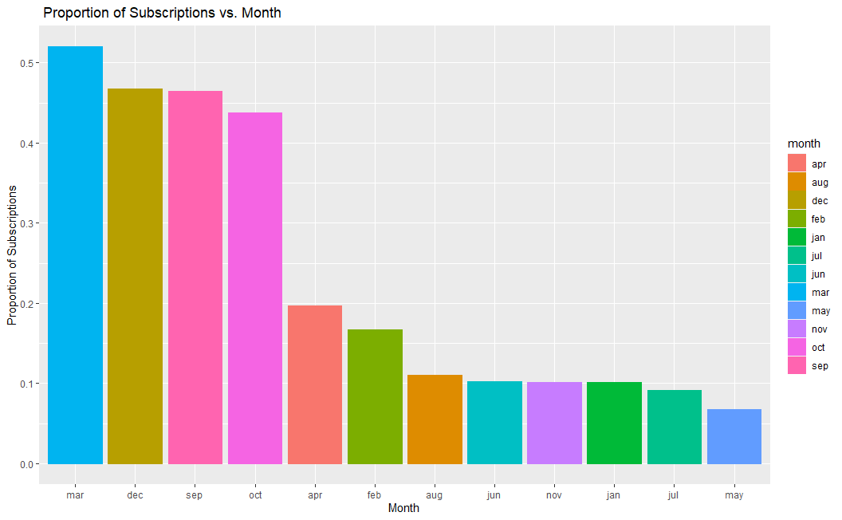
Exploratory Data Analysis
Relationship between Month and Term Deposit Subscriptions
Month seems to impact whether a client will resubscribe to a term deposit
September, October, December, and March seem to have almost half the clients resubscribe to a term deposit
The rest of the months have less than 25% rate of resubscribing to a term deposit

Slide 11
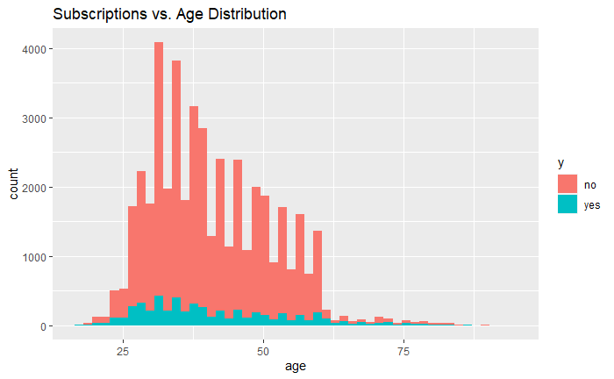
Exploratory Data Analysis
Relationship between Age and Term Deposit Subscriptions
Age seems like it could potentially affect the results of subscribtions to term renewals
Many of the clients are between 30-45 years old
Data is unbalanced

Slide 12
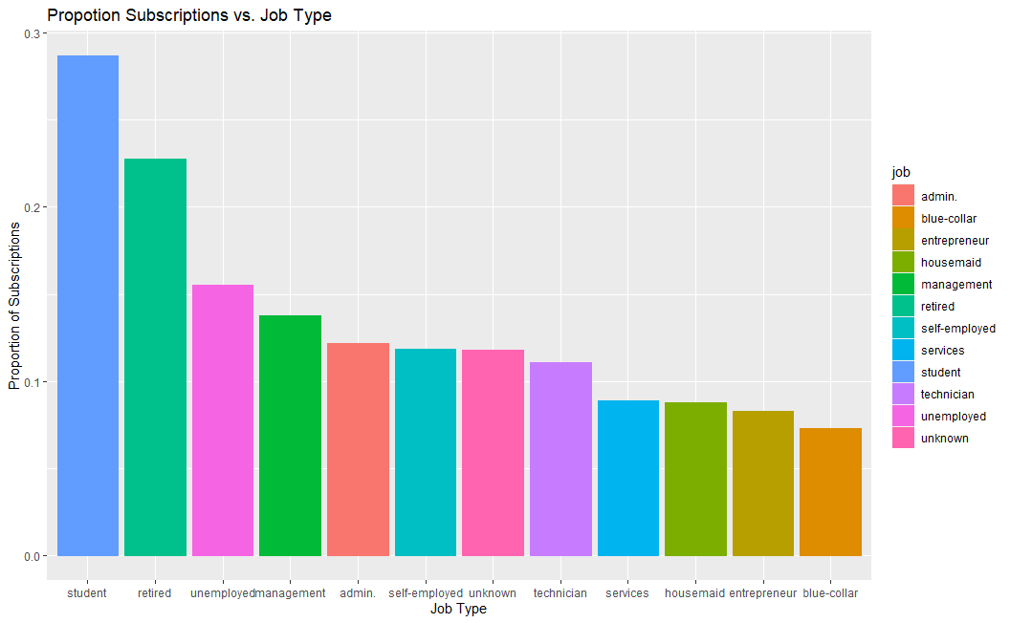
Exploratory Data Analysis
Relationship between Job Type and Term Deposit Subscriptions
The Student and Retired categories have the highest percent of subscriptions
Over 20% of each group subscribing to a term deposit
Services, housemaid, entrepreneur, and blue-collar job types have smallest subscription rates below 10%

Slide 13
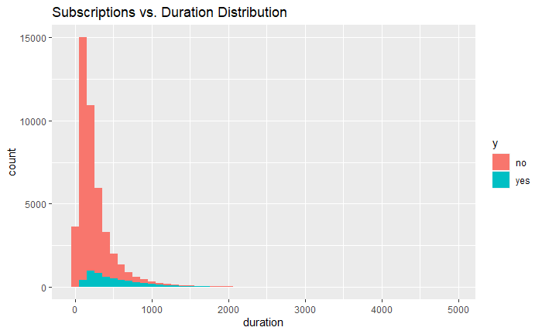
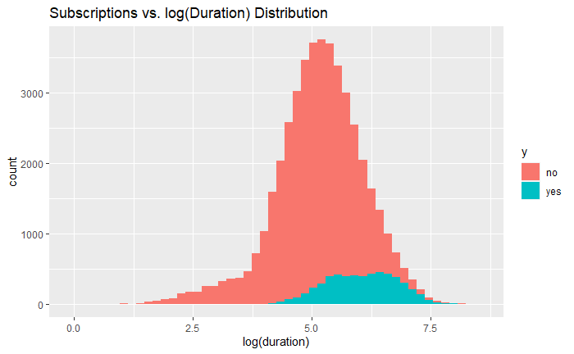
Exploratory Data Analysis
Relationship between Call Duration and Subscriptions
Call Duration: Last contact duration, in seconds
We see a more normal distribution looking at the graph of the log transformed Duration variables
Call Duration between 5-7.5 minutes seem to highly increase the chances of a client subscribing to a term deposit
No term deposit subscriptions under 3 minutes

Slide 14
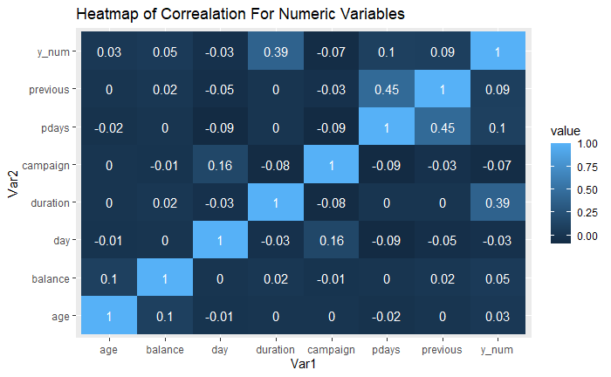
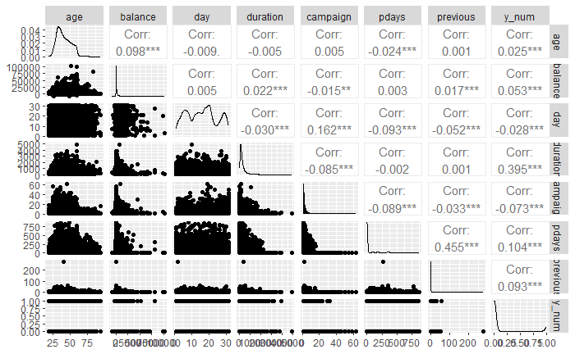
Exploratory Data Analysis
Correlation Plot and Heatmap
No very highly correlated variables or multicollinearity present

Slide 15
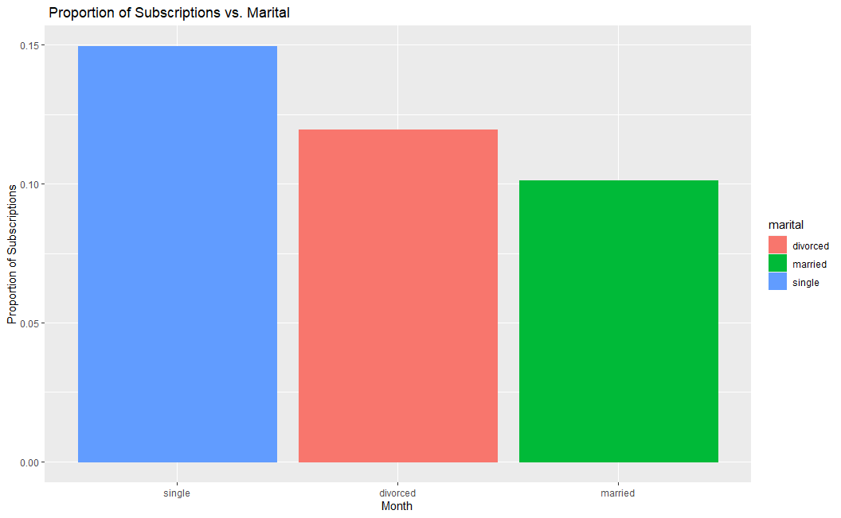
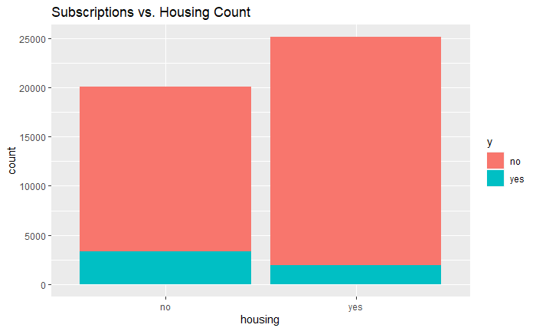
Exploratory Data Analysis
Relationship between Marital Status and Subscriptions
& Housing and Subscriptions
The highest proportion of term renewal subscriptions is in the “single” category with nearly 15% subscribers, followed by “divorced” (12%) and married (10%)

Slide 16
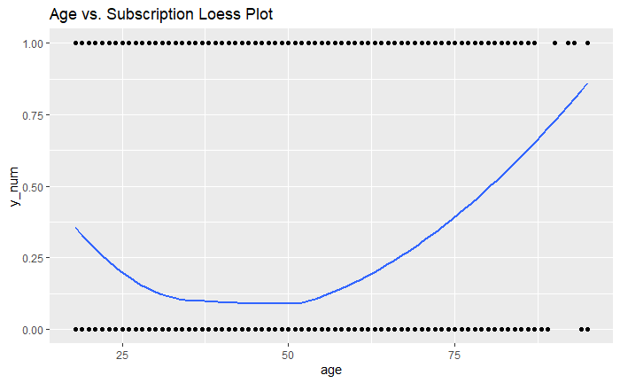
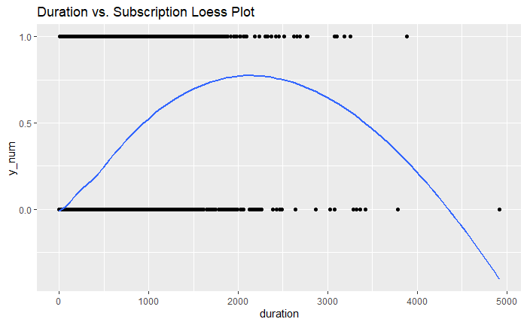
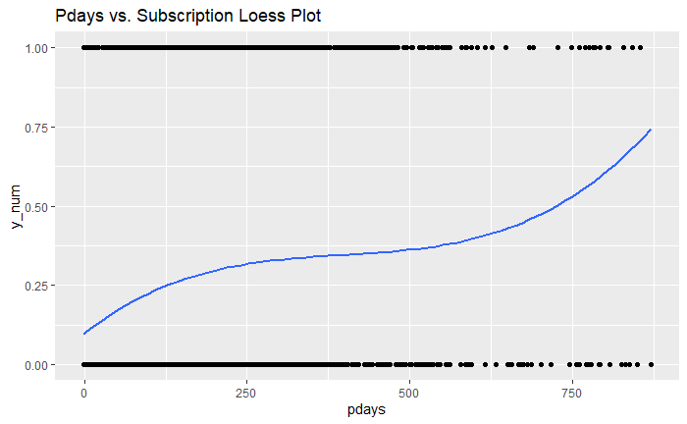
Exploratory Data Analysis
Loess Plots for Age and Previous Days variables
Loess plot suggests Age could be expected to be part of the model, however, it was not significant in the models
Loess plot suggests Pdays us expected to be part of the model, showing a linear relationship exists

Slide 17
Objective 1

Slide 18
Objective 1
Recapping the Primary Goal
Primary goal: Can we make a highly interpretable model that helps to better gain inference on what leads to successfully signing clients to new term deposits
Note: Data was split into two datasets for training and validation using a 70/30 split
Feature Selection
17 Variables
Reduction in variables to improve interpretation

Slide 19
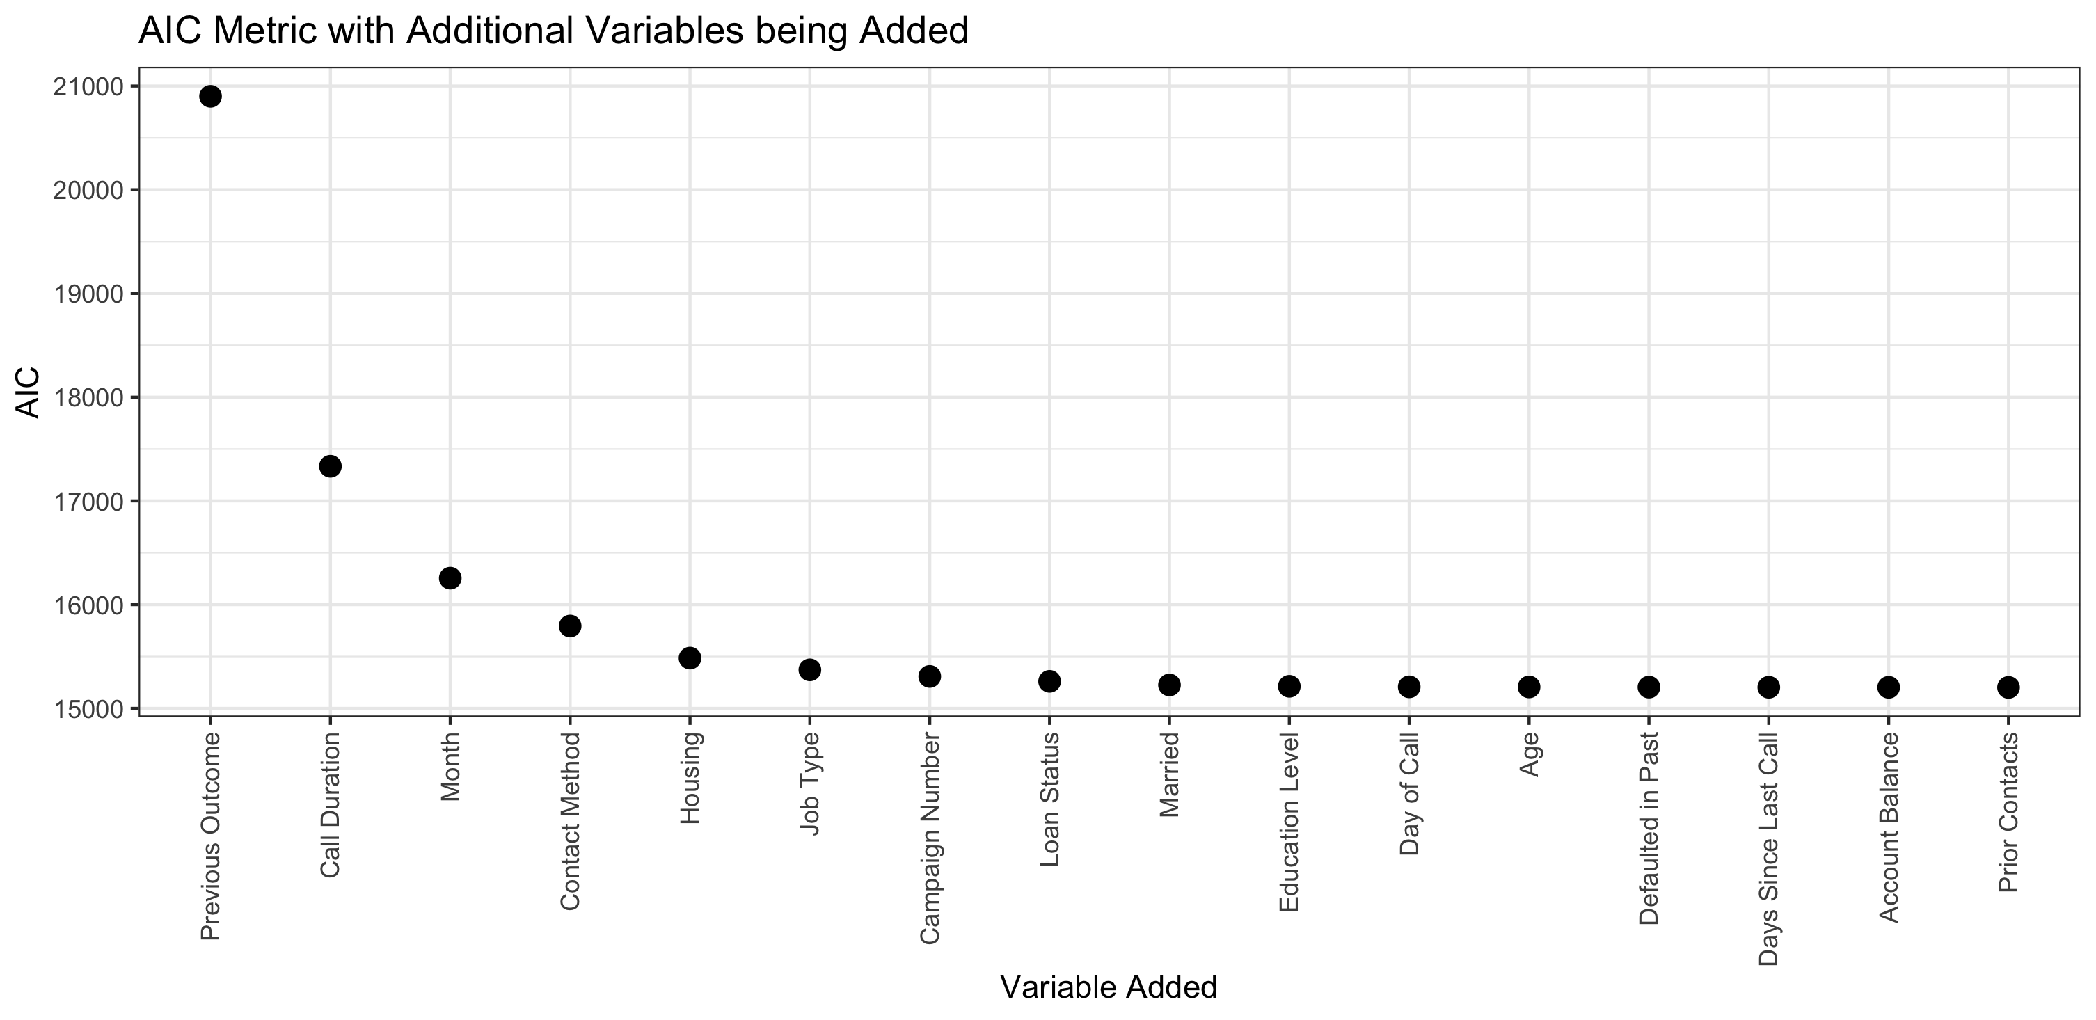
Objective 1
Feature Selection Algorithm
Main Algorithm: Stepwise logistic regression utilizing AIC as the performance metric
Diminishing returns are found after the 5th variable is included

Slide 20
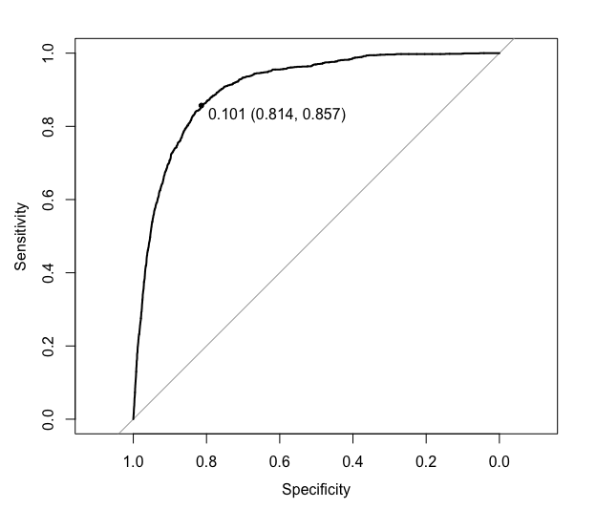
Objective 1
Model Performance
Metric | Score
AIC | 15,485
Accuracy | 81%
Sensitivity | 81%
Specificity | 86%
PPV | 97%
NPV | 38%
AUROC | 0.9045

Slide 21
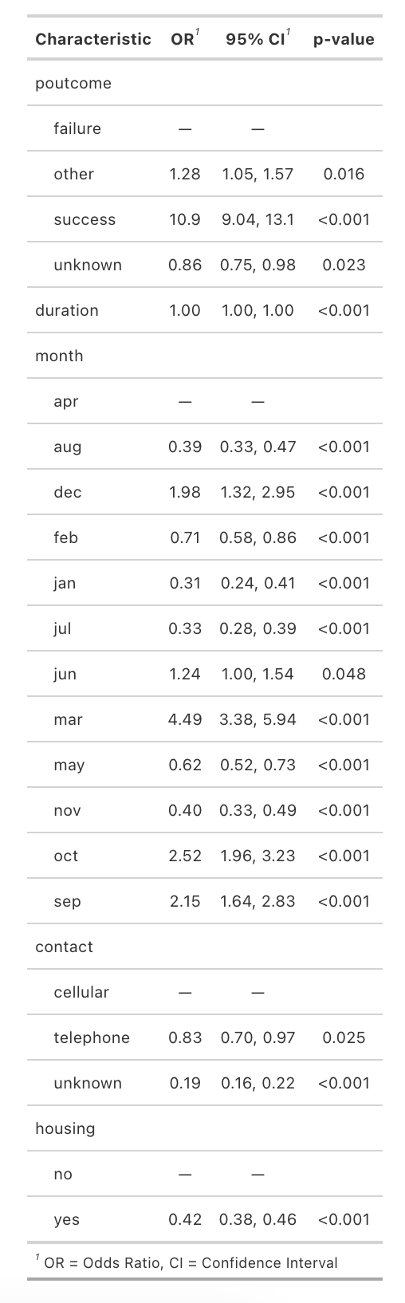
Objective 1
Model Interpretation and Inference
Note: All variables in the model were noted to have statistical significance
Relative to past failures, previous successful outcomes were associated with a ~1,000% increase in the odds of having another success¹
Relative to April, the month of March is particularly successful having an ~350% increase in the odds of having success¹
Relative to calling on a client’s cell phones, calling their telephone was associated with a ~20% reduction in the odds of having success¹
Relative to those clients without housing loans, having a housing loan was associated with a ~60% reduction in the odds of having success¹
1 Holding all other variables fixed

Slide 22
Objective 2

Slide 23
Objective 2
Recapping the Primary Goal
1. Higher Complexity Logistic Regression Model
Primary goal: Build 3 additional classification models to better gain inference on what leads to successfully signing clients to new term deposits and compare to simple model previously discussed
2. LDA/QDA
Simple Logistic Model
3. KNN Model
(Non-Parametric)
4. Random Forest Model
(Non-Parametric)
5. eXtreme Gradient Boosting Model
(Non-Parametric)

Slide 24
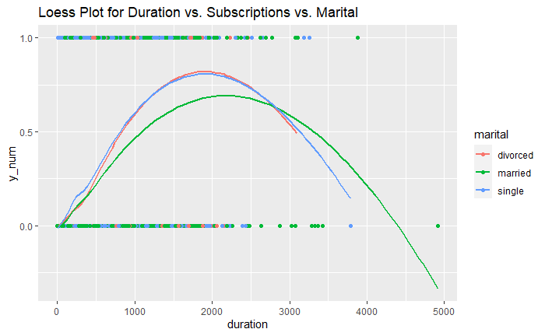
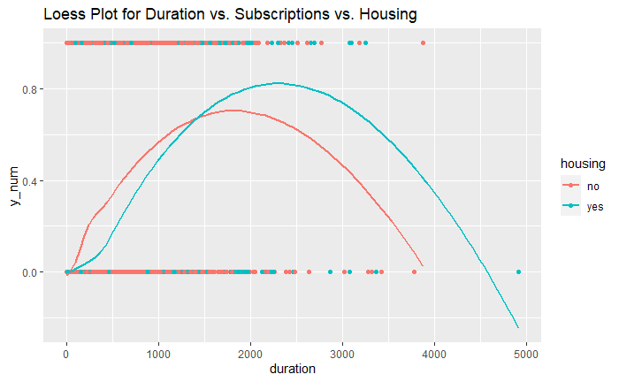
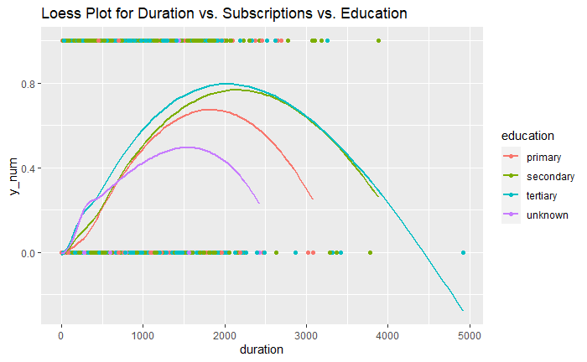
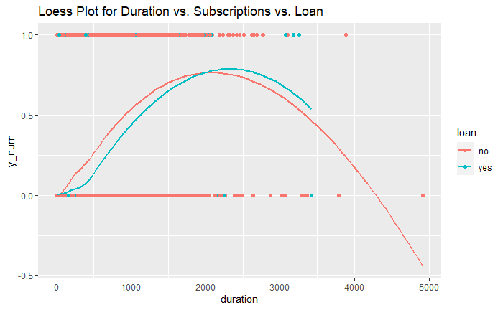
Objective 2
1. Higher Complexity Logistic Regression Model
EDA: Loess Plots for Duration

Slide 25
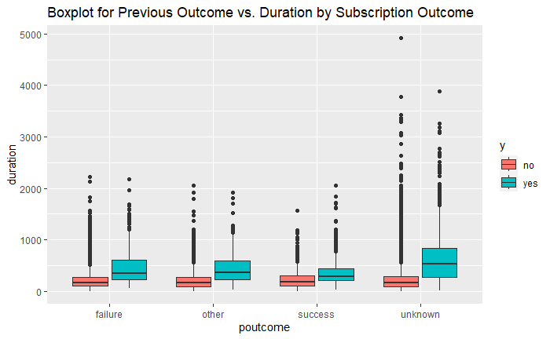
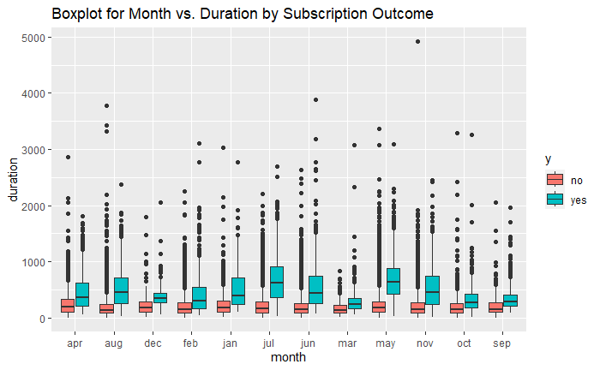
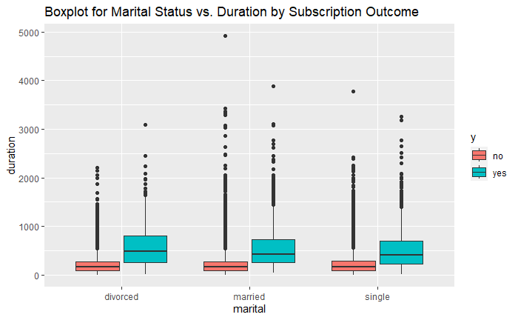
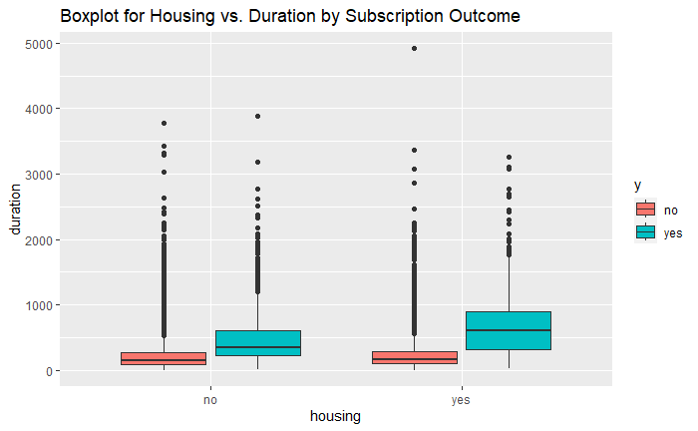
Objective 2
1. Higher Complexity Logistic Regression Model
EDA: Box Plots for Duration

Slide 26
Objective 2
1. Higher Complexity Logistic Regression Model
EDA: Box Plots for log(Balance)

Slide 27
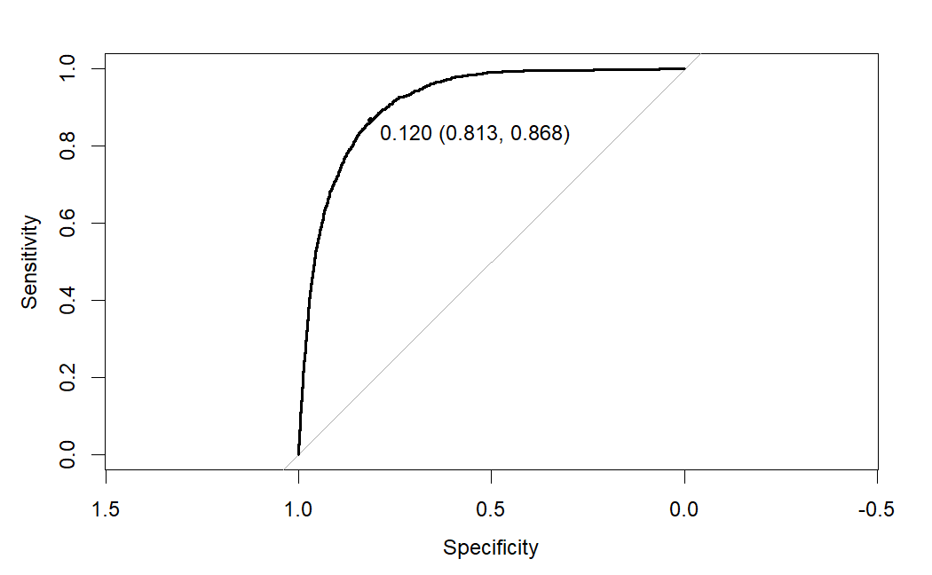
Objective 2
1. Higher Complexity Logistic Regression Model
Model Performance
Metric | Score
AIC | 14080.66
Accuracy | 82%
Sensitivity | 81%
Specificity | 87%
Prevalence | 88%
PPV | 98%
NPV | 38%
AUROC | 0.9149
Lower than simple model
ROC Curve

Slide 28
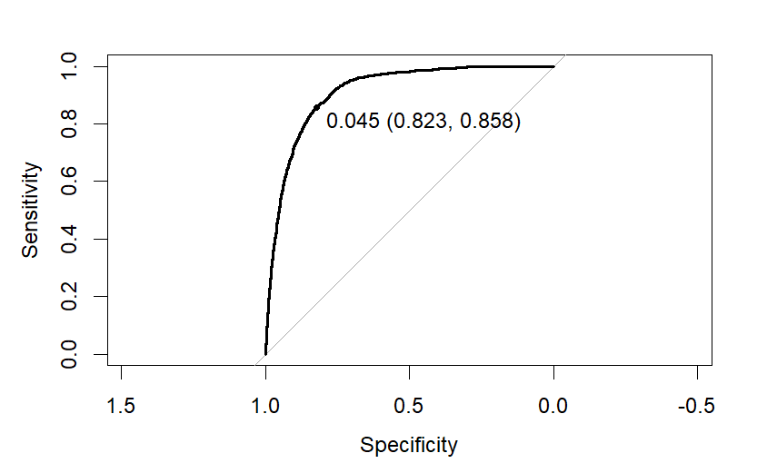
Objective 2
2. LDA
Model Performance
Metric | Score
Accuracy | 83%
Sensitivity | 82%
Specificity | 86%
Prevalence | 88%
PPV | 98%
NPV | 39%
AUROC | 0.9117
ROC Curve

Slide 29
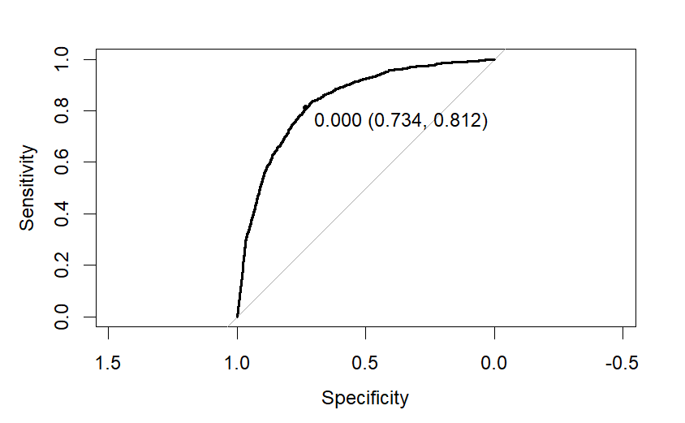
Objective 2
2. QDA
Model Performance
Note: QDA does not perform very well here. The optimal threshold was 0 which returns NaN’s in certain performance metrics.
Metric | Score
Accuracy | 12%
Sensitivity | 0%
Specificity | 100%
Prevalence | 88%
PPV | NaN
NPV | 12%
AUROC | 0.838
ROC Curve

Slide 30
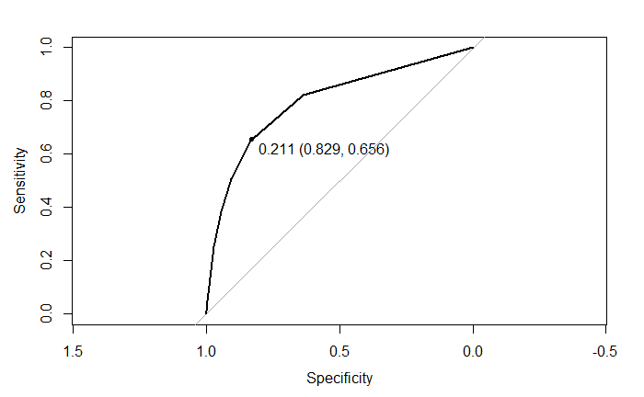
Objective 2
2. KNN Model (Non-Parametric)
Model Performance
Metric | Score
Accuracy | 81%
Sensitivity | 83%
Specificity | 66%
Prevalence | 88%
PPV | 95%
NPV | 34%
AUROC | 0.7963
ROC Curve

Slide 31
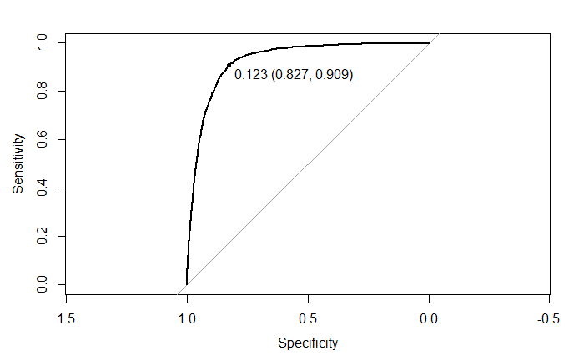
Objective 2
4. Random Forest Model (Non-Parametric)
Model Performance
Metric | Score
Accuracy | 84%
Sensitivity | 83%
Specificity | 91%
Prevalence | 88%
PPV | 99%
NPV | 41%
AUROC | 0.9281
ROC Curve

Slide 32
Objective 2
2. eXtreme Gradient Boosting Model
Model Performance
Metric | Score
Accuracy | 83%
Sensitivity | 82%
Specificity | 92%
Prevalence | 88%
PPV | 99%
NPV | 40%
AUROC | 0.9333
ROC Curve

Slide 33
Objective 2
Conclusion: Best Model Performance
Model | Sensitivity | Specificity | Prevalence | PPV | NPV | AUROC
Simple Stepwise Logistic Model | 81% | 86% | 88% | 97% | 38% | 0.9045
Complex Logistic Regression Model | 81% | 87% | 88% | 98% | 38% | 0.9149
LDA | 82% | 86% | 88% | 98% | 39% | 0.9117
QDA | 0% | 100% | 88% | NaN | 12% | 0.838
KNN | 83% | 66% | 88% | 95% | 34% | 0.7963
Random Forest | 83% | 91% | 88% | 99% | 41% | 0.9281
eXtreme Gradient Boosting | 82% | 92% | 88% | 99% | 40% | 0.9333

Slide 34
Thank you.

