Slide 1
MSc dissertation · viva · august 2026
Explainable Music Recommender Systems for Improving User Satisfaction
A hybrid neural recommender with post-hoc SHAP and LIME explanations, evaluated on the Spotify Million Playlist Dataset.
Presented by
Supervisor
Programme
Chike Egonu
Aoife Curran
MSc dissertation
Notes:
"Good morning. I'm Chike Egonu, supervised by Aoife Curran. My project is an
explainable music recommender system, evaluated on the Spotify Million Playlist
Dataset.
The short version: I built a hybrid recommender across five models, added an
explanation layer using SHAP and LIME, and evaluated both the accuracy and the
explanations themselves. Two of the results were not what the proposal expected,
and I will be explicit about what is finished and what is still provisional."

Slide 2
Aims · §2
One aim, three objectives
Status of each objective at the time of writing.
AIM
Design, implement and evaluate an explainable music recommender system that balances personalisation and accuracy with transparent, user-interpretable explanations.
Objective 1
Objective 2
Objective 3
Hybrid recommender, benchmarked
SHAP and LIME, evaluated
Accuracy–explainability trade-off
Develop a hybrid model combining NCF with content-based acoustic and metadata features, benchmarked against established accuracy baselines on the Spotify MPD.
Integrate model-agnostic post-hoc explainers and evaluate their suitability for the music domain, including agreement between them.
Measure the trade-off between accuracy and explainability through ablation, quantifying the cost of a feature-decomposable architecture.
Implemented
Implemented · surrogate
First pass
Objective 3 is a first pass because the trade-off cannot be settled while the neural models are under-trained (Section 4.5 of the report).
Chike Egonu · Explainable Music Recommender Systems · MSc Viva
02
Notes:
"The aim is on the slide: an explainable recommender that balances accuracy with
explanations a listener can use.
Three objectives. One, the hybrid model and the baselines: implemented. Two,
SHAP and LIME: implemented, but through a surrogate, and I will explain why in
the methodology. Three, the accuracy-explainability trade-off: a first pass only,
because the neural models are under-trained, and that is the same issue that
affects the model comparison later."

Slide 3
Background · §1.1
Why explanation matters in music recommendation
The recommender is the interface to the catalogue, and the feedback it learns from is ambiguous.
Three reasons
What the feedback actually means
● Catalogue scale. Streaming catalogues run to tens of millions of tracks, so the recommender is the only practical way to navigate them (Schedl et al., 2018).
● User expectation. Users now expect to know why an item was recommended, and transparency affects trust in the system (Zhang and Chen, 2020; Afchar et al., 2022).
● Music is different. Preferences are contextual and emotional, and the feedback is implicit — a skip may be a mismatch of context rather than dislike (Ferwerda et al., 2015; Schedl et al., 2018).
Observed signal | What it may actually mean
Skip | Dislike · wrong context · wrong moment
Full play | Preference · passive background listening
Playlist co-occurrence | Shared taste · one curator's taste
Where this differs from film and e-commerce
● Acoustic features. Explanations have to be expressed in musical terms, not product metadata.
● Popularity bias. Mainstream artists are over-exposed and the long tail is under-recommended (Celma, 2010).
Chike Egonu · Explainable Music Recommender Systems · MSc Viva
03
Notes:
"Three reasons explanation matters here.
Catalogue scale: at tens of millions of tracks the recommender is the only
navigation layer.
User expectation: users ask why something was recommended, and the literature in
e-commerce and film shows transparency affects trust.
And music is different. Preferences are contextual, and the feedback is implicit:
a skip can mean dislike or wrong context, a full play can mean preference or
passive listening.
The same ambiguity affects explanation too: if the signal is unclear, the
explanation has to help resolve it, which is why these explanations are in
musical terms rather than model internals."

Slide 4
Background · §1.3
Explaining recommendations: intrinsic and post-hoc
Two families of method, and a definition of explanation quality that is deliberately multi-dimensional.
Intrinsic — interpretable by design
Post-hoc — after the fact
Decision trees, linear models, rule lists. Faithful by construction, but rarely competitive with deep recommenders on accuracy, which is why the field moved away from them (Lipton, 2018; Arrieta et al., 2020).
● LIME a locally faithful linear surrogate around one prediction (Ribeiro et al., 2016).
● SHAP Shapley values from cooperative game theory; local accuracy, missingness and consistency (Lundberg and Lee, 2017).
● Attention has been used as an explanation, but is not reliably faithful (Jain and Wallace, 2019).
So intrinsic interpretability is a constraint on the architecture here, not a candidate solution.
Explanation quality
Explanation quality is multi-dimensional: transparency, scrutability, trustworthiness, effectiveness, persuasiveness, efficiency and satisfaction (Tintarev and Masthoff, 2007; 2015). No single format satisfies all of them, so two are evaluated here rather than one.
Chike Egonu · Explainable Music Recommender Systems · MSc Viva
04
Notes:
"Two families.
Intrinsic methods are interpretable by construction, but you pay for that in
accuracy, and at catalogue scale that price is not payable.
Post-hoc methods explain after training. LIME fits a small linear model around a
single prediction. SHAP comes from cooperative game theory and satisfies local
accuracy, missingness and consistency, which is why it is the main method here.
Attention has been tried; Jain and Wallace showed it is not reliable.
The bottom block is the definition of quality I am working to: Tintarev and
Masthoff's dimensions, extended by Afchar and colleagues. No one style covers all
of them, so I evaluate two formats."

Slide 5
Background · §1.5
Four gaps in the literature
Each gap drove a decision in the design.
1
2
Empirical scarcity
SHAP and hybrid models
There is conceptual work on explainability in music recommendation, but empirical studies lag behind e-commerce and film, domains with a different feature space (Afchar et al., 2022; Schedl et al., 2018).
SHAP is well established for tabular and image data. Attributing a recommendation jointly to latent collaborative embeddings and explicit acoustic features is largely unexplored.
3
4
Thin user evidence
No music-specific metrics
Existing explanation studies use small samples and a single explanation style, which limits what can be generalised (Knijnenburg et al., 2012; Tintarev and Masthoff, 2007).
Explanation quality lacks domain metrics and is often conflated with accuracy, although the two are largely orthogonal (Afchar et al., 2022).
Gaps 1 and 4 set the evaluation design; gap 2 set the architecture and the explainer; gap 3 is what the planned user study addresses.
Chike Egonu · Explainable Music Recommender Systems · MSc Viva
05
Notes:
"Four gaps.
One: the empirical base in music is thin compared with e-commerce and film, and
the feature space is not transferable.
Two, and this is the one closest to my contribution: SHAP is well understood for
tabular models, but attributing a recommendation jointly across latent
collaborative factors and acoustic features has not been done much in music.
Three: user studies are small and usually test one explanation style.
Four: there are no music-specific explanation metrics, and accuracy keeps getting
conflated with explanation quality."

Slide 6
Methodology · §3.1
Preprocessing and the resulting interaction graph
Four steps, and the shape of the matrix they produce.
Three-pass iterative k-core
Resulting interaction graph
1
Playlists with fewer than 5 matched tracks are removed; tracks appearing in fewer than 3 distinct playlists are removed. Three passes, so the removals converge.
Removes near-empty playlists and singleton tracks
96,827
20,042
playlists (users)
tracks (items)
Implicit feedback matrix
1,931,105
99.93%
2
A user (playlist) × track matrix is built from playlist co-occurrence, which is the only signal MPD provides.
No explicit ratings
interactions
matrix sparsity
Z-score normalisation
Random 70 / 10 / 20 split
3
All 9 continuous acoustic features are standardised before the content branch.
Loudness in dB, tempo in BPM
Train
Test
Train
Validation
Test
70 / 10 / 20 split
1,351,773 · 70%
191,179 · 10%
388,153 · 20%
4
Random split rather than temporal, because MPD playlists carry no reliable interaction-level timestamp.
Listed as a limitation
Top-10 tracks are 2.1% of interactions. Genre metadata is missing for 28,335 of 50,683 tracks (55.9%).
Audio features were matched from a pre-fetched catalogue on normalised artist–title pairs, because Spotify restricts the public audio-features endpoint. The same nine acoustic dimensions are used; cross-domain validation is deferred.
Chike Egonu · Explainable Music Recommender Systems · MSc Viva
06
Notes:
"Four preprocessing steps.
The k-core is iterative and runs three passes: drop playlists with fewer than
five matched tracks, drop tracks in fewer than three playlists, repeat. That
stops the evaluation being dominated by accidental one-track playlists.
Z-scoring matters because loudness is in decibels and tempo is in BPM.
And the split is random, not temporal. MPD has no reliable interaction-level
timestamp, so a temporal split would be arbitrary; I list it as a limitation
because it means drift is not modelled.
The result is 96,827 playlists, 20,042 tracks, 1.93 million interactions, 99.93%
sparse. The footnote is the deviation I need to declare: the audio features come
from a matched catalogue rather than the live API, because that endpoint is
restricted. The nine dimensions are unchanged."

Slide 7
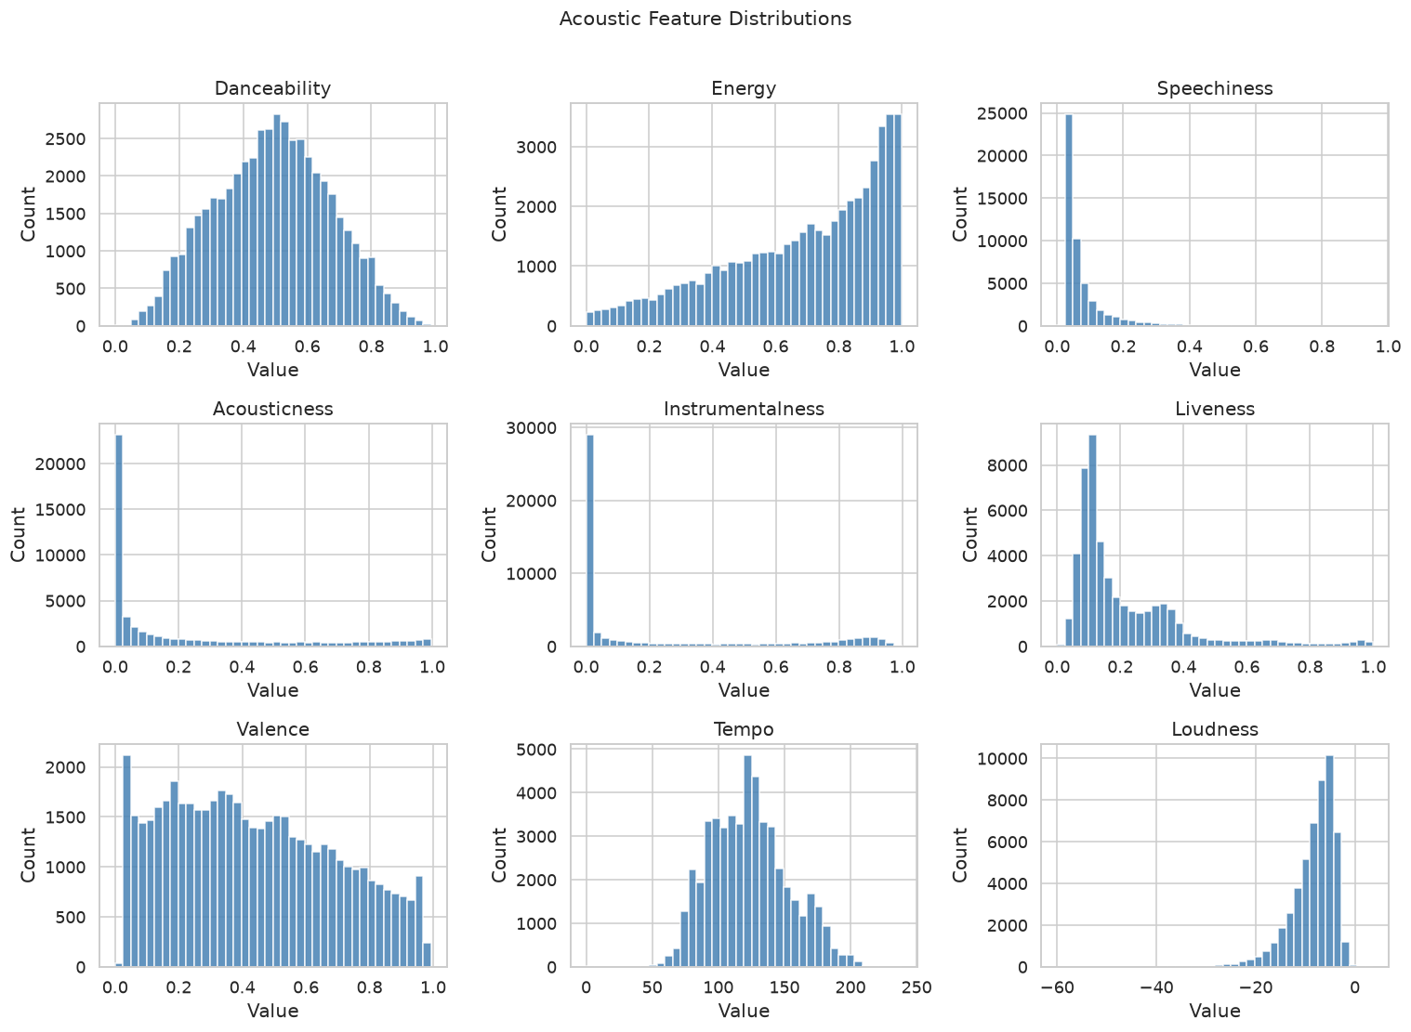
Methodology · §4.1
The acoustic features are skewed and correlated
These correlations matter for the SHAP–LIME comparison in Section 4.3.
Distribution shape
● Heavy skew. Speechiness, acousticness and instrumentalness pile up near zero with long right tails; energy and loudness skew high.
● Near symmetric. Danceability, valence and tempo are roughly unimodal.
Pairwise correlations |r| ≥ 0.4
Feature pair | r
Energy – Loudness | +0.78
Energy – Acousticness | −0.73
Acousticness – Loudness | −0.61
Danceability – Valence | +0.54
Both SHAP and LIME can split credit between correlated features, which is one plausible cause of the disagreement reported later.
Figure 2 · Distributions of the nine acoustic features (matched catalogue).
Chike Egonu · Explainable Music Recommender Systems · MSc Viva
07
Notes:
"Nine acoustic features, and the shapes matter.
Three of them are effectively zero-inflated with long right tails: speechiness,
acousticness and instrumentalness. Energy and loudness skew high; only
danceability, valence and tempo are near symmetric.
The correlation table is the important part. Energy and loudness correlate at
0.78; energy and acousticness at minus 0.73.
Both SHAP and LIME distribute credit among features, and when features are
strongly correlated that credit can be split or swapped between them. So when I
show you a near-zero agreement between the two methods, there is a mechanism on
the table. What I cannot yet say is how much of the disagreement is collinearity
and how much is the surrogate."

Slide 8
Methodology · §3.2
Hybrid architecture — late fusion
Separability is the design choice that makes feature-level attribution possible.
GMF
Playlist ID
element-wise product
Shared embeddings
d = 32
Track ID
MLP
Linear layer
6 → 32 → 16 · ReLU · drop 0.3
Concat
score ŷ ∈ (0,1)
9 acoustic features
Content MLP
z-scored
9 → 32 → 16
GMF captures linear interaction, the MLP captures non-linear interaction, and the content branch sees the track's acoustic properties. Their outputs are concatenated and scored, so the content contribution stays separable from the collaborative one.
≈ 7.49M parameters
Adam · lr 1e-3 · wd 1e-5
BCE · 4 negatives per positive
5 epochs · PyTorch
Chike Egonu · Explainable Music Recommender Systems · MSc Viva
08
Notes:
"This is the model, and one design decision drives the rest.
Two collaborative views of the user-item pair: GMF, which is the linear
interaction, and an MLP over the concatenated embeddings, which captures
non-linear interaction. They share a 32-dimensional embedding space, which is the
NCF design from He and colleagues.
The third branch only sees the nine acoustic features, through a two-layer
network.
The key word is late: I fused at the output rather than fusing representations
early. Early fusion would probably be slightly stronger and would destroy the
separable content contribution that makes feature-level explanation possible.
That is exactly the design choice Objective 3 tests the cost of."

Slide 9
Methodology · §3.2
Five models, one protocol
Non-personalised, content-only, classical collaborative and neural families.
Model | Family | Role in the study
Popularity | Non-personalised | Lower-bound reference
Content-based (cosine) | Content only | The acoustic signal in isolation
SVD-MF | Classical collaborative | Classical reference outside the neural family
NCF | Neural collaborative | Ablation reference: the hybrid minus content
Hybrid NCF + Content | Neural hybrid | Proposed model
Training
Evaluation cohort
● Loss binary cross-entropy over implicit-feedback pairs.
● Negatives 4 uniform negatives per positive (false-negative rate ≈ 0.07%).
● Optimiser Adam, lr 1e-3, weight decay 1e-5, 5 epochs.
Scores are materialised for 1,000 users sampled from the 87,663 test users with at least one held-out interaction, against all 20,042 items. Precision, recall, NDCG and MRR at K ∈ {5, 10, 20}. The same cohort is used by all five models.
Chike Egonu · Explainable Music Recommender Systems · MSc Viva
09
Notes:
"Five models, one protocol.
Popularity is the floor. Content-based cosine is the acoustic signal with no
collaborative information. SVD-MF is the classical reference, added after the
proposal as a non-neural comparison.
Then NCF and the hybrid. That pairing is the ablation for Objective 1: the hybrid
is NCF plus the content branch, so the difference between those two rows is the
content contribution.
Training: binary cross-entropy, four uniform negatives per positive, Adam, five
epochs.
A fixed cohort of a thousand users, because a dense score matrix is 1.94 billion
cells, and ranking metrics only need per-user ordering.
The five epochs is the caveat, and I will come back to it in the results."

Slide 10
Methodology · §3.3
How SHAP and LIME are applied
A deviation from the approved plan, and what it costs the explanation results.
Hybrid model
DeepExplainer
GBR surrogate
SHAP + LIME
the model being explained
intractable at this scale
9 features · 3,000 instances
TreeExplainer · tabular
held-out R² = 0.105
Explanation formats
Why R² = 0.105 matters
Feature-ranked text
built
The surrogate reproduces about 10% of the variance in the hybrid model's score. So the explanations describe the acoustic part of the model's decision, not the whole model. That is the main limitation of the results in the next section, and it is also one of the candidate causes of the SHAP–LIME disagreement.
Generated from each instance's top SHAP values.
Visual attribution
built
Top-5 SHAP bar charts and the global summary.
Knowledge-graph paths
not attempted
Artist / genre / label pathways.
Both built formats are grounded in musical features — instrumentalness, energy, danceability — rather than in embedding dimensions.
Chike Egonu · Explainable Music Recommender Systems · MSc Viva
10
Notes:
"Here is the pathway; the second box is what did not work.
The plan was SHAP's DeepExplainer on the hybrid network; at 20,042 items that was
not tractable with the compute I had.
So I trained a gradient-boosting surrogate to reproduce the hybrid model's score
from the nine acoustic features, on 3,000 sampled test instances, and applied
SHAP's TreeExplainer and LIME's tabular explainer to that surrogate instead.
Held-out R-squared is 0.105.
It is also a result: acoustic content explains about a tenth of the variance, and
the rest is collaborative signal a content-only surrogate cannot see.
So the explanations I show next describe the acoustic part of the model's
decision. Of the three formats in the proposal, two are built; the
knowledge-graph path is not attempted."

Slide 11
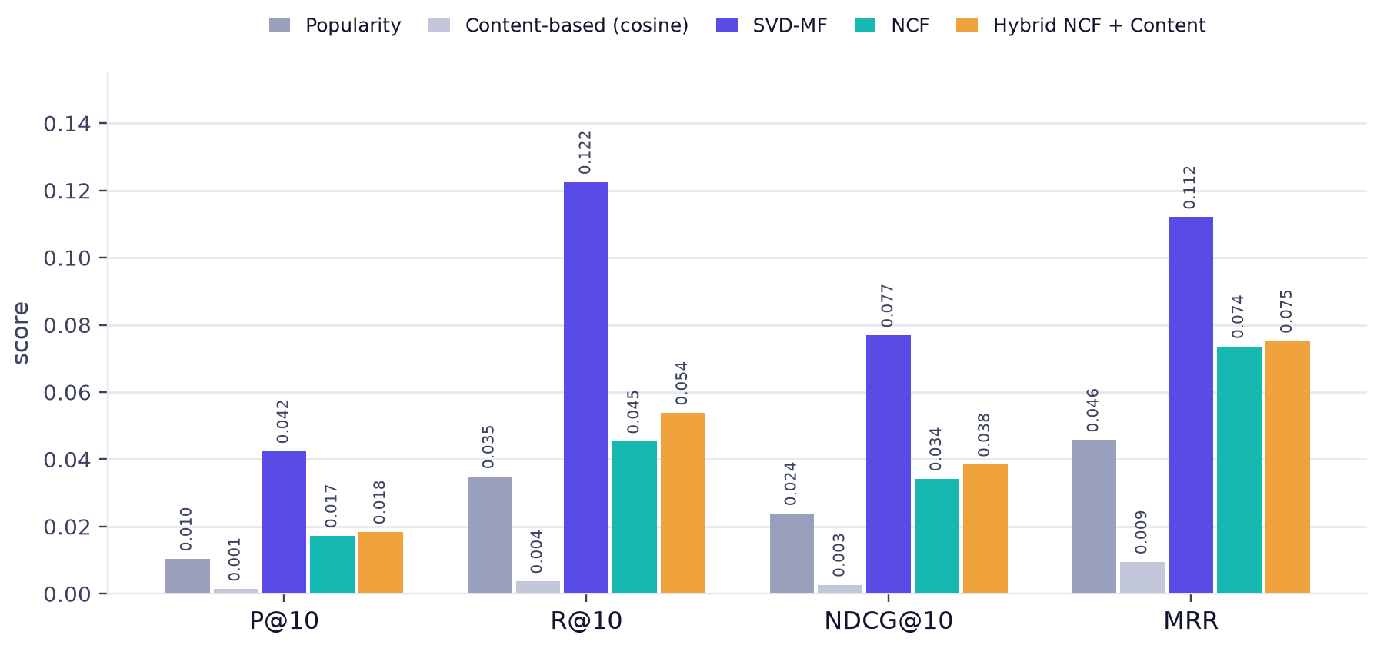
Results · §4.2
Offline accuracy at K = 10
Five models, one fixed cohort of 1,000 users, identical protocol.
Hybrid vs NCF
Metric | NCF | Hybrid | Δ
P@10 | 0.0173 | 0.0184 | +6.4%
R@10 | 0.0453 | 0.0538 | +18.8%
NDCG@10 | 0.0342 | 0.0384 | +12.3%
MRR | 0.0736 | 0.0752 | +2.2%
SVD-MF leads every metric
NDCG@10 0.0769 — about twice the hybrid model.
Two baselines are near the floor
Content-only reaches NDCG@10 of 0.0027.
Re-plotted from Table 2 of the report. Absolute values are small because the matrix is 99.93% sparse; the comparison between models is what matters.
Chike Egonu · Explainable Music Recommender Systems · MSc Viva
11
Notes:
"All five models on one cohort. Reading within each group of bars.
The ranking is the same on all four metrics: SVD-MF first, then the hybrid, then
NCF, then popularity, then content-only. The same order on all four metrics is
not an artefact of one measure.
The right-hand table isolates the comparison the first objective needs: the
hybrid against NCF, where the content branch is the only difference. It is better
on all four metrics, and NDCG at ten improves by 12.3%.
The levels are small because the matrix is 99.93% sparse; precision in the
hundredths is normal offline. The ordering is what the objectives rest on."

Slide 12
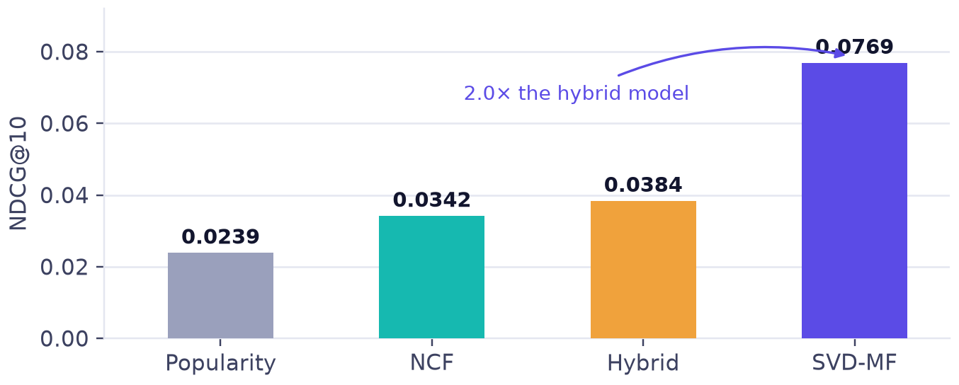
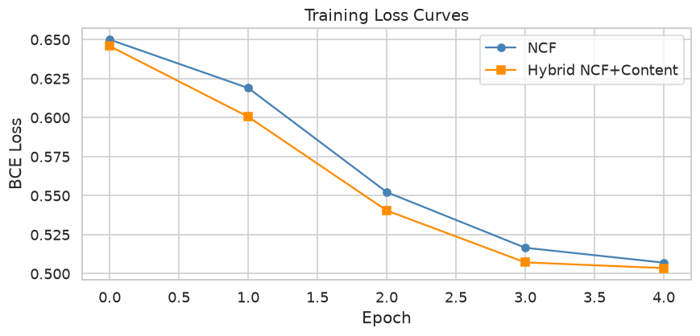
Results · §4.2
SVD-MF was the strongest model
This was not expected: the classical baseline outperforms both neural models.
● The gap is large. NDCG@10 0.0769 against 0.0384 for the hybrid, and the same pattern holds on precision, recall and MRR.
● The likely cause is the schedule. Five epochs for the neural models, against a closed-form solution for SVD-MF.
● The loss curves support that. Neither neural model has plateaued at epoch 5, so the comparison is not between trained equals.
Next run
Derived from Table 2 of the report.
Train the neural models to convergence and re-run all five before drawing conclusions about model choice. If the gap closes, this result is a training artefact; if it does not, it changes what I can claim about the architecture. Either outcome is reportable, but only after the rerun.
Training loss · NCF vs hybrid · five epochs
Chike Egonu · Explainable Music Recommender Systems · MSc Viva
12
Notes:
"Here is the result the proposal did not predict.
SVD matrix factorisation, which the proposal treated as an inferior baseline, is
the strongest model on this cohort: NDCG at ten of 0.0769 against 0.0384.
I want to be careful, because the explanation is probably not that neural
collaborative filtering is worse than matrix factorisation. These two neural
models were trained for five epochs and neither loss curve has plateaued. SVD-MF
is closed-form, so it is converged by construction.
So the comparison is not between trained equals, and I am treating it as
provisional rather than as a finding about architecture. What it does not affect
is the hybrid against NCF, because both were trained identically."

Slide 13
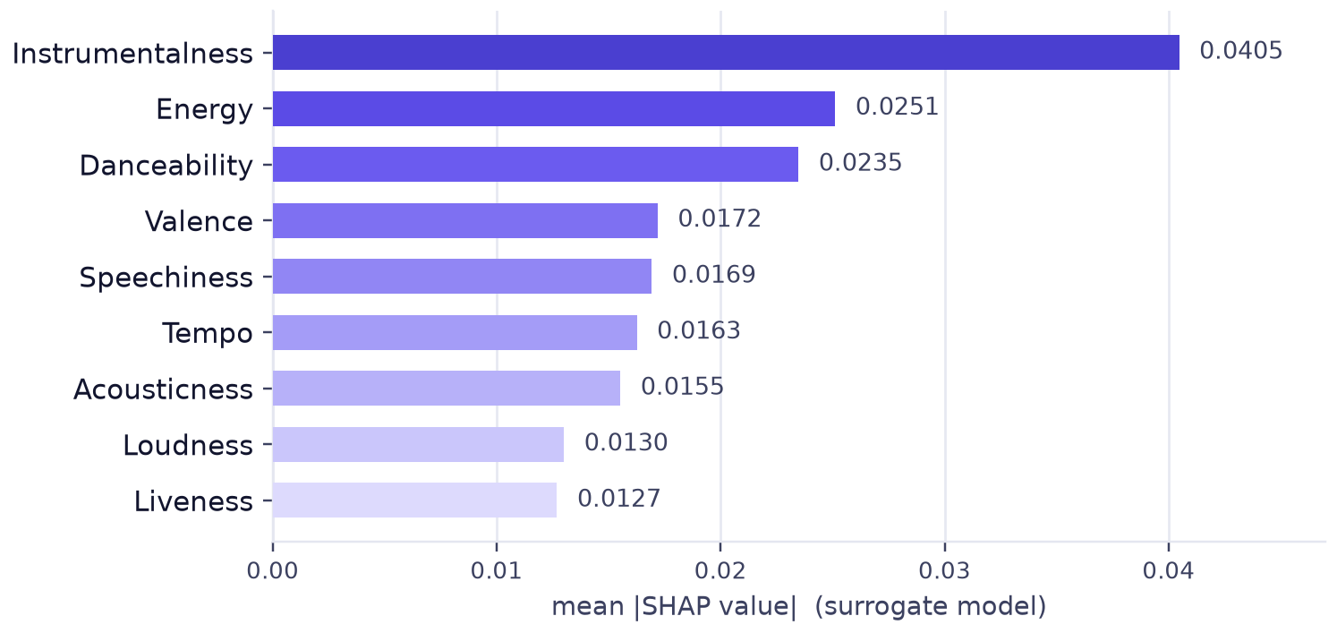
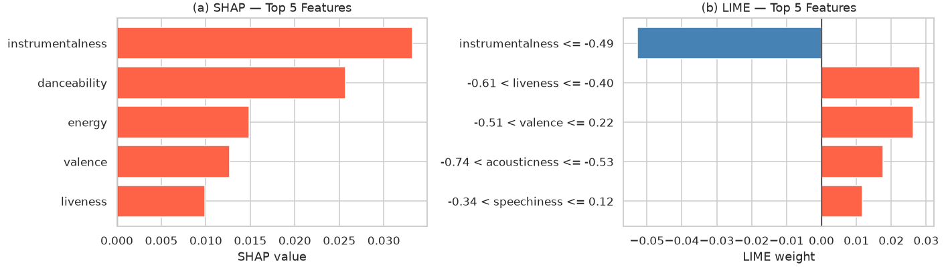
Results · §4.3
What the explanations say
Global importance on the left; one recommendation explained by both methods on the right.
Figure 6 · the same instance attributed by both methods. The top-ranked features do not overlap.
Figure 5 · global importance ranking, surrogate model.
Instrumentalness is the largest driver globally (0.0405), followed by energy and danceability. At instance level, SHAP's top driver is instrumentalness (+0.032); LIME's is a binned rule on instrumentalness with the opposite sign (−0.055), and ranks two and three do not overlap.
The generated text explanation uses the top three SHAP values: “recommended primarily because of its high instrumentalness, alongside danceability (+0.026) and energy (+0.015).”
Chike Egonu · Explainable Music Recommender Systems · MSc Viva
13
Notes:
"Two views of the attribution.
On the left, global importance: mean absolute SHAP value per feature. Instrumentalness
dominates at 0.0405, roughly 60% above energy, then danceability and valence.
Loudness is eighth, which is worth noting given it correlates with energy at 0.78.
On the right is a single recommendation attributed by both methods. SHAP's ranking
is instrumentalness, danceability, energy, valence, liveness, all positive. LIME's
top item is a binned rule on instrumentalness with a negative weight, then
liveness and valence. Ranks two and three do not overlap.
The text at the bottom is the generated explanation, produced from the top three
SHAP values, so any recommendation can be explained this way."

Slide 14
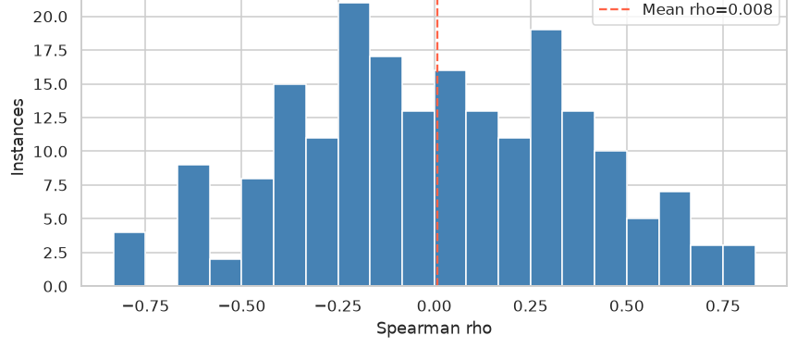
Results · §4.3
SHAP and LIME do not agree
Measured across 200 test instances. This is the most consequential result so far.
ρ = 0.008
mean Spearman correlation across 200 instances · SD = 0.359
Three candidate causes
1
Surrogate fidelity
R² = 0.105 — both explainers are attributing a model that barely resembles the recommender's decision function.
2
Collinearity
energy–loudness at +0.78, energy–acousticness at −0.73; credit can be split or swapped between near-duplicate features.
Figure 7 · per-instance Spearman ρ between the SHAP and LIME orderings.
3
Linear misfit
LIME's local linear approximation may not fit a non-linear, interaction-heavy gradient-boosting surface.
A mean of 0.008 with a standard deviation of 0.359 means there is no consistent agreement, rather than agreement plus noise. On this model the two methods are not interchangeable.
Chike Egonu · Explainable Music Recommender Systems · MSc Viva
14
Notes:
"This is the result that surprised me most.
I measured rank agreement between SHAP and LIME across 200 instances — Spearman
correlation between their importance orderings, per instance.
Mean rho is 0.008. The standard deviation is 0.359, so some instances agree
strongly in either direction, but there is no systematic agreement.
If this were noise around a positive value the mean would sit above zero; it does
not, so this is absence of agreement rather than measurement error.
Three candidate causes, which I cannot separate yet. One, the surrogate's
fidelity: both explainers are working on a model that only loosely resembles the
real one. Two, collinearity — the correlations I showed earlier. Three, LIME's
linear approximation against a non-linear, interaction-heavy surface.
Separating them is the methodological question for the next iteration."

Slide 15
Discussion · §5
Threats to validity
Four kinds of threat, and what each one requires.
Internal validity
Construct validity
Training budget
The surrogate is not the model
Five epochs, manual hyperparameters, no Optuna search. Every neural result is provisional until the models converge.
SHAP and LIME attribute a GBR surrogate with R² = 0.105, so the explanations describe the acoustic view of the score.
Next: extend the schedule, then run the scoped 50-trial search.
Next: a higher-fidelity surrogate, plus direct explainers where feasible.
External validity
Conclusion validity
One catalogue, one sample
One split, no users
150 of 1,000 MPD slices; 55.9% of tracks missing genre; a substituted feature catalogue rather than the live API.
A single random split and a single run per model. No user study has run, so no claim about satisfaction is supported.
Next: full-MPD replication as robustness work.
Next: multiple seeds and splits, then the user study.
What is already controlled: identical cohorts and protocols across models, declared deviations, and every metric reported under the same conditions.
Chike Egonu · Explainable Music Recommender Systems · MSc Viva
15
Notes:
"Four kinds of threat.
Internal: five epochs and manual hyperparameters, so every neural result is
provisional.
Construct, and this is the sharpest one: the surrogate is not the model. Both
explainers attribute an approximation that explains about a tenth of the
variance, so my explanation results are about the acoustic view of the score.
External: one catalogue, 150 of a thousand slices, and a substituted feature
source.
Conclusion: one split, one run, and no users yet, so nothing in this deck
supports a claim about user satisfaction.
Cohorts and protocols are identical across models, and every deviation is
declared."

Slide 16
Outcomes · §6
Anticipated outcomes and their status
Each outcome from the proposal, annotated with what the evidence shows.
Anticipated outcome | What the evidence says | Status
Hybrid outperforms NCF on recall and NDCG | Holds on every metric — NDCG@10 0.0384 vs 0.0342 | Confirmed
A 1–3 pp accuracy cost for explainability | Not observed: the hybrid was marginally better | Not observed
Explanations raise transparency and trust | Not tested — user study not yet run | Pending
SHAP and LIME behave consistently | ρ = 0.008 across 200 instances | New finding
The fourth outcome did not exist when the proposal was written. If it holds up, it argues against treating SHAP and LIME as interchangeable explainers for hybrid music recommenders, and it changes what the user study should measure: either explanation method becomes a design variable, or the study commits to SHAP alone with a higher-fidelity surrogate.
Chike Egonu · Explainable Music Recommender Systems · MSc Viva
16
Notes:
"Four outcomes, each with what the evidence shows.
One confirmed: the hybrid gain.
One not observed: the predicted accuracy cost did not appear.
One pending, and it combines the two user-study expectations from the proposal,
because neither can be tested until the study runs. I am not going to claim
satisfaction effects from offline metrics.
And the fourth is new. If the SHAP-LIME disagreement holds up, it argues against
treating these two methods as interchangeable, and it changes the user study
design."

Slide 17
Next steps · §8
Plan to submission
Ordered by dependency: the user study cannot run until the explanation method is fixed.
1
Train to convergence
Why the user study is last
Extend the schedule until validation NDCG plateaus, then re-run all five models.
A study that measured trust in an artefact of surrogate fidelity would produce a result about the surrogate rather than about explanation, and it would be expensive to repeat.
2
Resolve the SHAP–LIME gap
Raise surrogate fidelity; test TreeSHAP with collinearity handling; report both methods side by side.
3
Complete the explanation metrics
Add fidelity and coverage; run the scoped Optuna search.
User study — what it will measure
● Conditions no explanation · feature-ranked text · visual attribution.
● Measures perceived transparency, trust, satisfaction and intention to act.
● Design within-subject where possible, to control for music expertise.
● Instrument adapted from the dimensions in Tintarev and Masthoff (2015).
4
Knowledge-graph explanations
Artist, genre and label pathways — optional, gated on genre coverage.
5
User study
Explanation conditions against a no-explanation control; perceived transparency, trust and satisfaction.
Chike Egonu · Explainable Music Recommender Systems · MSc Viva
17
Notes:
"Five items, ordered by dependency.
One and two are the foundation: train to convergence, and resolve the SHAP-LIME
gap. Until those are done, the model numbers and the explanation results stay
provisional.
Three completes the fidelity and coverage metrics and runs the Optuna search.
Four is optional: the knowledge-graph path, which depends on genre coverage.
Five is the user study, and the box explains why it is last. If I ran it now I
would be measuring trust in a surrogate artefact rather than trust in an
explanation, and that is an expensive mistake to find later."

Slide 18
Summary
Three results and what is still open
01
The hybrid outperforms NCF on every metric.
NDCG@10 0.0384 against 0.0342, a 12.3% relative improvement. The content branch is the only difference between the two models, so the gain is attributable.
02
The model comparison is not settled.
SVD-MF leads on this cohort, and the likely cause is the five-epoch schedule — neither loss curve has plateaued. Re-running is the next step.
03
SHAP and LIME do not agree on this model.
Mean ρ = 0.008 across 200 instances, with three candidate causes. This is the result that most affects what the dissertation can claim.
Finished: the pipeline, the baselines and the explanation layer. Provisional: the model ranking and the attribution results. Next: train to convergence, resolve the attribution disagreement, then test the explanations with users.
Notes:
"Three points.
One, the hybrid beats NCF on every metric, and because the content branch is the
only difference, the gain is attributable.
Two, the model comparison is not settled. SVD-MF leads here, and the likely cause
is the training schedule rather than the architecture. That is the next thing I
run.
Three, SHAP and LIME do not agree on this model, and I have three candidate
causes but cannot yet separate them. That is the result that most affects what
the dissertation can claim.
So: finished, provisional, next."

Slide 19
End of presentation
Thank you — questions welcome
I would particularly welcome questions on the surrogate in Section 4.3, and on whether the SVD-MF result is a training artefact or an architectural finding.
0.0384
+12.3%
0.008
5
hybrid NDCG@10
over NCF
SHAP–LIME ρ
models benchmarked
Chike Egonu · MSc Dissertation · August 2026
Backup slides follow: references, four likely questions and the full results table.
Supervisor: Aoife Curran
Notes:
Thank you, then stop talking. Do not fill the silence.
"I would particularly welcome questions on the surrogate in Section 4.3, because
I know it is the weakest link in the explanation results, and on whether the
SVD-MF result is a training artefact or an architectural finding.
The backup slides cover references, four questions I expect, and the full
results table."

Slide 20
References
References
Twenty-four sources, Harvard style, as in the report.
Afchar, D., Melchiorre, A.B., Schedl, M., Hennequin, R., Epure, E.V. and Moussallam, M. (2022) ‘Explainability in music recommender systems’, AI Magazine, 43(2), pp. 190–208.
Alvarez-Melis, D. and Jaakkola, T.S. (2018) ‘On the robustness of interpretability methods’, ICML Workshop on Human Interpretability in Machine Learning.
Arrieta, A.B. et al. (2020) ‘Explainable Artificial Intelligence (XAI): concepts, taxonomies, opportunities and challenges toward responsible AI’, Information Fusion, 58, pp. 82–115.
Celma, O. (2010) Music Recommendation and Discovery: The Long Tail, Long Fail, and Long Play in the Digital Music Space. Berlin: Springer.
Chen, C.-W., Lamere, P., Schedl, M. and Zamani, H. (2018) ‘RecSys Challenge 2018: automatic music playlist continuation’, Proceedings of the 12th ACM Conference on Recommender Systems, pp. 527–528.
Ferwerda, B., Schedl, M. and Tkalcic, M. (2015) ‘Personality and emotional states: understanding users’ music listening needs’, UMAP 2015 Extended Proceedings.
He, X., Liao, L., Zhang, H., Nie, L., Hu, X. and Chua, T.-S. (2017) ‘Neural collaborative filtering’, Proceedings of the 26th International Conference on World Wide Web, pp. 173–182.
Jain, S. and Wallace, B.C. (2019) ‘Attention is not explanation’, Proceedings of NAACL-HLT 2019, Volume 1, pp. 3543–3556.
Knijnenburg, B.P., Willemsen, M.C., Gantner, Z., Soncu, H. and Newell, C. (2012) ‘Explaining the user experience of recommender systems’, User Modeling and User-Adapted Interaction, 22(4–5), pp. 441–504.
Koren, Y., Bell, R. and Volinsky, C. (2009) ‘Matrix factorization techniques for recommender systems’, Computer, 42(8), pp. 30–37.
Lipton, Z.C. (2018) ‘The mythos of model interpretability’, Communications of the ACM, 61(10), pp. 36–43.
Lundberg, S.M. and Lee, S.-I. (2017) ‘A unified approach to interpreting model predictions’, Advances in Neural Information Processing Systems, 30, pp. 4765–4774.
Melchiorre, A.B., Rekabsaz, N., Ganhör, C. and Schedl, M. (2022) ‘ProtoMF: prototype-based matrix factorization for effective and explainable recommendations’, Proceedings of the 16th ACM Conference on Recommender Systems, pp. 246–256.
Oramas, S., Ostuni, V.C., Di Noia, T., Serra, X. and Di Sciascio, E. (2017) ‘Sound and music recommendation with knowledge graphs’, ACM Transactions on Intelligent Systems and Technology, 8(2), pp. 21.1–21.21.
Ribeiro, M.T., Singh, S. and Guestrin, C. (2016) ‘“Why should I trust you?”: explaining the predictions of any classifier’, Proceedings of the 22nd ACM SIGKDD, pp. 1135–1144.
Schedl, M., Zamani, H., Chen, C.-W., Deldjoo, Y. and Elahi, M. (2018) ‘Current challenges and visions in music recommender systems research’, International Journal of Multimedia Information Retrieval, 7(2), pp. 95–116.
Shashaani, S. (2024) ‘Explainability in music recommender system’, Proceedings of the 18th ACM Conference on Recommender Systems, pp. 1395–1401.
Tintarev, N. and Masthoff, J. (2007) ‘A survey of explanations in recommender systems’, Proceedings of the 2007 IEEE 23rd International Conference on Data Engineering Workshop, pp. 801–810.
Tintarev, N. and Masthoff, J. (2015) ‘Explaining recommendations: design and evaluation’, in Ricci, F., Rokach, L. and Shapira, B. (eds) Recommender Systems Handbook. 2nd edn. Boston, MA: Springer US, pp. 353–382.
van den Oord, A., Dieleman, S. and Schrauwen, B. (2013) ‘Deep content-based music recommendation’, Advances in Neural Information Processing Systems, 26, pp. 2643–2651.
Wang, H., Zhao, M., Xie, X., Li, W. and Guo, M. (2019) ‘Knowledge graph convolutional networks for recommender systems’, Proceedings of the 2019 World Wide Web Conference, pp. 3307–3313.
Zhang, Y. and Chen, X. (2020) ‘Explainable recommendation: a survey and new perspectives’, Foundations and Trends in Information Retrieval, 14(1), pp. 1–101.
Zhang, Y., Lai, G., Zhang, M., Zhang, Y., Liu, Y. and Ma, S. (2014) ‘Explicit factor models for explainable recommendation based on phrase-level sentiment analysis’, Proceedings of SIGIR 2014, pp. 83–92.
Zhou, F., Ji, Y. and Jiao, R.J. (2013) ‘Affective and cognitive design for mass personalization: status and prospect’, Journal of Intelligent Manufacturing, 24(5), pp. 1047–1069.
Chike Egonu · Explainable Music Recommender Systems · MSc Viva
20
Notes:
Backup slide. Do not present it. If a citation is challenged, give the author and
year, then describe the method rather than the title.

Slide 21
Backup
Four questions I expect
Prepared answers; the full set is in the speaker notes.
Q1
SVD-MF beats both neural models. Why should I trust the hybrid result?
I would not ask you to trust it as a final ranking. Five epochs, and neither loss curve has plateaued, while SVD-MF is closed-form. What Objective 1 needs — hybrid versus NCF — is like-for-like, because the schedule is identical. The absolute ranking is provisional, and the rerun is the first item on the plan.
Q2
Your surrogate has R² = 0.105. Aren't you explaining the wrong model?
Partly, yes, and it is stated rather than hidden. The gap is informative: acoustic content accounts for about a tenth of the variance, so the rest is collaborative signal a content-only surrogate cannot see. So the explanations describe a content view of the model. It is also candidate cause one for the SHAP–LIME disagreement, which is why a higher-fidelity surrogate is the next test.
Q3
Why a random split rather than temporal — doesn't that leak information?
The MPD has no reliable interaction-level timestamps, so a temporal split would be arbitrary rather than principled. The cost is that drift and novelty are not modelled, which I list under external and conclusion validity. It does not affect the relative ranking of models, which is what the claims rest on.
Q4
Is ρ ≈ 0 just noise from 200 instances?
No. Noise around a genuine agreement would centre above zero. What I observe is a mean indistinguishable from zero (0.008) with SD 0.359, which is the absence of systematic agreement rather than agreement plus error. I also report the per-instance distribution so it is visible that this is not driven by a few outliers.
Chike Egonu · Explainable Music Recommender Systems · MSc Viva
21
Notes:
Backup slide, for answers you have rehearsed.
Also be ready for these, which are not on the slide:
"Precision@10 of 0.018 looks unusable." It is not deployable, and I do not claim
it is. At 99.93% sparsity with four sampled negatives per positive, values in the
hundredths are expected in offline evaluation; the study compares models under
one protocol rather than claiming production quality.
"What is new, if SHAP, LIME and NCF all exist?" The combination and the
measurement: joint attribution across a hybrid recommender, the consistency
measurement in music, and a music-specific evaluation design.
"Why only 150,000 playlists?" Compute. The 150-slice graph is already 1.93
million edges; scaling is a rerun of the same pipeline, not a redesign.
"Where is fairness?" Not modelled directly, and I say so. Attribution offers a
diagnostic: if a popularity proxy dominates, the recommendation is
popularity-driven. That is planned analysis, not a delivered result.

Slide 22
Backup
Reported numbers
The accuracy table and the global attribution ranking, for reference.
Offline accuracy at K = 10
Global SHAP importance (mean |SHAP|)
Model | P@10 | R@10 | NDCG@10 | MRR
Popularity | 0.0104 | 0.0349 | 0.0239 | 0.0458
Content-based | 0.0014 | 0.0037 | 0.0027 | 0.0095
SVD-MF | 0.0424 | 0.1225 | 0.0769 | 0.1121
NCF | 0.0173 | 0.0453 | 0.0342 | 0.0736
Hybrid | 0.0184 | 0.0538 | 0.0384 | 0.0752
Feature | Mean |SHAP|
Instrumentalness | 0.04047
Energy | 0.02512
Danceability | 0.02348
Valence | 0.01719
Speechiness | 0.01693
Tempo | 0.01626
Acousticness | 0.01553
Loudness | 0.01301
Liveness | 0.01270
Derived comparisons used in the talk
Hybrid − NCF
NDCG@10 +0.0042 (+12.3% relative)
SVD-MF − Hybrid
NDCG@10 +0.0385 (2.0× the hybrid)
SHAP vs LIME
ρ = 0.008 · SD 0.359 · n = 200
Surrogate fidelity
held-out R² = 0.105 · 3,000 instances
Attributions of the gradient-boosting surrogate, not of the network directly.
Chike Egonu · Explainable Music Recommender Systems · MSc Viva
22
Notes:
Backup slide. Confirm numbers from here rather than from memory.
If the SHAP values are challenged, restate immediately that they are attributions
of the surrogate (R² = 0.105), not of the hybrid network directly.

