Slide 1
Contoso Hotolink
A smart desk management system using MSTeams and SPFx

Slide 2

Team Turbo
Radha Krishna Thatavarthi
Works @ EY
Love developing using SPFx and Power Platform and Azure
LinkedIn

Slide 3
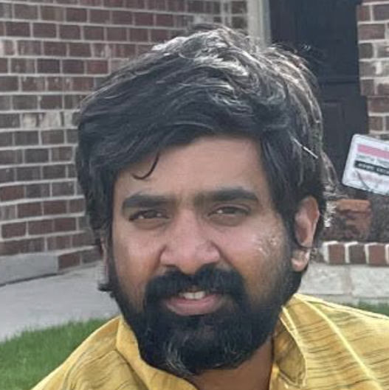
Team Turbo
Vinaydeep Ayinapurapu
Works @ GM Financial
M365 Enthusiast, Azure Dev
LinkedIn, twitter

Slide 4

Use Case
To help user to book the desk space in advance
User should be able to reserve from laptop and mobile
User should be able to view upcoming reservations

Slide 5
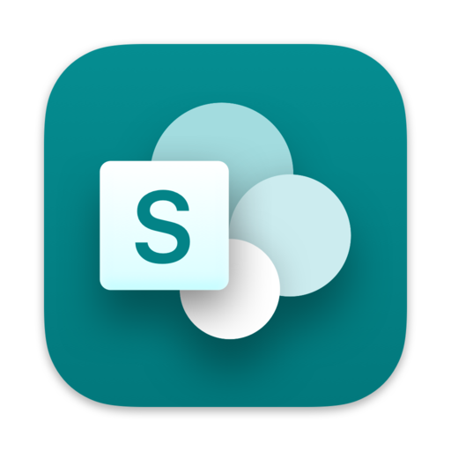
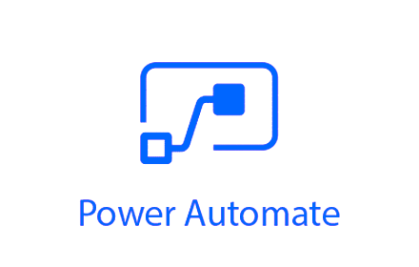






Architecture
Teams App
Screen1
Screen2
Screen3

Slide 6

Demo

Slide 7
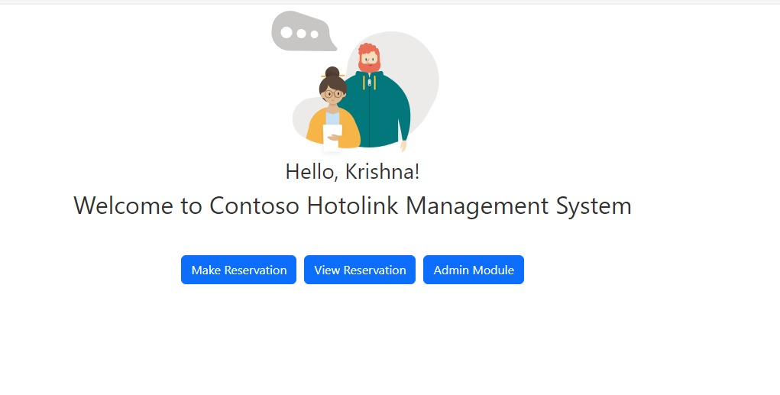
Sample Output

Slide 8
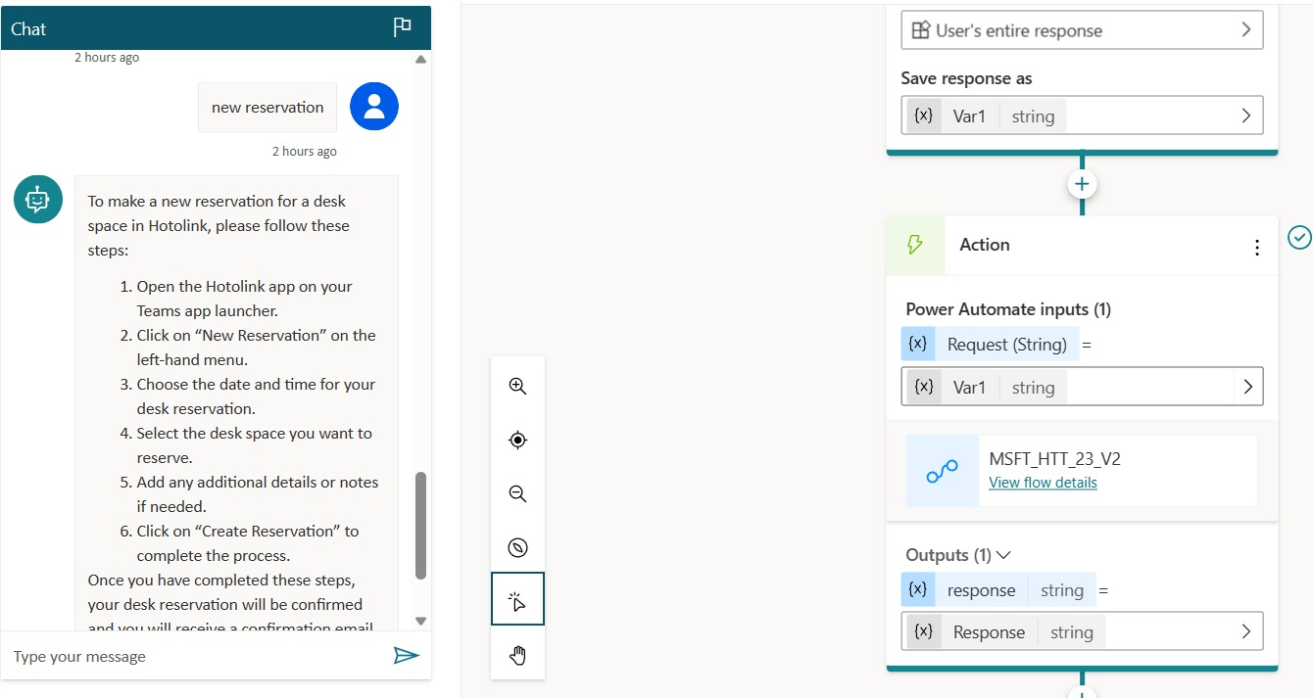
Sample response

Slide 9

Road-Map
Training AI model to do the following by itself
Create Reservation
Cancel Reservation
Edit Existing reservation

Slide 10

References
https://learn.microsoft.com/en-us/azure/cognitive-services/openai/how-to/prepare-dataset
https://devblogs.microsoft.com/microsoft365dev/deploy-your-chatgpt-based-model-securely-using-microsoft-teams-power-virtual-agent-and-azure-openai/

Slide 11

Thank you

