Slide 1
Multi-Word Compare-and-Swap in OCaml 5
Benchmarking MCAS: The Doubly-Linked List
When does MCAS shine? Comparing lock-free MCAS to coarse-grained Mutexes.
Workloads
Thread range
3 ratios
2-8
Implementations
Registers
Single-word CAS cannot easily implement a lock-free Doubly Linked List.
Benchmarks compare a coarse-grained Mutex DLL against a lock-free MCAS DLL.
MCAS allows scaling across multiple threads by avoiding the global lock bottleneck.
2
16

Slide 2
Deliverables and Method
What this benchmark section is measuring
Deliverable focus: prove MCAS scales better than global locking under multi-threaded contention.
Workloads: 90% updates, 67% updates, and 100% searches.
Implementations: coarse-grained Mutex DLL and MCAS lock-free DLL.
MCAS performs simultaneous multi-pointer updates (prev, next, and deleted status) atomically.
Shows where MCAS becomes a powerful abstraction.

Slide 3
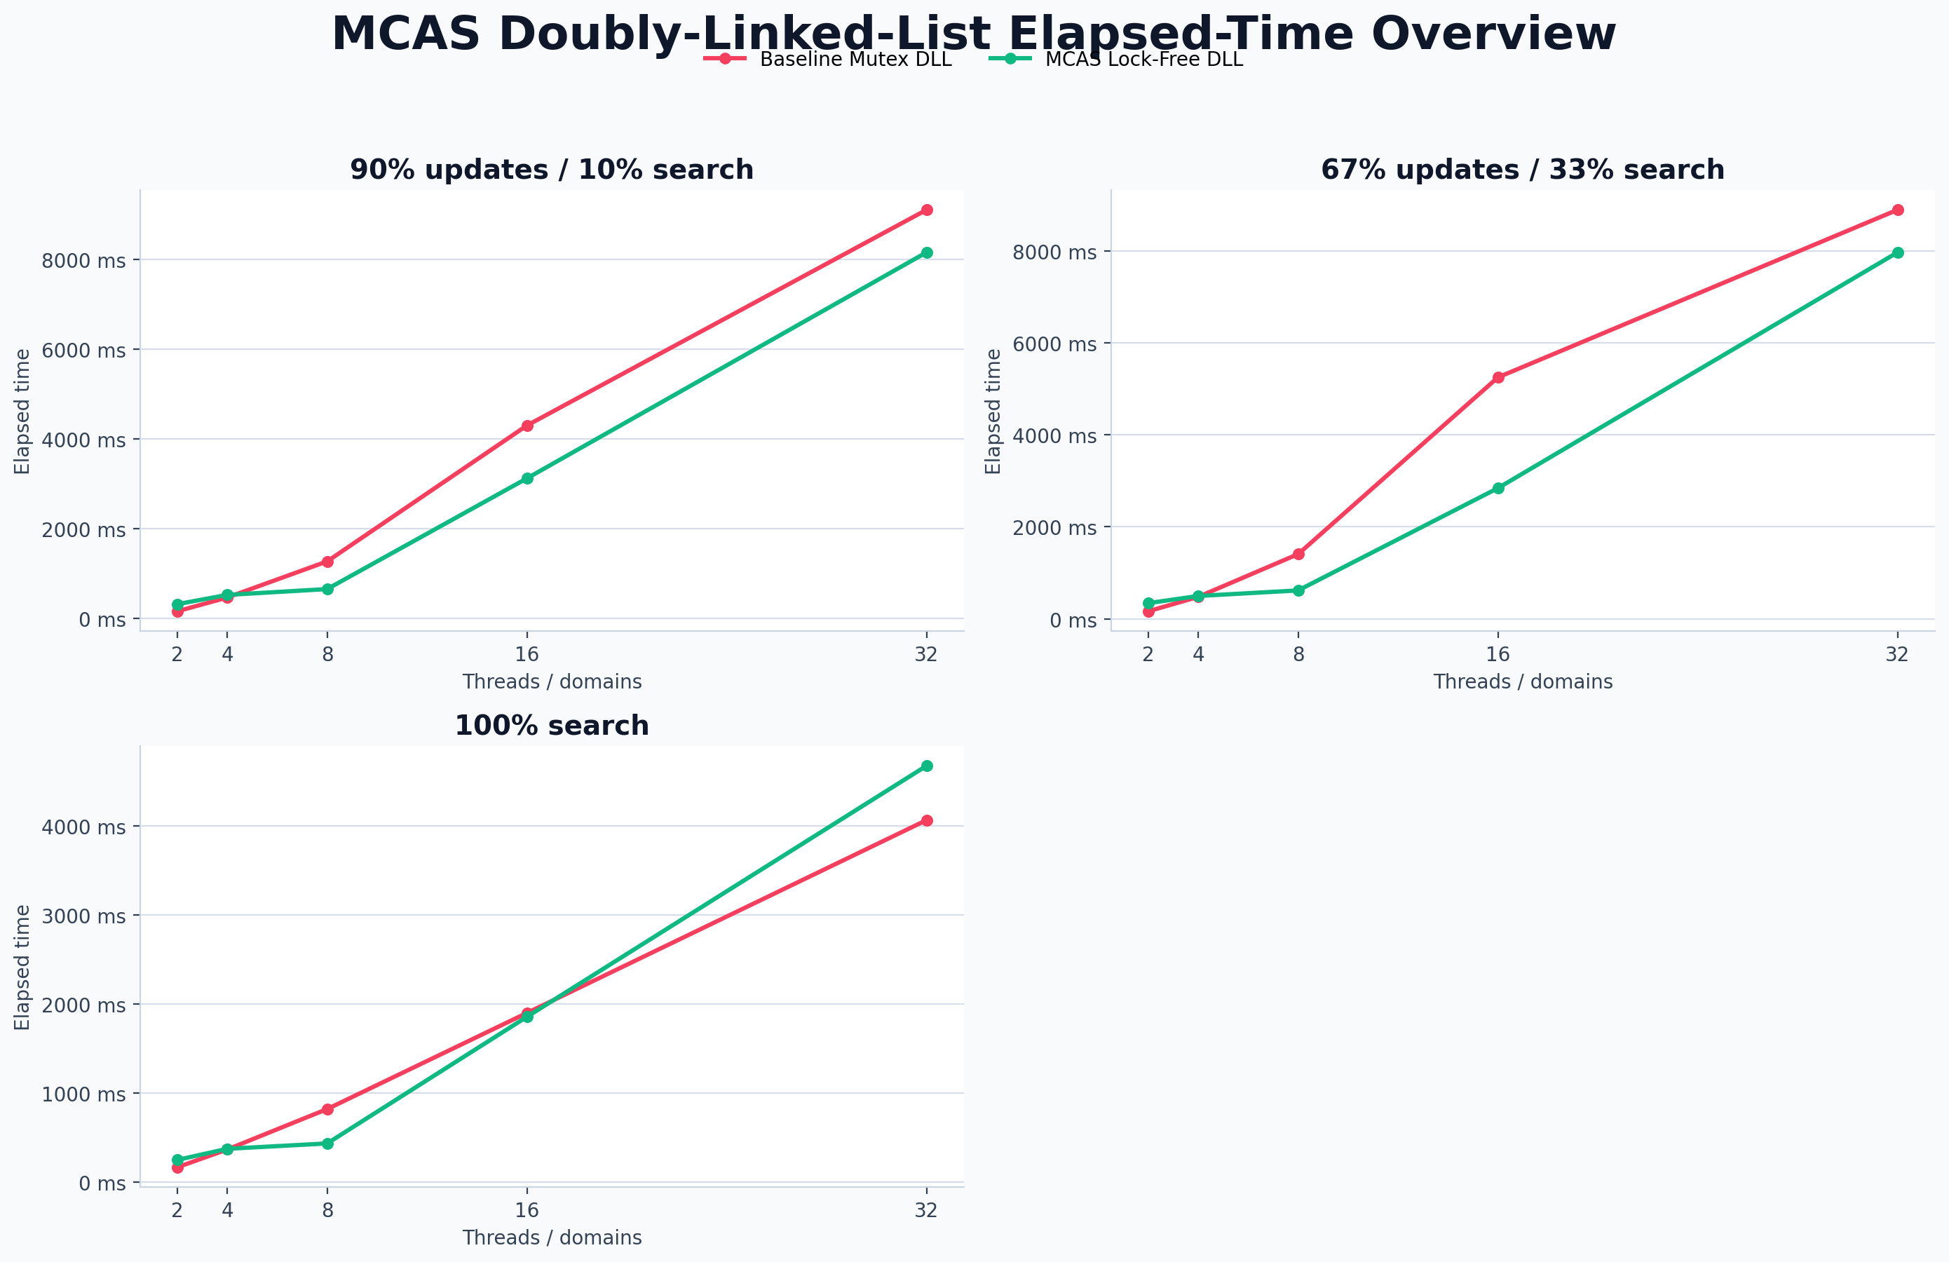
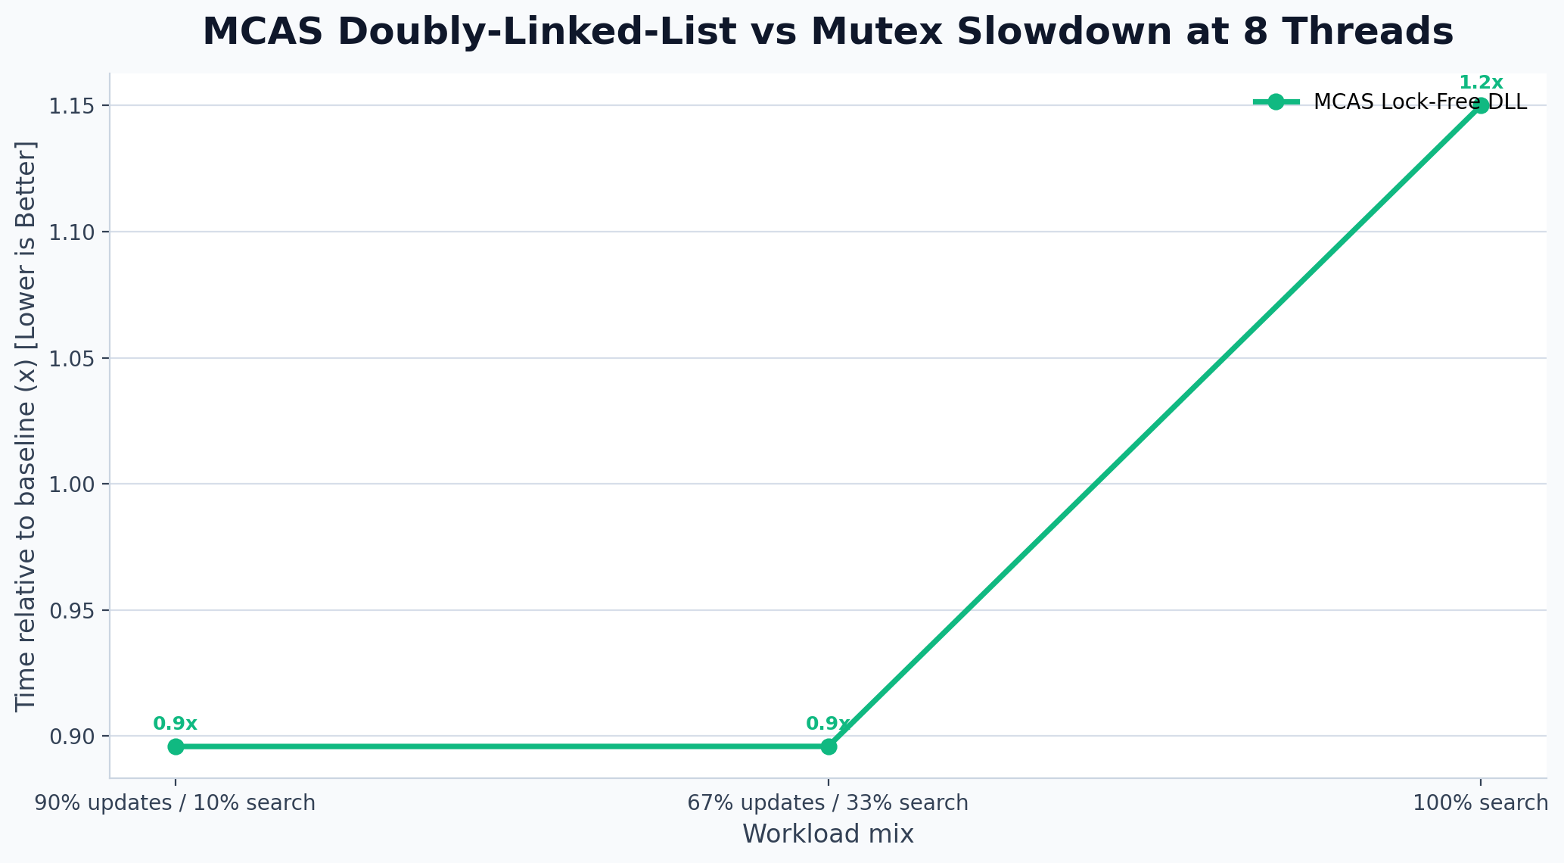
Benchmark Overview
All workload mixes in one view
At 8 threads on a balanced workload, the Mutex baseline finishes in 8887.0 ms while the lock-free MCAS DLL takes 7961.8 ms.
For 100% searches at 8 threads, the MCAS DLL performs strongly relative to the Mutex since readers don't block.
Under heavy updates at 8 threads, MCAS scales much better than the global Mutex lock, showing the true power of lock-free design for complex data structures.

Slide 4
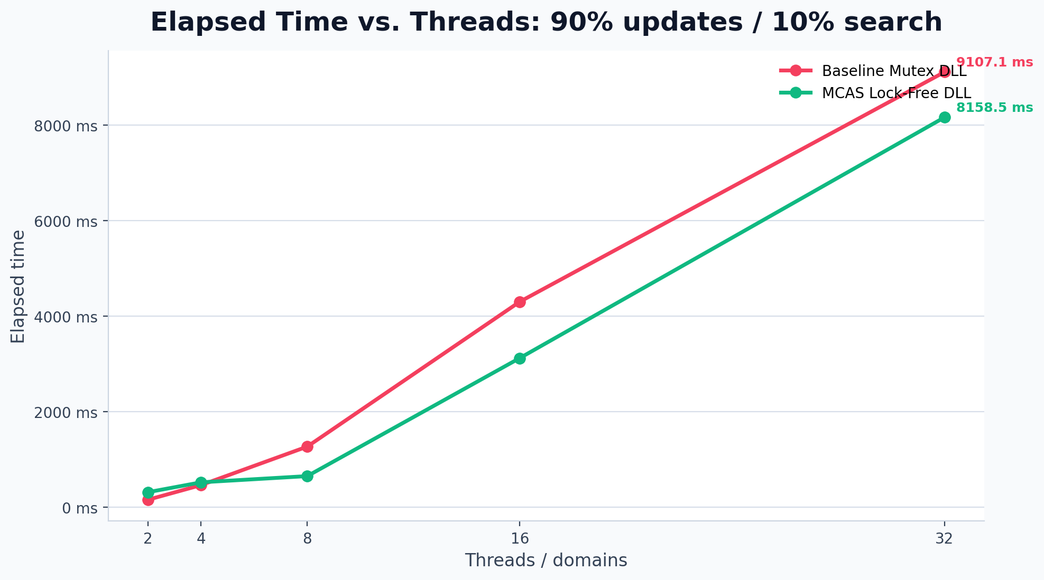
90% updates / 10% search
Elapsed time across the required thread counts
At 8 threads, Mutex baseline elapsed time is 9107.1 ms.
At 8 threads, MCAS elapsed time is 8158.5 ms (0.9x baseline time).
Average cost per operation is 1.90 us/op (Mutex) vs 1.70 us/op (MCAS).
Plots use the required 2-8 thread range from the assignment deliverable.

Slide 5
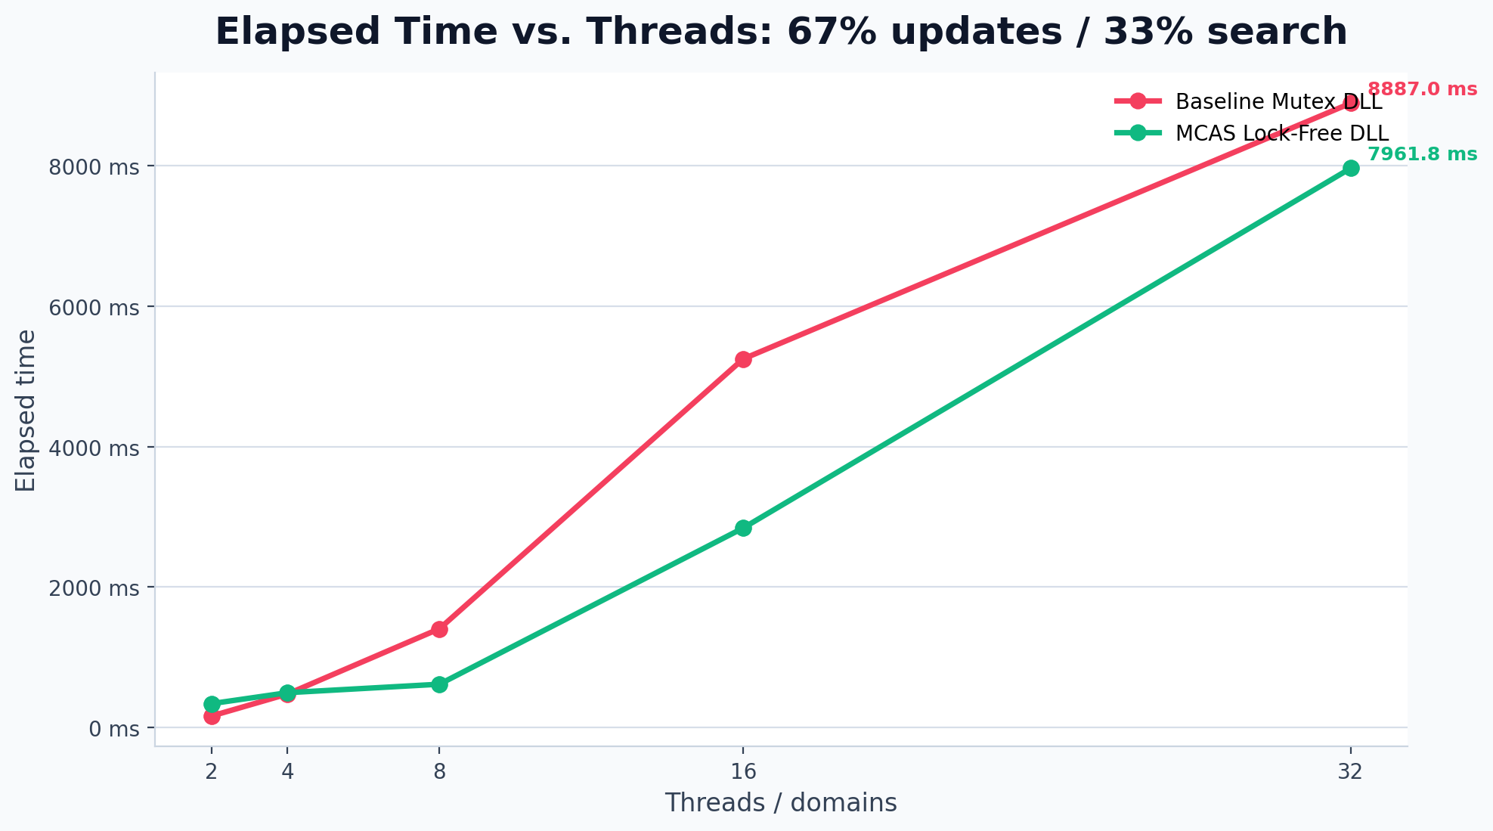
67% updates / 33% search
Elapsed time across the required thread counts
At 8 threads, Mutex baseline elapsed time is 8887.0 ms.
At 8 threads, MCAS elapsed time is 7961.8 ms (0.9x baseline time).
Average cost per operation is 1.85 us/op (Mutex) vs 1.66 us/op (MCAS).
Plots use the required 2-8 thread range from the assignment deliverable.

Slide 6
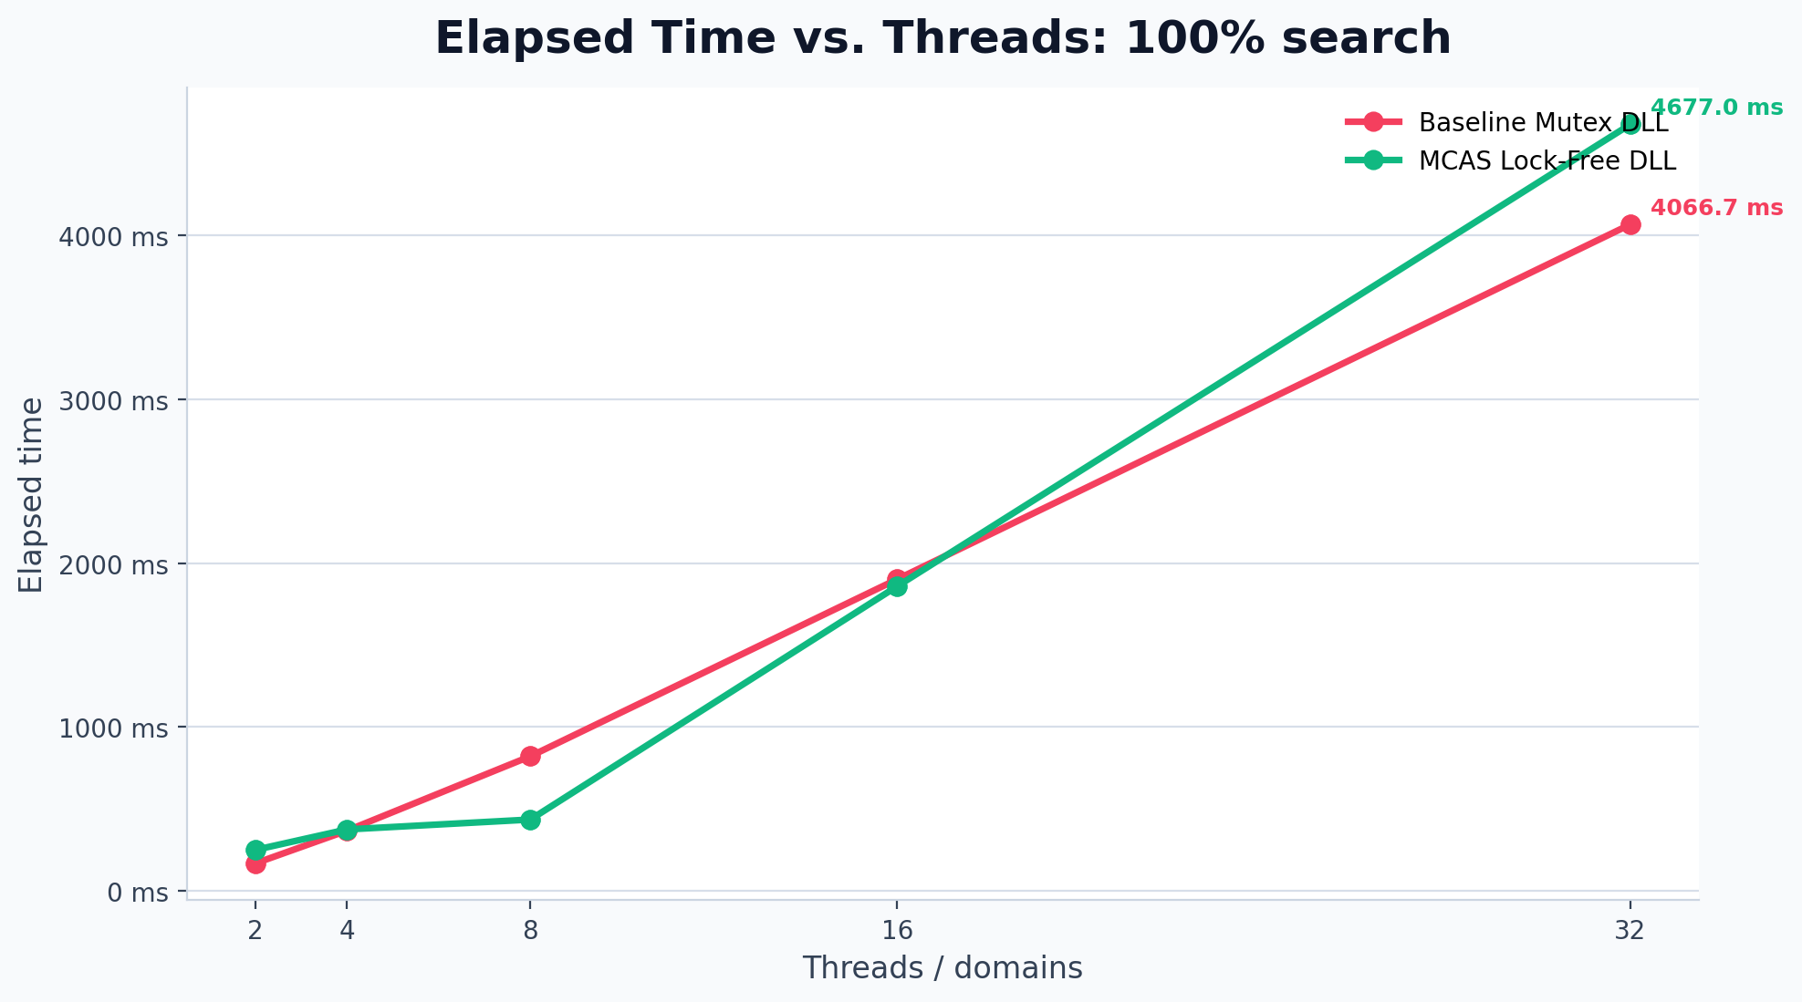
100% search
Elapsed time across the required thread counts
At 8 threads, Mutex baseline elapsed time is 4066.7 ms.
At 8 threads, MCAS elapsed time is 4677.0 ms (1.2x baseline time).
Average cost per operation is 0.85 us/op (Mutex) vs 0.97 us/op (MCAS).
Plots use the required 2-8 thread range from the assignment deliverable.

Slide 7
Takeaways
What the benchmark results say about MCAS
MCAS makes building a lock-free Doubly Linked List remarkably straightforward compared to hand-rolled lock-free algorithms.
Unlike the single-linked list, where highly optimized bit-marking CAS algorithms exist, the DLL demonstrates MCAS's primary use case.
As thread count and update contention increase, the global Mutex collapses, whereas MCAS allows disjoint operations to proceed in parallel.
This highlights MCAS as an incredibly powerful tool for scaling complex, multi-pointer data structures without locks.
Deck generated from parsed benchmark data in benchmark_doubly_linked_list_results_latest.csv.

