Slide 1
Multi-Word Compare-and-Swap in OCaml 5
Benchmarking and lock-free linked list performance presentation deck
How much simplicity does MCAS buy us for linked lists, and what does the software layer cost?
Workloads
Thread range
3 ratios
2-8
Implementations
Registers
Implements descriptor-based MCAS and applies it to a lock-free linked list.
Benchmarks baseline CAS linked list against the MCAS linked list.
Slides focus on elapsed time trends across the benchmark deliverable.
2
16

Slide 2
Deliverables and Method
What this benchmark section is measuring
Deliverable focus: compare linked list elapsed time across varying update/search ratios and 2-8 threads.
Workloads: 90% updates, 67% updates, and 100% searches.
Implementations: baseline CAS linked list and MCAS linked list.
Benchmark harness runs operations uniformly per domain.
Each point reports total elapsed time for the full workload, plus average microseconds per operation.

Slide 3
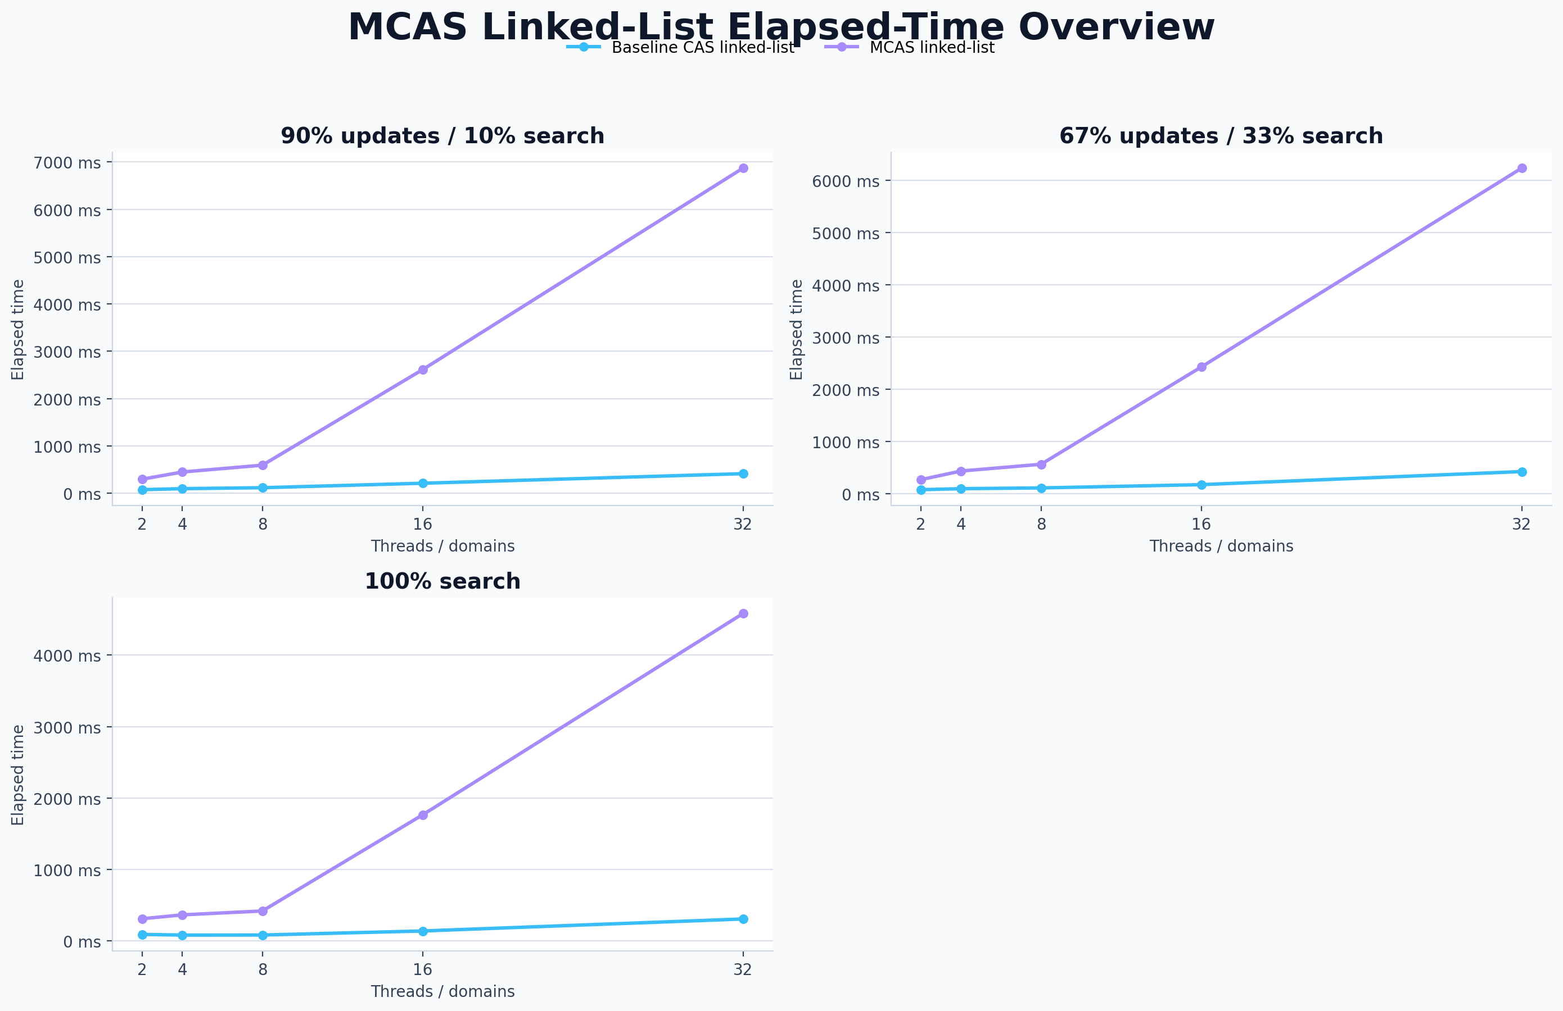
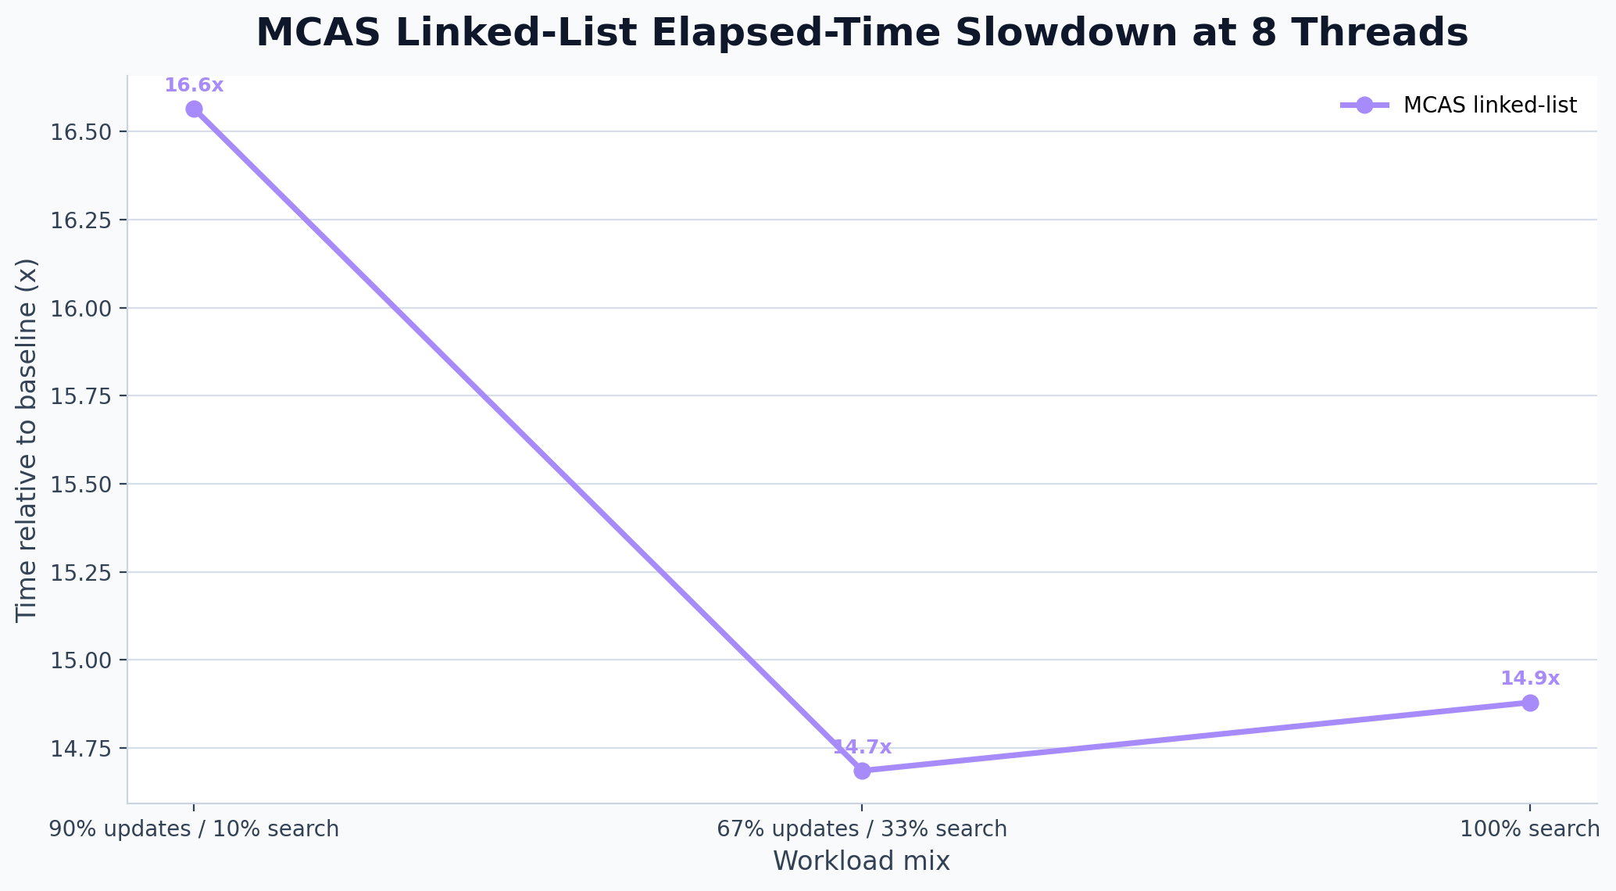
Benchmark Overview
All workload mixes in one view
At 8 threads on a balanced workload, the baseline finishes in 424.5 ms while the MCAS linked list takes 6234.4 ms.
For 100% searches at 8 threads, the MCAS linked list is 14.9x slower than the CAS baseline.
Even on heavy updates at 8 threads, the MCAS layer stretches total runtime from 414.7 ms to 6870.0 ms.

Slide 4
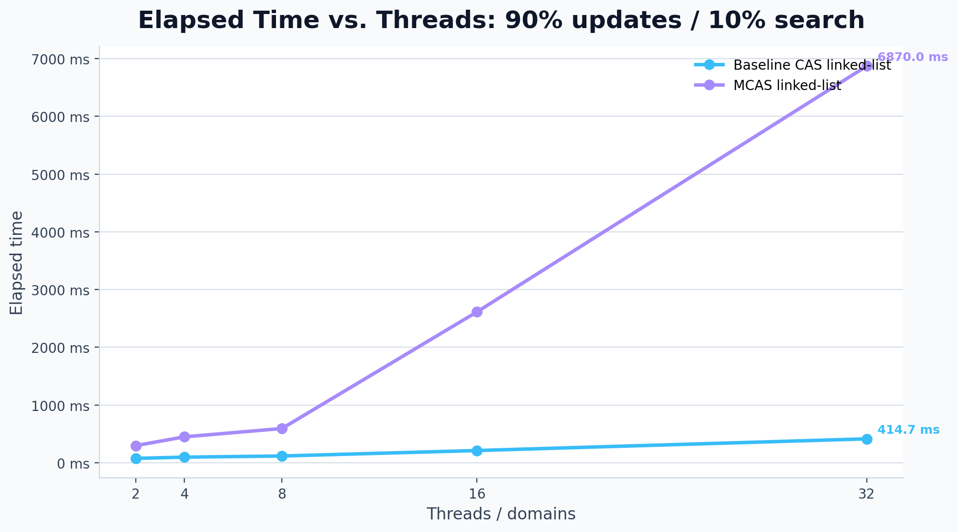
90% updates / 10% search
Elapsed time across the required thread counts
At 8 threads, baseline elapsed time is 414.7 ms.
At 8 threads, MCAS elapsed time is 6870.0 ms (16.6x baseline time).
Average cost per operation grows from 0.09 us/op to 1.43 us/op.
Plots use the required 2-8 thread range from the assignment deliverable.

Slide 5
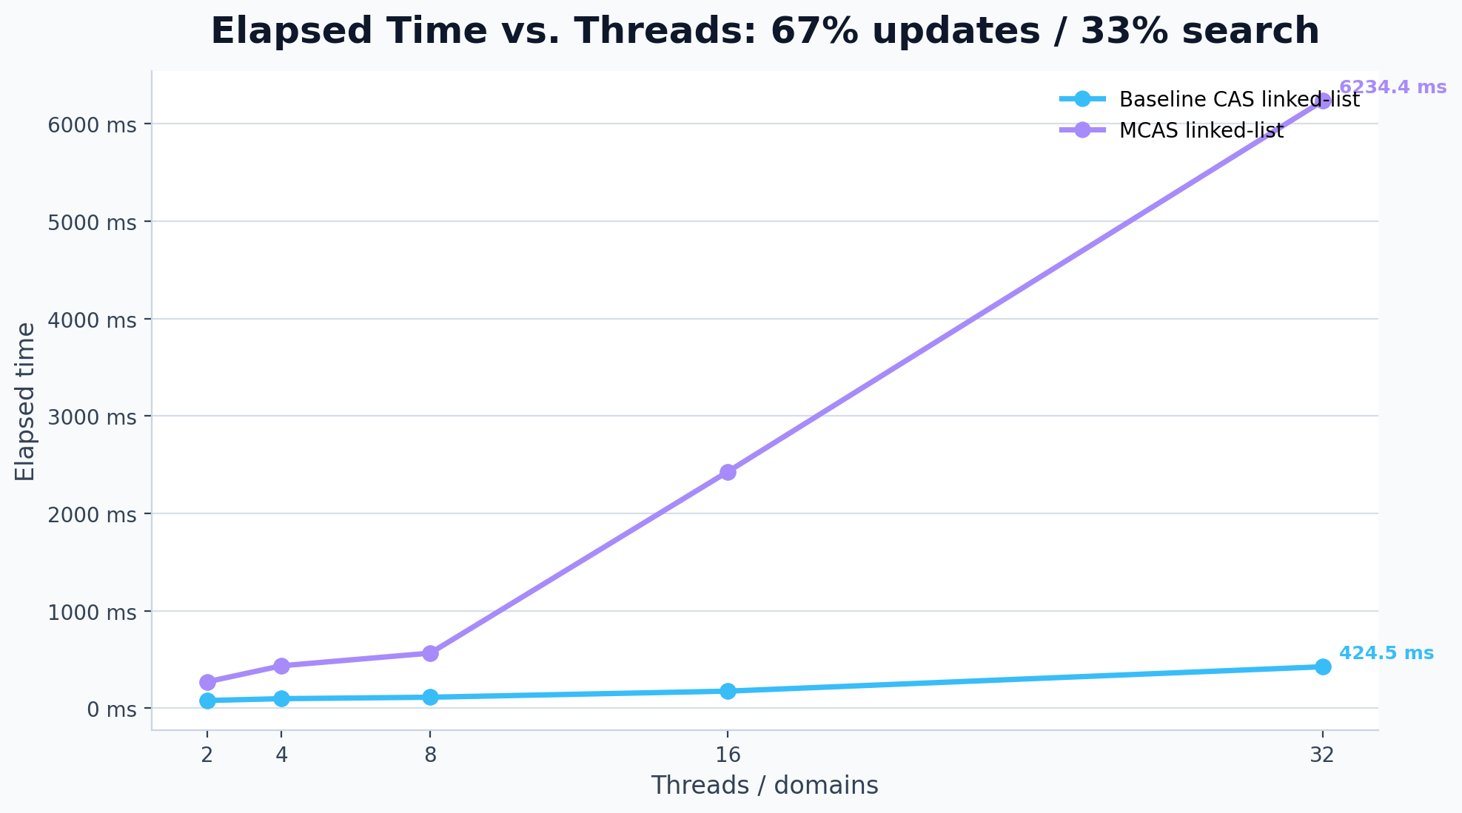
67% updates / 33% search
Elapsed time across the required thread counts
At 8 threads, baseline elapsed time is 424.5 ms.
At 8 threads, MCAS elapsed time is 6234.4 ms (14.7x baseline time).
Average cost per operation grows from 0.09 us/op to 1.30 us/op.
Plots use the required 2-8 thread range from the assignment deliverable.

Slide 6
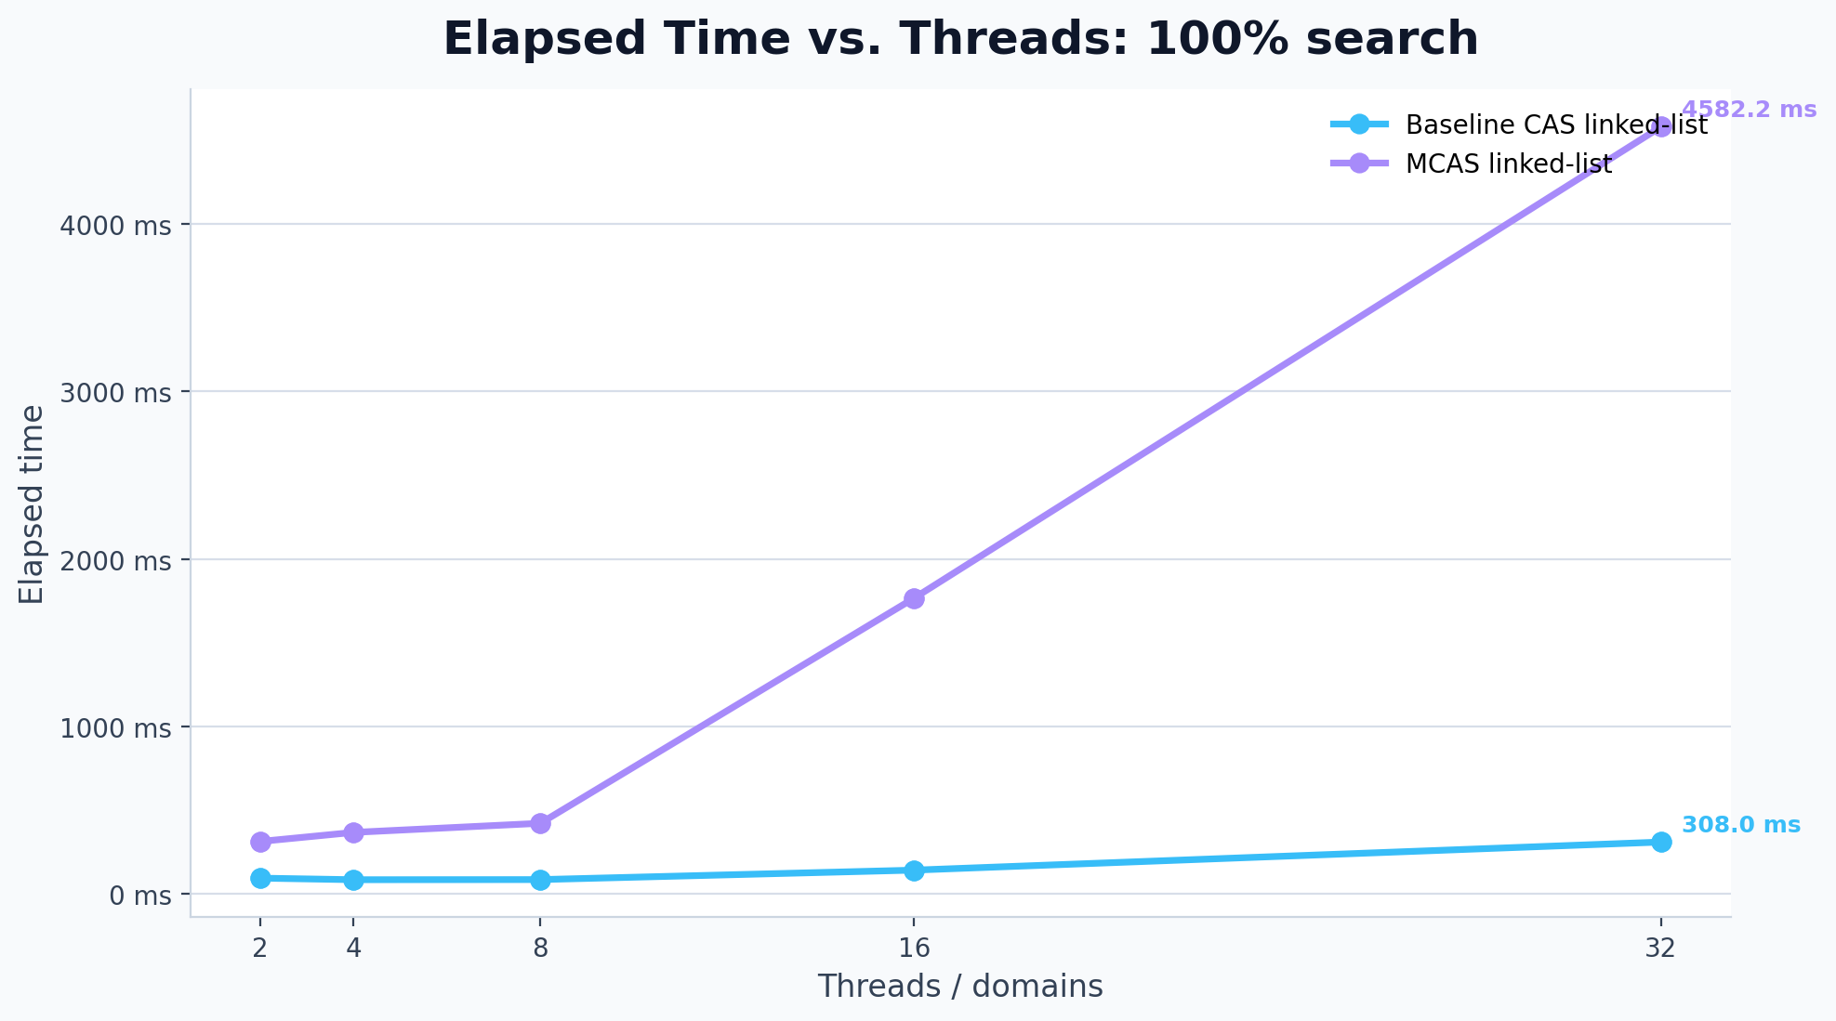
100% search
Elapsed time across the required thread counts
At 8 threads, baseline elapsed time is 308.0 ms.
At 8 threads, MCAS elapsed time is 4582.2 ms (14.9x baseline time).
Average cost per operation grows from 0.06 us/op to 0.95 us/op.
Plots use the required 2-8 thread range from the assignment deliverable.

Slide 7
Takeaways
What the benchmark results say about the project
MCAS makes the linked list implementation conceptually straightforward by using multi-word operations for insertion and deletion.
That expressiveness comes with a visible time cost, compared to a carefully crafted CAS-based lock-free linked list.
The time-based view is easier to explain in a presentation: same workload mix, more wall-clock time once the MCAS software layer is involved.
The cleanest story for the deck is simplicity versus runtime cost: MCAS gives a neat abstraction, but not a free one.
Deck generated from parsed benchmark data in benchmark_linked_list_results_latest.csv.

