Slide 1
Multi-Word Compare-and-Swap in OCaml 5
Benchmarking and snapshot-performance presentation deck
How much simplicity does MCAS buy us, and what does the software layer cost?
Workloads
Thread range
4 ratios
2-8
Implementations
Registers
Implements descriptor-based MCAS and applies it to atomic snapshot.
Benchmarks baseline snapshot against the volatile MCAS snapshot only.
Slides focus on elapsed time trends across the benchmark deliverable.
2
16

Slide 2
Deliverables and Method
What this benchmark section is measuring
Deliverable focus: compare snapshot elapsed time across varying update/scan ratios and 2-8 threads.
Workloads: 100% updates, 50/50, 10/90, and 100% scans.
Implementations: baseline double-collect snapshot and volatile MCAS snapshot.
Benchmark harness uses 16 registers and 2,000 operations per domain.
Each point reports total elapsed time for the full workload, plus average microseconds per operation.

Slide 3
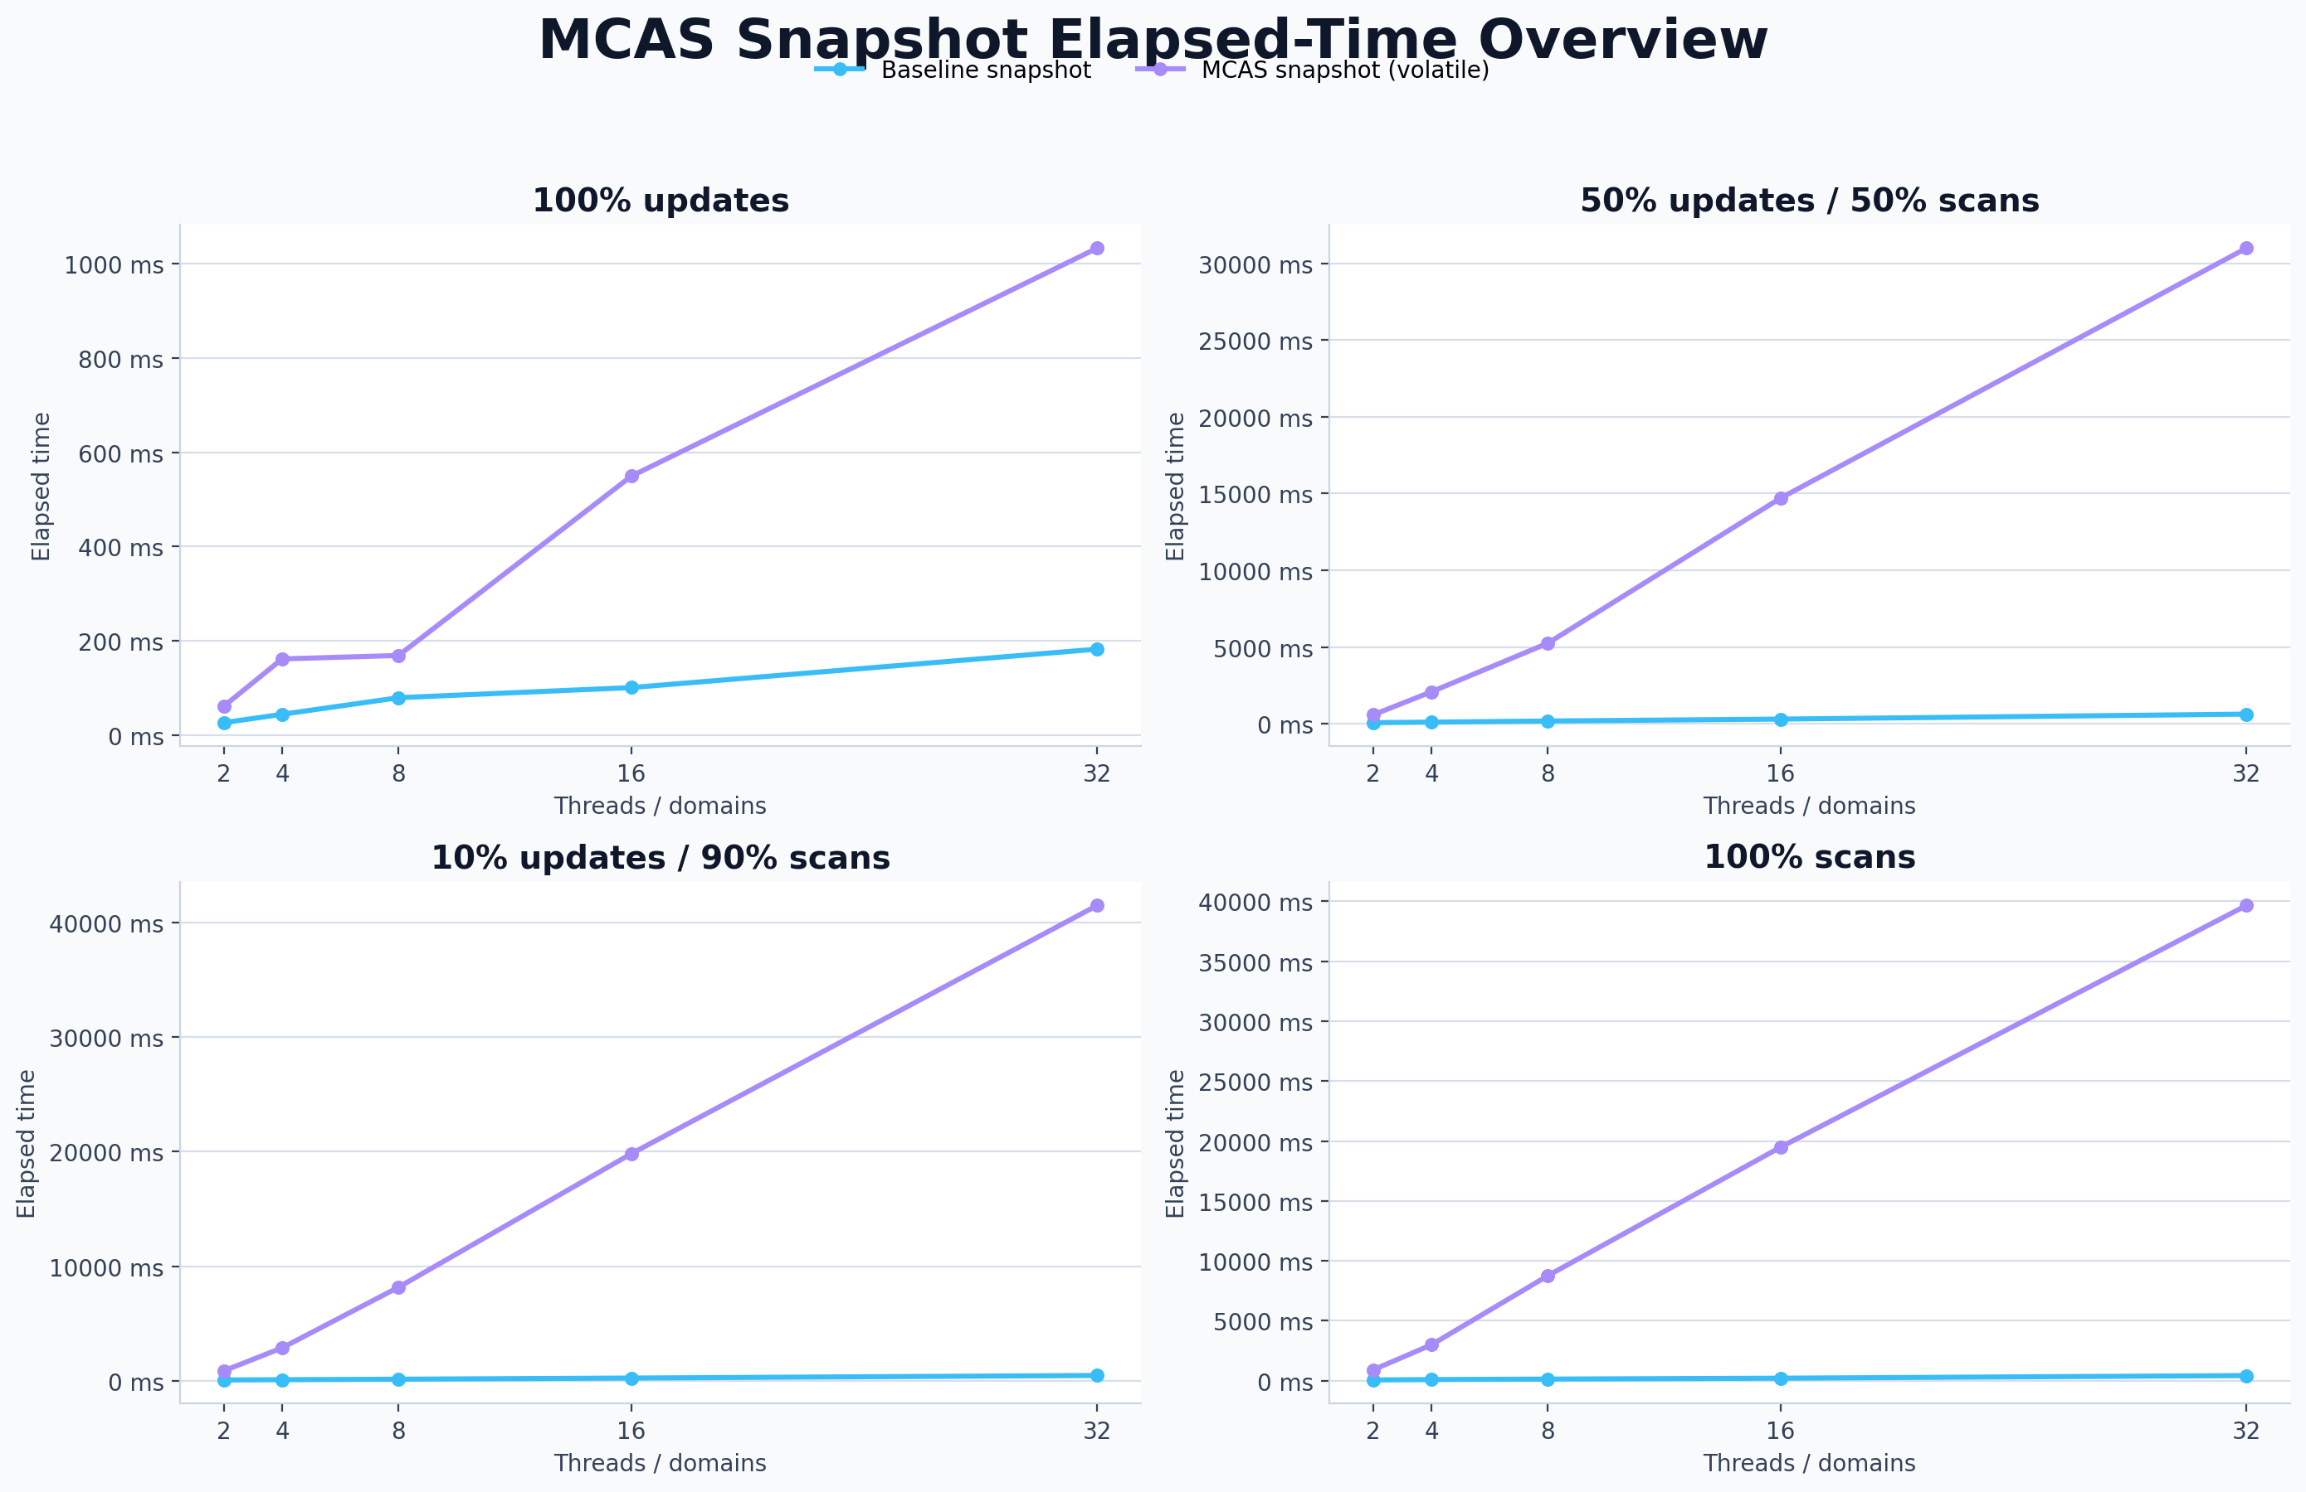
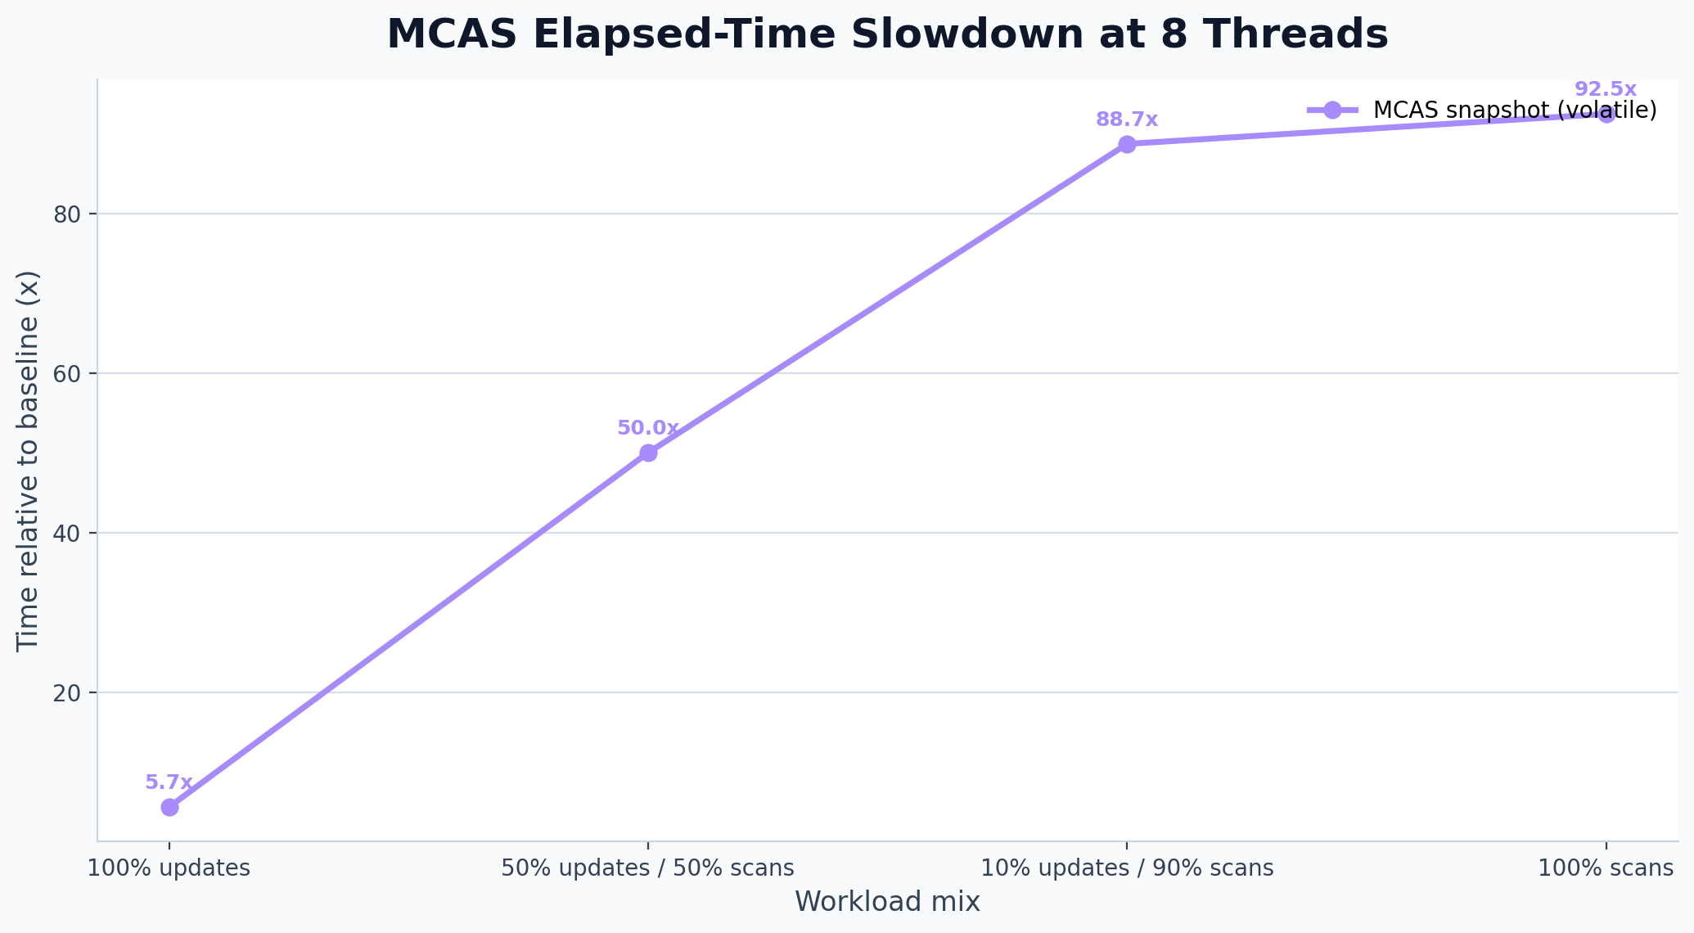
Benchmark Overview
All workload mixes in one view
At 8 threads on a balanced workload, the baseline finishes in 619.7 ms while the MCAS snapshot takes 31008.8 ms.
For 100% scans at 8 threads, the MCAS snapshot is 92.5x slower than the double-collect baseline.
Even on 100% updates at 8 threads, the MCAS layer still stretches total runtime from 182.5 ms to 1033.4 ms.

Slide 4
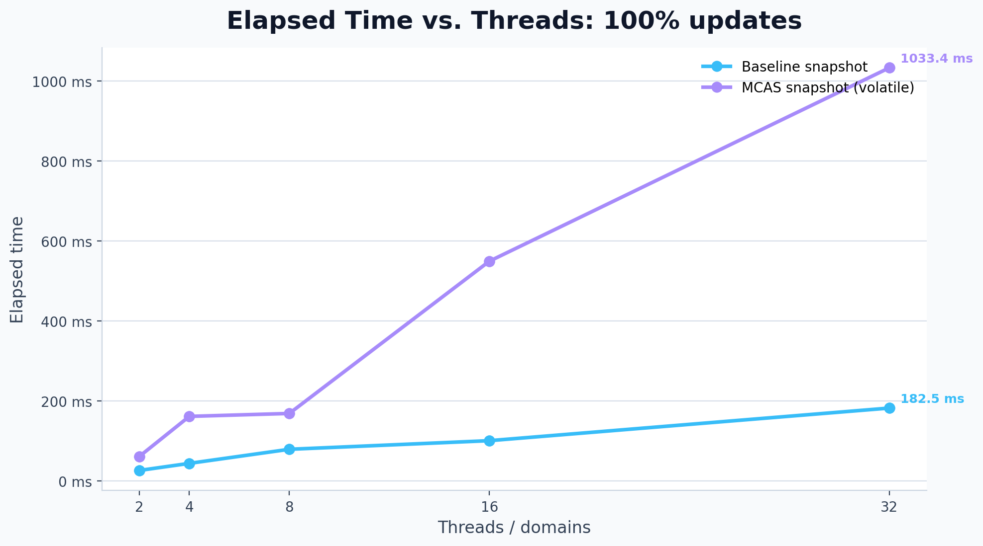
100% updates
Elapsed time across the required thread counts
At 8 threads, baseline elapsed time is 182.5 ms.
At 8 threads, MCAS elapsed time is 1033.4 ms (5.7x baseline time).
Average cost per operation grows from 0.03 us/op to 0.16 us/op.
Plots use the required 2-8 thread range from the assignment deliverable.

Slide 5
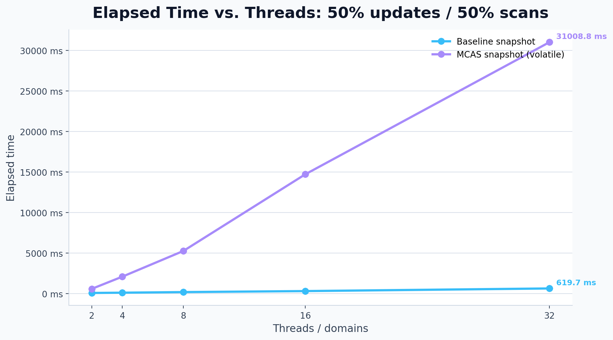
50% updates / 50% scans
Elapsed time across the required thread counts
At 8 threads, baseline elapsed time is 619.7 ms.
At 8 threads, MCAS elapsed time is 31008.8 ms (50.0x baseline time).
Average cost per operation grows from 0.10 us/op to 4.84 us/op.
Plots use the required 2-8 thread range from the assignment deliverable.

Slide 6
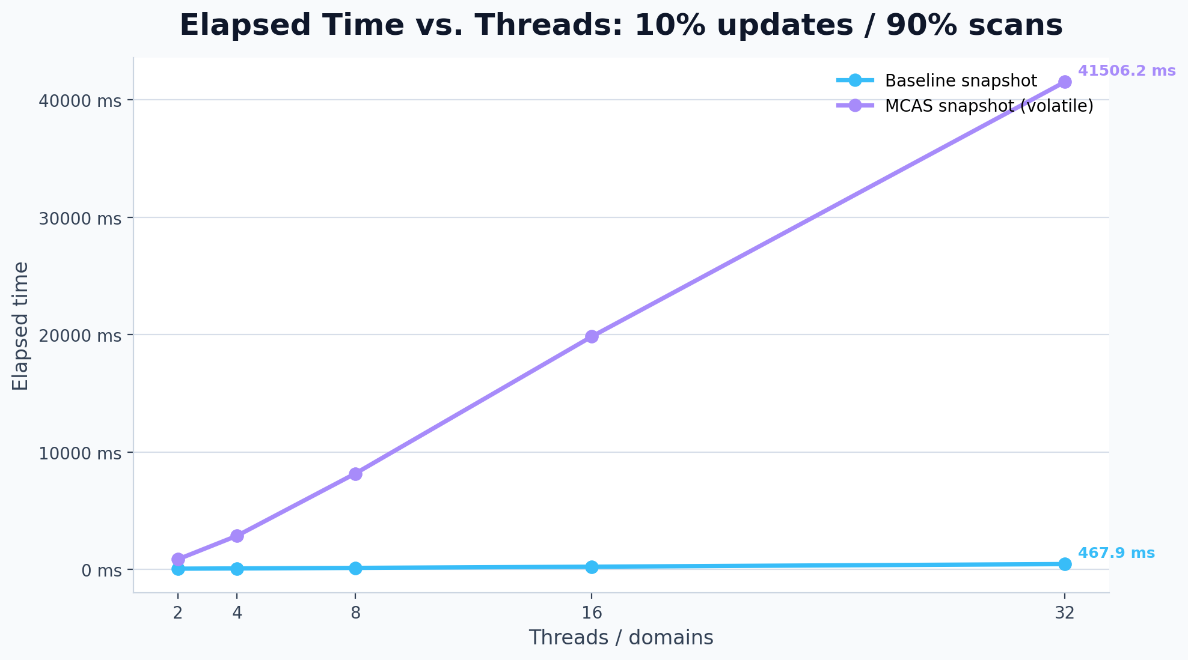
10% updates / 90% scans
Elapsed time across the required thread counts
At 8 threads, baseline elapsed time is 467.9 ms.
At 8 threads, MCAS elapsed time is 41506.2 ms (88.7x baseline time).
Average cost per operation grows from 0.07 us/op to 6.49 us/op.
Plots use the required 2-8 thread range from the assignment deliverable.

Slide 7
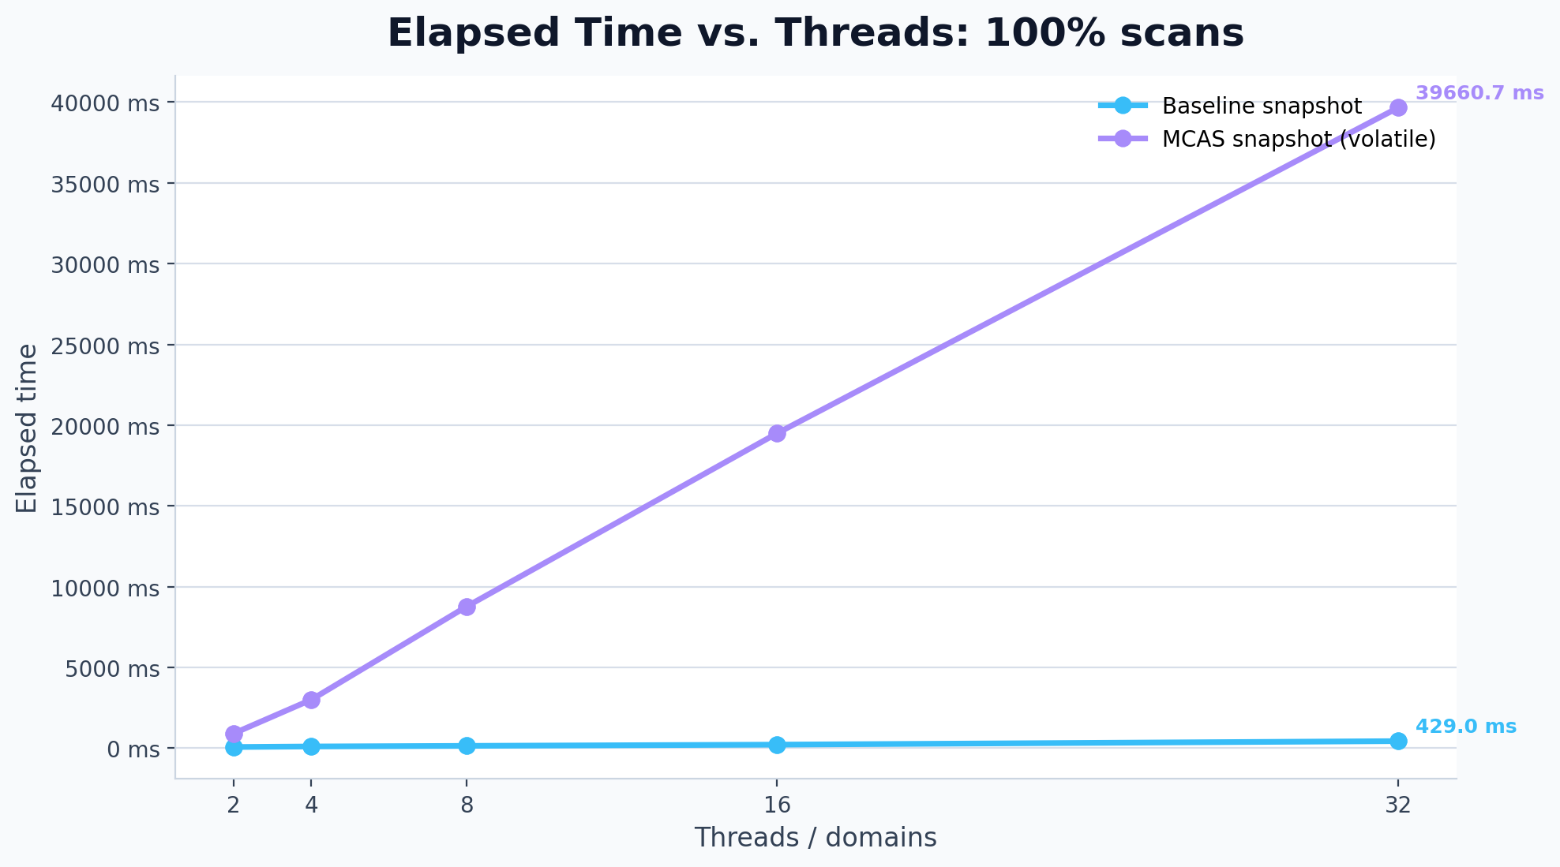
100% scans
Elapsed time across the required thread counts
At 8 threads, baseline elapsed time is 429.0 ms.
At 8 threads, MCAS elapsed time is 39660.7 ms (92.5x baseline time).
Average cost per operation grows from 0.07 us/op to 6.20 us/op.
Plots use the required 2-8 thread range from the assignment deliverable.

Slide 8
Takeaways
What the benchmark results say about the project
MCAS makes the snapshot implementation conceptually uniform: update and scan are both expressed in terms of MCAS operations.
That expressiveness comes with a visible time cost, especially for scan-heavy workloads where double-collect finishes much faster.
The time-based view is easier to explain in a presentation: same workload mix, more wall-clock time once the MCAS software layer is involved.
The cleanest story for the deck is simplicity versus runtime cost: MCAS gives a neat abstraction, but not a free one.
Deck generated from parsed benchmark data in benchmark_results_latest.csv.

