Slide 1

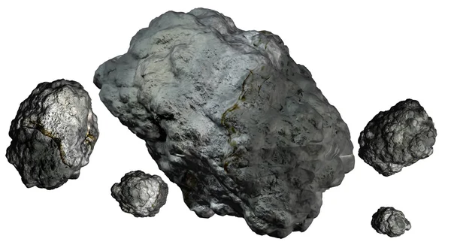
Asteroid Classification
Using NASA JPL Asteroid Dataset
GROUP 1:
Preetkamal Kaur
Kavach Dheer
Gaurav Kumar
Arpit Dhankhar

Slide 2
Dataset
Overview
Officially maintained by Jet Propulsion Laboratory, CA
958524 Unique Instances
45 Columns
Classification of Potentially Hazardous Asteroids to Earth.
Classification Models
Comparison of machine learning algorithms with neural networks

Slide 3
Understanding Data and X & Y
Based on the mentioned research papers and study , x and y has been identified
X: Independent Variables which give insights such as,
Moid : Earth Minimum Orbit
e: Eccentricity
a: Semi-major axis au Unit
q: perihelion distance au Unit
i: inclination; angle with respect to x-y ecliptic plane
tp: Time of perihelion passage TDB Unit
Y: Dependent variable
PHA: Potentially Hazardous Asteroid (PHA) flag

Slide 4
Overview
Classification of Potentially Hazardous Asteroids to Earth
Some asteroids can collide with Earth and cause significant damage.
Classification of Potentially Hazardous Asteroids to Earth.
This is done by tracking their orbit and predicting their movements.
AI can aid in classifying hazardous asteroids by analyzing asteroid data to identify patterns and potential risks

Slide 5
Research work
Identifying Earth-impacting asteroids using an artificial neural network. Astronomy & Astrophysics
utilizes an artificial neural network (ANN) to assess data using Kelperain components
Hazardous Asteroid Classification through Various Machine Learning Techniques
Implemented a number of machine learning methods and compared their results
Deep Neural Networks for Near Earth Object: uses deep neural networks (DNNs) for identifying and characterizing near Earth objects
Prediction of Potentially Hazardous Asteroids using Deep Learning : iinvestigates the use of deep learning techniques for predicting potentially hazardous asteroids uses Keplerian elements a, e, i, Ω, ω, M for prediction
Supervised Classification for Analysis and Detection of Potentially Hazardous Asteroid : presents a useful exploration of supervised classification methods for asteroid detection and analysis

Slide 6
Data Exploration
Less Columns with Missing Values
Sigma , Name -> 97% Missing Values
'diameter', 'albedo' and 'diameter sigma’ has 85 % missing values .
80 % Colums-> Float and 15%-> Object

Slide 7
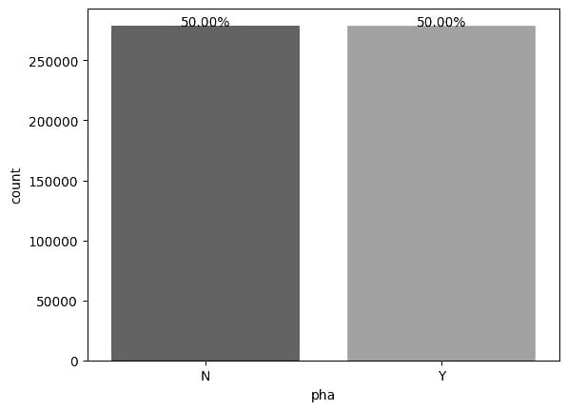
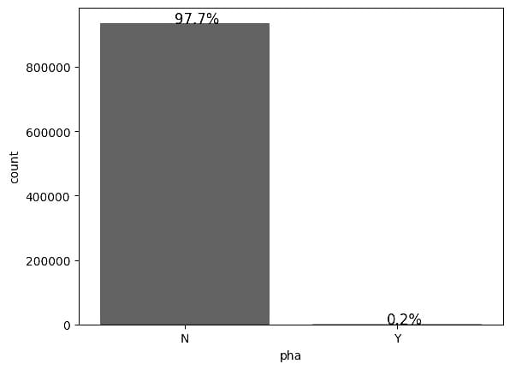
Data Exploration
Imbalanced Dataset
After Sampling
Before Sampling

Slide 8
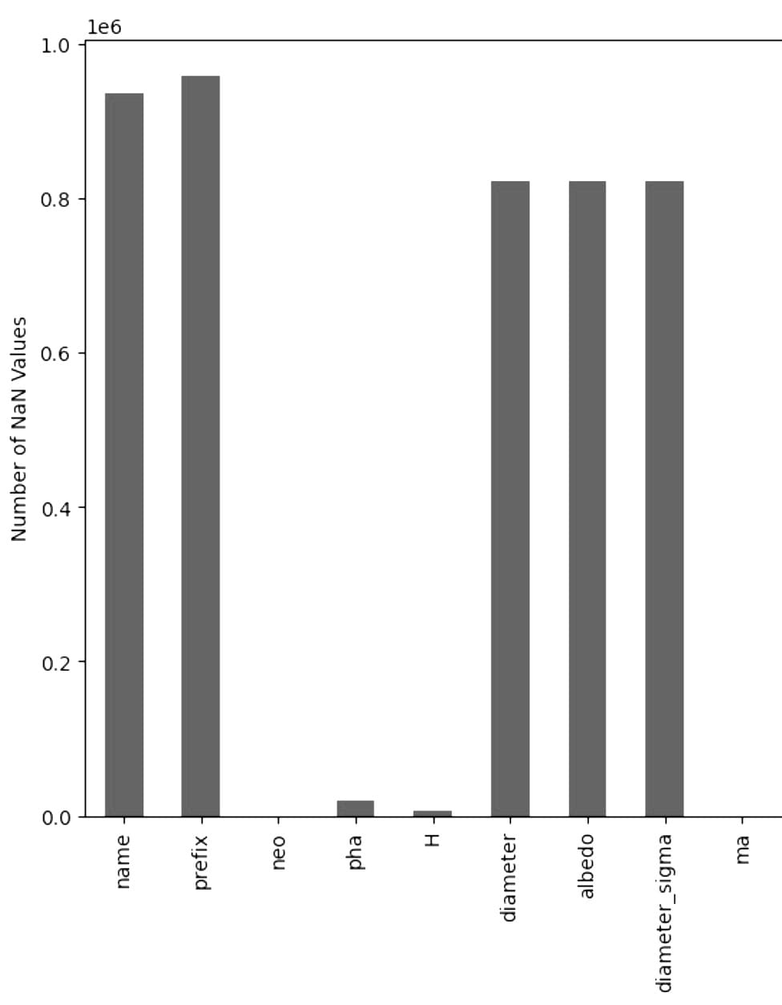
Data Cleaning
‘name’ and ‘prefix’ dropped
'diameter', 'albedo' and 'diameter sigma’ dropped
'H' - absolute magnitude dropped as ‘diameter’ and albedo are dropped.

Slide 9
Data Preprocessing
Encoding variables
Label encoding :Transformed data with ‘Y’ and ‘N’ categories into 1 and 0 respectively
One hot encoding :Preformed on categorical data ‘class’ i.e. class to which asteroids belong
Data Scaling
Standard scalar is utilized to ensure features have the same significance in the dataset
Sampling
Combined SMOTE and RandomUnderSampler to handle imbalanced data

Slide 10
Algorithms implemented
Logistic Regression
K-Nearest Neighbours (KNN)
Decision tree
Naive Bayes
Random Forest
XG Boost
Multilayer Perceptron Model (MLP)

Slide 11
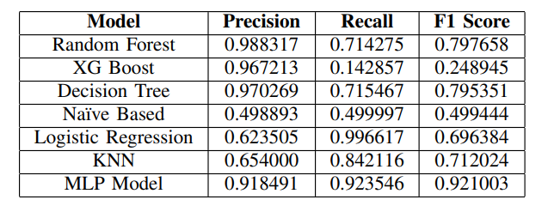
Evaluation
Below table shows results of various machine learning algorithms implemented

Slide 12
Conclusion
Concluded that Random Forest, MLP Model, K-Nearest Neighbours, and Decision Tree algorithms performed well
Naive Bayes and Logistic Regression were unsuitable for this task
additional asteroid attributes such as orbital Lcan improve PHA prediction accuracy in future research
More advanced machine learning algorithms such as CNNs or RNNs can enhance classification performance.

Slide 13
Resources
NASA JPL - Small-Body Database Query (nasa.gov)
Kaggle Dataset Link- Asteroid Dataset | Kaggle
Classification Models - Classification Models | Towards Data Science

