Slide 1
Left-Leaning Red-Black Tree

Slide 2
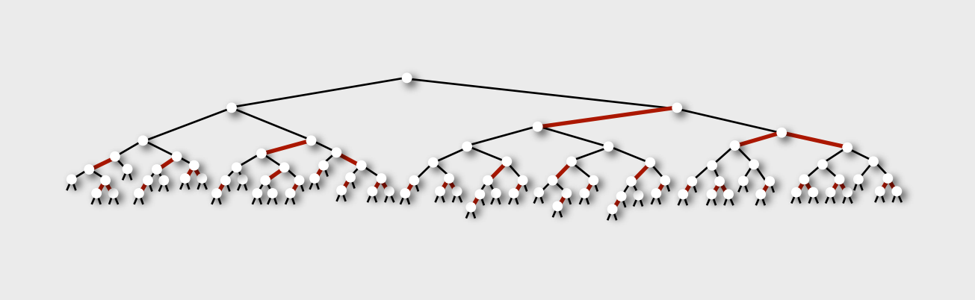
What is a Left Leaning Red-Black Tree?
It is a type of data tree that is used to represent a 2-3-4 tree as a BST(Binary Search Tree) and uses “internal” black nodes for 3 and 4 nodes, and that 3 nodes are left-leaning.

Slide 3
Why Left Leaning Red Black Trees?
RB Trees offer a very efficent searching time for larger data bases because they are balanced. They are currently being used as data bases, and can be found in most Linux Kernels(Process Schedulers).

Slide 4
Red Black Tree Rules
Because of these rules, it is very easy to compare this tree to a 2-3-4 tree.
Each node must have a color
Red or Black
The Root node must be Black
All null children are Black
Red nodes must have black children
Red nodes cannot touch
There must be the same amount of black nodes in each sub-path to a leaf

Slide 5
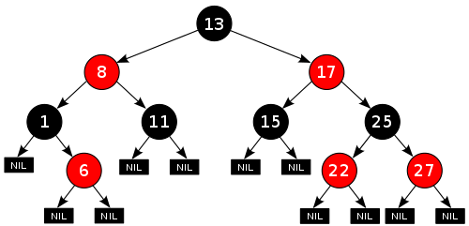
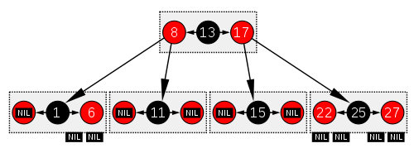
2-3-4 Node Comparison

Slide 6
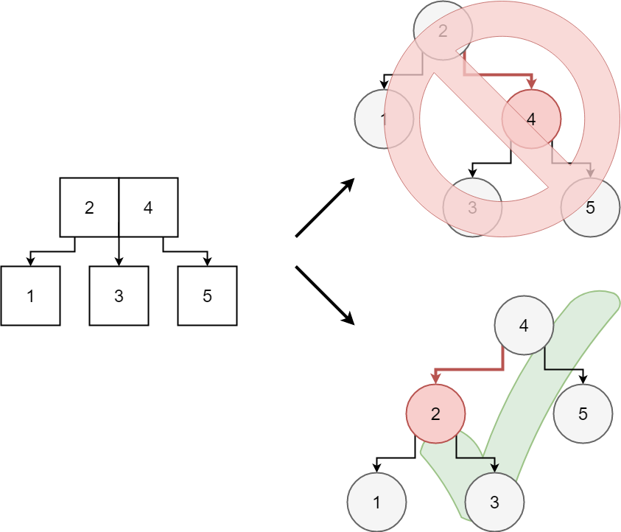
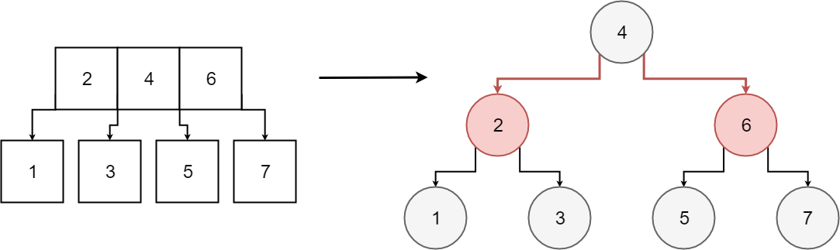
3 and 4 Node Caparisons

Slide 7
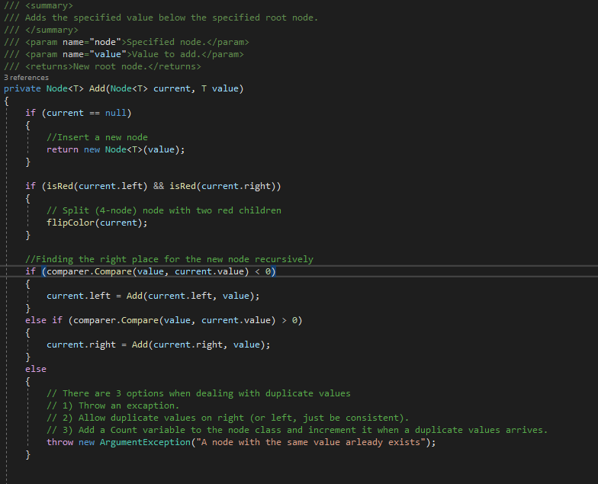
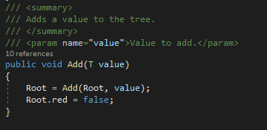
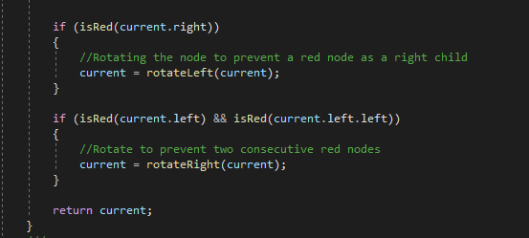
Adding
Adding is done recursively.
Going down the tree is done by running the function multiple times with new nodes until the insertion point is reached.
Then balancing of the tree is done on the way back up the tree

Slide 8
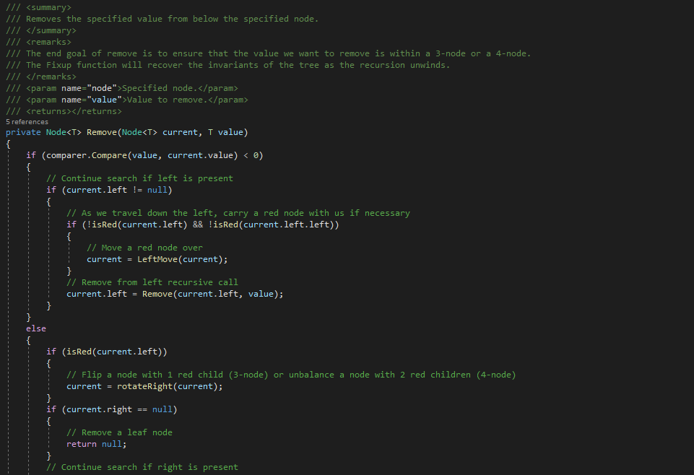
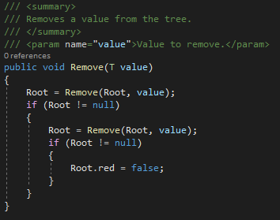
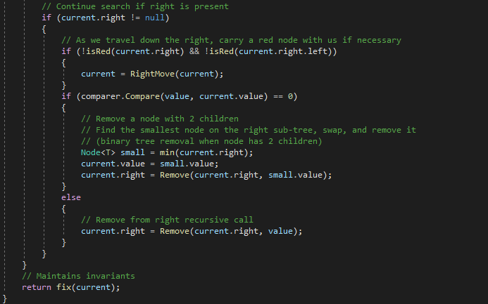
Removing
Removing is done recursively.
Use MoveRedRight/Left functions so the current node is never a 2 node to find the deleting node.
Once the node is deleted, use the FixUp function to fix the balance.

Slide 9
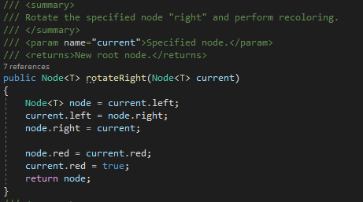
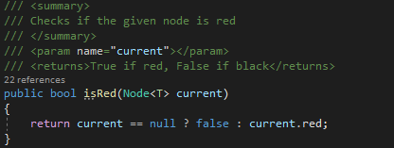
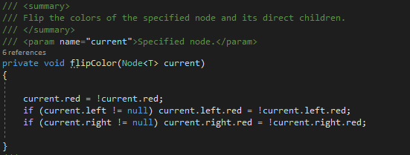
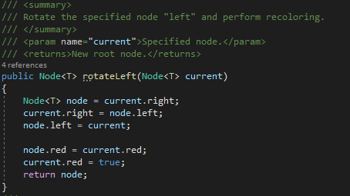
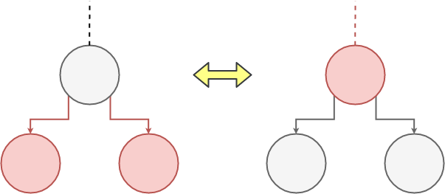
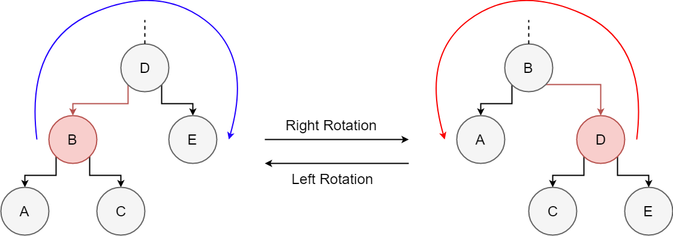
Flip Color, Rotates, IsRed

Slide 10
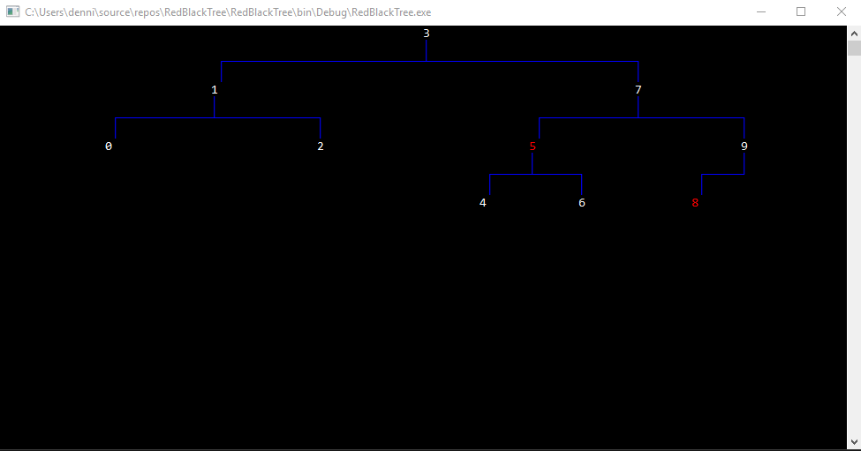
In my Red-Black Tree, I created a visualizer for the tree so it can be seen without imagining it.
To see the visualizer open the .exe file in the drive.

