Slide 1
SECURE DATA HIDING IN IMAGES USING STEGANOGRAPHY
PROJECT
Presented By : Dheeraj Sharma
College Name: PGDAV College ,
Department : B. Sc Mathematical science

Slide 2
OUTLINE
Problem Statement
Technology used
Wow factor
End users
Result
Conclusion
Git-hub Link

Slide 3
Problem Statement
Traditional encryption methods are easily detectable and can raise suspicion.
Need for a secure way to hide confidential messages within images.
Ensuring data security while maintaining the integrity of the cover image.
Making encryption and decryption accessible to non-technical users through a simple interface.

Slide 4
Technology used
Python (Programming Language):- Used to implement the encryption and decryption logic.
OPEN CV2 Library :- Reads and manipulates images where the secret message is hidden.
NUMPY library :- Used for storing and retrieving ASCII values in pixels.
File Handling :- Saves and reads passwords using text files. Uses os.system() to open the encrypted image automatically.
Image Formats:- JPEG & PNG
ASCII Encoding (Character-to-Pixel Conversion):- ord(char)- >Converts a character to its ASCII value and
chr(value) ->Converts ASCII value back to a character.

Slide 5
Wow factors
Lossless Encryption Using PNG 🔐 → Ensures pixel accuracy for perfect decryption.
Simple & Fast Execution ⚡ → Just run the script, enter a message, and it’s encrypted instantly.
Custom Password Protection 🔑 → Prevents unauthorized access to the hidden message.
No External Databases Needed 🗃️ → Entire data storage is within the image itself.
Cross-Platform Compatibility 🖥️ → Works on Windows, macOS, and Linux.
Minimal Dependencies 📦 → Only requires Python & OpenCV (easy installation).
Hides Messages in Images 🖼️ → Secret messages are stored inside image pixels without affecting visibility.

Slide 6
End users
Cybersecurity & Ethical Hackers 🛡️
🔹 Use for secure message transmission and digital watermarking. 🔹 Helps in forensic analysis and covert communication.
Journalists & Whistleblowers 📰
🔹 Hide sensitive information in images to avoid censorship and surveillance. 🔹 Useful for confidential news reporting.
Military & Intelligence Agencies 🕵️‍♂️
🔹 Encrypt mission-critical data inside images for classified communication. 🔹 Used in counter-surveillance tactics.
Digital Artists & Content Creators 🎨
🔹 Watermark artwork subtly without altering visuals. 🔹 Protect copyright ownership using hidden metadata.

Slide 7
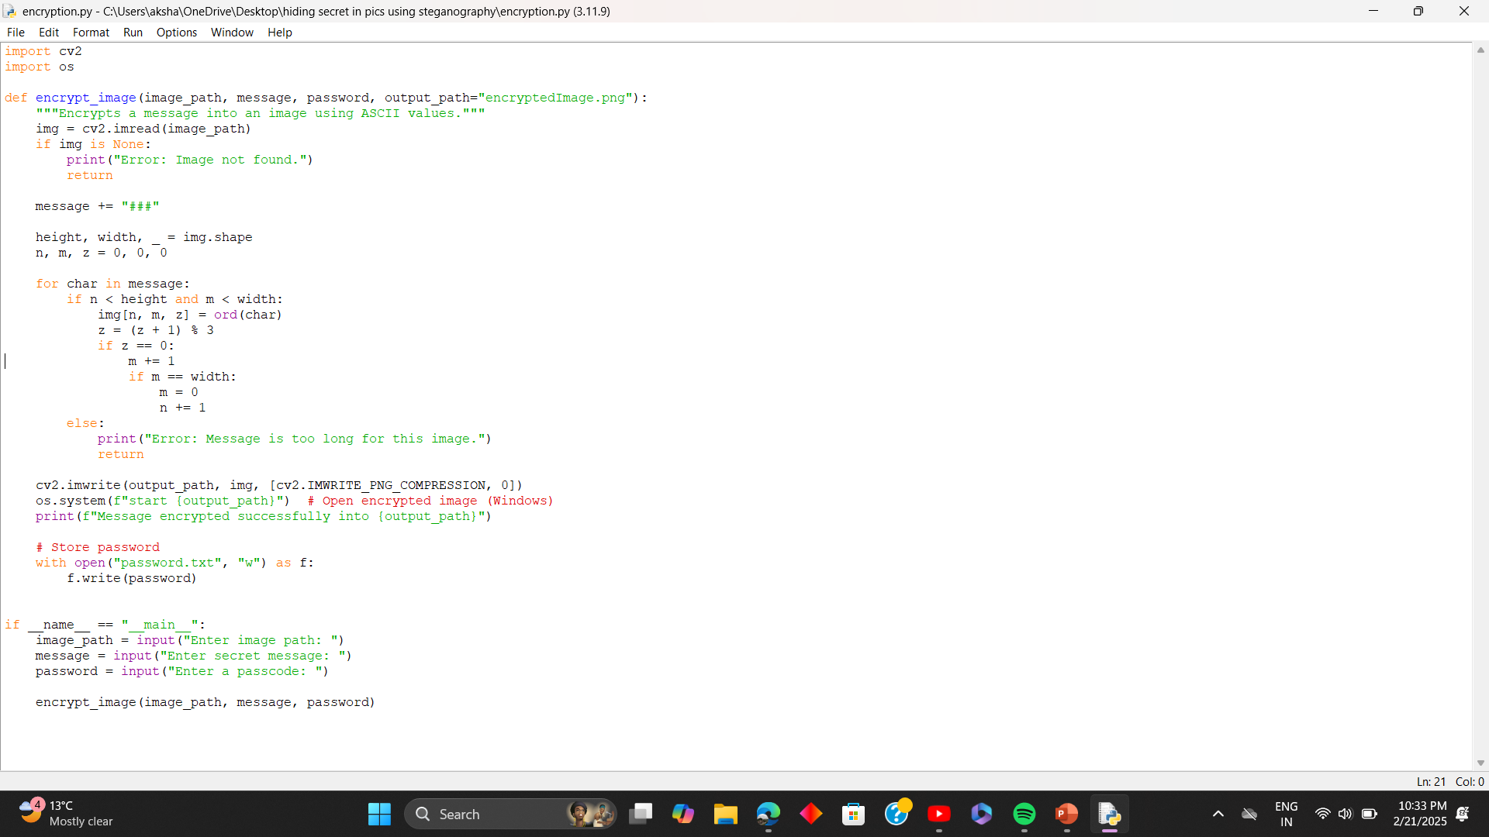
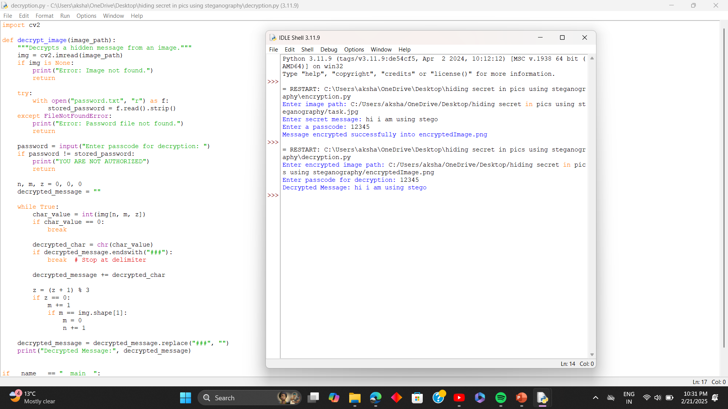
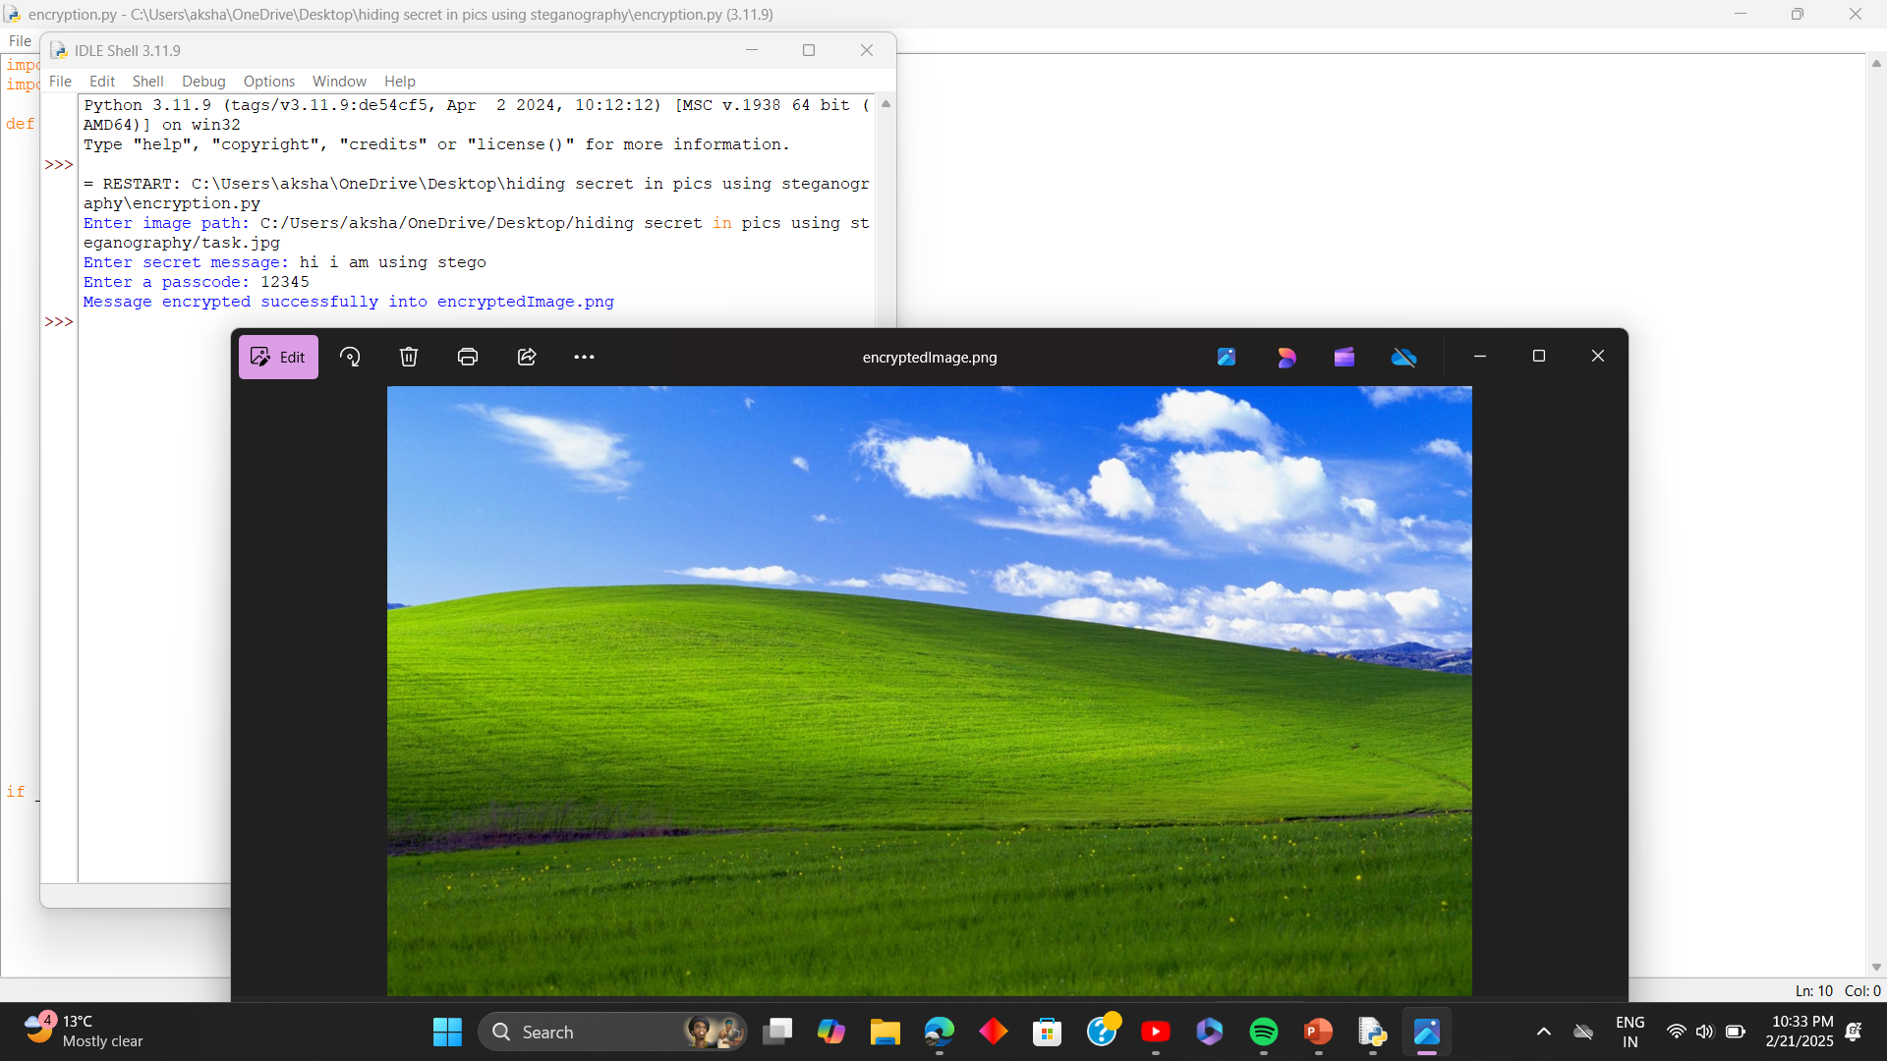
Results

Slide 8
Conclusion
This steganography project effectively demonstrates how secret messages can be hidden inside images using Python and OpenCV. By modifying pixel values, the project ensures secure and undetectable communication.
The use of lossless PNG format, password protection, and ASCII-based encoding makes this method reliable for cybersecurity, digital watermarking, and confidential messaging. With minimal dependencies and a simple implementation, it is both accessible and efficient for various users, from cybersecurity experts to everyday individuals.
Overall, this project highlights the power of steganography in modern digital security and offers a practical tool for protecting sensitive information.

Slide 9
GitHub Link
https://github.com/Mr-GHOST47/stegnography-aicte-project.git

Slide 10
THANK YOU

