Slide 1

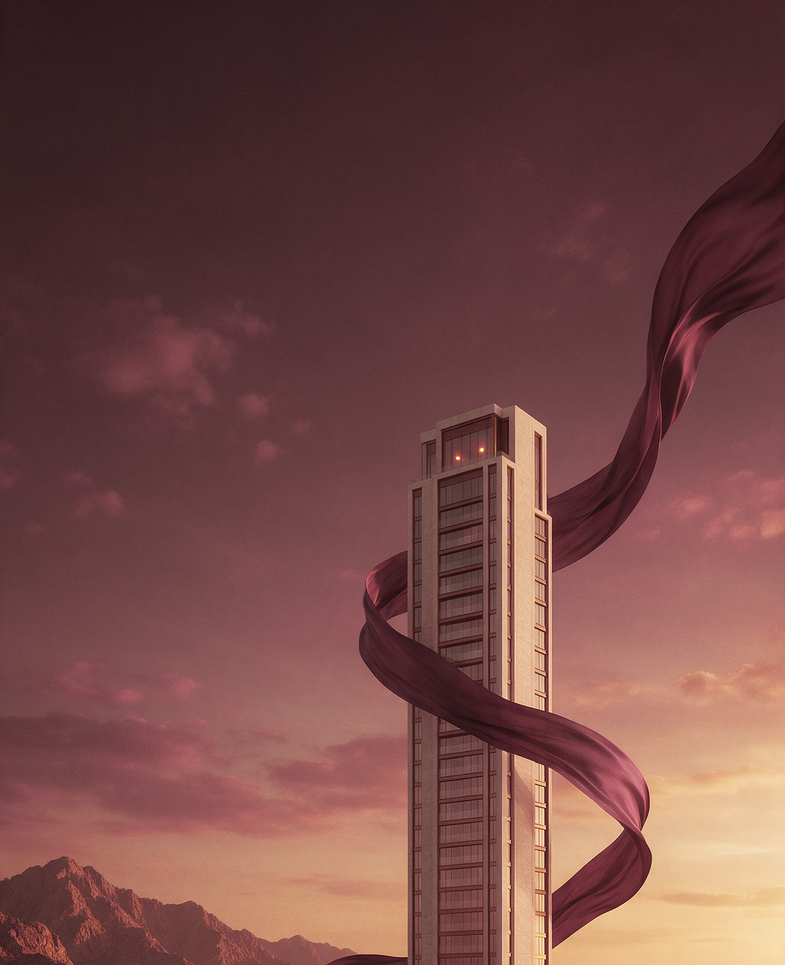
INVESTOR PRESENTATION · OCTOBER 2026
Noor Residences
مساكن نور
A 24-storey tower of 168 residences in Al Khuwair, Muscat.
SIRAJ REAL ESTATE DEVELOPMENT · CONFIDENTIAL
Notes:
Layout: Cover. Replace the portal image (right) by right-click → Change Picture; the rounded top keeps the SIRAJ Portal shape.

Slide 2

01
The project
Twenty-four storeys shaped by light, on Muscat's coastal spine.
Notes:
Layout: Section divider (dark silk). Use silk only on cover, dividers and closing.

Slide 3

EXECUTIVE SUMMARY
A quiet tower at the centre of Muscat, half sold in seven months.
A prime, connected address
On Sultan Qaboos Street in Al Khuwair, five minutes from the Grand Mosque and fifteen from the airport.
Strong early absorption
84 of 168 residences sold since launch in March 2026, about twelve each month.
Resilient economics
OMR 40.0 M gross development value and a projected 27% gross margin on an OMR 29.2 M budget.
84 / 168
On programme for Q4 2027
Foundations and podium are complete. The structure has reached level 9 of 24.
RESIDENCES SOLD · SEPTEMBER 2026
EXECUTIVE SUMMARY
03
Notes:
Layout: Title + text. Title 56–64 px Jost Light (28–32 pt), body 24–28 px (12–14 pt).

Slide 4
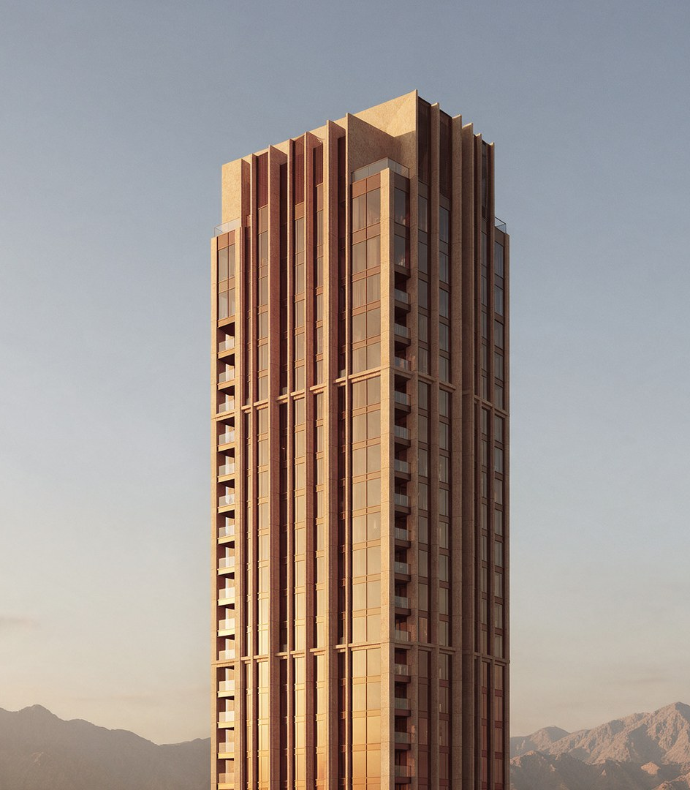
PROJECT OVERVIEW
Noor Residences
A slender tower of warm stone and bronze. Deep loggias temper the afternoon sun and frame long views to the Gulf of Oman.
LOCATION
TYPOLOGY
Al Khuwair, Muscat
Residential tower
FLOORS
RESIDENCES
24 + podium
168
PLOT AREA
GROSS FLOOR AREA
5,170 m²
31,500 m²
SALEABLE AREA
HANDOVER
23,930 m²
Q4 2027
01 · THE PROJECT
04
Notes:
Layout: Two-column — image with one Silk Corner (top-end) + specification grid.

Slide 5
KEY NUMBERS
Noor Residences at a glance
168
50%
40.0 M
Residences across 24 floors
Sold within seven months of launch
Gross development value · OMR
27%
6.4%
2027
Projected gross margin
Projected gross rental yield
Handover · Q4
02 · PERFORMANCE
05
Notes:
Layout: Key numbers (dark). Numerals Jost ExtraLight; units in Sand. Mark the key figure with one Lumen.

Slide 6
SALES & PRICING
Steady absorption at a premium to the market
Sales velocity
Price per m²
Residences sold per month, 2026 · 84 to date
Average asking price, OMR per m² of saleable area
Source: SIRAJ sales records, Sep 2026. Market series are illustrative demonstration data.
02 · PERFORMANCE
06
Notes:
Layout: Charts. Native charts — right-click → Edit Data. Brand rules: hairline gridlines, light numerals, direct labels (no legend), Maroon for the highlight, Stone for the rest, Lumen ◆ for the key point.

Slide 7
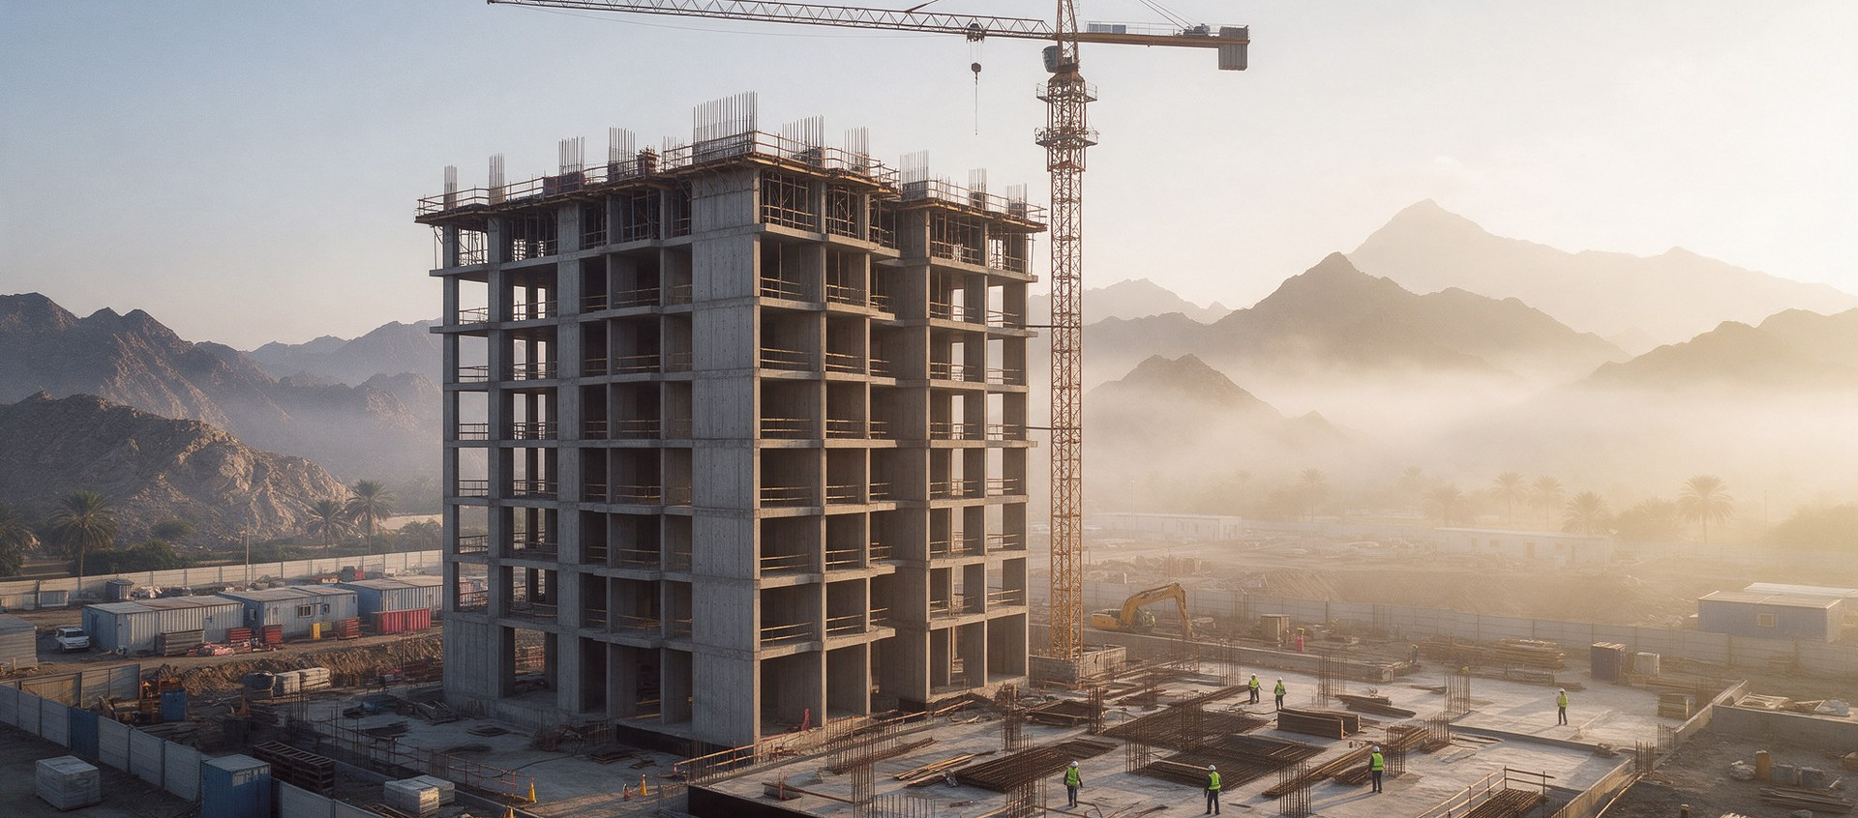
DELIVERY
On programme for handover in Q4 2027
The structure has reached level 9 of 24. Construction is 38% complete.
SITE PROGRESS · OCTOBER 2026
TODAY · OCT 2026
Q2 2025
Q4 2025
Q1 2026
Q2 2026
Q3 2026
Q2 2027
Q3 2027
Q4 2027
Land acquired
Permits & design
Sales launch
Foundations
Podium
Topping out
Façade & fit-out
Handover
Plot secured on Sultan Qaboos Street
Building permit and design freeze
Released to market in March
Piling and two basement levels
Podium slab and amenity shell
Structure complete to level 24
Envelope sealed, interiors underway
Keys to the first residents
02 · PERFORMANCE
07
Notes:
Layout: Timeline. Filled Maroon Lumen = complete, outlined = upcoming, Stone = key milestone. Move the dashed Today marker as the programme advances.

Slide 8
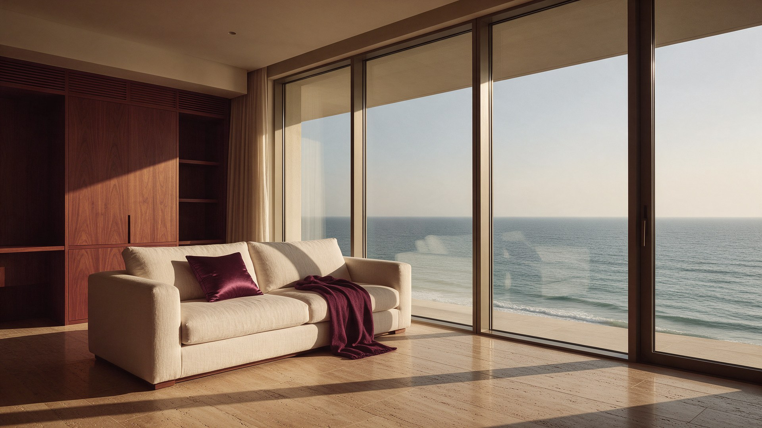
THE RESIDENCES
Every home opens to the light of the Gulf.
TYPICAL TWO-BEDROOM LIVING ROOM · VISUALISATION
01 · THE PROJECT
08
Notes:
Layout: Full-bleed image + caption. Keep text in the calm, darker third of the photograph.

Slide 9
FINANCIALS
Development budget and returns
BUDGET LINE | OMR M | SHARE OF COST | COMMITTED TO DATE
Land | 4.6 | 15.8% | 100%
Construction | 19.8 | 67.8% | 46%
Professional fees | 1.9 | 6.5% | 72%
Marketing & sales | 1.2 | 4.1% | 38%
Finance & contingency | 1.7 | 5.8% | 30%
Total development cost | 29.2 | 100.0% | 55%
GROSS DEVELOPMENT VALUE
OMR 40.0 M
GROSS PROFIT
OMR 10.8 M
GROSS MARGIN
27.0%
PROJECT IRR, UNLEVERED
19.6%
CONTRACTED SALES
Figures in OMR million unless stated. Projections are illustrative and subject to change.
OMR 18.4 M
03 · INVESTMENT
09
Notes:
Layout: Data table — native table, no fills, hairline rules, figures right-aligned in light tabular numerals.

Slide 10
We build slowly, so that the people who live here can live quietly.
CHIEF EXECUTIVE OFFICER · SIRAJ REAL ESTATE DEVELOPMENT
CLOSING
10
Notes:
Layout: Quote. One sentence, Jost Light, attribution in caption style.

Slide 11

Light, built.
BOOK A PRIVATE VIEWING AT THE SIRAJ SALES CENTRE
sirajproperties.net ◆ info@sirajproperties.net ◆ +968 2400 0000 ◆ Al Khuwair, Muscat
Noor Residences is a demonstration project. All figures are illustrative and do not constitute an offer.
Notes:
Layout: Closing / contact. Contact details come from 00-Brand-Foundation/brand.config.json (placeholders until confirmed).

Slide 12
عرض المستثمرين · أكتوبر 2026
مساكن نور
Noor Residences
برج سكني من 24 طابقاً يضم 168 وحدة سكنية في الخوير، مسقط.
سراج للتطوير العقاري · سرّي
Notes:
Layout: Arabic cover (RTL). Paragraphs are set right-to-left; numbers stay Western (0–9). Arabic is never tracked or uppercased.

Slide 13
الملخص التنفيذي
عنوان مميّز ومتّصل
برج هادئ في قلب مسقط، بيع نصفه خلال سبعة أشهر.
على شارع السلطان قابوس في الخوير، على بُعد خمس دقائق من الجامع الأكبر وربع ساعة من المطار.
إقبال قوي منذ الإطلاق
بيعت 84 وحدة من أصل 168 منذ الإطلاق في مارس 2026، بمعدل 12 وحدة شهرياً تقريباً.
جدوى اقتصادية متينة
قيمة تطوير إجمالية 40.0 مليون ر.ع. وهامش ربح إجمالي متوقع 27% على ميزانية 29.2 مليون ر.ع.
التسليم في الربع الرابع 2027
اكتملت الأساسات والمنصة، ووصل الهيكل إلى الطابق 9 من 24.
13
الملخص التنفيذي
Notes:
Layout: Arabic title + text (RTL). Mirror the grid: title on the right (start), content on the left.

