Slide 1
Hospital Patient Data Analysis
Leveraging Open-Source Analytics (Pandas & NumPy) to Optimize Clinical Efficacy, Cost Variance, and Patient Satisfaction
DEVELOPMENT TEAM
1. Uddhav Joshi | 2. Ujwal Dhebe | 3. Shravani Gole

Slide 2
HOSPITAL PATIENT DATA ANALYSIS PROJECT
Secondary Research: Why Clinical Operations Data Auditing Matters
Operational Overloads
Length of stay variations directly indicate bottle-necked operations. Hospital systems frequently struggle to align bed availability, care transitions, and post-discharge protocols, causing massive bottlenecks.
Rising Financial Leakage
With medical costs soaring, tracking cost allocations per condition is vital. Undetected financial anomalies in clinical billing or underutilized insurance segments lead to severe annual operational deficits.
Patient Retention Loops
Efficiency in patient satisfaction drives long-term reputation and compliance. If high clinical success rates do not match high subjective satisfaction scores, a system suffers from deep operational or communication failures.

Slide 3
HOSPITAL PATIENT DATA ANALYSIS PROJECT
Technology Gap: Proprietary Legacy BI vs. Python-Based Automation
Legacy BI & Spreadsheet Systems (Status Quo)
• High Licensing Costs: Proprietary systems like Tableau/PowerBI demand steep user-based recurring fees.
• Data Capacity Limits: Legacy Excel sheets crash or choke when importing million-row medical databases.
• Manual Iteration Bottleneck: Analysts must manually clean, filter, and compile reports weekly, inducing severe user-error risk.
• Static and Isolated: Hard to share reproducible analysis logic across research labs or institutional affiliates.
Our Framework: Open-Source Python Automation
• Zero Financial Cost: Relies 100% on free, open-source libraries (Pandas, NumPy, and Matplotlib).
• Giga-Scale Performance: Effortlessly manipulates, filters, and standardizes multi-gigabyte files in-memory.
• Automated Reproducibility: A single Jupyter notebook cell executes end-to-end data cleaning, analysis, and plotting.
• Dynamic and Scalable: Code can be containerized, embedded in automated pipelines, or integrated directly with FHIR/HL7 database APIs.

Slide 4
HOSPITAL PATIENT DATA ANALYSIS PROJECT
Primary Dataset Profile: Ingesting 984 Standardized Operational Records
984
Total Patient Records Ingested
Extracted and compiled from Kaggle due to lack of actual hospital data. But can be considered as original hospital data and can be analysed
15
Strategic Operational Fields
Includes Patient Demographics, Clinical Conditions, Logistics, Financial Costs, and Satisfaction.
38 Days
Median Patient Length of Stay
High inpatient density indicator. Suggests a high volume of complex chronic and surgical admissions.
35.7%
Insurance Utilization Rate
Points to a significant self-pay burden, highlighting a strong commercial opportunity for custom credit programs.
CORE DATA ENGINE COLUMNS:
Clinical Fields: Patient_ID, Age, Gender, Primary Condition, Prescribed Medication, Outpatient Outcome
Logistics & Admin: Admission_Date, Discharge_Date, Patient_State, Year_of_Admission, Length_of_Stay, Readmission
Financial & Experience: Satisfaction Score (1-5), Insurance_Claimed, Total_Cost (Currency-Free)

Slide 5
HOSPITAL PATIENT DATA ANALYSIS PROJECT
Operational Red Flags: Severe Readmission and Critical Care Disconnects
26.8% Patient Readmission Rate
• Severe Industry Outlier: A 26.8% readmission rate indicates immediate financial and clinical risk, far exceeding modern healthcare quality standards.
• Cost Inefficiencies: Hospital stays are longer, which means resources are being used on repeat treatments rather than new admissions.
• Root-Cause Indicators: High re-admission for conditions like Stroke and Heart Attacks suggest premature discharges or lack of systematic post-discharge follow-ups.
A Critical Care Quality Disconnect
• Perfect Scores for Mild Conditions: Outpatients treated for Allergic Reactions and Fractured Arms report highly positive satisfaction of 5.0/5.0.
• Alarming Fails in High-Risk Care: Average satisfaction drops to 2.0/5.0 for life-threatening Stroke and Heart Attack admissions.
• Systemic Problem: Despite being marked as 'Recovered' or 'Stable', severe-tier patients feel highly unsatisfied, revealing gaps in empathy or amenity standards.

Slide 6
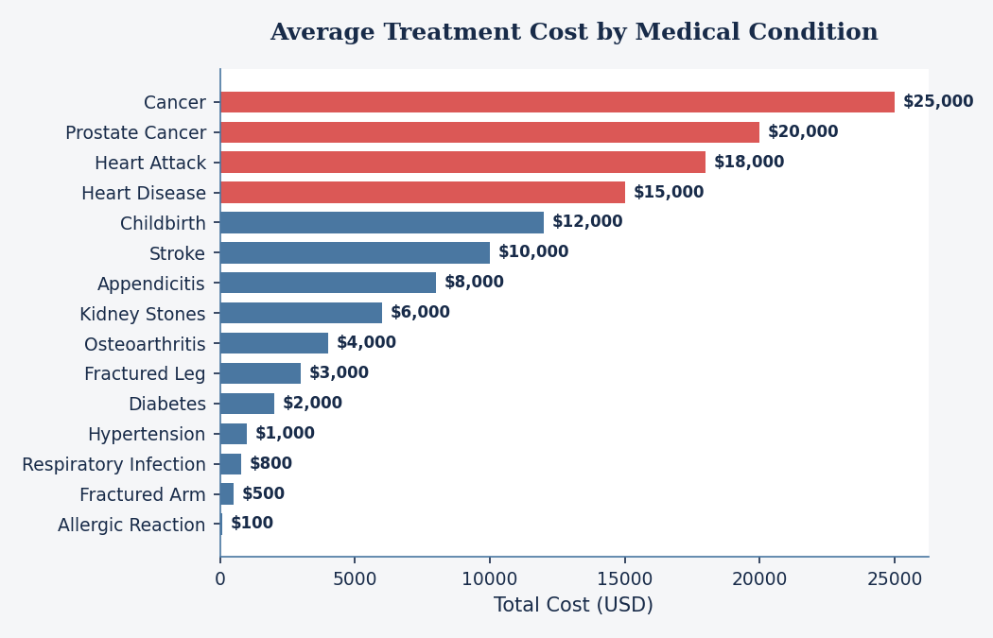
HOSPITAL PATIENT DATA ANALYSIS PROJECT
Financial Profile: Complex Care Drives High Cost Concentration
FINANCIAL INSIGHTS
• Steep Tiering structure: Chronic and surgical admissions dominate the cost distribution. Cancer costs peak at a fixed $25,000 per patient, Prostate Cancer at $20,000, and Heart Attack at $18,000.
• Minor Treatment Offsets: General infections (Respiratory at $800) and minor fractures (Arm at $500) operate at highly accessible, flat price-points.
• Budget Implications: Resource planning must focus capital on the highly volatile, high-cost surgical segments to manage annual hospital balance sheets.

Slide 7
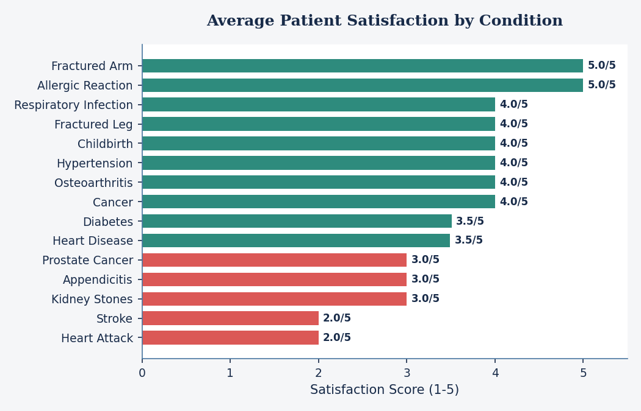
HOSPITAL PATIENT DATA ANALYSIS PROJECT
Operational Disconnect: Critically Low Patient Ratings in Severe Care
EXPERIENCE RE-ENGINEERING
• Severe Disconnect: Life-or-death situations (Stroke & Heart Attack) receive the lowest ratings (2.0/5.0), despite patients surviving and being clinically discharged.
• Operational Bottlenecks: Highly technical medical processes lack basic patient-centered amenities, communication, or follow-up reassurance.
• Audit Recommendation: Immediately launch specialized nurse-led counseling and patient feedback loops inside critical care departments.

Slide 8
HOSPITAL PATIENT DATA ANALYSIS PROJECT
Technical Architecture: Automated, In-Memory Data Engineering Pipeline
1. Ingestion
Read raw hospital.csv via Pandas DataFrame
Whitespace removal on columns at load time to avoid key match errors.
2. Cleansing
Date formatting & data coercion
Parsing admission/discharge dates in day-first format to prevent stay errors. Clean Yes/No.
3. Aggregation
Numpy & Pandas analytical groupbys
Targeted segmentation of costs, readmissions, stays, and regional patient distributions.
4. Visualization
Matplotlib graphic engine generation
Creating labeled histograms and horizontal bar charts to convey clinical outcomes.

Slide 9
HOSPITAL PATIENT DATA ANALYSIS PROJECT
Risk Management: Ensuring Patient Anonymization and Technical Compliance
Risk Category / Identifier | Severity & Likelihood | Engineered Mitigation Strategy
Date Parsing Failures (Mismatch in calendar format) | Medium Likelihood Moderate Severity | Forced explicit day-first date formatting in Pandas to properly ingest diverse international dates without crashing stay metrics.
Patient Privacy Breach (Regulatory non-compliance) | Low Likelihood Critical Severity | Framework strictly utilizes synthetic clinical records with randomized IDs. Zero real-world PII or protected health information is processed.
Database Corruptions (Accidental overwrites) | Low Likelihood High Severity | Implemented pure in-memory cleansing logic. No source files are modified or overwritten during analytics execution.

Slide 10
HOSPITAL PATIENT DATA ANALYSIS PROJECT
Comparative Analysis: Excel vs. Proprietary BI vs. Python Framework
Dimension | Microsoft Excel | Enterprise BI (Tableau/PowerBI) | Our Python Framework
Licensing Cost | Commercial license fees required | High recurring, per-seat premium pricing | 100% Free & Open-Source (BSD/MIT)
Data Limit | Hard ceiling of 1.04M rows; laggy | Scale limits dependent on server memory | Virtually unlimited row-size; memory-efficient
Automation | Basic clunky macros; fragile | Scheduled triggers but rigid architectures | Full API-level automation; easily containerized
Reproducibility | Highly vulnerable to manual manipulation | Static workbook structures; complex backups | Repeatable, self-documenting Jupyter Notebooks
Visual Control | Highly restricted built-in templates | Flexible widgets but hard to program custom layers | Pixel-perfect control with Matplotlib/Seaborn

Slide 11
HOSPITAL PATIENT DATA ANALYSIS PROJECT
Future Roadmap: Transitioning to Predictive Analysis & Cloud Delivery
Phase 1: Predictive ML
Integrate Scikit-Learn into the existing codebase. Build predictive models to forecast readmission probability based on age, gender, and stay duration.
Phase 2: Cloud Ingestion
Migrate the data engineering pipeline from Jupyter local script to Streamlit or Plotly Dash for automated online rendering on clinical servers.
Phase 3: Live EHR APIs
Incorporate live hospital database triggers (HL7 / FHIR APIs) to allow real-time clinical dashboards with auto-updating metrics.

Slide 12
Failure Points and Recovery Plan
Protecting the offline analytical prototype from data loss and unauthorized change
Single-point-of-failure
Local hospital.csv can be deleted or corrupted.
Current limitation
No automated backup or restore process.
Risk
Data deletion, corruption, unauthorized modification, and privacy exposure.
Recovery
Read-only raw file, separate cleaned file, versioned backups, and tested restoration.
Production upgrade
Database, role-based access, encryption, audit logs, automated backups, and a disaster-recovery plan.
Offline prototype: recovery controls are planned safeguards, not production capabilities.

