Slide 1


Game Analytics
By: Karthik Paranthaman
Game Labs

Slide 2
Introduction
Tools Used
EDA
Future Works
& Recommendation
Conclusion

Slide 3
INTRODUCTION
Aim :
Main aim of this study is to analyze key influencing factors involved in game ratings.
In this case study “Top Games in 2019” dataset was scraped from RAWG.
Additionally, Game Labs – Internal staff rating was also collected and compared in data studio.
Possibility of a ML model.
Case study to support:
    Game Labs Management.
    Gaming Professionals.
    Gaming Console Manufacturers.

Slide 4
EDA – Software Used
Platform | Algorithm / Tool | Purpose
RStudio 4.0 | Library(httr) | Fetching data from the web.
 | library(jasonlite) | Converting JSON data into readable character values.
 | Library(tidyverse) | Applying piping.
 | library(tidyr) | Data wrangling tools i.e: separate()
 | Library(stringr) | Data Wrangling.
 | Library(taskscheduleR) | Automate Web Scraping, Data Wrangling & Uploading data to Google sheets processes.
 | Library(readr) | Read data.
 | Library(googlesheets4) | Edit/Upload & Download Google sheets.
Google | Google Sheets | Storage of dataset.
 | Google Form | Game Labs Internal Rating data collection.
 | Data Studio | Dashboard Building.

Slide 5
EDA – UNI, BI & MULTI VARIATE ANALYSIS
As requested by the management, following attributes were selected for further analysis
  Game Title
  Released date
  Platforms
  Ratings
  Playtime
Following questions were asked to investigate further on this study.
  Game Title Vs Platforms
    Console manufacturers play a vital role in game rating than the game itself?
  Released Month Vs Playtime
    Does game released month influence the playtime? (i.e: summer holidays)
  Ratings Vs Platform
    Gaming experience differs console to console?
    What are top platforms and their ratings?

Slide 6
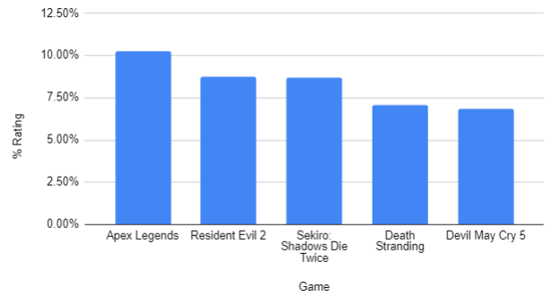
EDA – Univariate Analysis
  Top 5 rated games in RAWG
Top 5 Rated Games | Rating %
Apex Legends | 10.14%
Resident Evil 2 | 8.68%
Sekiro: Shadows Die Twice | 8.63%
Death Stranding | 7.18%
Devil May Cry 5 | 6.85%

Slide 7
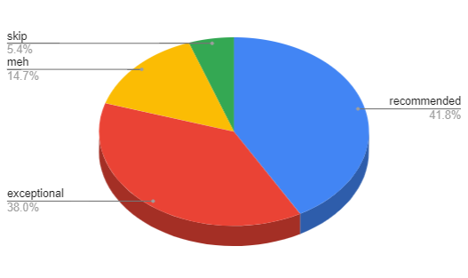
EDA – Univariate Analysis
  Types of Rating RAWG
Rating Type | Percentage of Total
Recommended | 41.84%
Exceptional | 38.04%
Meh | 14.69%
Skip | 5.43%

Slide 8
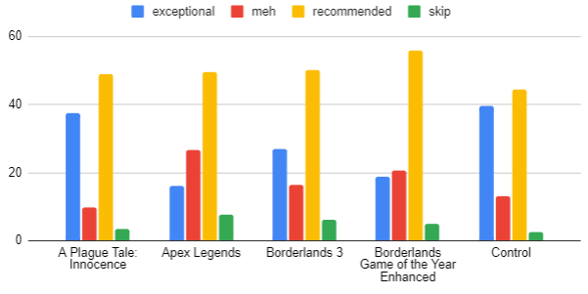
EDA – Univariate Analysis
  Top 5 “Exceptionally” Rated RAWG games.
Top 5 Games | Exceptional | Meh | Recommended | Skip
A Plague Tale: Innocence | 37.61 | 9.78 | 49.07 | 3.54
Apex Legends | 16.12 | 26.65 | 49.57 | 7.66
Borderlands 3 | 27 | 16.5 | 50.25 | 6.25
Borderlands Game of the Year Enhanced | 18.82 | 20.59 | 55.74 | 4.85
Control | 39.64 | 13.21 | 44.47 | 2.67

Slide 9
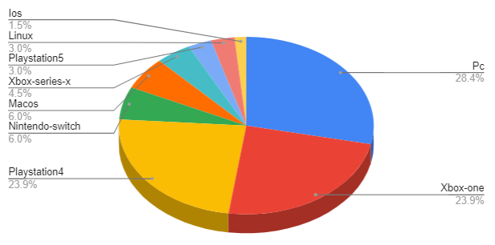
EDA – Univariate Analysis
  Game platforms used in the RAWG games.
Platform Type | Percentage of Total
Pc | 28.36%
Xbox-one | 23.88%
Playstation4 | 23.88%
Nintendo-switch | 5.97%
Macos | 5.97%
Xbox-series-x | 4.48%
Playstation5 | 2.99%
Linux | 2.99%
Ios | 1.49%

Slide 10
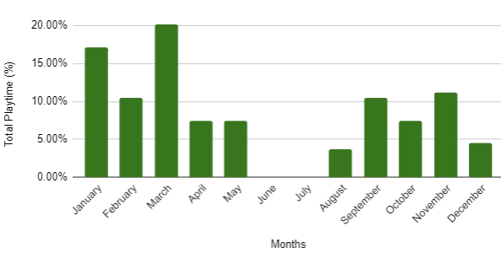
EDA – BI VARIATE ANALYSIS
  Spring Break
  Released Month Vs Playtime
Top 5 Rated Games | Released Month
Apex Legends | February
Resident Evil 2 | January
Sekiro: Shadows Die Twice | March
Death Stranding | November
Devil May Cry 5 | March
  Fall Break
  Summer Break
  Source Reference : https://www.edarabia.com/school-holidays-united-states/

Slide 11
EDA – BI VARIATE ANALYSIS
  Released Month Vs Playtime
Months | Total Playtime | % of Total Playtime
January | 23 | 17.16%
February | 14 | 10.45%
March | 27 | 20.15%
April | 10 | 7.46%
May | 10 | 7.46%
June | 0 | 0.00%
July | 0 | 0.00%
August | 5 | 3.73%
September | 14 | 10.45%
October | 10 | 7.46%
November | 15 | 11.19%
December | 6 | 4.48%

Slide 12
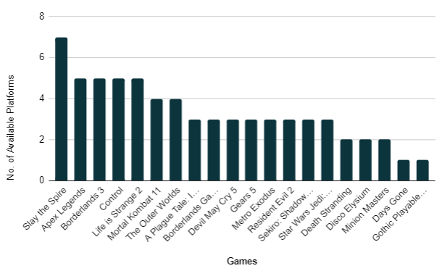
EDA – BI VARIATE ANALYSIS
Top 5 Rated Games | Platforms
Apex Legends | Pc, xbox-one, playstation4, nintendo-switch, macos
Resident Evil 2 | pc, xbox-one, playstation4
Sekiro: Shadows Die Twice | pc, xbox-one, playstation4
Death Stranding | pc, playstation4
Devil May Cry 5 | pc, xbox-one, playstation4
1
  Game Vs Platforms
5
2
3
4

Slide 13
EDA – BI VARIATE ANALYSIS
  Ratings Vs Platform
Platform Type | Percentage of Total
Pc | 28.36%
Xbox-one | 23.88%
Playstation4 | 23.88%
Nintendo-switch | 5.97%
Macos | 5.97%
Xbox-series-x | 4.48%
Playstation5 | 2.99%
Linux | 2.99%
Ios | 1.49%

Slide 14
Discussion
Released month does influence players game rating behavior.
  i.e. High playtime on games released during Spring Break.
  No games were released during Summer Break.
Gaming experience depends on the console used.
  i.e. Most popular consoles seem to be PlayStation - 4 & Xbox-one.
  Top 5 games ranked in this dataset are available in both PS4 & XBOX-one.
Dependency of console experience on game ratings.
  However, we need more evidence to prove this hypothesis right.
  As, the ratings are biased purely on gaming experience not the console based.
Questionnaire form, information are not included in the discussion in order to avoid an
“Algorithmic Biasness”.
Feel free to access the form via data studio dashboard link to rate games your favorite games.

Slide 15
Conclusion
In conclusion it can be said that, gaming rating highly dependent on parameters such as platforms used, released month and playtime. Furthermore, as the original dataset discusses, there are more hidden parameters which needs to be taken into consideration in order to improve the accuracy of our findings. (i.e. Genre, Store details etc.)

Slide 16
IMPROVEMENT & RECOMMENDATIONS
For Data Collection Team / Source:
The Reliability and the Quality of the data needs to be verified.
  i.e. Formula for overall gaming rating needs to be studied.
Geographical location information of the gamer would be more beneficial to study the user rating behavior in depth.
Improvement:
Unsupervised clustering technique can be implemented by including more key indicators.
  i.e. Genre, Game purchased store and etc.
ML model can be built and deployed at gaming competitions/workshops to predict the success rate of the game based on the user experience feedback.
  Sentiment Analysis ( Pre-released)

Slide 17
Thank You … !
By: Karthik Paranthaman
Game Labs

