Slide 1

Diggibyte (Python- venv (virtual Environment)

Slide 2
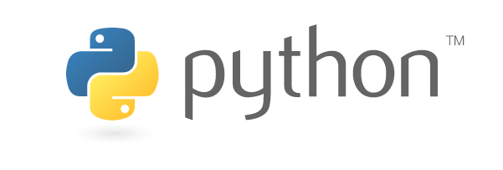
1
What is a virtual environment?
2
Creating a virtual environment
3
Activating & deactivating your virtual environment
4
Using pip to install python packages
2
Wharton Research Data Services

Slide 3



What is a Virtual Environment?
An environment for your user account
Install python packages without adversely affecting other users
Use different sets of packages for different projects
Project A requires Pandas 1.0
Project B requires Pandas 0.25
Solution ... create 2 separate virtual environments
3
Wharton Research Data Services

Slide 4
1
What is a virtual environment?
2
Creating a virtual environment on WRDS
3
Activating & deactivating your virtual environment
4
Using pip to install python packages
4
Wharton Research Data Services

Slide 5

Creating a Virtual Environment
The python –m venv command tells python it is creating a virtual environment
The --system-site-packages parameter indicates that the packages already installed in the server’s main python instance should also be included in the virtual environment
The ~/virtualenvs/environment01 directory path parameter indicates where the virtual environment should be created
5
Wharton Research Data Services

Slide 6

Creating a Virtual Environment
Leaving out the --system-site-packages parameter will create an empty virtual environment with only base python packages installed.
Also note that the ~/virtualenvs/environment01 path with create the virtual environment directory “environment01” as a subdirectory of “virtualenvs”. If you think you will need more than one virtual environment, this will keep them within a common location.
6
Wharton Research Data Services

Slide 7
1
What is a virtual environment?
2
Creating a virtual environment
3
Activating & deactivating your virtual environment
4
Using pip to install python packages
7
Wharton Research Data Services

Slide 8

Activate & Deactivate Virtual Environment
The environment can be activated with the command source [virtual environment path]/bin/activate. The path will depend on the directory path you chose in the prior step.
When the environment is successfully activated you will see its name at the command prompt, as seen above.
To exit the virtual environment, simply enter the deactivate command. You should no longer see the environment name at the prompt.
8
Wharton Research Data Services

Slide 9
1
What is a virtual environment?
2
Creating a virtual environment
3
Activating & deactivating your virtual environment
4
Using pip to install python packages
9
Wharton Research Data Services

Slide 10
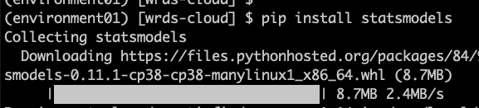
Using pip to Install Python Packages
The pip command can be used within an activated virtual environment to install a packaged.
For a searchable python package index, visit https://pypi.org/
10
Wharton Research Data Services

Slide 11
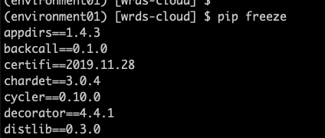
Using pip to Install Python Packages
The command pip freeze will display a list of all the packages that are currently installed in the environment.
11
Wharton Research Data Services

