Slide 1

Diggibyte

Slide 2
Tuples

Slide 3
Data structure in python.
It is another sequence data type that is similar to the list.
Unlike list tuples are enclosed within parameters,() and values separated by commas
The value that make up tuple are called its elements.
Elements need not be of the same datatype, they can be heterogeneous
Tuples are immutable: we cannot perform insert, update and delete operations
Eg: tup = (10,20,30)

Slide 4
Tuple creation
Tuple is enclosed in parentheses() for creation and each item is separated by a comma.
Eg: digits = (0,1,2,3,4,5,6)
An empty tuple: tup =()
Heterogeneous tuple: tup = ('hello',1,2,6.5,'Python')
Singleton Tuple:
If a tuple comprises a single element, the elemnt should be followed by a comma to distingush a tuple from a parenthesized expression
tup = (70,)
We can create tuple using buit-in function tuple, using function tuple we can create empty tuple and tuple can be created by accepting user input using while/for loop

Slide 5
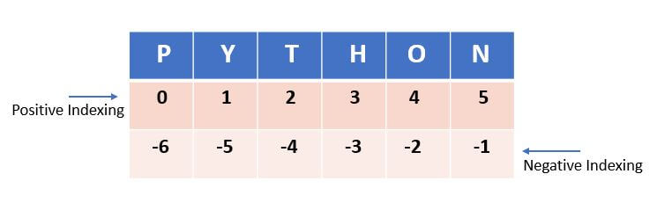
Nesting of tuples
Tuples can be placed inside other tuples.
When you add one or more tuples inside another tuple, the items in the nested tuples are combined together to form a new tuple
Eg: ((0, 1, 2, 3), ('python', 'book'))
Accessing and traversing a Tuple
Individual elements of a tuple can be accessed through indexes
Elements of a tuple can be accessed using an indexing method
Traversing a tuple means accessing each element of a tuple. This can be done using either for or while loop.

Slide 6
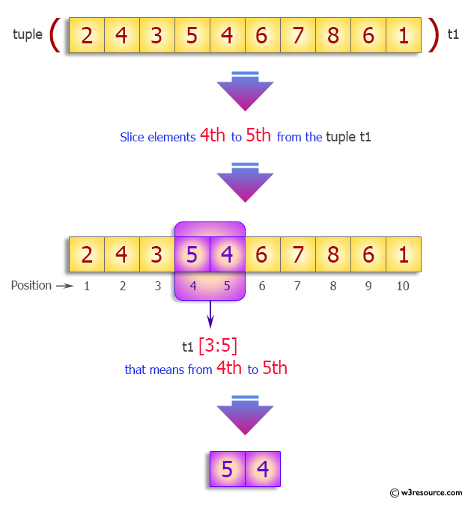
Tuple Slicing
Used to retrieve a subset of values.
A slice of a tuple is basically its sub-tuple
Syntax : tuple_name[start: stop: step]

Slide 7
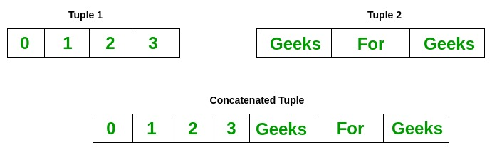
Tuple Concatenation
New elements can be added to a tuple using ‘+’ operator
Can use ‘+’ operator with tuple slice
‘+’ operator performs concatenation with tuples only
Tuple Multiplication
(*) is used for repetition of the tuple
‘in’ and ‘not in’ membership operator
‘in’ operator checks whether a given element is contained in a tuple. It returns Boolean value
‘not in’ operator returns true if element does not appear in the tuples, o.w return false

Slide 8
Tuple functions
len()
Returns the length of a tuple i.e. count the total number of elements in a tuple
Syntax: len(tuple_name)
Count()
Count the occurrences of an item in the tuple
Index()
Index gives the indexing value of an item
Syntax: tuple.index(value,start,end)
Min() and Max()
Max() function will return the element with maximum value from the tuple.
Min() function shall return the element with minimum value from the tuple
To use min and max function, all values in the tuple must be of same type

Slide 9
Sorted ()
Used to sort the elements of a tuple
It returns a list after sorting
Deleting a tuple
The del statement is used to delete a tuple
Tuples have the following features:
We can’t add elements to a tuple because of their immutable property
There’s no append or extend method for tuples
We cant remove elements from a tuple, bcz of their immutability.
Tuples have no remove() or pop( ) method.

Slide 10
Sets

Slide 11
A Python set is the collection of the unordered items.
Each element in the set must be unique, immutable, and the sets remove the duplicate elements.
Sets are mutable which means we can modify it after its creation.
Unlike other collections in Python, there is no index attached to the elements of the set, i.e., we cannot directly access any element of the set by the index.
However, we can print them all together, or we can get the list of elements by looping through the set.
Eg: Days = {"Monday", "Tuesday", "Wednesday", "Thursday", "Friday", "Saturday", "Sunday"}

Slide 12
Creating sets
The set can be created by enclosing the comma-separated immutable items with the curly braces {}.
Python also provides the set() method, which can be used to create the set by the passed sequence.
Creating an empty set is a bit different because empty curly {} braces are also used to create a dictionary as well.
So Python provides the set() method used without an argument to create an empty set.
Adding items to the set
Python provides the add() method and update() method which can be used to add some particular item to the set.
The add() method is used to add a single element
Whereas the update() method is used to add multiple elements to the set.

Slide 13
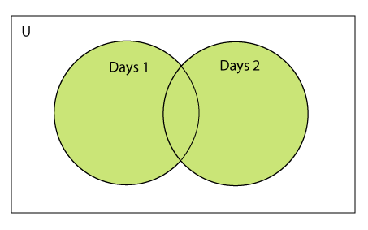
Removing items from the set
Python provides the discard() method and remove() method which can be used to remove the items from the set.
The difference between these function, using discard() function if the item does not exist in the set then the set remain unchanged whereas remove() method will through an error.
We can also use the pop() method to remove the item.
Generally, the pop() method will always remove the last item but the set is unordered, we can't determine which element will be popped from set.
Python Set Operations
Union of two Sets
The union of two sets is calculated by using the pipe (|) operator. The union of the two sets contains all the items that are present in both the sets.

Slide 14
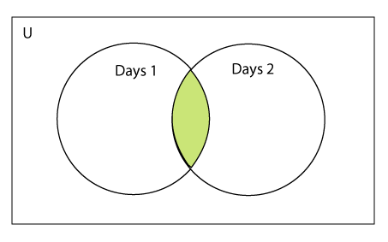
Intersection of two sets
The intersection of two sets can be performed by the and & operator or the intersection() function.
The intersection of the two sets is given as the set of the elements that common in both sets.
The intersection_update() method
The intersection_update() method removes the items from the original set that are not present in both the sets (all the sets if more than one are specified).
The intersection_update() method is different from the intersection() method since it modifies the original set by removing the unwanted items, on the other hand, the intersection() method returns a new set.

Slide 15
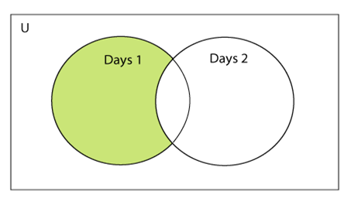
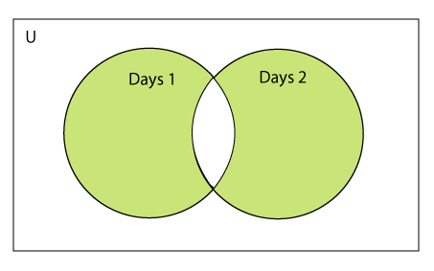
Difference between the two sets
The difference of two sets can be calculated by using the subtraction (-) operator or intersection() method.
Suppose there are two sets A and B, and the difference is A-B that denotes the resulting set will be obtained that element of A, which is not present in the set B.
Symmetric Difference of two sets
The symmetric difference of two sets is calculated by ^ operator or symmetric_difference() method.
Symmetric difference of sets, it removes that element which is present in both sets.

Slide 16
FrozenSets
The frozen sets are the immutable form of the normal sets, i.e., the items of the frozen set cannot be changed and therefore it can be used as a key in the dictionary.
The elements of the frozen set cannot be changed after the creation.
We cannot change or append the content of the frozen sets by using the methods like add() or remove().
The frozenset() method is used to create the frozenset object.
The iterable sequence is passed into this method which is converted into the frozen set as a return type of the method.

Slide 17
Dictionary

Slide 18
Python dictionary is an unordered collection of items where each item is a key-value pair.
Dictionary is a mapping between a set of keys/indices and a set of values.
Each key map to a value. The association of a key and a value is called a key- value pair
Each key is separated from its value by a colon(:), the items are separated by commas
Keys are unique while values may not be.
The value of a dictionary can be of any type, but keys must be of an immutable data type.
Dictionary is mutable. We can add new items or change the value of existing items

Slide 19
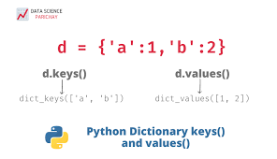
Creating a Dictionary
Dictionary can be created by placing items (i.e., key-value pair) inside curly braces {} separated by commas
A dictionary is extremely useful data storage construct for storing and retrieving all key value pairs, where each element is accessed by a unique key.
Accessing and Traversing elements in a dictionary
To access dictionary elements we can use square brackets along with key to obtain its value
Traversing a dictionary means accessing each element of a dictionary.

Slide 20
Appending values in a Dictionary
We can add new elements to the existing dictionary, extend it with single pair of values or join two dictionaries into one.
Syntax: Dictionary_name[key] = value
Updating elements in a dictionary
We can update it by modifying existing key-value pair or by merging another dictionary to an existing one
Syntax: Dictionary[key]= value
Merging
Two dictionaries can be merged into one using update() method.
Syntax : dict_name1.update(dict_name2)
Using this dict_name2 is added to dict_name1

Slide 21
Removing an item
Using del command
Syntax: del dicname[key]
Using pop () method
Syntax: Dictname.pop(key)
Pop method will not only delete the item from the dictionary, but also return the deleted value
Functions
Len()
Returns number of key-value pairs in the given dictionary
Syntax: len(d)
Clear()
It removes all items from the particular dictionary
Syntax: d.clear()

Slide 22
Get( ) method:
Returns a value for the given key.
If key is not available, then returns default value None
Syntax : dict.get(key, default = None)
Key – value to be searched in the dictionary
Default – this is the value to be returned in case the key doesnot exist
Items()
Returns the content of dictionary as a list of tuples having key-value pairs
Syntax: D.items()
Keys()
Returns a list of the key values in a dictionary
Syntax: D.keys()
Values()
Returns alist of values from key-value pairs in a dictionary
Syntax: D.values()

Slide 23
Bundle packages in python

Slide 24
Python packages
A Python package usually consists of several modules. Physically, a package is a folder containing modules and maybe other folders that themselves may contain more folders and modules.
A package is the form of a collection of tools which helps in the initiation of the code.
A python package acts as a user-variable interface for any source code.
This makes a python package work at a defined time for any functionable code in the runtime.
A Python module may contain several classes, functions, variables, etc. whereas a Python package can contains several module.
In simpler terms a package is folder that contains various modules as files.

Slide 25
Creating Package
Let’s create a package named mypckg that will contain two modules mod1 and mod2. To create this module follow the below steps –
Create a folder named mypckg.
Inside this folder create an empty Python file i.e. __init__.py
Then create two modules mod1 and mod2 in this folder.

Slide 26
Module
A module is a file containing Python code in run time for a user-specific code. A package also modifies the user interpreted code in such a way that it gets easily functioned in the run time.
A module is a pythonic statement which contains multiple functions in it. Modules act as a pre-defined library in the code, which is accessible to both coder and user.
Example:
Import module_name
When the import is used, it searches for the module initially in the local scope by calling __import__() function. The value returned by the function is then reflected in the output of the initial code.

Slide 27
Import packages
Python modules can get access to code from another module by importing the file/function using import.
import module_name.member_name
In the above code module, math is imported, and its variables can be accessed by considering it to be a class and pi as its object.
The value of pi is returned by __import__(). pi as a whole can be imported into our initial code, rather than importing the whole module.
from module_name import *
In the above code module, math is not imported, rather just pi has been imported as a variable. All the functions and constants can be imported using *.

Slide 28

Importing a Python Package
We’ll import a package using the import statement:
Namespaces and Aliasing
When we had imported the math module, we initialized the math namespace. This means that we can now refer to functions and classes from the math module by way of “dot notation”:
Syntax:
Import <some package> as name

Slide 29
Distribution packages
A versioned archive file that contains Python packages, modules, and other resource files that are used to distribute a Release.
The archive file is what an end-user will download from the internet and install.
Source Distribution (or “sdist”):
A distribution format (usually generated using python setup.py sdist) that provides metadata and the essential source files needed for installing by a tool like pip, or for generating a Built Distribution.

Slide 30
Built-in distribution
Built distribution(bdist)– It creates distribution which includes .pyc files(python bytecode)
Setup.py:
setup.py is a python file, which usually tells the system that, the module/package you are about to install has been packaged and distributed using Distutils, which is the standard for distribution of python modules.
It is the most important file. It’s the file where various aspects of your project are configured. The primary feature of setup.py is that it contains a global setup() function.
The keyword arguments to this function are how specific details of your project are defined.

Slide 31
PyPI
The Python Package Index (PyPI) stores metadata describing distributions packaged with distutils and other publishing tools, as well the distribution archives themselves

Slide 32
# import setup function from python distribution utilities
from distutils.core import setup
# Calling the setup function
setup(
name = 'nesters',
version = '1.0.0',
py_modules = ['addition'],
author ='a keeg’,
author_email = 'akeeg@gmail.com',
url = 'https;//akeeg.com',
description = 'a simple program to add two numbers',
keywords='adds two numbers',
)

Slide 33
name: It is the name of the project. The package will be listed by this name on PyPI.
version: It is a string which can specify the current version of the project. It is totally your choice how you want to set the scheme of the series of versions (‘1.0’ or ‘0.1’ or even ‘0.0.1’ can also be used). This version is displayed on PyPI for each release if the project is published. Every-time a new version is uploaded, you will have to change this argument as well.
description: A short description about the package. Long description argument can be used for long descriptions.
url: A homepage URL for the project. This makes it easier for people to follow or contribute to the project.
author, author_email: Details about the author.
license: specify the type of license which is used.
classifiers: It is a list of strings which can specify more details about the project like its development status, topic, license and supported python versions for the project.
install_requires: It can be used to specify what third-party libraries your package needs to run. These dependencies will be installed by pip when someone installs your package.
keywords: List keywords to describe the project.

Slide 34
Script in python
A Python script, the file containing the commands, is structured to be executed like a program. These files are designed to contain various functions and import various modules. Python interactive shell or the respective command line is used to execute the script, to perform a specific task

Slide 35






LET’S CONNECT
info@diggibyte.com
www.diggibyte.com
+91 81108 89199
Novel Tech Park, Ground Floor, Kudlu Gate, Bengaluru, Karnataka.
Pin Code: 560068

