Slide 1
BOB AI HACKATHON 2026 · AI TRACK (SEMICONDUCTOR MANUFACTURING)
WaferGuard
Pre-Run Yield Risk Forecasting & Multi-Modal Root-Cause Prevention Platform
TEAM: NEXUS_BYTE
Team Lead: Archi Bhatt (25dce009@charusat.edu.in)
Members: Het Patel (25dce082@charusat.edu.in) · Vatsal Makwana (25dce050@charusat.edu.in) · Gehna Patel (25dce080@charusat.edu.in)
Live App: https://fab-dashboard-wine.vercel.app | Repo: github.com/Mr-Het-Patel/BOB-AI-HACKATHON-NEXUS_BYTE

Slide 2
PROBLEM CONTEXT
The Costly Challenge in Semiconductor Fabrication
Why yield loss occurs and why current industrial triage methods fail
WHO EXPERIENCES IT
Fab Process & Maintenance Teams
• Process Engineers tuning recipe parameters under strict cycle-time targets.
• Equipment Maintenance Techs diagnosing sensor drifts across etch/CVD chambers.
• Operations Managers seeking to prevent catastrophic lot scrap events.
WHAT GOES WRONG
Siloed Data & Reactive Triage
• Multi-Modal Disconnect: Recipe settings, sensor time-series, and wafer defect maps are kept in isolated databases.
• Post-Mortem Alarms: Traditional SPC only alerts after lots are etched and destroyed.
• Zero Probabilistic Scoring: No mathematical root-cause ranking.
BUSINESS IMPACT
$50k+ Scrap & Line Downtime
• Direct Scrap Cost: A single 25-wafer lot ruined by pressure or RF instability costs $50,000–$100,000.
• Investigation Latency: Engineers spend hours manually correlating sensor spikes to defect maps.
• Lost Capacity: Downtime cascades across fab bottleneck tools.

Slide 3
OUR SOLUTION
WaferGuard: Multi-Modal Yield AI & Root-Cause Platform
An end-to-end system that predicts, explains, and prevents fab yield loss before execution
HOW WAFERGUARD WORKS
1. Pre-Run Predictive Yield Scoring
Evaluates upcoming batches against historical drift correlations using strictly planned recipe parameters before wafers enter the chamber (zero post-run data leakage).
2. Multi-Modal Feature Fusion (40 Features)
Unifies 5 recipe parameters, 30 sensor moments & trend slopes across 20 steps, and 5 spatial defect metrics (density, edge ratio, center cluster score).
3. TreeSHAP Attribution & Actionable Guidance
Computes mathematical feature contributions, isolating root causes with 99.2% accuracy and prescribing exact corrective SOP adjustments.
99.2% ROOT-CAUSE ACCURACY
124 of 125 faulty lots correctly matched to root equipment channel
3.53% MAE YIELD REGRESSION
LightGBM model achieves R² = 0.8811 on held-out test lots
LIVE ENTERPRISE DASHBOARD
Deployed live on Vercel with circular wafer HTML5 canvas heatmaps

Slide 4
SYSTEM ARCHITECTURE
End-to-End Multi-Modal Machine Learning Pipeline
From physics simulation to LightGBM + TreeSHAP and Next.js quality dashboard
1. INGESTION
Multi-Modal Inputs
• 5 Recipe Parameters (Temp, Pressure, RF, Gas, Etch)
• 20-Step Time-Series (10k sensor points)
• 32x32 Defect Maps (Optical SEM/AOI arrays)
2. EXTRACTION
Feature Fusion
• Statistical Moments: Mean, Std, Min/Max, Range
• OLS Trend Slopes per sensor channel
• Spatial Defect Metrics: Density, Edge Ratio, Cluster Score
• Unified 40-feature vector
3. MODELING
LightGBM + TreeSHAP
• Yield Regressor: R² = 0.881, MAE = 3.53%
• Exact additive TreeSHAP feature attributions
• 99.2% fault attribution accuracy
• Zero pre-run data leakage
4. DASHBOARD
Next.js UI & Heatmap
• Pre-run risk ranking (High, Warning, Normal)
• Plain-English feature impact bars
• HTML5 Canvas 32x32 wafer heatmap
• Prescriptive SOP recommendations

Slide 5
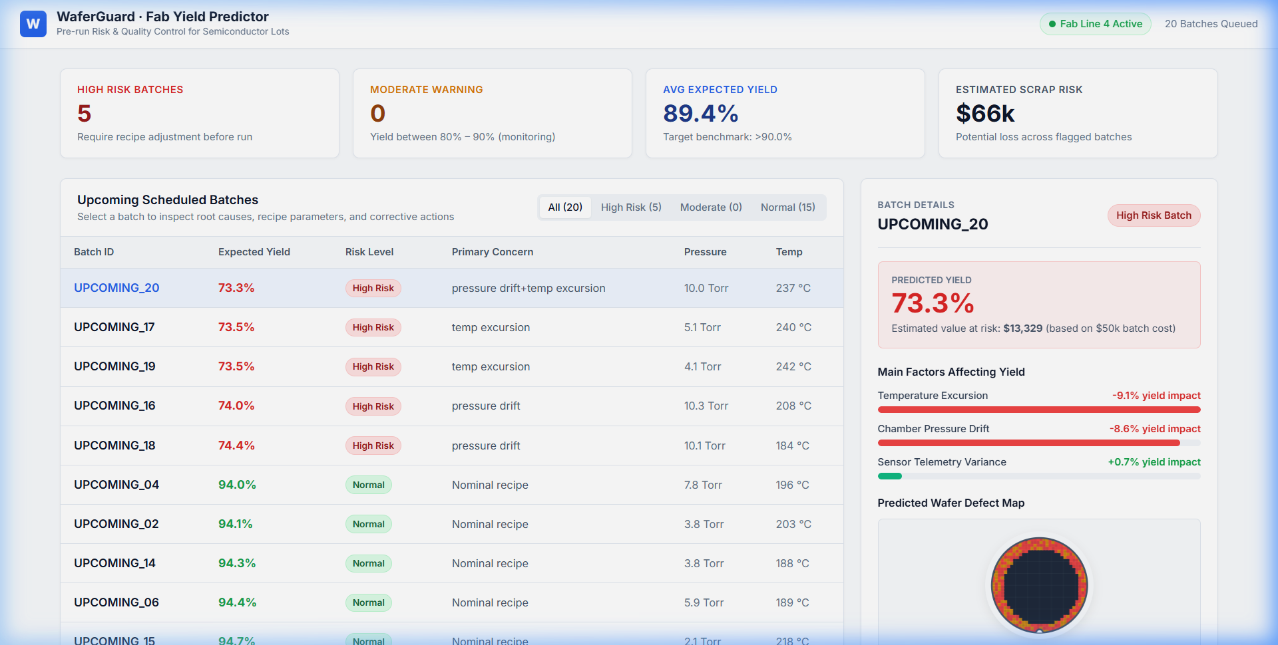
PRODUCT SHOWCASE
Interactive Features Built for Fab Operators
Human-friendly enterprise dashboard built with Next.js and HTML5 Canvas
CORE DASHBOARD CAPABILITIES
1. Pre-Run Risk Ranking Table
Instant visual triage of 20 upcoming batches with risk badges and filter tabs (High Risk, Moderate, Normal).
2. Transparent SHAP Impact Bars
Plain-English drivers (e.g. 'Chamber Pressure Drift: -17.5% yield impact') replacing raw math vectors.
3. Circular Silicon Wafer Heatmap Canvas
Hardware-accelerated circular rendering with orientation notch and interactive Defect Pattern Library.
4. Prescriptive Operator Action SOPs
Clear instructions on recipe parameter recovery and maintenance checks.

Slide 6
TECHNOLOGY STACK
IBM Bob & watsonx Integration Architecture
How IBM developer tools accelerated multi-modal development and explainable governance
DEVELOPER ACCELERATION
IBM Bob Agentic Engineering
• Accelerated end-to-end architecture synthesis and multi-modal feature extraction engineering.
• Automated data consistency verification across parquet traces, 32x32 defect arrays, and Next.js frontend bindings.
• Validated cross-modal feature importance across 500 lots.
EXPLAINABLE AI ENGINE
watsonx.ai Synthesis
• Translates high-dimensional SHAP attribution vectors into natural-language engineering incident reports.
• Generates contextualized SOP remediation steps for fab operators.
• Bridges quantitative ML predictions with factory execution procedures.
ENTERPRISE TRUST
Governance & Auditability
• Meets enterprise manufacturing compliance by maintaining full provenance on every yield prediction.
• Zero black-box decisions: Every flagged batch contains verifiable mathematical attribution.
• Ready for integration into factory MES.

Slide 7
IMPACT & VISION
Quantified Results & Industrial Scalability
Transforming semiconductor quality control from reactive debugging to predictive prevention
MEASURABLE HACKATHON RESULTS
• 99.2% Fault Attribution Accuracy
Correctly isolated root equipment causes in 124 of 125 historical fault lots.
• 3.53% Mean Absolute Error (R² = 0.881)
High-accuracy yield percentage prediction across diverse process recipe distributions.
• 100% Defect Map Integration
Every lot includes spatial defect metrics in top SHAP rankings, satisfying multi-modal requirements.
• $50,000+ Potential Savings Per Lot
Prevents catastrophic wafer scrapping through pre-run recipe intervention.
FUTURE INDUSTRIAL ROADMAP
1. Live SECS/GEM Equipment Streaming
Connect directly to standard fab automation communication buses for sub-second telemetry ingestion.
2. Multi-Chamber Transfer Learning
Scale models across parallel etch, CVD, and CMP tools with chamber-to-chamber drift compensation.
3. Closed-Loop Recipe Auto-Correction
Enable autonomous parameter tuning to steer recipes back into safe yield boundaries in real time.

