Slide 1



Name of Project: Real-Time Air Quality Prediction System

Slide 2

Learning Objectives
Understand the concept of air quality and the importance of monitoring pollutants like PM2.5, PM10, CO, NO₂, SO₂, and O₃.
Learn how to collect and preprocess real-time air quality data using APIs and synthetic datasets.
Apply machine learning regression models to predict future air quality levels.
Evaluate model performance using metrics such as Mean Absolute Error (MAE) and R² Score.
Gain experience in Python libraries like Pandas, NumPy, Scikit-learn, and Requests for real-time prediction tasks.
Understand the role of predictive analytics in addressing environmental issues and supporting smart city initiatives.
Develop skills to visualize predictions and interpret results for better decision-making.
GOAL
Source :
www.freepik.com/

Slide 3
Tools and Technology used
Programming Language: Python
Development Environment: Jupyter Notebook / Google Colab
Libraries & Frameworks:
Pandas & NumPy → Data collection, cleaning, and preprocessing
Scikit-learn → Machine learning model building & evaluation
Matplotlib / Seaborn → Data visualization & graphical analysis
Requests → Fetching real-time air quality data from APIs
Joblib → Saving and loading trained models
Dataset Source:
OpenAQ API (real-time air quality data)
Synthetic dataset (for fallback / testing)
Version Control: GitHub (for project storage and collaboration)
Operating System: Windows / Linux (cross-platform support)

Slide 4
Methodology
1.Problem Identification
Need for real-time monitoring & prediction of air quality
Focus on key pollutants: PM2.5, PM10, NO₂, SO₂, O₃, CO
2. Data Collection
Real-time pollutant data via OpenAQ API
Synthetic dataset for testing & backup
3. Data Preprocessing
Handle missing values & outliers
Format timestamps correctly
Normalize & structure dataset
4. Model Selection & Training
Regression models: Linear Regression, Random Forest, Decision Tree
Train models with historical data
5. Model Evaluation
Performance metrics: MAE, R² Score
Compare models for best accuracy
6. Prediction & Visualization
Generate real-time pollutant predictions
Use graphs & charts for interpretation
7. Deployment
Integrate trained model into system
Provide outputs for awareness & decision-making

Slide 5
Problem Statement:
Air pollution has become a critical global challenge that directly affects human health, the environment, and overall quality of life. With the rapid increase in urbanization, industrialization, and vehicular emissions, pollution levels in many cities have risen beyond safe limits. Pollutants such as PM2.5, PM10, NO₂, SO₂, O₃, and CO are known to cause severe health issues including respiratory diseases, cardiovascular problems, and premature deaths.
Existing air quality monitoring systems primarily provide real-time or historical data but lack accurate predictive insights that can forecast future pollution levels. Without such predictions, citizens, policymakers, and healthcare authorities are unable to take timely preventive actions to reduce exposure and mitigate risks.
Additionally, in many regions, data gaps, missing values, and irregular updates make it difficult to rely solely on raw monitoring stations. There is a strong need for an intelligent, machine learning–based system that can process real-time data, handle inconsistencies, and generate reliable forecasts of air quality trends.
Therefore, the problem is to design and implement a Real-Time Air Quality Prediction System that not only monitors pollutants but also predicts future air quality with accuracy. Such a system can help in awareness generation, policy planning, and early warnings, contributing towards sustainable development and healthier communities.

Slide 6
Solution:
To address the challenges of air pollution monitoring and forecasting, this project proposes a Real-Time Air Quality Prediction System that combines data collection, machine learning, and visualization for accurate and actionable insights.
Real-Time Data Collection
Fetch air quality data from the OpenAQ API.
Use a synthetic dataset as backup for testing and training.
Data Preprocessing
Handle missing values and outliers.
Normalize and structure data for better model performance.
Machine Learning–Based Prediction
Train multiple regression models such as Linear Regression, Random Forest, and Decision Tree.
Select the best-performing model using MAE and R² Score.
Real-Time Forecasting
Generate future pollutant level predictions based on historical and live data.
Provide insights into upcoming pollution spikes.
Visualization & Decision Support
Display results through graphs, charts, and dashboards for easy interpretation.
Help citizens, policymakers, and health authorities take proactive measures.
Deployment & Accessibility
Deploy the trained model into a real-time system.
Make the solution accessible for awareness, planning, and sustainable development initiatives.

Slide 7
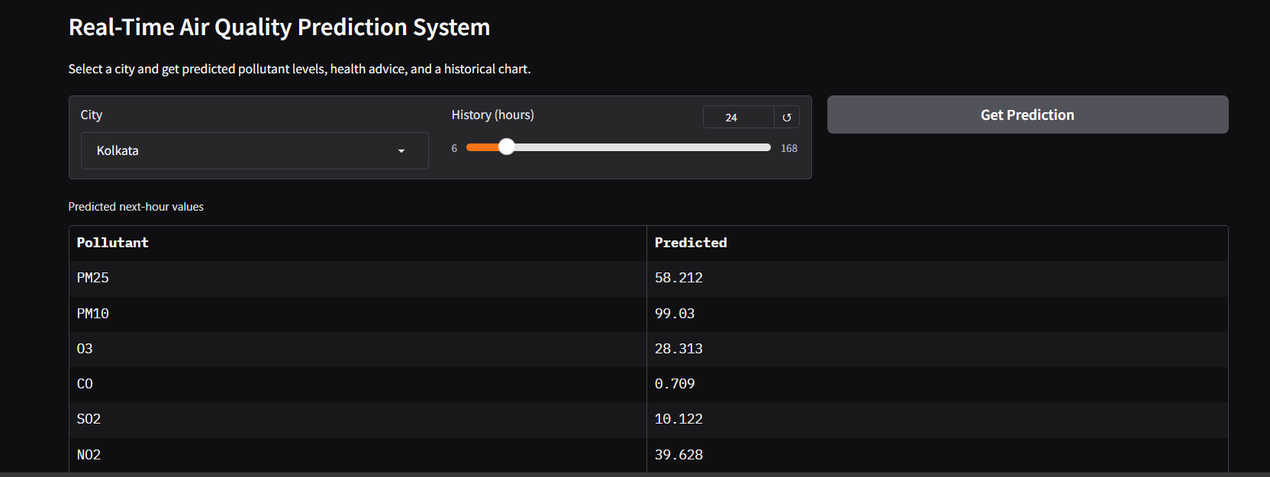
Screenshot of Output:

Slide 8
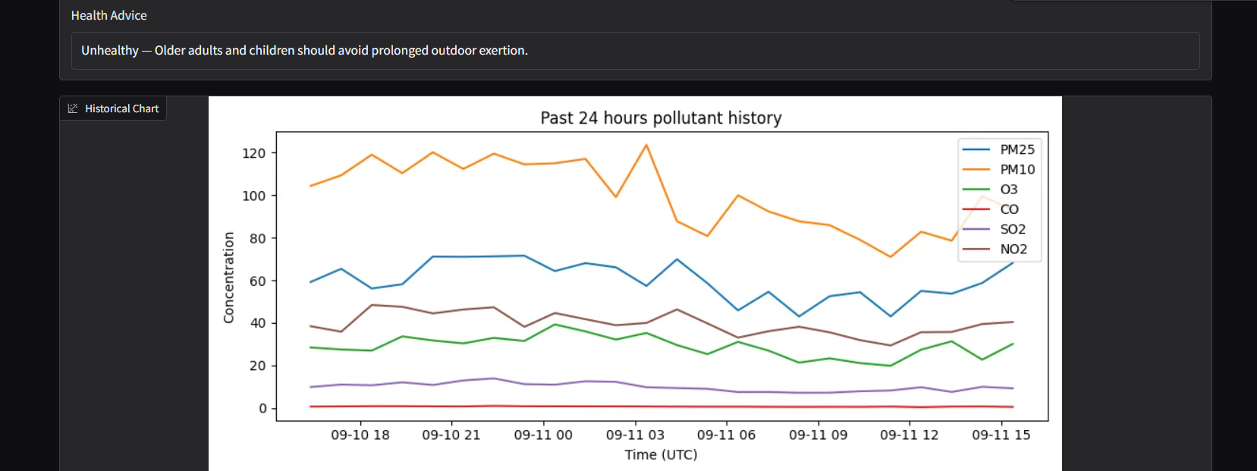

Slide 9
Conclusion:
The project successfully demonstrates a machine learning–based approach for predicting real-time air quality levels.
By integrating real-time data collection, preprocessing, model training, and visualization, the system provides accurate forecasts of pollutant levels such as PM2.5, PM10, NO₂, and others.
Evaluation using metrics like MAE and R² Score ensures the reliability of the prediction models.
The system can be applied in smart cities, environmental monitoring, and public health planning to raise awareness and provide early warnings about pollution spikes.
This solution highlights the importance of predictive analytics in combating environmental challenges and contributes towards sustainable and healthier communities.
Future scope includes integrating IoT sensors, deep learning models, and mobile applications for wider accessibility and higher accuracy.

