Slide 1

Copyright Incorporated Ecommerce Database
Presented by: Corin Canepa, John Luke Denny, Caleb WallS, and Cole Mckay

Slide 2
Goal and Motivation
The Problem
Tracking customer and seller accounts for an ecommerce site
Tracking items for sale and customer purchases
Where did we get our data?
Mackaroo (Random Data Generator)
Size and Format
7 Tables each between 100 – 400 rows of data
Tracking Shipping Statuses
About Our Project
Notes:
Caleb

Slide 3
Database Design
Normalization
Level 2
We have a total of 7 tables:
Account
Address
Cart
CartItem
Customer
Item
Seller
Constraints and Assumptions
Every account has a unique ID.
No account can have a NULL value
Notes:
Caleb

Slide 4
Database Design Continued
•Account-
oAccount_ID INT not Null,
oEmail Varchar(30),
oFirstName Varchar(10),
oLastName Varchar(10),
oPhone Varchar(12),
oIsSeller Boolean not null,
oPrimary key (Account_ID)
•Customer-
oCustomer_ID varchar(20) not null,
oCart_ID varchar(20) not null,
oAccount_ID int not null,
oPrimary Key (Customer_ID),
oForeign Key (Account_ID) references Account(Account_ID)
Seller-
oSeller_ID int not null,
oCompany_Name Varchar(30),
oAccount_ID int not null,
oPrimary Key (Seller_ID),
oForeign Key (Account_ID) references Account(Account_ID)
Notes:
JL

Slide 5
Database Design Continued
Address-
oAddress_ID int not null,
oAddress varchar(30) not null,
oCity varchar(20) not null,
oState varchar(20) not null,
oAccount_ID int,
oPrimary Key (Address_ID),
oForeign Key (Account_ID) references Account(Account_ID)
Item-
oItem_ID int not null,
oCategory varchar(20) not null,
oItemPrice float not null,
oSeller_ID int not null,
oPrimary key (Item_ID),
oForeign key (Seller_ID) references Seller(Seller_ID)
Notes:
JL

Slide 6
Database Design Continued
Cart_Item-
oQuantity int,
oCartItem_ID varchar(12) not null,
oPurchased boolean,
oStatus varchar(10) not null,
oCart_ID varchar(12) not null,
oItem_ID int not null,
oAddress ID int not null,
oOrder Date date varchar(12),
oPrimary Key(CartItem_ID),
oForeign Key (Cart_ID) references Cart(Cart_ID),
oForeign Key (Item_ID) references Item(Item_ID),
oForeign Key (Address_ID) references Address(Address_ID)
Cart-
oAccount_ID int not null
oCustomer_ID varchar(20) not null,
oCart_ID varchar(12) not null,
oForeign Key(Account_ID) references Account(Account_ID)
Notes:
JL

Slide 7
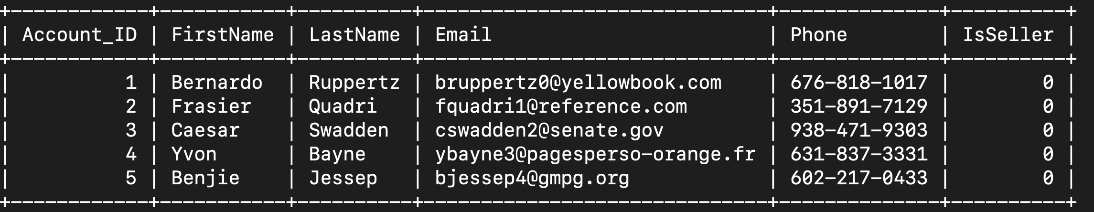
Database Data Example: Accounts
Notes:
JL

Slide 8
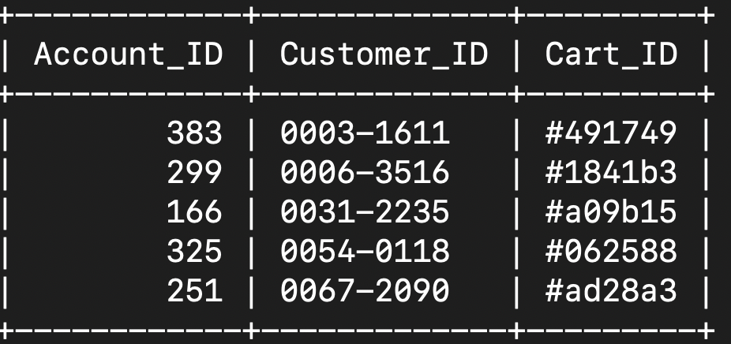
Database Data Example: Customer
Notes:
JL

Slide 9
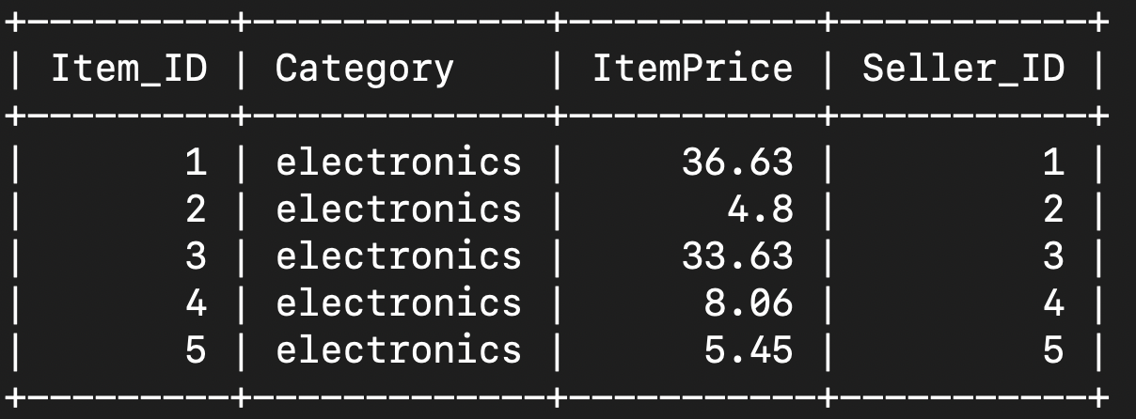
Database Data Example: Item
Notes:
JL

Slide 10
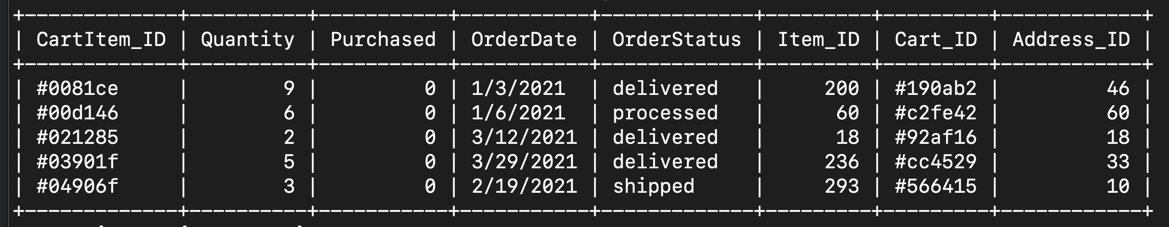
Database Example: Cart Item
Notes:
JL

Slide 11
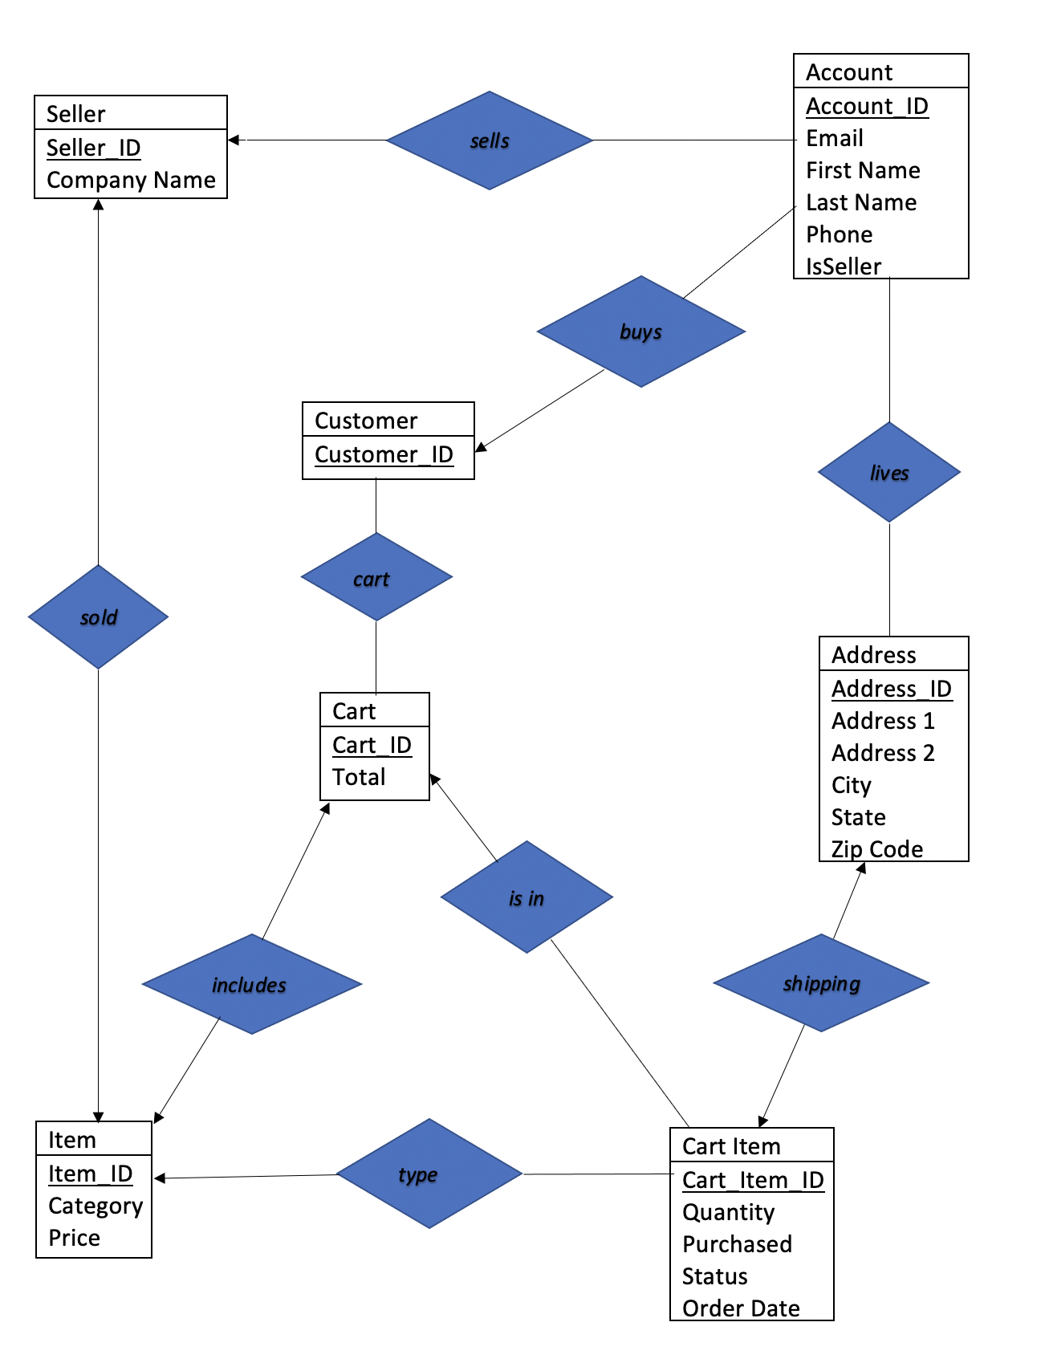
ER Diagram
Notes:
Cole

Slide 12
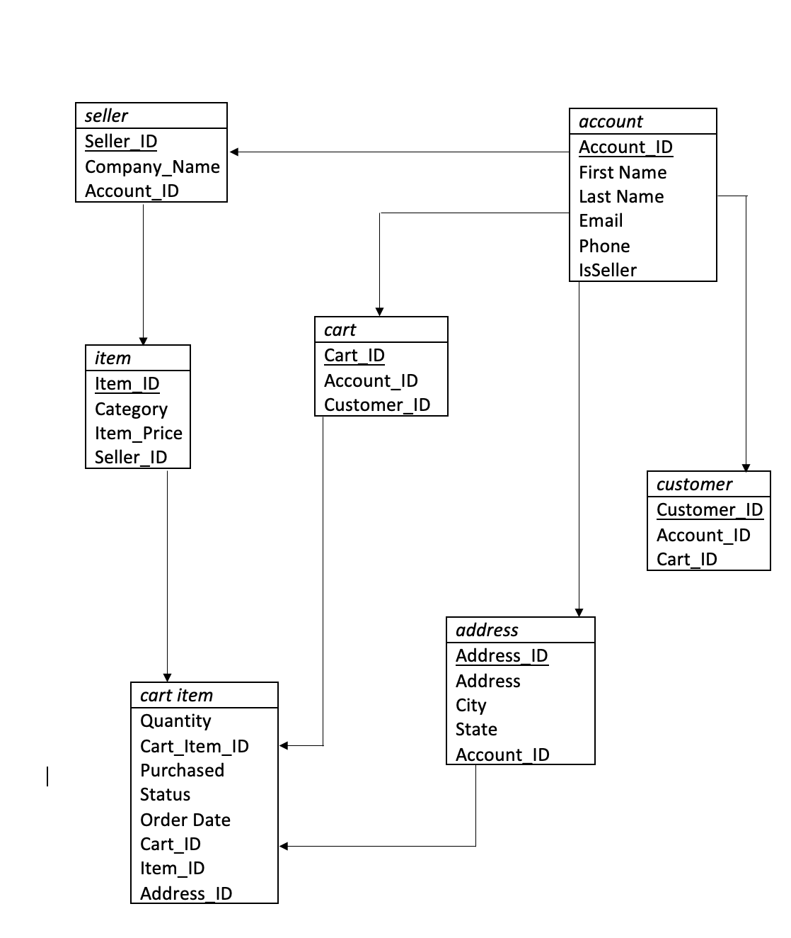
Relational Data Model
Notes:
Cole

Slide 13
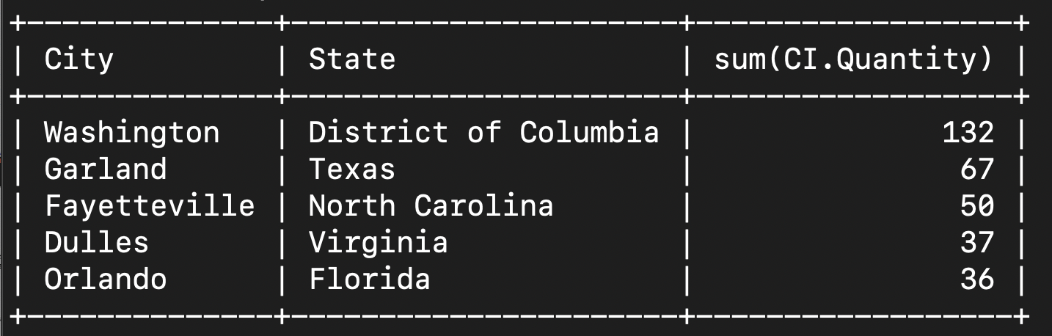
Queries and Data Continued
The top 5 Cities with the most items being shipped there
Tables Query Uses:
Address
CartItem
Purpose: Great for tracking the cities or cities with the most (or lowest) purchases in quantity (not necessarily based on revenue. This could be used with helping with shipping changes or increasing/decreasing warehouse space in certain areas due to volume.
Select A.City, A.State, sum(CI.Quantity)
from Address A, CartItem CI
Where A.Address_ID = CI.Address_ID
group by A.City
Order by sum(CI.Quantity)
Limit 5;
Notes:
Corin

Slide 14
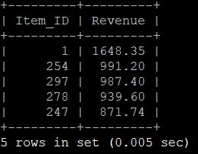
Queries and Data
Top 5 revenue itemS
select CI.Item_ID, round(sum(I.ItemPrice * CI.Quantity),2) as Revenue from CartItem CI, Item I Where CI.Item_ID = I.Item_ID and CI.Purchased = TRUE Group by CI.Item_ID Order by Revenue desc Limit 5;
Tables Query Uses:
CartItem
Account
Purpose: Lets Sellers know what items are making the most money which helps to decide where production costs go.

Slide 15
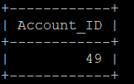
Queries and Data
select ac.Account_ID
from Account ac
left join Address ad
on ac.Account_ID = ad.Account_ID
where ad.State = "Louisiana"
and ac.IsSeller = TRUE;
Locate all the sellers in Louisiana
Tables Query Uses:
Address
Account
Purpose: As a customer query, some people like to buy local, or an advertiser can use this query to help show customers.

Slide 16
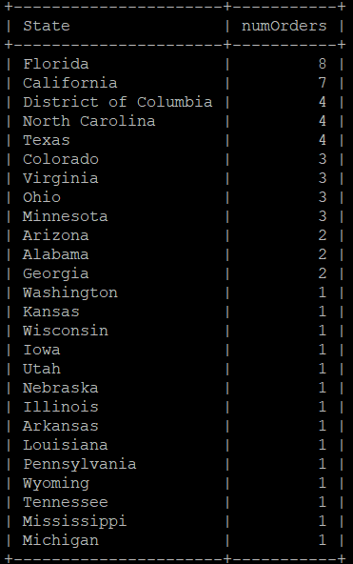
Queries and Data
Top 50% of states with highest number of orders
Tables Query Uses:
CartItem
Address
Purpose: Allows Sellers to know where distributors should be set up to optimize shipping costs.
Select A.State, Count(A.State) as numOrders
From (Address as A)
Right Join (CartItem as CI)
on A.Address_ID = CI.Address_ID
Where CI.OrderStatus in ("pending", "processed")
Group by A.State
Having numOrders > Avg(numOrders)
Order by numOrders desc;

Slide 17
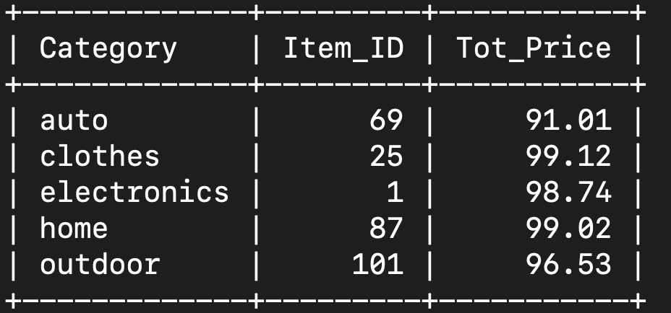
Queries and Data Continued
Most Expensive Item Per Category
Tables Query Uses:
Item
Purpose: Great for tracking the most expensive Item in each categories. Queries similar to this could be used for sorting from lowest to highest price
Select Category,Item_ID, MAX(ItemPrice) as Tot_Price
From Item
Group by Category;
Notes:
Corin

Slide 18
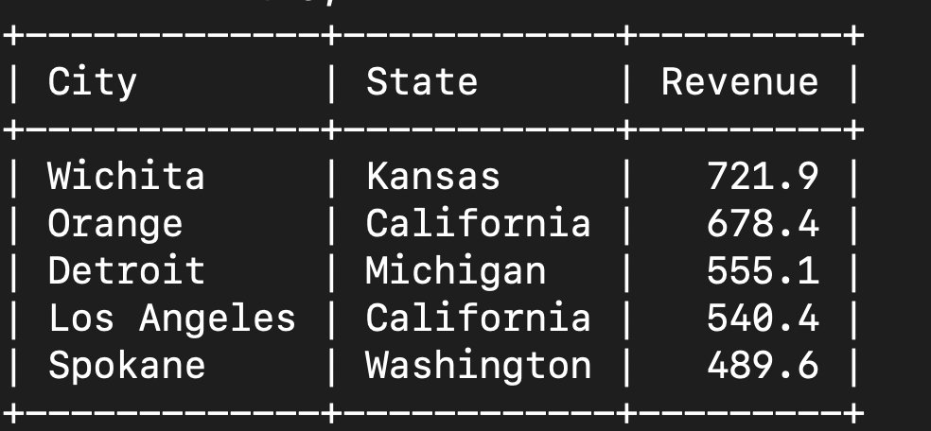
Queries and Data Continued
Top Revenue Generating Cities
Tables Query Uses:
Address
CartItem
Purpose: Great for tracking the cities generating the most revenue from purchases
Select A.City, A.State, ROUND(I.ItemPrice * CI.Quantity, 1) AS Revenue
From Address A, Item I, CartItem CI
Where A.Address_ID = CI.Address_ID AND I.Item_ID = CI.Item_ID
Group by A.City
Order by Revenue desc
Limit 5;
Notes:
Corin

Slide 19
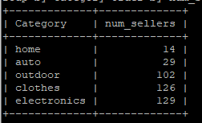
Queries and Data
Item categories with highest number of sellers
select Category, count(Seller_ID) as num_sellers From Item Group by Category Order by num_sellers;
Tables Query Uses:
Item
Purpose: Shows which markets might be easy to enter or be oversaturated.

Slide 20
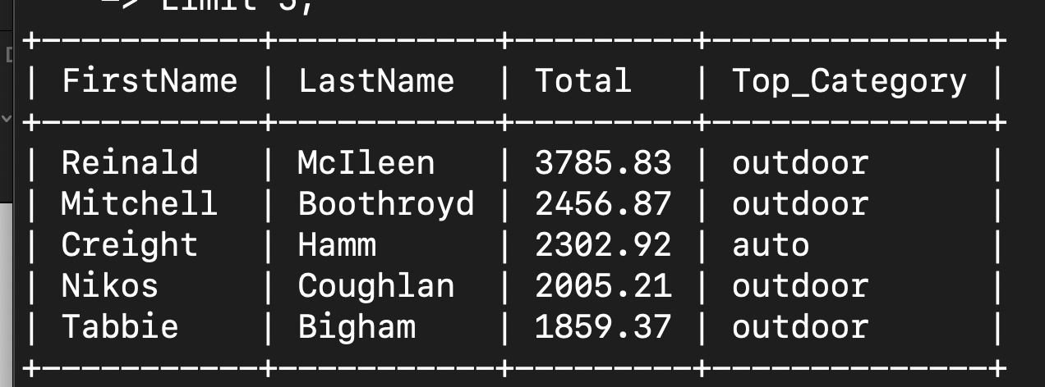
Queries and Data
The Top 5 Spenders most purchased Item Category
Tables Query Uses:
Customer
Account
Item
Cart
CartItem
Purpose: Great for tracking your top spenders, but also knowing what category they are spending the most money in. You can use this or a similar query to target ads for other items in the categories top spenders purchase most from.
Select a.FirstName, a.LastName, ct.Total, I.Category AS Top_Category
From Item I, CartItem CI, Account a, Customer c, Cart ct,
(Select count(I.Category) From Item I, CartItem CI, Account a, Customer c, Cart ct Where I.Item_ID = CI.Item_ID AND c.Cart_ID = CI.Cart_ID AND CI.Cart_ID = ct.Cart_ID AND c.Account_ID = a.Account_ID Group by ct.Cart_ID, I.Category Order by count(I.Category) desc Limit 1) as top
Where I.Item_ID = CI.Item_ID AND c.Cart_ID = CI.Cart_ID AND CI.Cart_ID = ct.Cart_ID AND c.Account_ID = a.Account_ID
Group by CI.Cart_ID
Order by ct.total desc
Limit 5;
Notes:
Corin

Slide 21
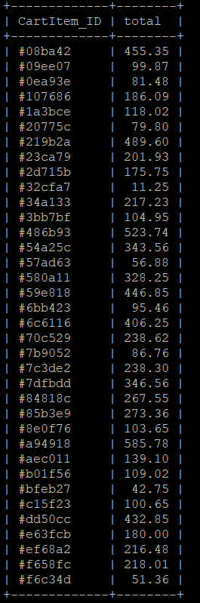
Queries and Data
Checks if a product is pending and the purchase is true and the total is over 10 dollars
select CI.CartItem_ID, round(sum(CI.Quantity*I.ItemPrice),2) as total
from (CartItem CI)
Left join Item I
on CI.Item_ID = I.Item_ID
where CI.OrderStatus = “pending“ and CI.Purchased = TRUE
group by CI.CartItem_ID
having total >= 10.0;
Tables Query Uses:
CartItem
Item
Purpose: Lets Seller know what orders they need to fulfill and are making a reasonable sale on.

Slide 22
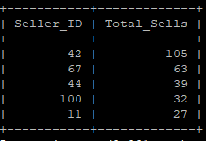
Queries and Data
Find the seller with the most sells
select Seller_ID,count(Seller_ID) as Total_Sells from Item Group by Seller_ID Order by Total_Sells desc Limit 5;
Tables Query Uses:
Item
Purpose: Helps to identify Seller with largest market share.

Slide 23
Query Matrix
 | 1 | 2 | 3 | 4 | 5 | 6 | 7 | 8 | 9 | 10
Join |  |  | X | X |  |  |  |  | X
Subquery |  |  |  |  |  |  |  | X
Group by | X | X |  |  | X | X | X | X |  | X
Group by w/ having |  |  |  | X |  |  |  |  | X
Order by | X |  |  | X |  | X | X | X |  | X
Aggregate | X | X |  | X | X | X | X |  | X | X
String Operations
Set Operations
In/Not |  |  |  | X
Is NULL

Slide 24
What we learned!
How to build a database
How to import data into a database
Importance of primary and foreign keys
Importance of a ER diagram when documenting and building a database
Create meaningful queries
Notes:
Corin

Slide 25

Questions?

