Slide 1
Agentic System
Tips and Tricks
John Tan Chong Min

Slide 2
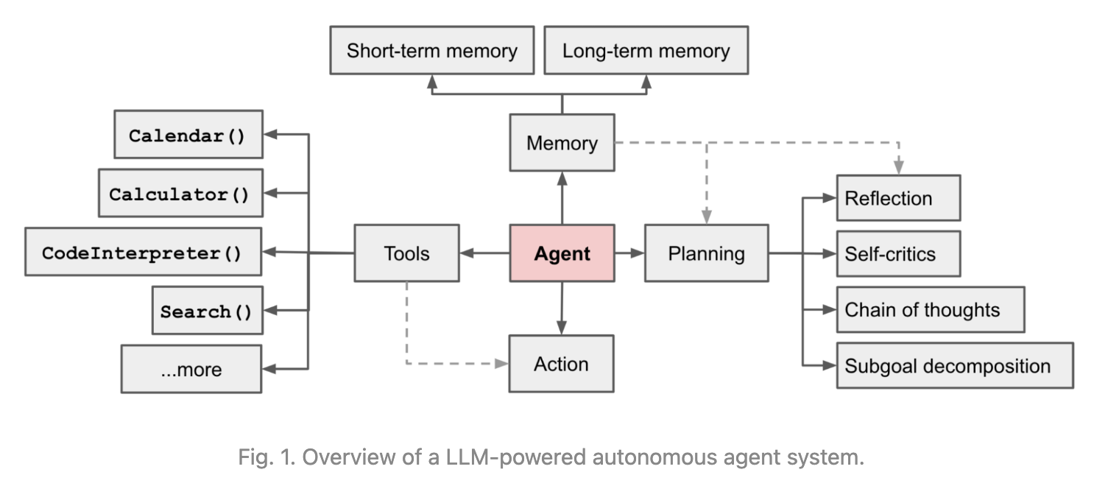
Agent Definition
https://lilianweng.github.io/posts/2023-06-23-agent/

Slide 3
TaskGen Overview
Function Call
Task
Subtask
Inner Agent
Meta Agent
Pass on some steps to
another Agent for more complex tasks
Subtask
Subtask
Function Call
Pass on Meta Agent’s Context and Shared Memory to Inner Agents / Functions
End Task
Execute Task and Store in Shared Memory
https://github.com/simbianai/taskgen

Slide 4
Process Flow
Fixed Processes help increase reliability

Slide 5
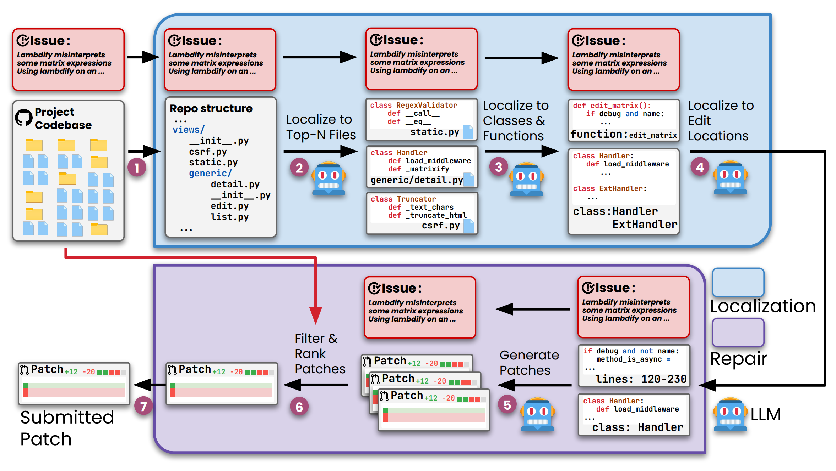
AGENTless
Agentless: Demystifying LLM-based Software Engineering Agents. Chunqiu et al. 2024.

Slide 6
AGENTless Overview
AGENTLESS does not allow LLMs to autonomously decide future actions or operate with any complex tools
AGENTLESS fixes the process, then leverages LLMs to perform each detailed task

Slide 7
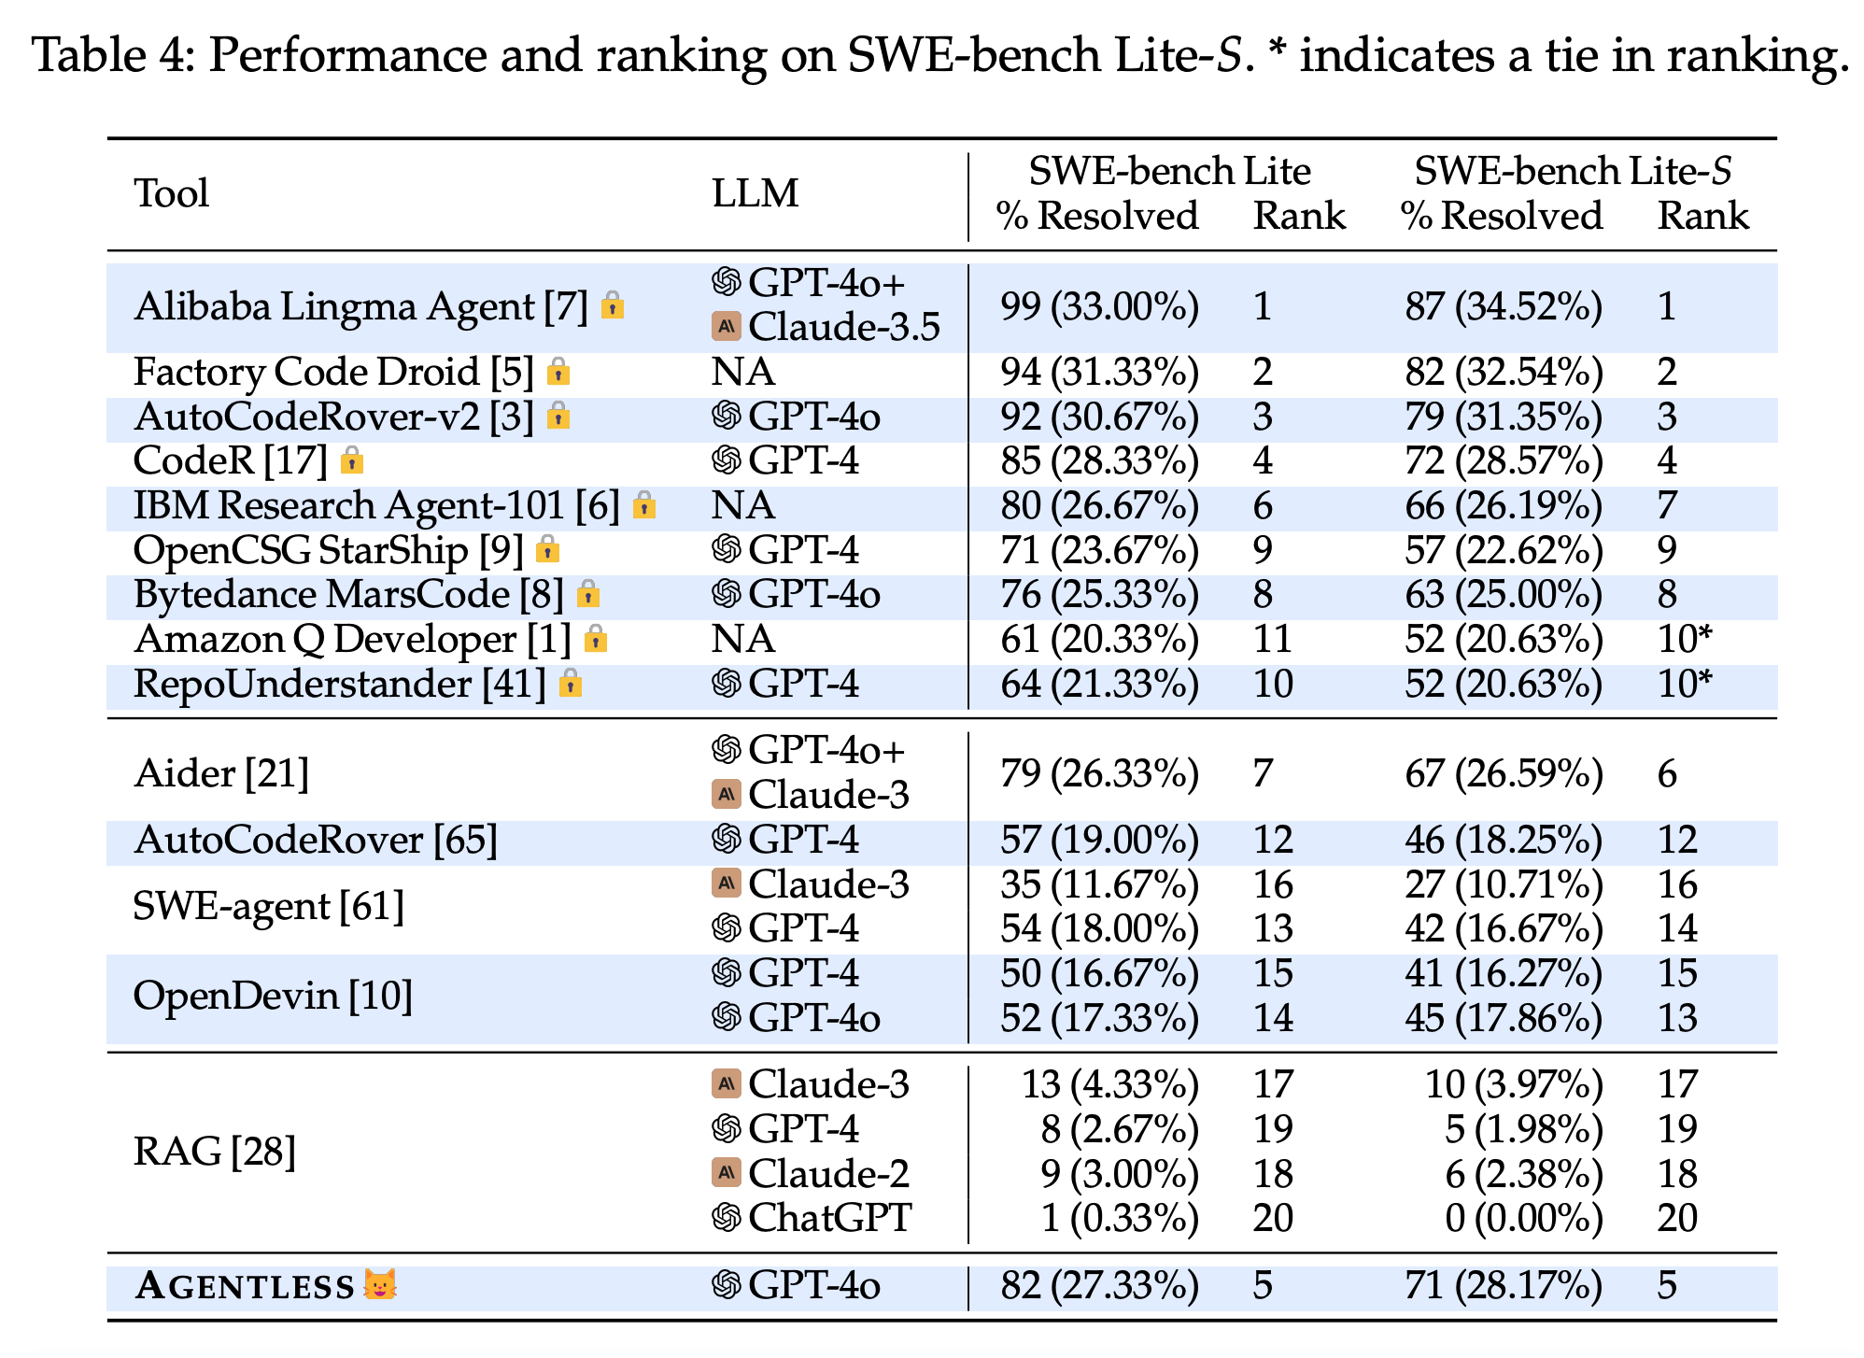
AGENTLess is competitive with close-sourced systems

Slide 8
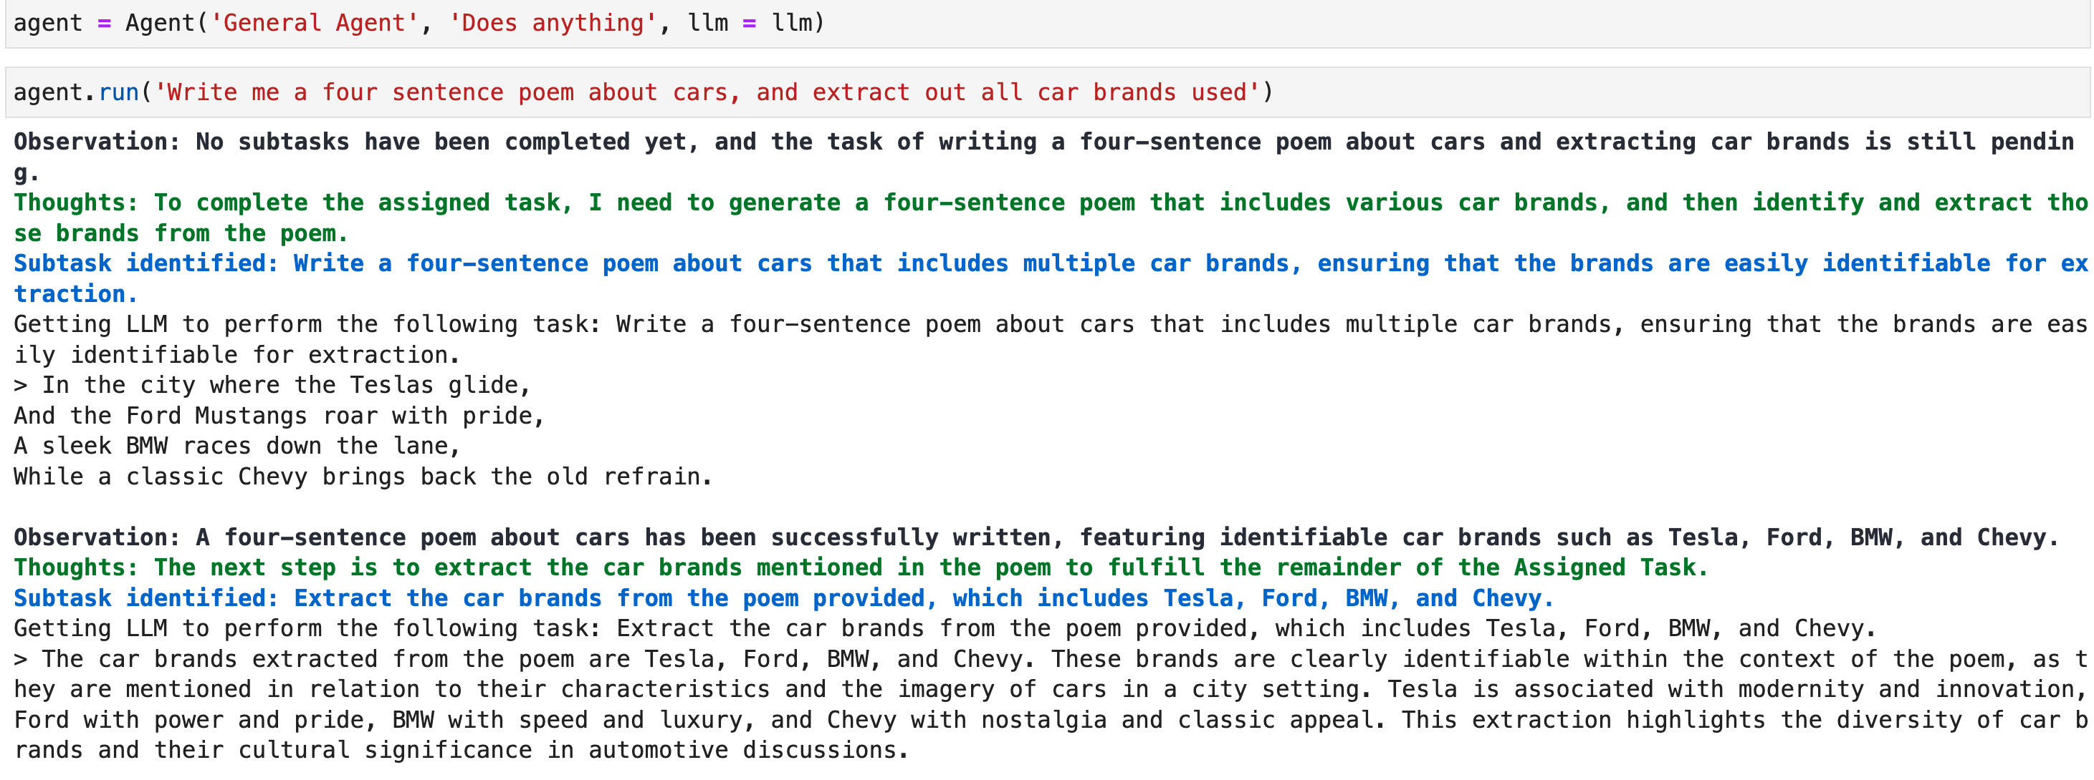
Letting Agent Decide Everything

Slide 9
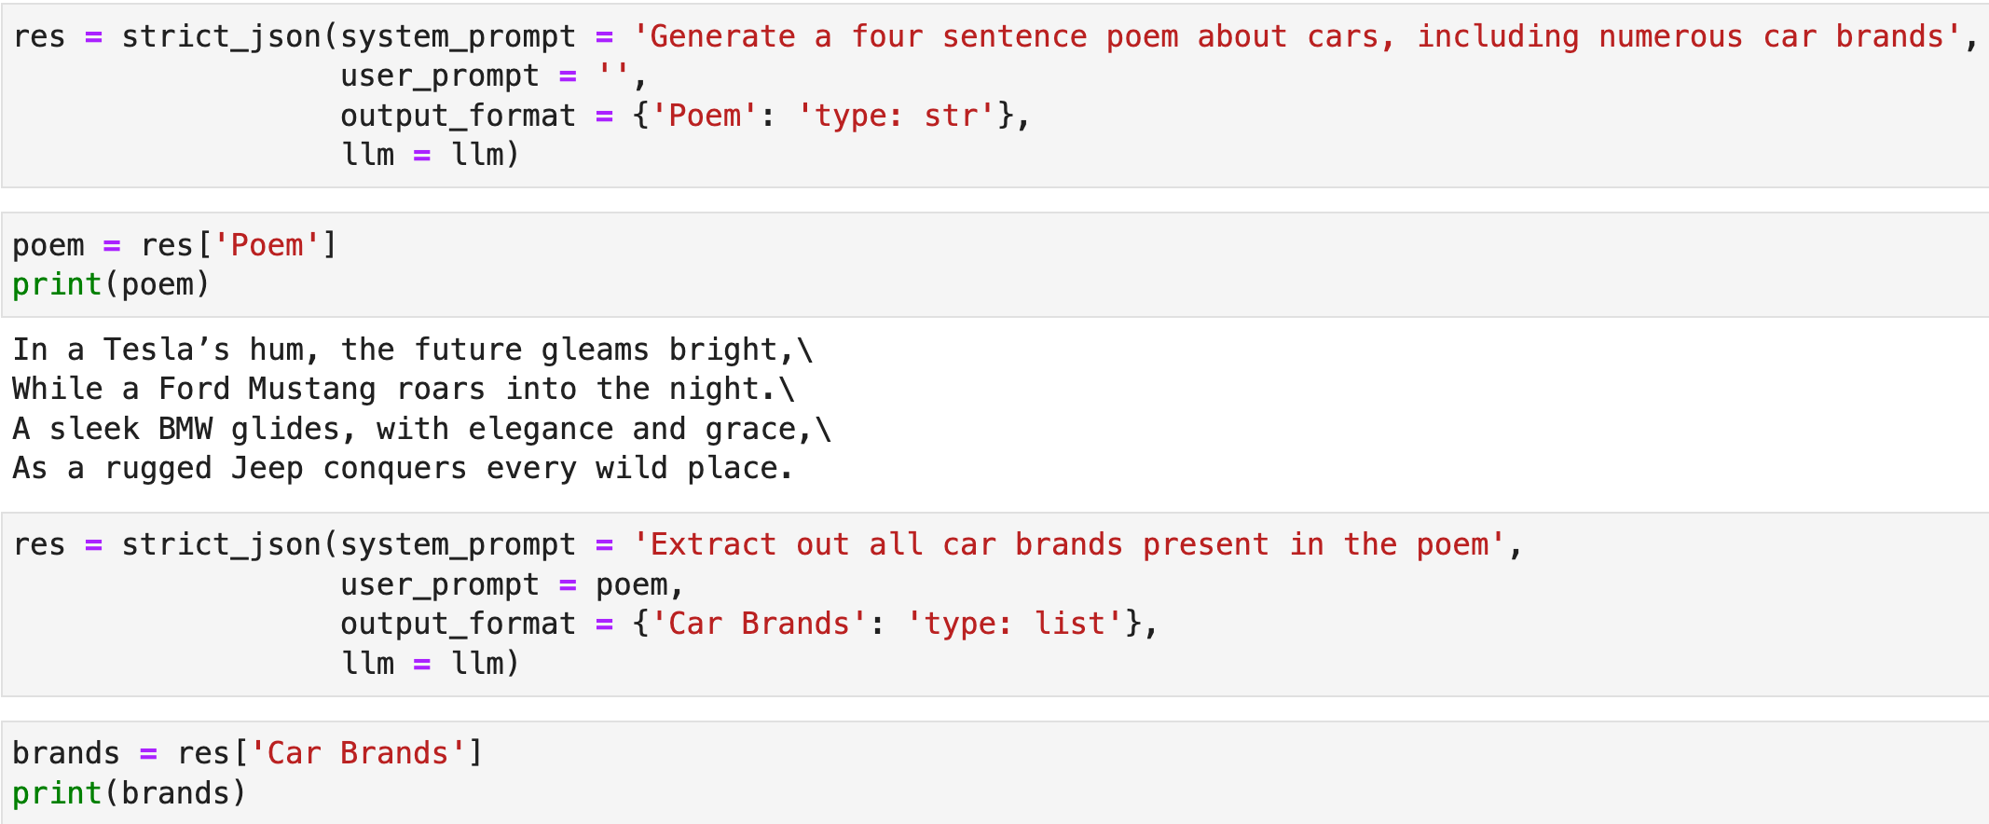
Fixing Process, using LLM for each part

Slide 10
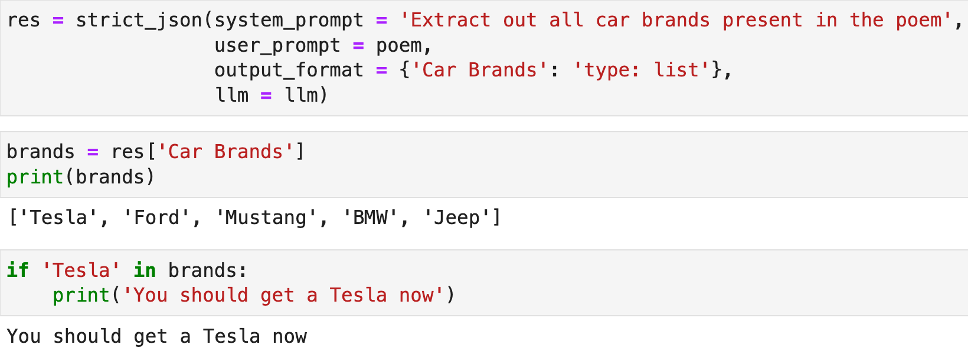
Conditional Flow along with fixed process

Slide 11
Pyramid of Complexity
Full Agentic
Workflow
LLM with fixed processes
Rule-based
Increase
complexity
as
required

Slide 12
Tool Use
Fewer tools can be more reliable

Slide 13
Giving more tools is not always good
Divide and conquer is better approach
Fewer tools for each agent = better performance

Slide 14
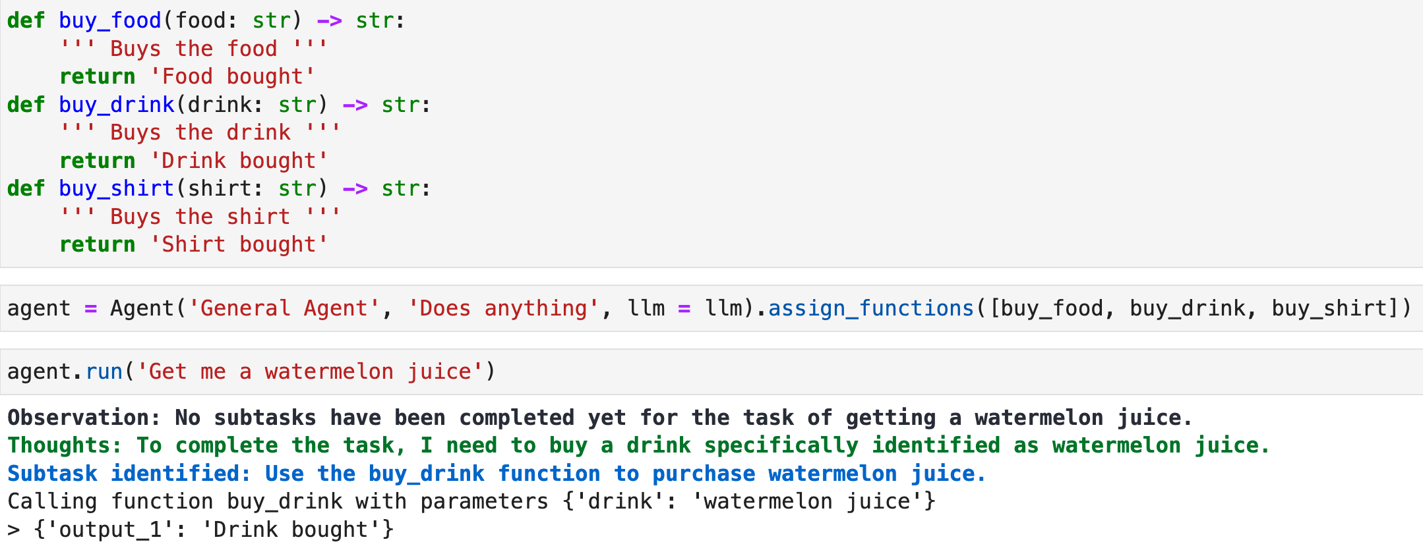
Using more tools is all right if disambiguated well

Slide 15
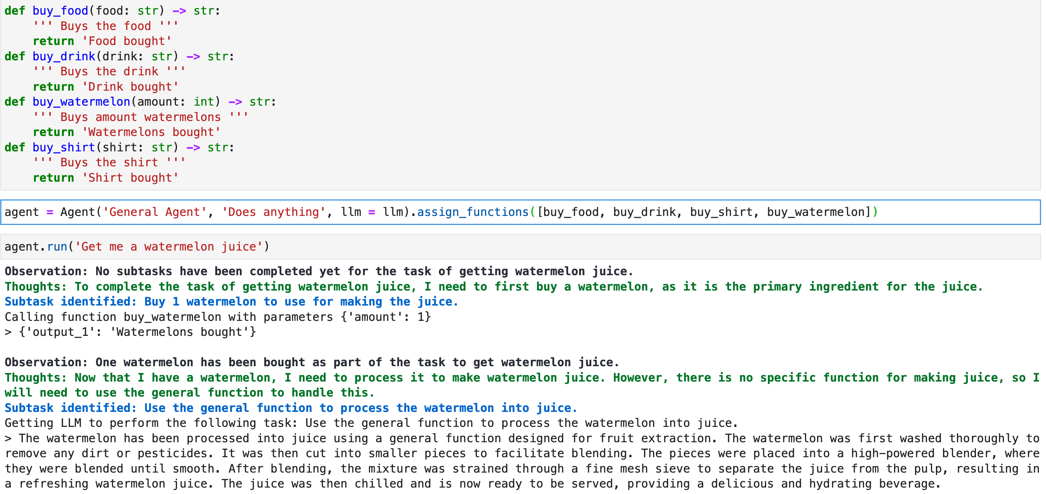
Tools can interfere

Slide 16
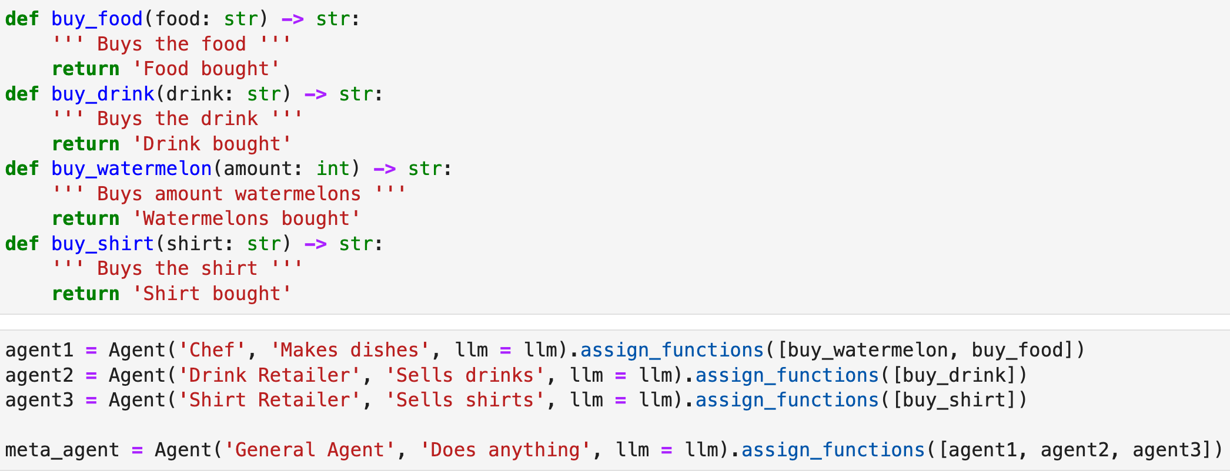
Divide and Conquer by Inner Agents (Part 1)

Slide 17
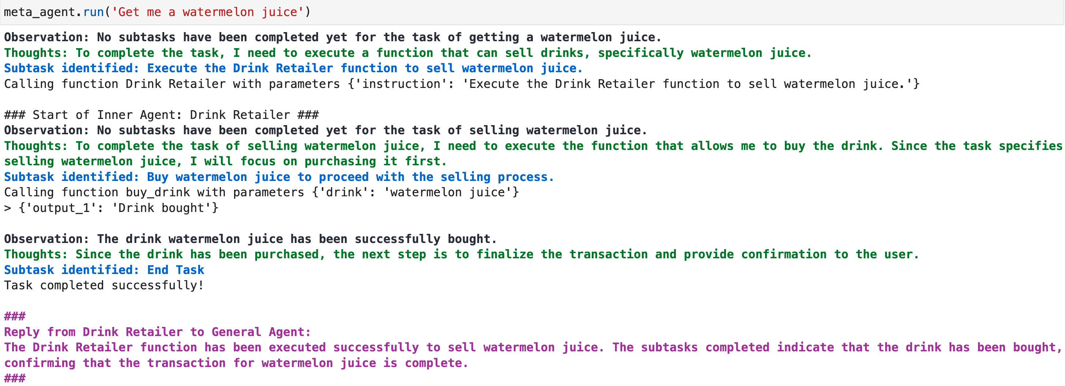
Divide and Conquer by Inner Agents (Part 2)

Slide 18
Retrieval Augmented Generation
Where to put it

Slide 19
RAG
Retrieval Augmented Generation can help by putting several in-context examples in the prompt for better generation
But placing it at the start of main prompt means that it might interfere with every process even when unrelated
Should do on-demand RAG

Slide 20
RAG vs On-demand RAG
Agent
Task
Task
Subtask
RAG
Agent
RAG
Subtask
Function
Output
Output
RAG
On-demand RAG

Slide 21
A Better RAG System
Consider also using RAG based off LLM-prompts (if memory is small)
Consider RAG with multiple abstraction spaces
Consider doing RAG based off entity filtering first
Consider Graph-based RAG (e.g. Knowledge Graphs, GraphRAG)

Slide 22
Memory
Memory can aid, memory can also harm

Slide 23
Learning from Previous Tasks
Learning from previous tasks can help with better performance in current task, if the task is similar
Otherwise, it can hinder learning
Insight: May need two separate agents, one with memory and one without

Slide 24
Questions to Ponder
When should Agents be used end-to-end, as opposed to just using LLMs for each part of the process?
How many tools should one Agent use to be reliable?
How to improve RAG?

