Slide 1
Secure Data Hiding in Image Using Steganography
Presented By:
Student Name : KUMARASWAMY KHANDAPU
College Name & Department : Raghu Engineering College – ECE

Slide 2
OUTLINE
Problem Statement
Technology used
Wow factor
End users
Result
Conclusion
Git-hub Link
Future scope

Slide 3
Problem Statement
In today’s digital age, secure communication is a critical concern. Traditional encryption methods, while effective, can still be intercepted or raise suspicion when detected. Steganography provides an alternative approach by concealing information within multimedia files, making it less likely to attract attention. This project focuses on embedding text messages within images by modifying pixel values, ensuring that the hidden message remains imperceptible to the human eye. A passcode-based decryption mechanism enhances security, allowing only authorized users to retrieve the hidden information. The challenge lies in preserving the visual integrity of the image while embedding data effectively. Additionally, the method must optimize pixel modification to prevent noticeable distortions. By implementing this technique, the project offers a simple yet powerful solution for covert communication in sensitive applications.

Slide 4
Technology used
Programming Language: Python
1.The project is implemented using Python, which provides extensive libraries for image processing and manipulation.
Libraries & Dependencies:
1.OpenCV (cv2) – Used for image processing, reading, and writing images.
2.OS (os) – Helps in file handling and system operations like opening the encrypted image.
Platform:
1.The project can be executed on Windows.
IDE & Development Environment:
1.Compatible with Python3.11.
File Formats Supported:
1.Works with image formats like JPEG, PNG, but performs best with uncompressed formats like PNG.

Slide 5
Wow factors
Unlike complex cryptographic methods, this project uses a lightweight approach to embed messages within image pixels, making it efficient and easy to implement.
Unlike basic steganography tools, this project incorporates a passcode mechanism, ensuring that only authorized users can retrieve the hidden message.
The message is embedded using pixel value modification while maintaining the visual integrity of the image, reducing detection risks.
The project runs on Windows, macOS, and Linux with minimal dependencies, making it accessible across different systems.
Unlike many steganography tools that require third-party applications, this project relies solely on Python and OpenCV, making it lightweight and easy to use.
The encoding technique can be enhanced further to support more complex encryption algorithms or alternative data-hiding methods.
The project quickly encodes and decodes messages without requiring significant computational power, making it practical for real-time use.
The project is open-source, allowing further modifications, optimizations, and integration with more advanced security techniques.

Slide 6
End users
Cybersecurity Enthusiasts & Researchers
Individuals interested in learning and experimenting with steganography techniques for secure communication.
Government & Intelligence Agencies
Organizations that require covert communication methods for secure data exchange.
Software Developers & Ethical Hackers
Developers and security professionals exploring innovative ways to integrate steganography into security applications.
Privacy-Conscious Individuals
People who want to send personal or sensitive information securely without relying on traditional encryption.
Educational Institutions & Students
Universities and students researching steganography as part of cryptography, cybersecurity, and data security courses.
Corporate & Business Professionals
Businesses that require hidden watermarking or secure internal communication methods.

Slide 7
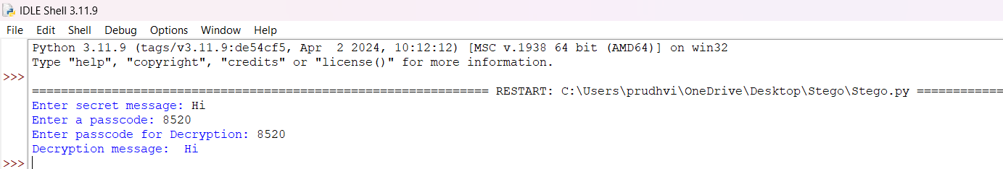
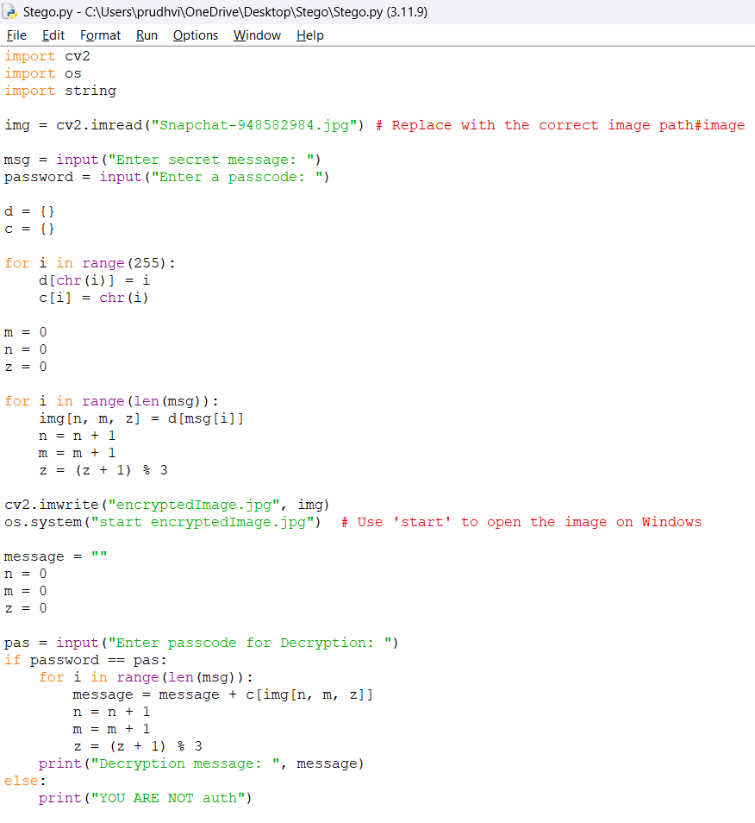
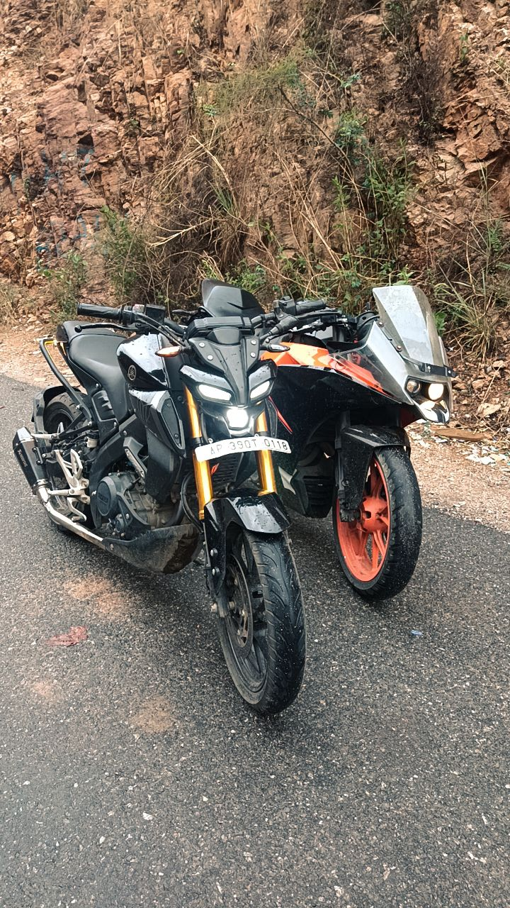
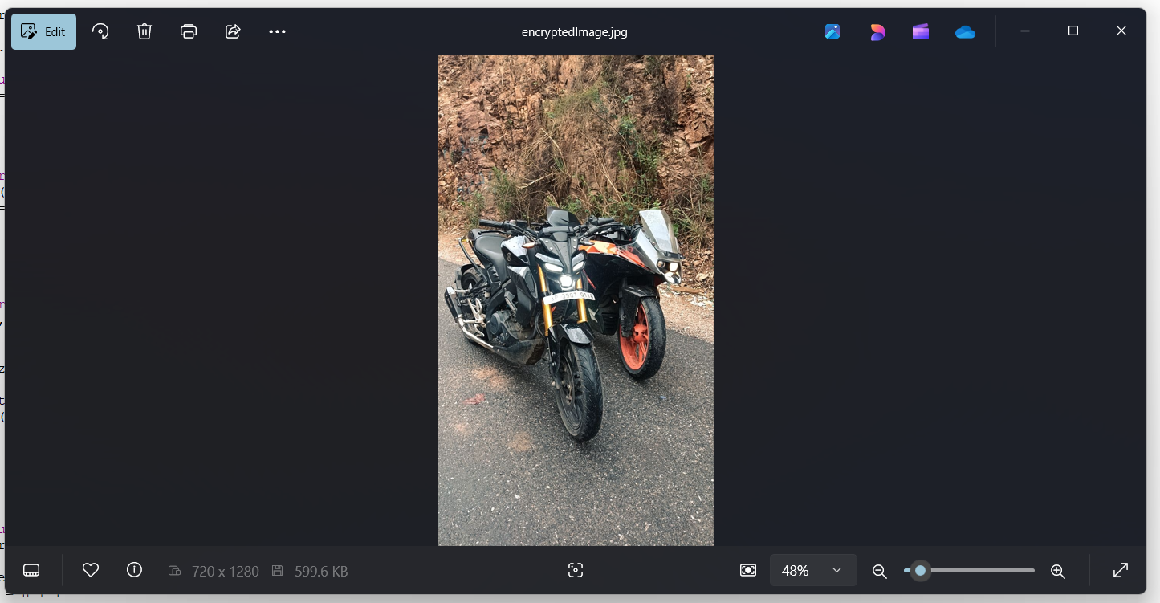
Results

Slide 8
Conclusion
This project demonstrates a simple yet effective approach to image steganography by embedding secret messages within images while maintaining their visual integrity. By utilizing pixel value modification and a passcode-protected decryption system, it ensures a basic level of security and confidentiality. The implementation is lightweight, platform-independent, and requires minimal dependencies, making it accessible to a wide range of users.
While the current technique is straightforward, it opens the door for further enhancements, such as more advanced encryption, improved pixel distribution, and larger data-hiding capacities. This project serves as a foundation for exploring secure communication methods and can be expanded for real-world applications in cybersecurity, digital forensics, and confidential data exchange.
Future improvements could focus on refining the encryption algorithm, integrating machine learning for better detection resistance, and developing a graphical user interface (GUI) for user-friendly operation. Overall, this project highlights the potential of steganography in privacy protection and covert communication.

Slide 9
GitHub Link
https://github.com/Mr-KK-87/Steganography-python.git

Slide 10
Future scope(optional)
Enhanced Encryption Techniques
Implement stronger encryption algorithms to improve the security of the hidden message, making it more resistant to steganalysis.
Support for Multiple File Formats
Extend the project to support various image formats (BMP, TIFF) and even other media types like audio and video for steganography.
Machine Learning Integration
Use AI-based steganography techniques to make hidden messages even harder to detect by automated analysis tools.
Graphical User Interface (GUI) Development
Create a user-friendly GUI to make the tool more accessible to non-programmers, improving usability and adoption.
Cloud & Web-Based Implementation
Develop a cloud or web-based version to enable remote and secure steganography applications for online communication.
Steganalysis & Counter-Detection Mechanisms
Develop tools to detect and analyze hidden messages within images, helping cybersecurity professionals counter illicit steganography use.

Slide 11
THANK YOU

