Slide 1
DISTRIBUTION EQUIPMENT
OVERHEAD LINES, SINGLE PHASE AND THERE PHASE CABLES,
DISTRIBUTION TRANSFORMERS, SWITCHER
PRESENTERS
Deepa Bhattarai | KCE076BEL013
Dikshit Karki | KCE076BEL014
Dipesh Acharya | KCE076BEL015
Jagrit Parajuli | KCE076BEL016
Jitendra Mandal | KCE076BEL017
Notes:
ID=d924773e-9a16-4d6d-9803-8cb819e99682 Recipe=text_billboard Type=TextOnly Variant=0 FamilyID=AccentBoxWalbaum_Zero

Slide 2
Distribution System
That part of power system which distributes electric power for local use is known as distribution system.
In general, the distribution system is the electrical system between the substation fed by the transmission system and the consumers meters.

Slide 3
Distribution System
Distribution system is further classified on the basis of voltage as:
Primary Distribution
Secondary Distribution

Slide 4
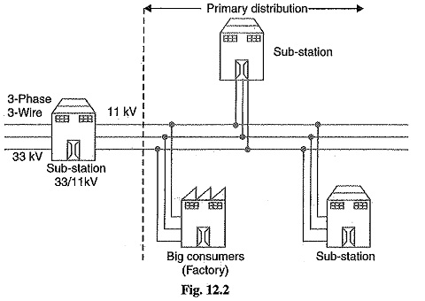
Primary Distribution
Primary distribution refers to the stage where the voltage is reduced from the transmission level (high voltage) to a lower level suitable for local distribution.
Typically, this involves the use of high-voltage distribution lines, substations, and transformers.

Slide 5
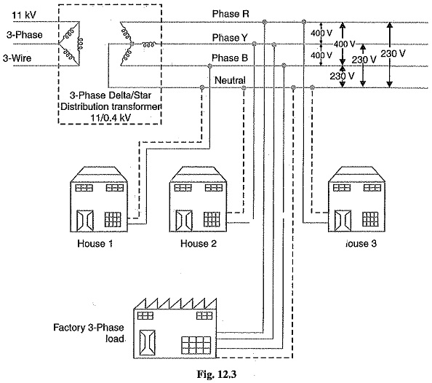
Secondary Distribution
Secondary distribution occurs after primary distribution and involves further reducing the voltage to levels suitable for end-users.
This is typically the stage where electricity is delivered to residential, commercial, and industrial consumers.

Slide 6
Distribution Equipment
Distribution equipment refers to the various components and devices used in the distribution system of an electrical power network.
Some common types of distribution equipment are:
Distribution cables
Distribution Transformer
Switches, etc.

Slide 7
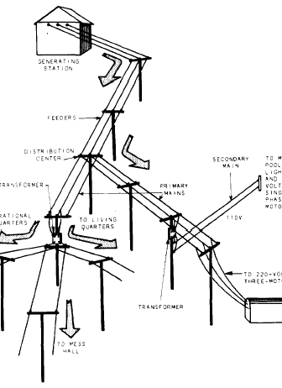
Overhead Lines
An overhead power line is a structure used in electric power distribution to transmit electrical energy along large distances.
It consists of one or more conductors suspended by towers or poles.
Since most of the insulation is provided by air, overhead power lines are generally the lowest-cost method of power distribution.

Slide 8
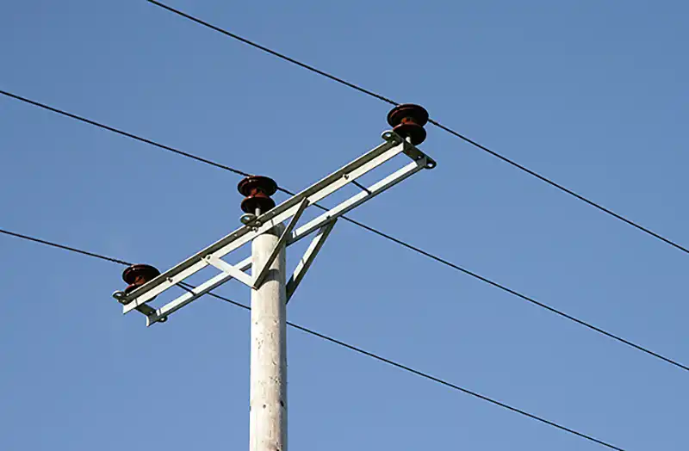
Overhead Lines
Overhead lines are mainly used in rural areas, developing regions and remote locations
Because they are Ideal for covering vast distances with lower population density, cost-effective solution for basic electrification infrastructure
And can reach areas where underground installation is impractical.

Slide 9
Overhead Lines
ADVANTAGES
They carry power from substations to homes and businesses, forming the final leg of the electrical journey before it reaches your light switch.
Installation and maintenance are significantly cheaper than underground lines.
Repairs and inspections are simpler due to visibility and accessibility.
Can easily span long distances and harsh terrain.
DISADVANTAGES
Vulnerable to weather; Storms, lightning, ice, and snow can damage lines and cause outages.
Can be visually intrusive and affect aesthetics.
Safety concerns: Potential hazard if lines come down due to accidents or wear and tear.
Power losses because higher resistance leads to some energy loss compared to underground lines.

Slide 10
Single Phase Installations
Most domestic installations are single-phase. They have a single phase with a single alternating current and a contracted power of up to 10 kW.
Single-phase connects the home with two wires: active and neutral. The neutral wire is connected to earth at the switchboard.

Slide 11
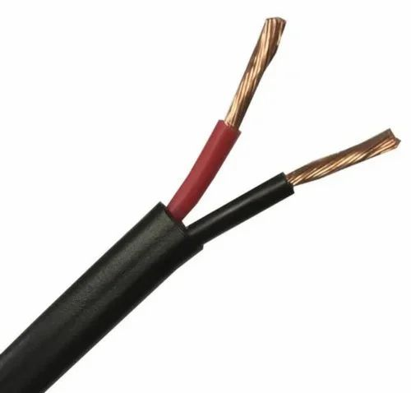
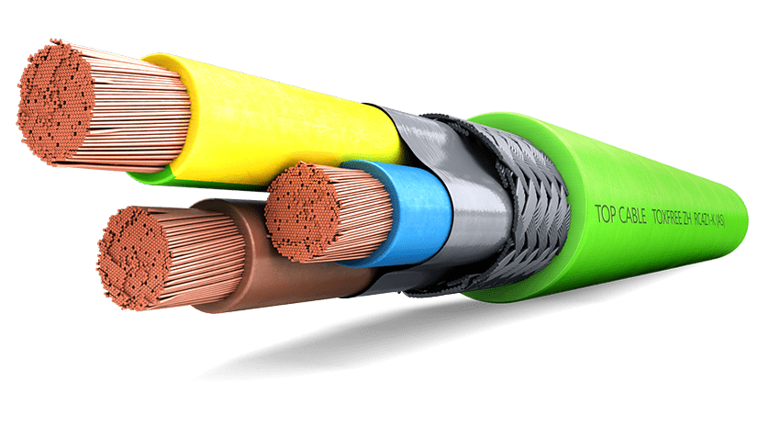
Cables for a single phase installations
Two conductors: blue (neutral) and brown (one phase).
Three conductors: blue (neutral), brown (one phase) and green-yellow (earthing).

Slide 12
Three Phase Installations
Three-phase installations are those formed by three different alternating currents that divide the installation into several parts which are reached by a constant power.

Slide 13
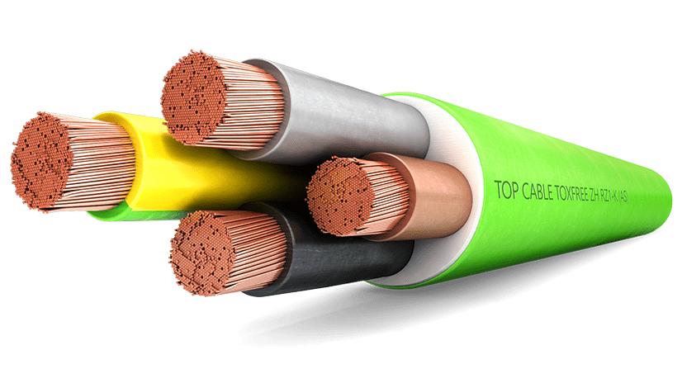
Cables for a three-phase installations
Three conductors: Grey, brown and black (all three phases)
Four conductors: Grey, brown and black (the three phases) and blue (neutral)
Four conductors: Grey, brown and black (all three phases) and green-yellow (earthing).
Five conductors: Grey, brown and black (the three phases), green-yellow (earthing) and blue (neutral).

Slide 14
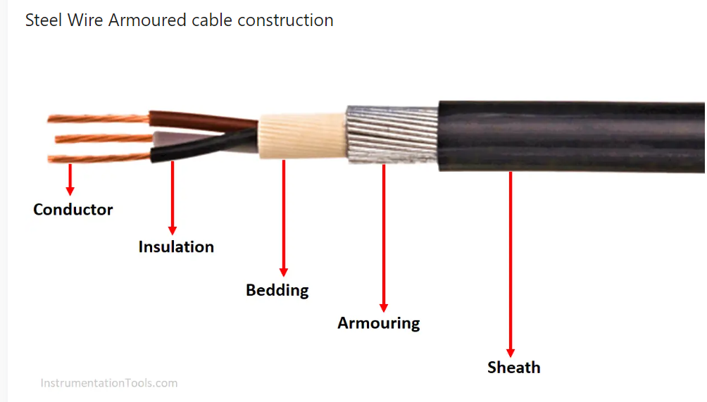
Armored cables (AC):
The cable with an outside layer or layers of armour wired or tapes to provide tensile strength during the cable laying operation, and protection while resting underground.

Slide 15
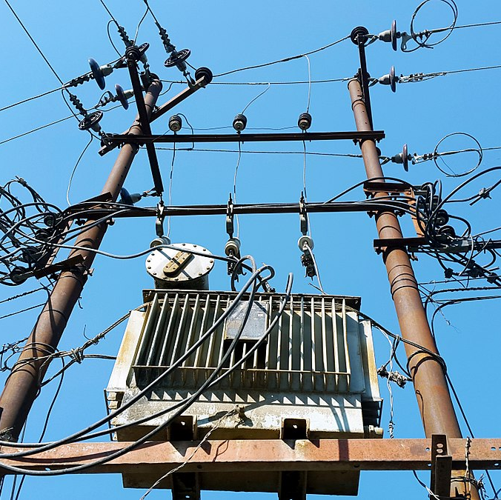
Distribution Transformer
A transformer used to alter the high voltage to the normal voltage like 240/120 V to use in electric power distribution.
A distribution transformer provides the final voltage transformation in the electric power distribution system.
There are various forms of transformers, such as single-phase, three-phase, pad-mounted, and pole-mounted distribution transformers.

Slide 16
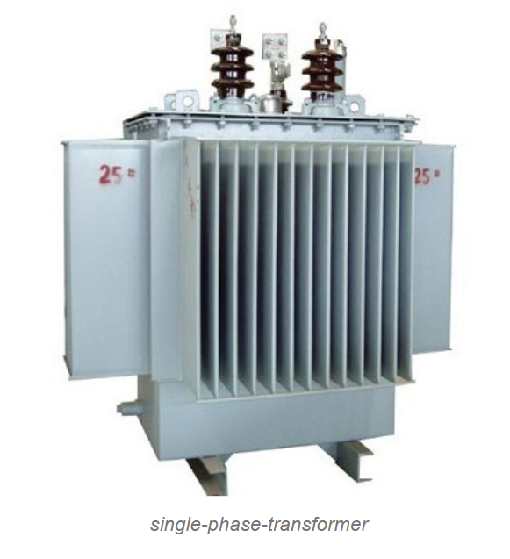
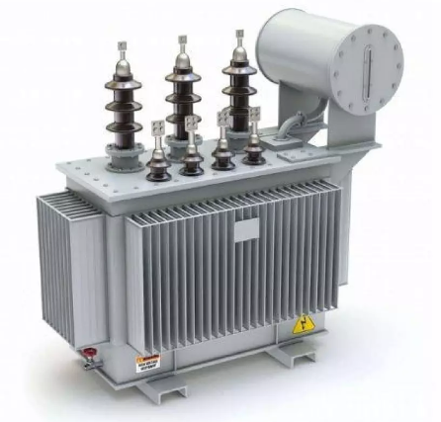
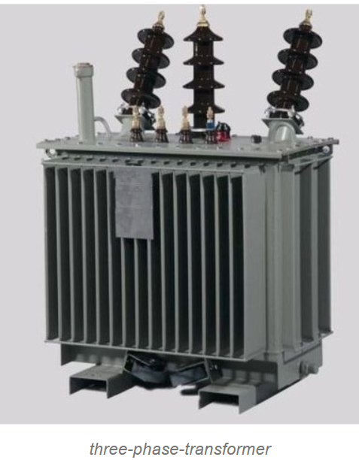
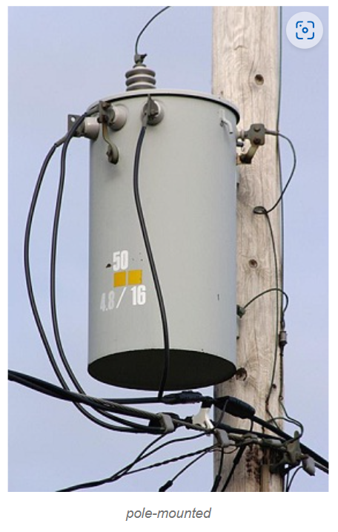
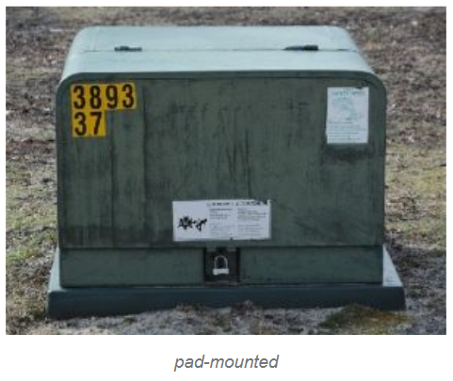
Distribution Transformer

Slide 17
Distribution Transformer
Generally, this transformer distributes the electrical energy to industries with less voltage under 33KV and 440volts to 220volts for domestic purposes.
Normally, a distribution transformer level is less than 200MVA, while some national norms can allow for ratings up to 5000 MVA to be known as distribution transformers. If the level is more than 200MVA (or 5000MVA in some regions), it’s introduced as a power transformer.

Slide 18
Efficiency of Distribution Transformer
The distribution transformers are energized for 24 hours, but they deliver very light loads for the major portion of the day, and they do not supply rated or full load, and most of the time the distribution transformer has 50 to 75% load on it.
Distribution transformers have maximum efficiencies at approximately 50% load.
Hence, the performance of such transformers cannot be judged by the commercial or ordinary efficiency, but the efficiency is calculated or judged by All Day Efficiency also known as operational efficiency or energy efficiency which is computed by the energy consumed for 24 hours.

Slide 19
Switches
A switch is used to open or bypass an electrical circuit to isolate a piece of equipment or the downstream circuit in order to perform maintenance.
It can be both manual and automatic.
Types of switches in distribution system:
Disconnect switch
Bypass switch
Gang-operated disconnects

Slide 20
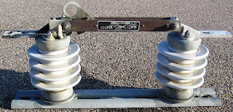
Disconnect Switch
A disconnect switch is a safety device that allows operators to completely power down an electrical circuit, creating a safe environment for maintenance, repairs, or inspections. By ensuring that no energy is flowing through the circuit, disconnect switches eliminate the risk of electrical hazards.
These switches are ordinarily used to disconnect branch lines, off-circuit breakers, and transformers where the load current may otherwise be broken.

Slide 21
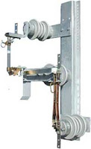
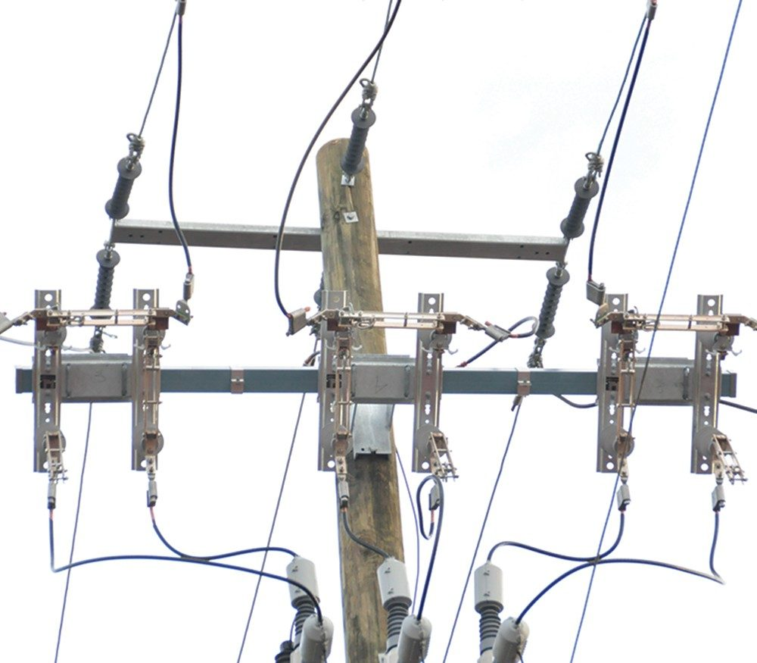
Bypass Switch
A bypass switch is designed to provide an economical way for bypassing and disconnecting pole-mounted distribution-class reclosers and regulators, permitting maintenance without disturbing continuity of service.

Slide 22
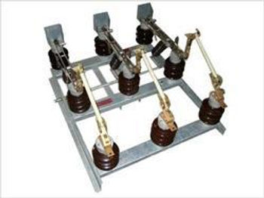
Gang-operated disconnects
Gang-operated disconnects are used where more than one phase of a circuit must be opened simultaneously.
"Gang-operated" because the three separate switches for each phase are operated as a group from a single control.
The most common gang-operated disconnect switches are the air-brake type manufactured in 200-, 300-, and 400-ampere ratings in all voltage classes from 5,000 volts up.
They are used at substations, switching structures, and on the lines for energizing and de-energizing transformer banks and other apparatus.

Slide 23
Thank You

