Slide 1
Distribution Equipment: Overhead lines, single phase and three phase cables, distribution transformer & switcher
PRESENTERS
Deepa Bhattarai [KCE076BEL013]
Dikshit Karki [KCE076BEL014]
Dipesh Acharya [KCE076BEL015]
Jagrit Parajuli [KCE076BEL016]
Jitendra Kumar Mandal [KCE076BEL017]

Slide 2
Overhead Lines:
An overhead power line is a structure used in electric power distribution to transmit electrical energy along large distances. It consists of one or more conductors suspended by towers or poles. Since most of the insulation is provided by air, overhead power lines are generally the lowest-cost method of power distribution.
Overhead lines are mainly used in rural areas, Developing regions and Remote locations because they are Ideal for covering vast distances with lower population density, cost-effective solution for basic electrification infrastructure and can reach areas where underground installation is impractical.

Slide 3
Why Overhead Lines?
They carry power from substations to homes and businesses, forming the final leg of the electrical journey before it reaches your light switch.
Installation and maintenance are significantly cheaper than underground lines.
Repairs and inspections are simpler due to visibility and accessibility.
Can easily span long distances and harsh terrain.

Slide 4
Drawbacks of Overhead Lines:
Vulnerable to weather; Storms, lightning, ice, and snow can damage lines and cause outages.
Can be visually intrusive and affect aesthetics.
Safety concerns: Potential hazard if lines come down due to accidents or wear and tear.
Power losses because higher resistance leads to some energy loss compared to underground lines.

Slide 5
Single Phase and Three Phase Cables:
Types of Cables:
Non-metallic sheathed cable
Armored cables (AC)

Slide 6
Non-metallic sheathed cable
Mostly used in residential structures for interior wiring. Non-metallic sheathed cables are available in various types, each made for particular uses such as residential wiring, data transfer, cable TV, and telephone systems. Its types are:
Two-Wire Non-Metallic Cables
Three-Wire Non-Metallic Cables.

Slide 7
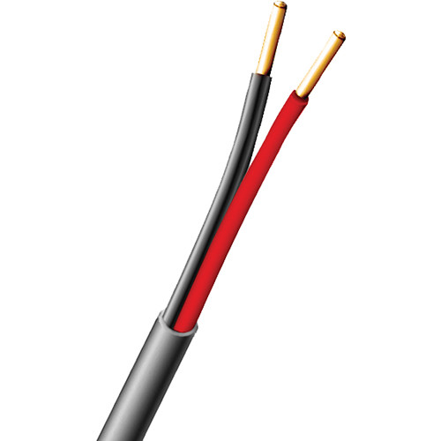
Two-Wire Non-Metallic Cables
Two-wire non-metallic cables, often called twin-lead or twin cables, are frequently employed for low-voltage tasks like connecting a router or a printer. These cables consist of a pair of insulated copper wires twisted together and encased in a plastic covering.

Slide 8
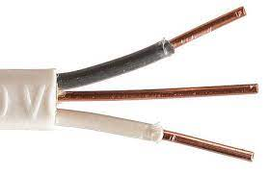
Three-Wire Non-Metallic Cables
Three-wire non-metallic cables feature three insulated copper wires twisted together and encased in a plastic covering. These cables are often chosen for high-voltage tasks. The third wire typically serves as a grounding wire to minimize the risk of electric shock.

Slide 9
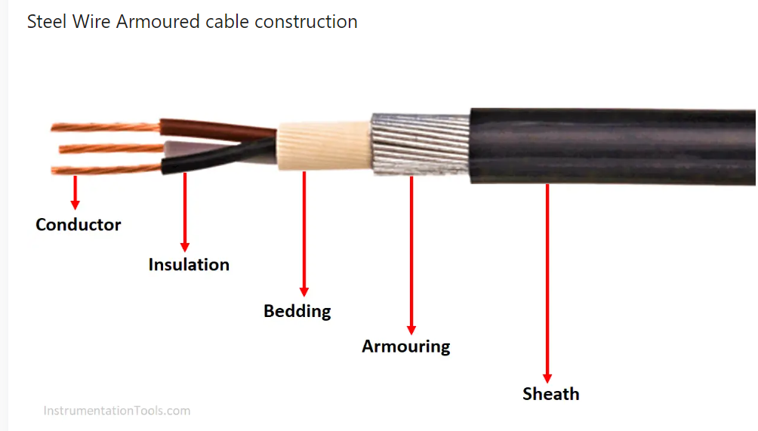
Armored cables (AC):
The cable with an outside layer or layers of armour wired or tapes to provide tensile strength during the cable laying operation, and protection while resting underground.

Slide 10
When to use Armoured Cable?
When transmitting power in harsh environments, cable protection is necessary for safe and reliable operation.
They are used primarily in industrial applications, often run in cable trays and raceways.
They are often not used in flexible applications.

Slide 11
Types of Armored cables (AC):
Wire-Braid Armour cable
Steel Wire armoured cables
Steel Tape armoured cable
Aluminum or aluminum alloy wire armoured cable

Slide 12
Wire-Braid Armoured Cable
Wire braid armor is also known as basket-weave armour. It is used when light and flexible protection is needed.
Wire braid is constructed much like a fibrous braid. The metal is knitted directly over the cable as the outer covering.
Generally, the braid is made of galvanized steel, copper, bronze, or aluminium.

Slide 13
Steel Wire Armoured Cable
They are generally abbreviated as SWA cable (Steel Wire Armour).
SWA Cables is suitable for high drop areas and can withstand external mechanical forces and extensive tension.
Cables with multiple cores use Steel wire armour. It withstands high pull loads.

Slide 14
Steel Tape Armoured Cable(STA):
STA Cables are suitable for buried laying and can withstand external mechanical forces but cannot withstand large tensile forces.

Slide 15
Aluminum Wire Armoured Cable(AWA):
Due to the non-magnetic nature of Aluminium, there would not be any induced currents in the armour due to the currents flowing in the main conductor.
Aluminum Wire armour is used in single-core cable.
Aluminium Wire Armoured cables are used in electrical power networks, underground installations, outdoor and indoor applications, as well as power and auxiliary control cables for cable ducts.

Slide 16
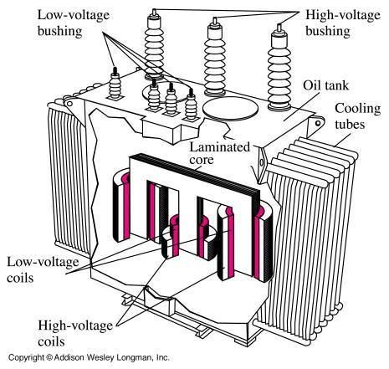
Distribution Transformer:
The distribution transformer is a main and largest equipment of distribution substation.
It is basically a static electrical device which steps down the primary voltage of 33kV or 11 kV to secondary distribution voltage of 415-440 volts between phases and 215 volts between phase and neutral through delta-star windings by electromagnetic induction without change in frequency.

Slide 17
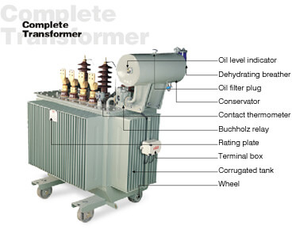
Transformer consists of the following components:
Windings
Insulation
Transformer Tank
Cooling Tubes
Buchholz Relay
Tap Changer
Oil outlet Valve
L.T. and H.T. Terminals
Temperature Gauge
Secondary Winding
Conservator
Breather
Explosion Vent
Oil inlet Valve
Oil Indicator

Slide 18
Core:
Serves as the magnetic path for the transformer's operation.
Made of laminated steel sheets to reduce eddy currents and heat losses.
Two common core types:
Shell Type: Windings surround a core with three limbs, resembling a shell.
Core Type: Windings are placed on two outer limbs of a rectangular core.
Windings:
Two sets of insulated copper or aluminum coils wound around the core.
Primary Winding: Receives high-voltage input from the power grid.
Secondary Winding: Delivers low-voltage output to consumers.
Insulation:
Prevents electrical short circuits between windings and the core.
Typically made of paper, oil, or resin.

Slide 19
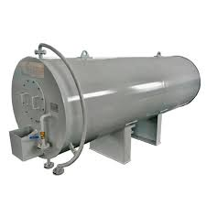
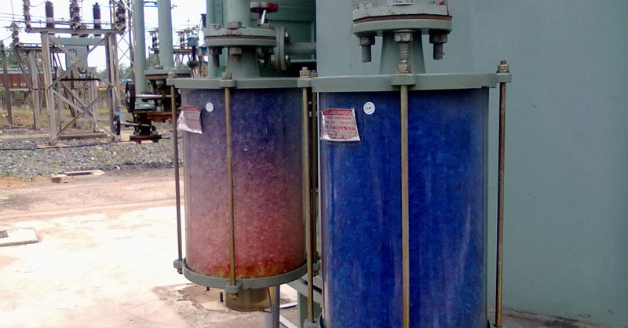
Conservator:
It is a drum containing transformer oil and mounted at the top of the transformer and connected to the main tank by a pipe. As the volume of oil of transformer tank expands and contracts according to heat produced, this expansion and contraction of oil causes the level of the oil in conservator to rise and fall.
The aim of conservator is to:
Maintain the oil level in tank
Provide space for the expanded oil
Breather:
It is attached to conservator tank and contains silica gel, which prevents the moist air from entering into the tank during contraction of oil. When oil is hot there is expansion and gas passes to atmosphere through it. When oil is cooled, it contracts and the air enters in it.
It prevents transformer oil from moisture contamination.

Slide 20
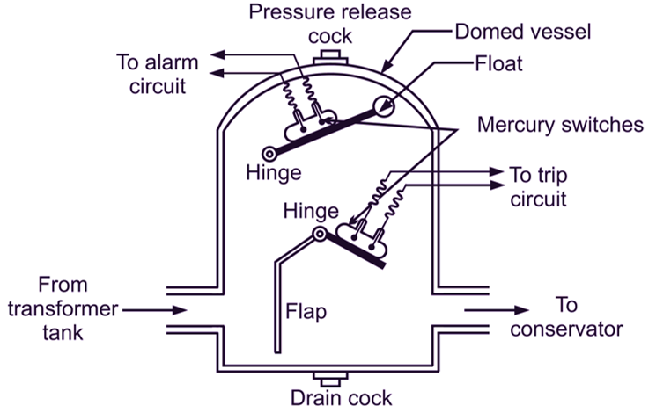
Buchholz Relay:
It is protective relay of transformer. This device signals the fault as soon as it occurs and cuts the transformer out of the circuit immediately. This is gas operated protective relay. It is installed in between the pipe connecting the tank and the conservator.
Explosion Vent:
A major fault inside the transformer causes instantaneous vaporization of oil, leading to extremely rapid buildup of gaseous pressure. If this pressure is not released with in few milliseconds, the transformer tank can rupture, spilling oil over a wide area.

Slide 21
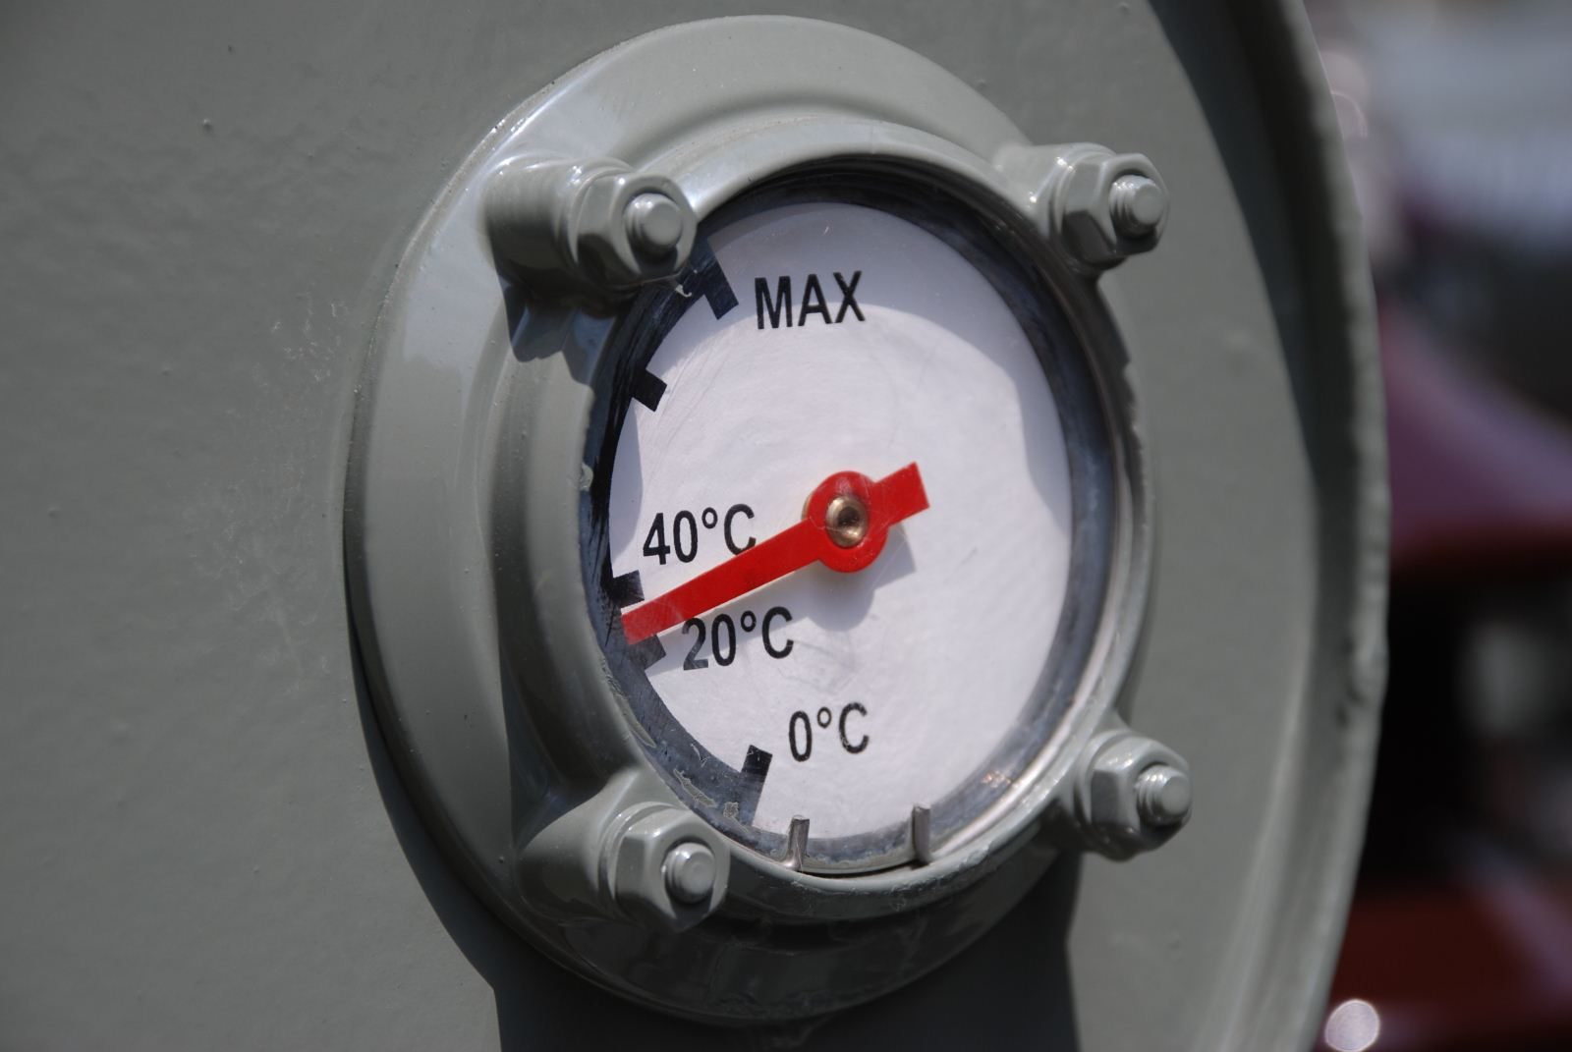
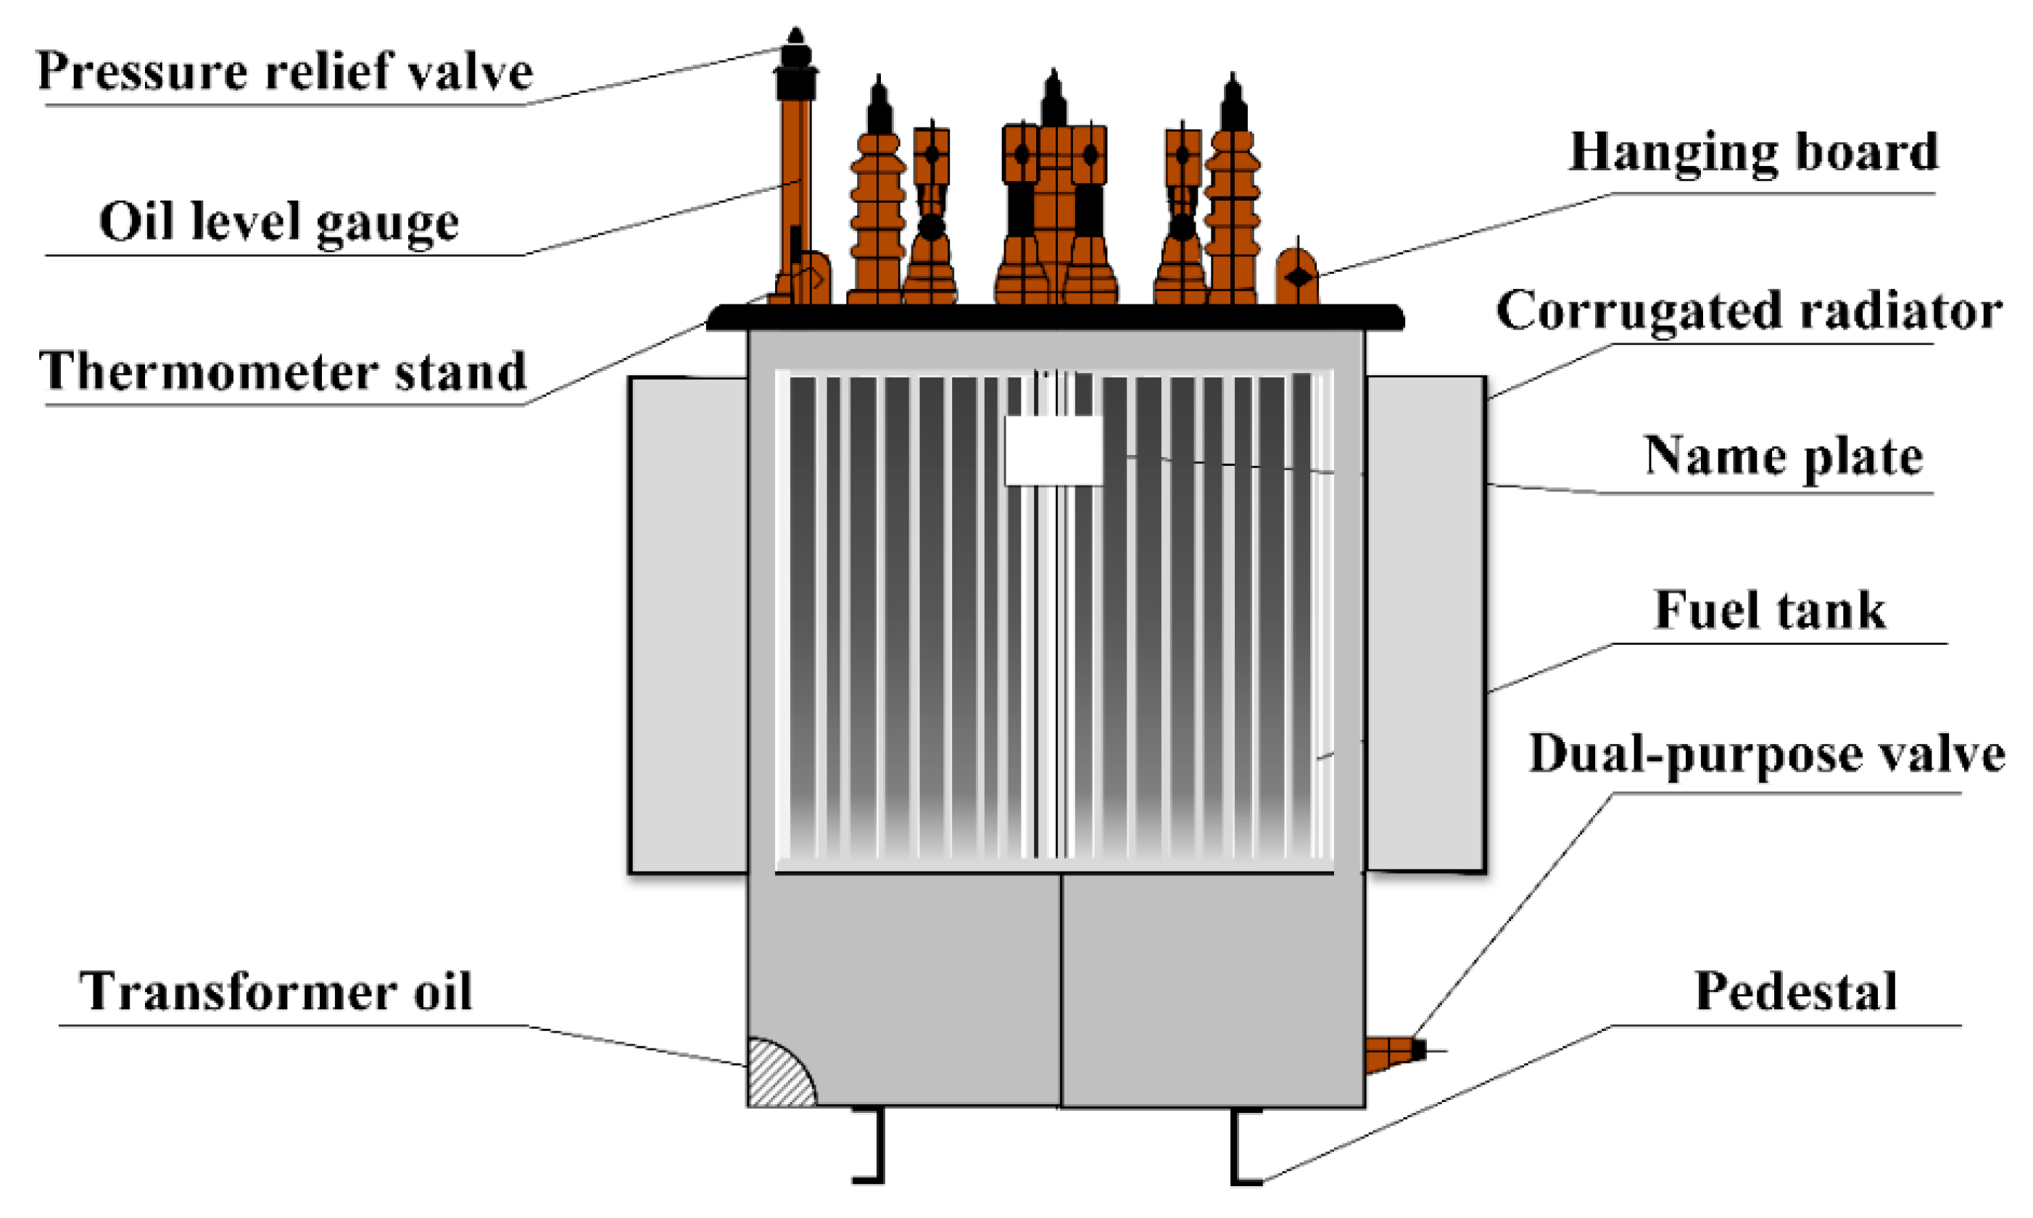
Oil Level Indicator:
It indicates level of transformer oil at the conservator of the transformer. It has markings on transparent sheet for maximum and minimum levels
Inlet Valve:
It provides passage to pour the transformer oil in the tank during purification or in case of shortage found in the tank.
Outlet Valve:
It provides passage to drain the oil during overhauling or as and when required oil sample for testing

Slide 22
Cooling Tubes:
These tubes provide better and effective cooling of transformer oil by increasing the surface area of tank to the atmosphere.
Tap Changer:
The tap changer is used to regulate the output voltage manually according to line voltage. The taps of transformer can be changed by the tape changer manually. It is provided on HV side so that the voltage on LV side feeding to the load can be maintained.
Normally tap selection range is ± 15 % in steps of 2.5 %.

Slide 23
Switcher:

