Slide 1

Payment System Analysis of NYC Yellow Taxis

Slide 2




Our Timeline
Dataset synopsis
What Are Talking About ?
Analyst
Conclusion & Action
Brief Overview of the Dataset
A Brief Overview of the Issue.
Exploring the NYC Yellow Taxi Data: An Analyst's Perspective
Summary and Next Steps

Slide 3
Dataset Synopsis
1

Slide 4




Verifone Inc.
&
Creative Mobile Technologies, LLC
Standard rate
JFK
Newark
Nassau or Westchester
Negotiated fare
New York City
January 2023
USA
Cash
Credit card
No charge Dispute

Slide 5
What Are We Talking About ?
2

Slide 6

“Please help us identify any factors that can encourage people to use our payment system for taxi rides based on the trip records we have. This will enable us to increase our revenue.”
- Verifone & Creative ☺
Identify any factors what could bring / attract people to use their system as primary payment choice.

Slide 7
Analyst
3

Slide 8
Table Analyst
Business Performance
Operational Performance
Passenger Behaviour
Conclusion & Action

Slide 9
Business Performance

Slide 10
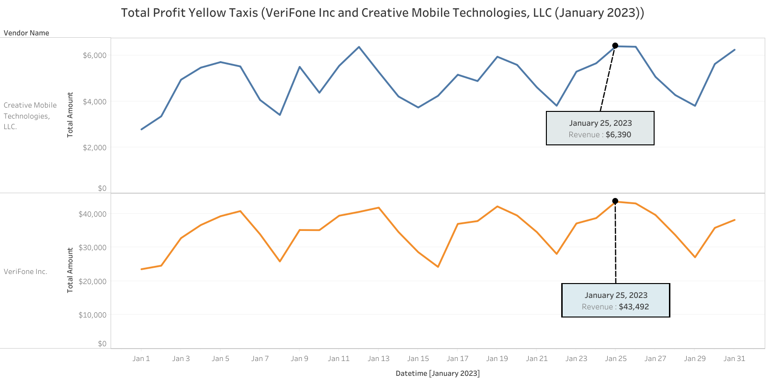
Creative Mobile
Vendor (Revenue)
Verifone
Datetime
Both third-party vendors have high revenue on the same date with an identical trend line. Verifone's revenue is higher than Creative Mobile’s
However, neither third-party vendor has a significant impact on Yellow Cabs' revenue. The primary factor affecting the business is Yellow Cabs itself.

Slide 11
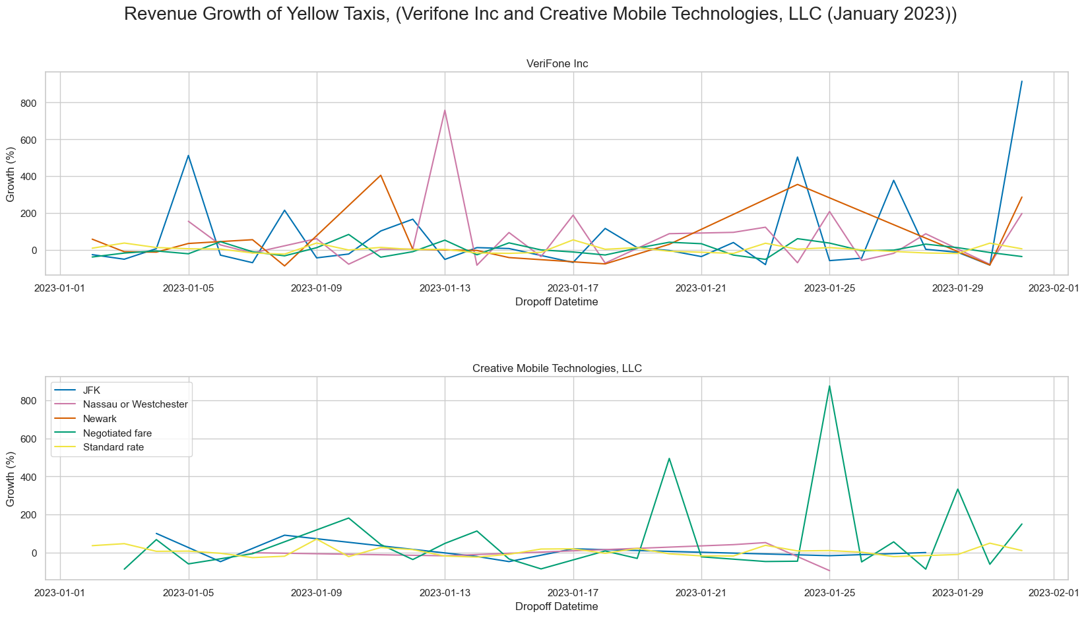
Verifone
JFK
Growth (%)
Na or We
Creative Mobile
Newark
Nego Fare
Standard Rate
Datetime
Both third-party vendors share different growth patterns. Each RatecodeID also has a different growth pattern on Both third-party. For example, on January 13th, Verifone had a more significant growth rate for the Nassau or Westchester RatecodeID, but not for Creative Mobile.

Slide 12
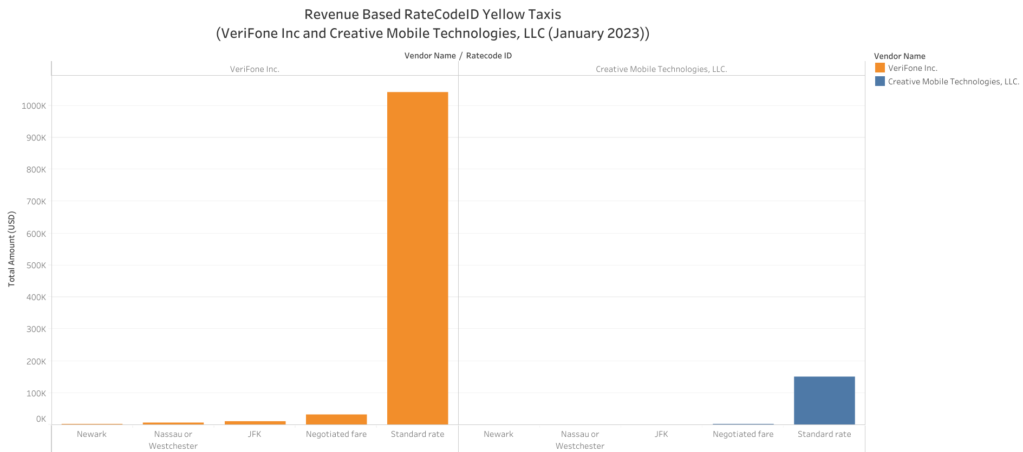
Verifone
Creative Mobile
Total Revenue
RatecodeID
From both third-party vendors, the Standard rate generates the highest revenue. However, each third-party has a different revenue. Additionally, the Standard rate is the most commonly used RatecodeID by New Yorkers.

Slide 13
Operational Performance

Slide 14
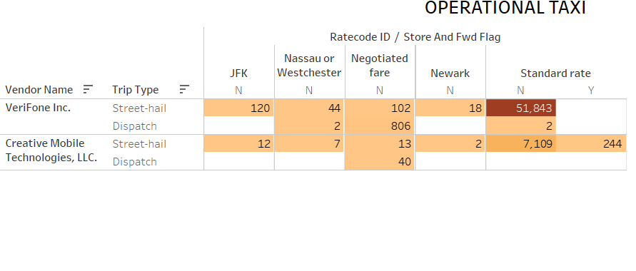
Operational Cabs Yellow Taxis
(VeriFone Inc and Creative Mobile Technologies, LLC (January 2023))
The majority of taxis from both third-party vendors use the Not Stored And Forward method to save their trip records. Additionally, there were 244 records that showed taxis storing their records first and then forwarding them to the server after completing their job.
Additionally, Street-hail is the most popular among Trip type. In other words People prefer to hail taxis on the street compared to other People ordering taxis via telephone or through ride-hailing apps like Uber (Dispatch)

Slide 15
Passenger Behaviour

Slide 16
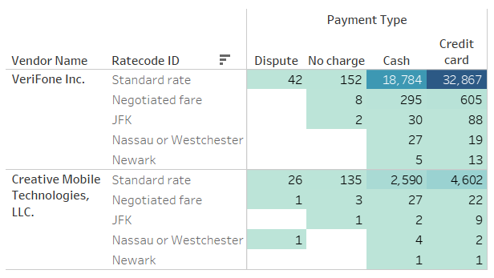
Payment Type Based RatecodeID Yellow Taxis
(VeriFone Inc and Creative Mobile Technologies, LLC (January 2023))
The majority of people prefer to pay their taxi fees using credit cards, although some still use the old-fashioned method of paying in cash.
68
287

Slide 17
Conclusion & Action
4

Slide 18
In Nutshell:
Revenue of both third-party are depending on Yellow Cabs company. Because The taxi company has determined the fees for each trip and any extra fees.
Here’s the solution to increasing Revenue’s Creative & Verifone through their Service Payment Despite the taxi company has already determined the fees.
Offer a 5-10% discount for popular trips such as Standard rate or trips within New York City for all types of credit cards.
Provide cashback rewards or exchange coupons with reward points for credit card payments.
Develop an E-Payment app option for payment, so people can pay using their app balance instead of having to use their credit card.
Add a debit card payment option in addition to credit card payments, so people without credit cards can still pay for taxi rides using the VeriFone Inc. & Creative Mobile Technologies, LLC EDC machines.
Ensure that credit card payment service is provided only to taxis with good driver criteria and good reviews, as there are disputes where passengers refuse to pay or pay an incorrect fare.

Slide 19
Thanks!
Any questions?

