Slide 1

Movie RECOMMENDATION SYSTEM

Slide 2

Introduction
Hybrid Movie Recommendation System
Our project is centered around the development of a sophisticated Hybrid Movie Recommendation System
In a world where users are inundated with countless options, our system aims to cut through the noise, offering a tailored cinematic experience

Slide 3
Data Overview
Our recommendation system draws insights from a diverse set of datasets
Credits: This dataset enriches our understanding of movies by providing details about the cast and crew involved in their creation
Keywords: Offering a glimpse into the thematic elements of movies, this dataset includes keywords associated with each film
Links: By connecting movie IDs to external databases, this dataset facilitates cross-referencing and enriches our movie database
Movies Metadata: Serving as our primary dataset, it encompasses a comprehensive array of details about each movie
Ratings: User ratings, a vital component for collaborative filtering, are gleaned from this dataset

Slide 4
DATA EXTRACTION

Slide 5
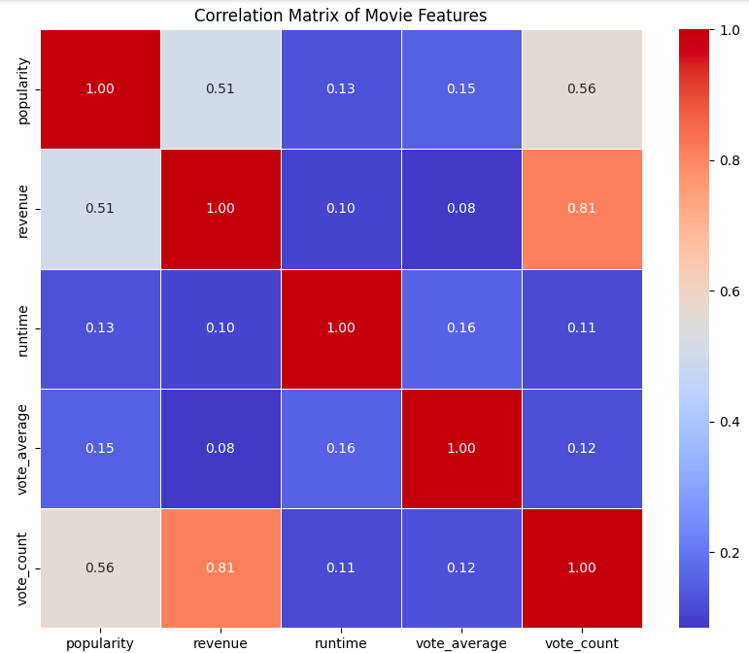
CORRELATION MATRIX OF MOVIE FEATURES

Slide 6
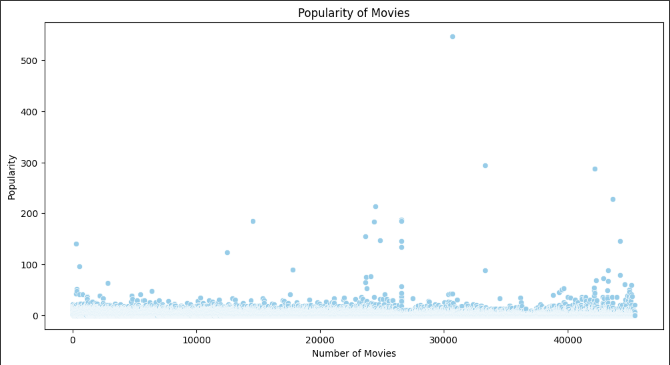
SCATTER PLOT ON POPULARITY OF MOVIES

Slide 7
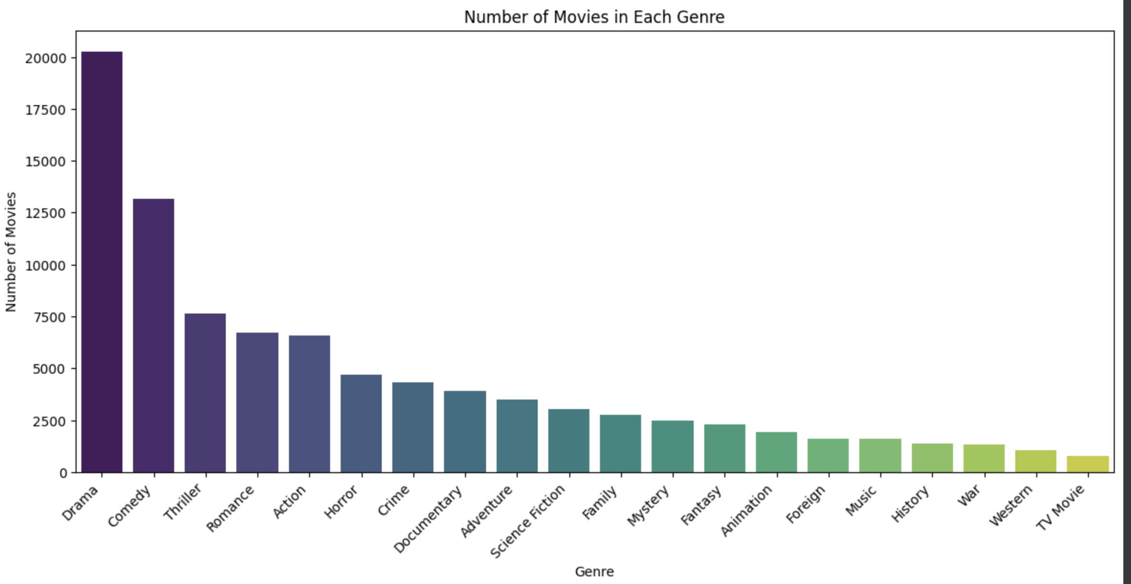
BAR GRAPH ON NUMBER OF MOVIES IN EACH GENRE

Slide 8
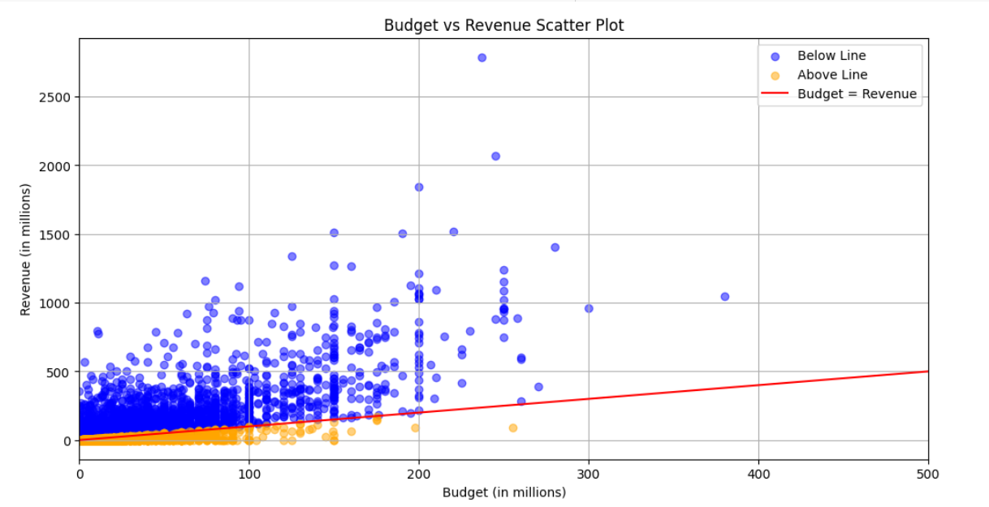
SCATTER PLOT BUDGET VS REVENUE

Slide 9
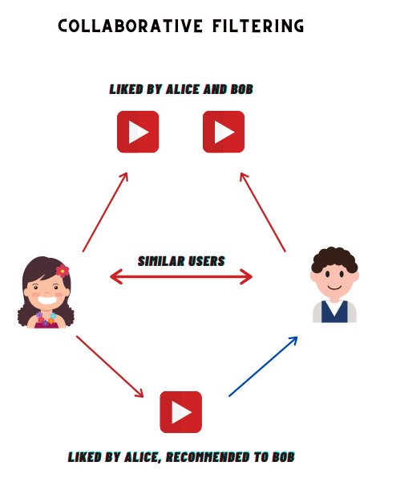
Collaborative Filtering
Our implementation of collaborative filtering leverages the powerful Surprise library, specifically employing the Singular Value Decomposition algorithm
SVD is a matrix factorization technique that uncovers latent features within the user-item rating matrix
To evaluate the effectiveness of our model, we perform a train-test split, setting aside a portion of the data for testing, and use the Root Mean Squared Error metric
Collaborative filtering, at its core, predicts user preferences based on their historical behavior and the preferences of users with similar tastes

Slide 10

Collaborative Filtering Results
The collaborative filtering model yields a Root Mean Squared Error value of
For example, let's consider a user named user1. After evaluating our ratings dataset, the SVD model gives the following output:

Slide 11
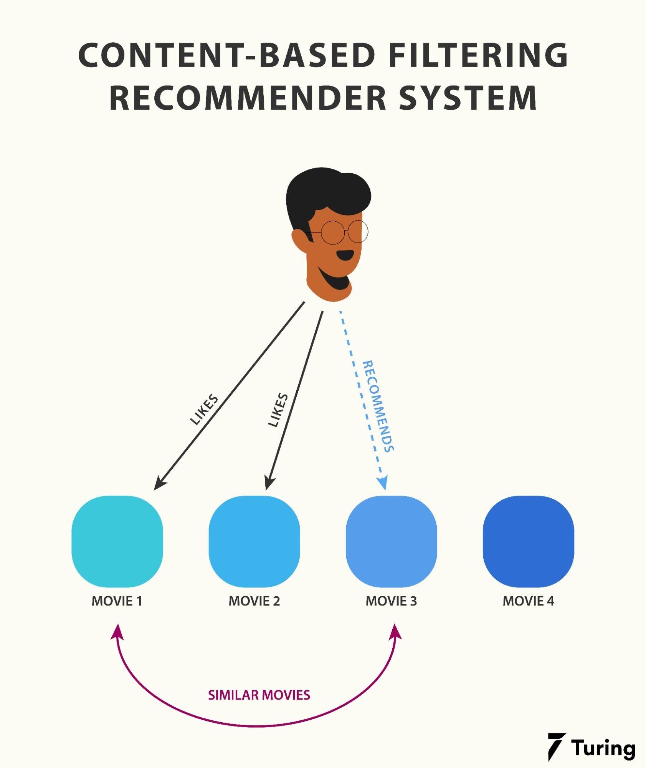
Content-Based Filtering Results
Content-based recommendations are generated by considering various features such as 'cast,' 'crew,' and 'keywords.' These recommendations showcase the system's ability to understand and suggest movies based on specific content attributes

Slide 12
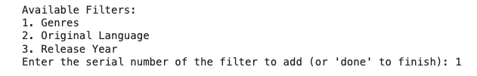
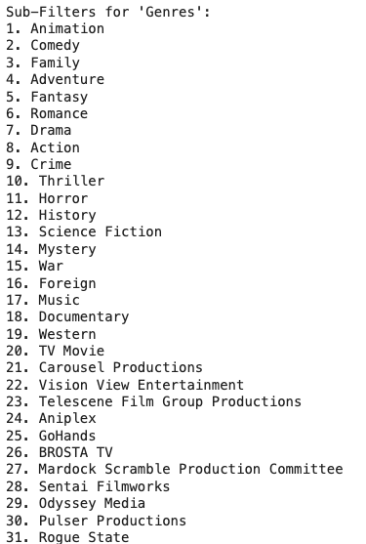
CONTENT BASED OUTPUT

Slide 13
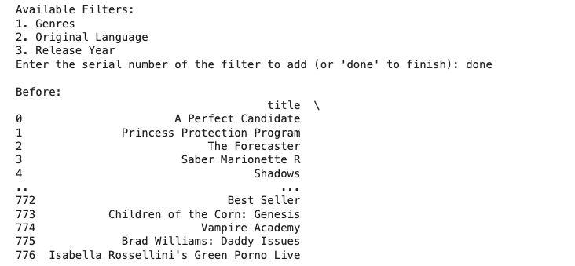
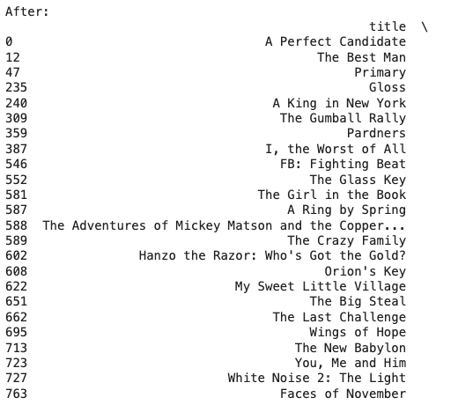

Slide 14
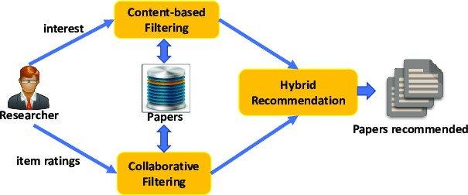
Hybrid Recommender
Our hybrid approach combines the results of both collaborative and content-based filtering to provide more robust and accurate movie recommendations
By leveraging the collective intelligence of user preferences and the nuanced features of movies, the hybrid recommender seeks to overcome limitations inherent in standalone methods

Slide 15

Hybrid Recommender Workflow
The integration process seamlessly weaves together collaborative and content-based recommendations, creating a unified and comprehensive approach
A visual representation, whether in the form of a flowchart or diagram, elucidates the step-by-step process, offering clarity on how both models are harmoniously combined

Slide 16
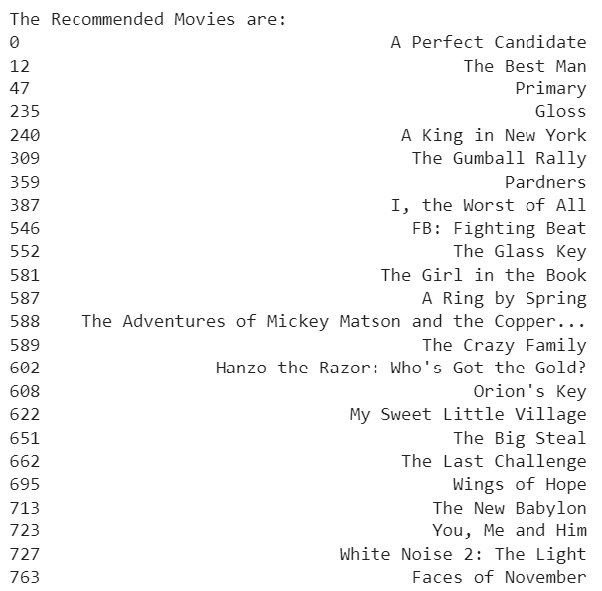
HYBRID RECOMMENDATION SYSTEM OUTPUT

Slide 17
OUR CONTRIBUTION
Collaborative Filtering:
SVD Matrix Integration:
The collaborative filtering aspect relies on Singular Value Decomposition (SVD) matrices.
It tailors recommendations based on individual user preferences within the dataset.
Individual User Preferences:
For example, if User 1 has distinct tastes in movies, the collaborative model recommends films aligned with those specific preferences.

Slide 18

OUR CONTRIBUTION
Content-Based Recommender:
NLP (TF-IDF) Movie Filtering:
In the content-based recommender system, we employ Natural Language Processing (NLP) techniques, specifically Term Frequency-Inverse Document Frequency (TF-IDF) analysis.
TF-IDF enhances movie filtering within a chosen genre by analyzing and extracting key features from movie descriptions or synopses.

Slide 19

OUR CONTIBUTION
Integrated User Experience:
Combined Output:
The combined output from both collaborative and content-based recommenders is presented to the user.
Personalized Recommendations:
Recommendations are filtered based on the user's input, aligning with the selected movie, preferred genres, and desired publication year.
Nuanced Movie Discovery:
This comprehensive approach aims to provide a nuanced and personalized movie recommendation system, seamlessly integrating collaborative and content-based filtering methodologies, along with sophisticated NLP techniques through TF-IDF analysis.

Slide 20
Challenges and Solutions
Throughout the implementation, our team encountered a myriad of challenges
These challenges ranged from data inconsistencies to algorithmic complexities, each requiring thoughtful consideration
To address these challenges, our team proactively sought and implemented solutions, ensuring the robustness and reliability of the recommendation system

Slide 21

Conclusion
As we draw the curtain on our project, it's pivotal to revisit our initial objectives and recognize the significant findings and achievements along the way
Our hybrid recommendation system successfully combines the best of both collaborative and content-based approaches, paving the way for more personalized and accurate movie recommendations

Slide 22

Future Improvements
In our pursuit of continuous improvement, we have identified several areas for future enhancement
These include refining algorithms, exploring new datasets to broaden the system's knowledge base, and incorporating emerging technologies to stay at the forefront of recommendation systems

Slide 23
Thank You
-
Pitta Manoj
Pratheek KB
Siddh Shetty
Nischith Gowd

