Slide 1
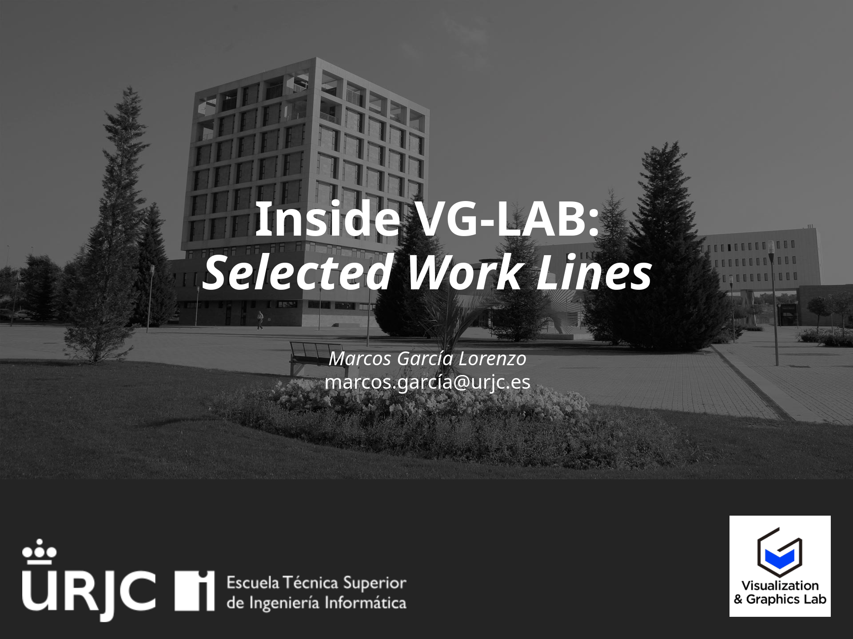

Slide 2
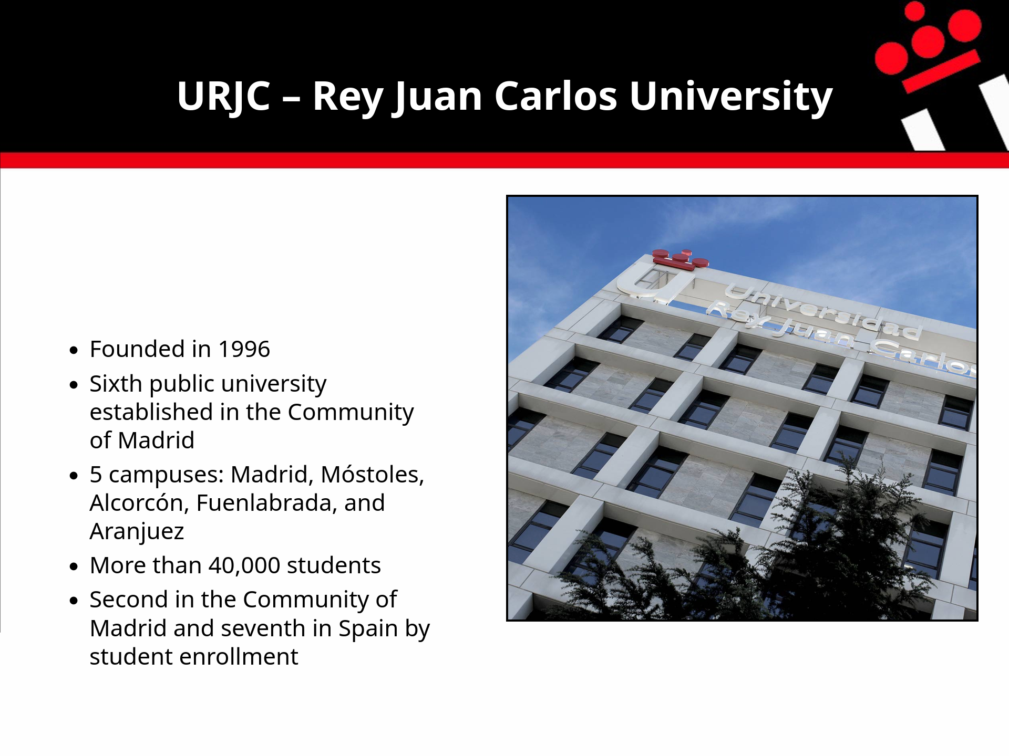

Slide 3
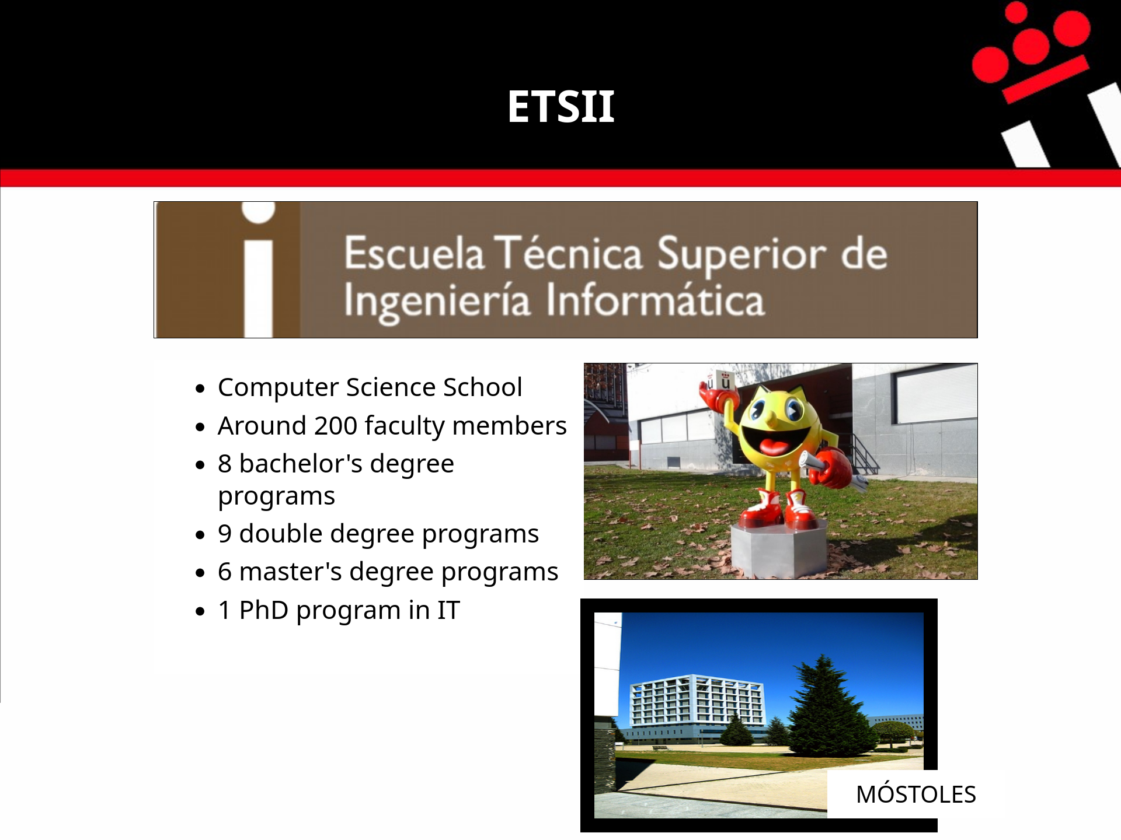

Slide 4
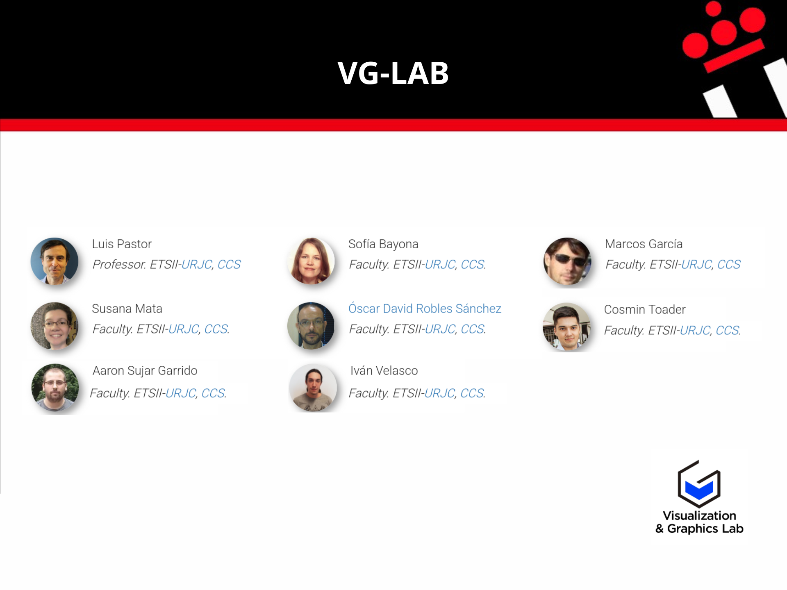

Slide 5
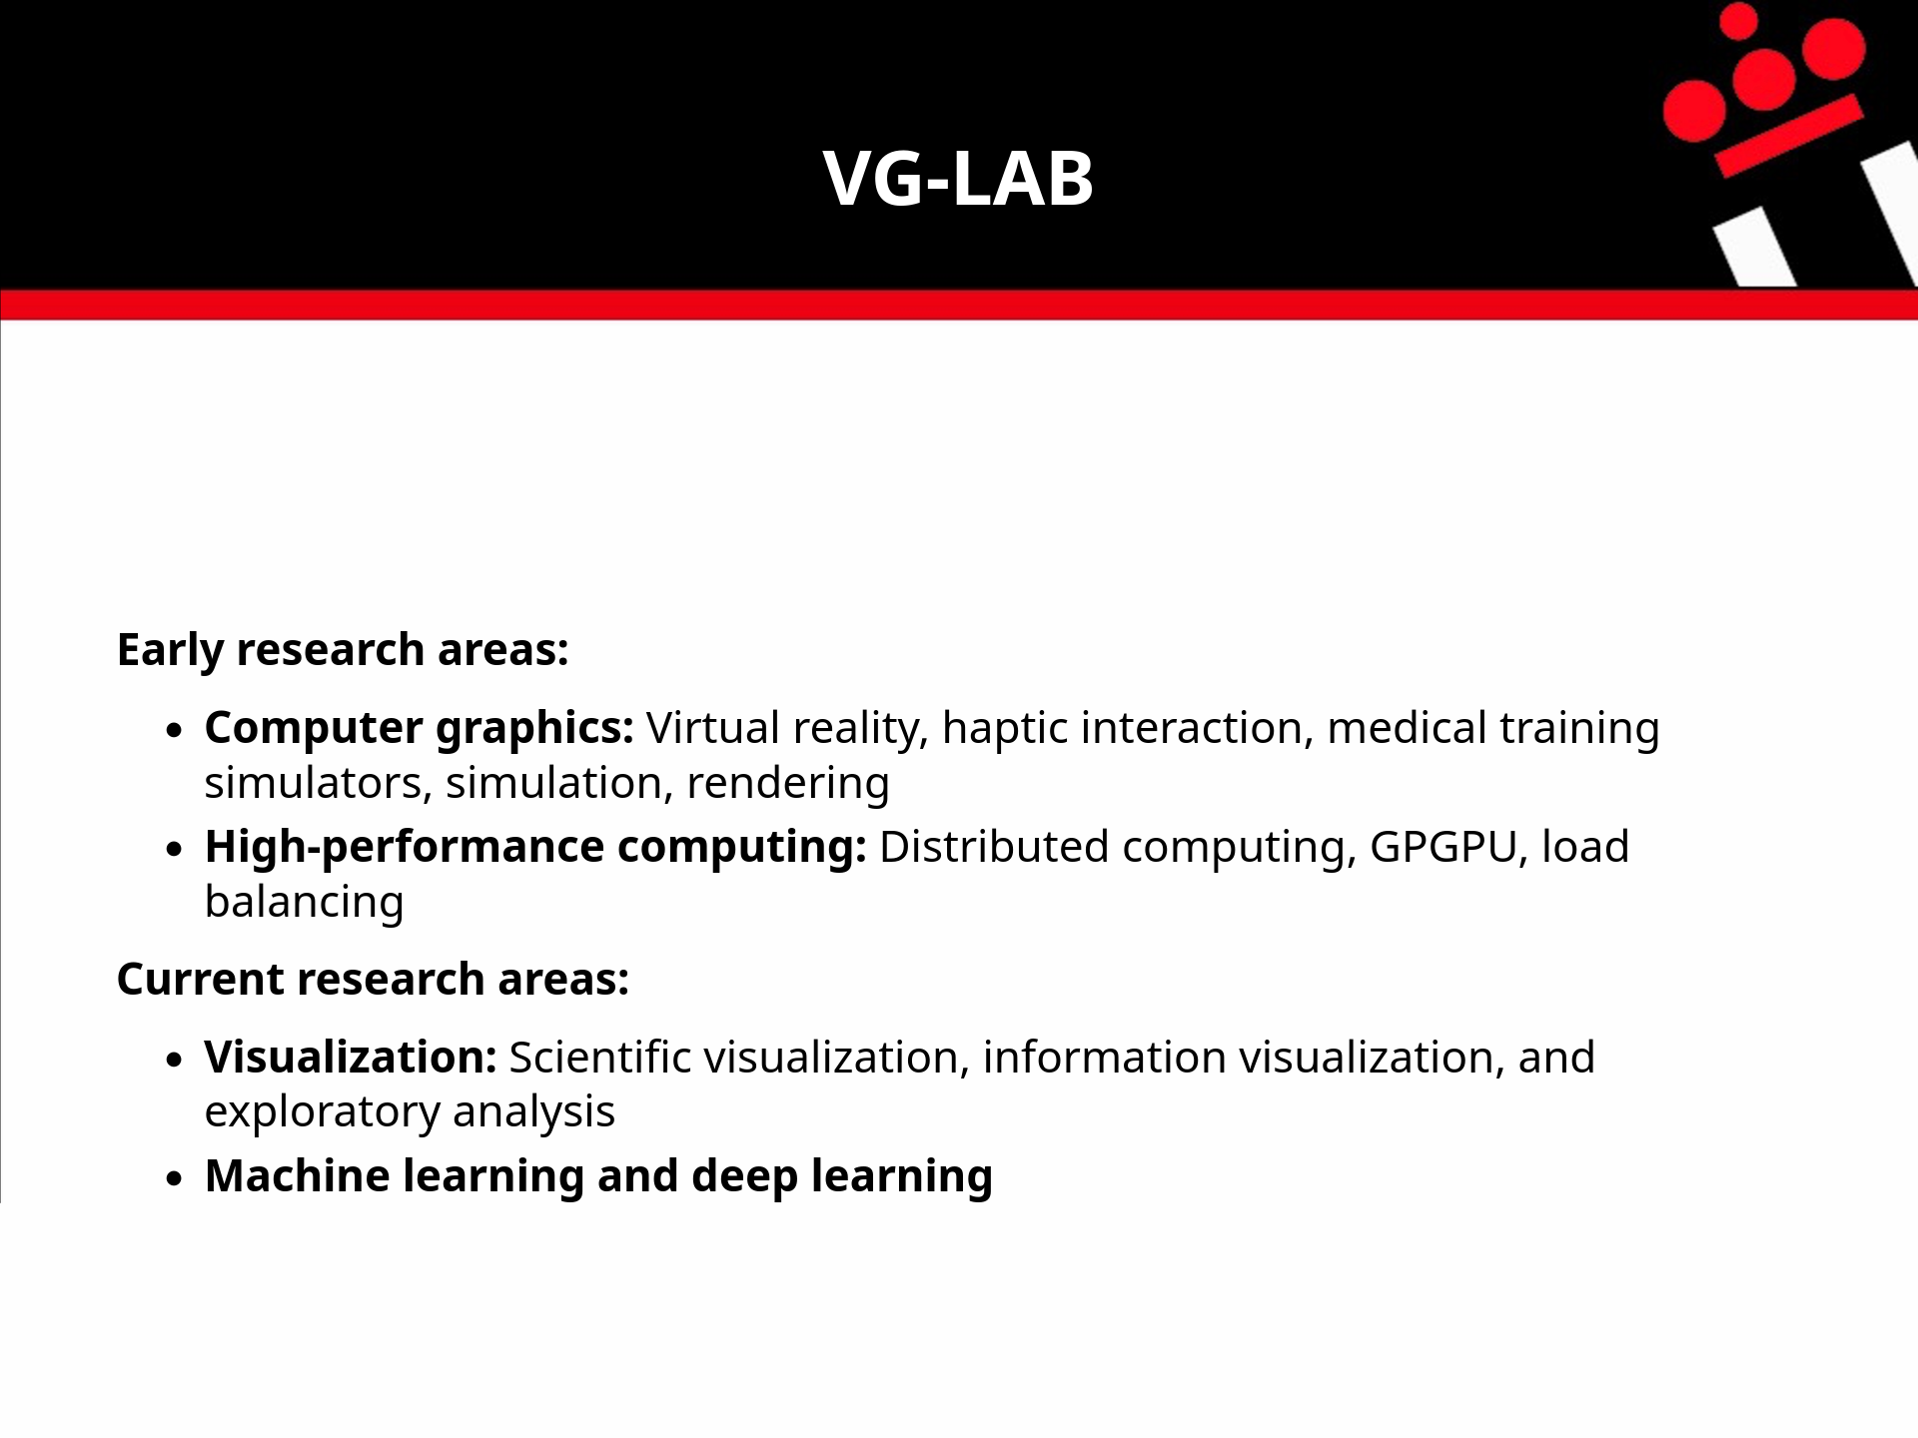

Slide 6
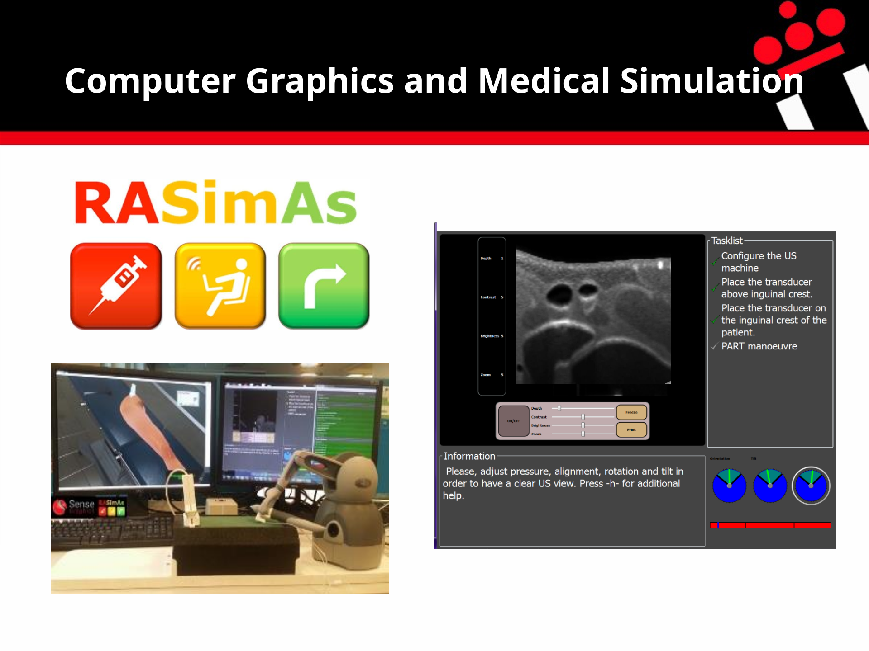
Notes:
Technical degree programs in Systems and Management Informatics have been offered since the 1997–1998 academic year.
The School of Computer Engineering was established in July 2007.

Slide 7
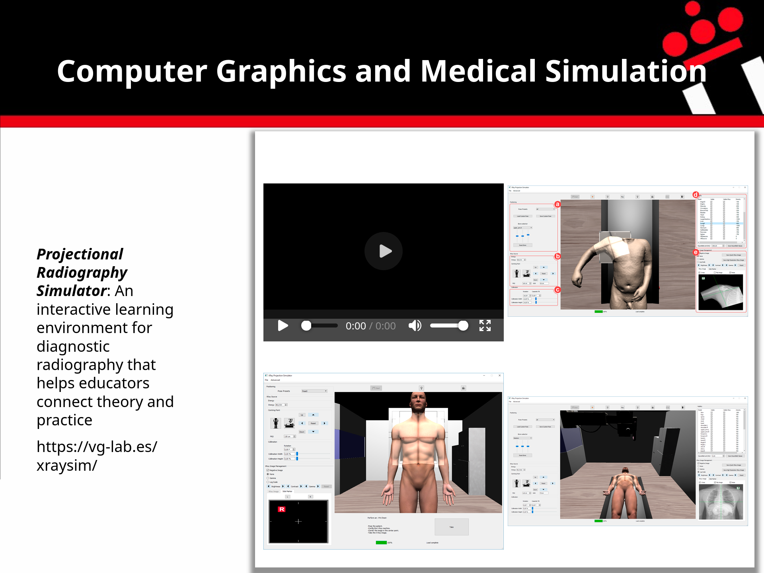
Notes:
X-ray simulator:
This is a safe environment for training radiographers, with no risk of radiation exposure.
It simulates the full procedure, including patient positioning and machine settings.
Different patient models can be added easily.
This work is a collaboration with hospitals in the UK and Bangor University.

Slide 8
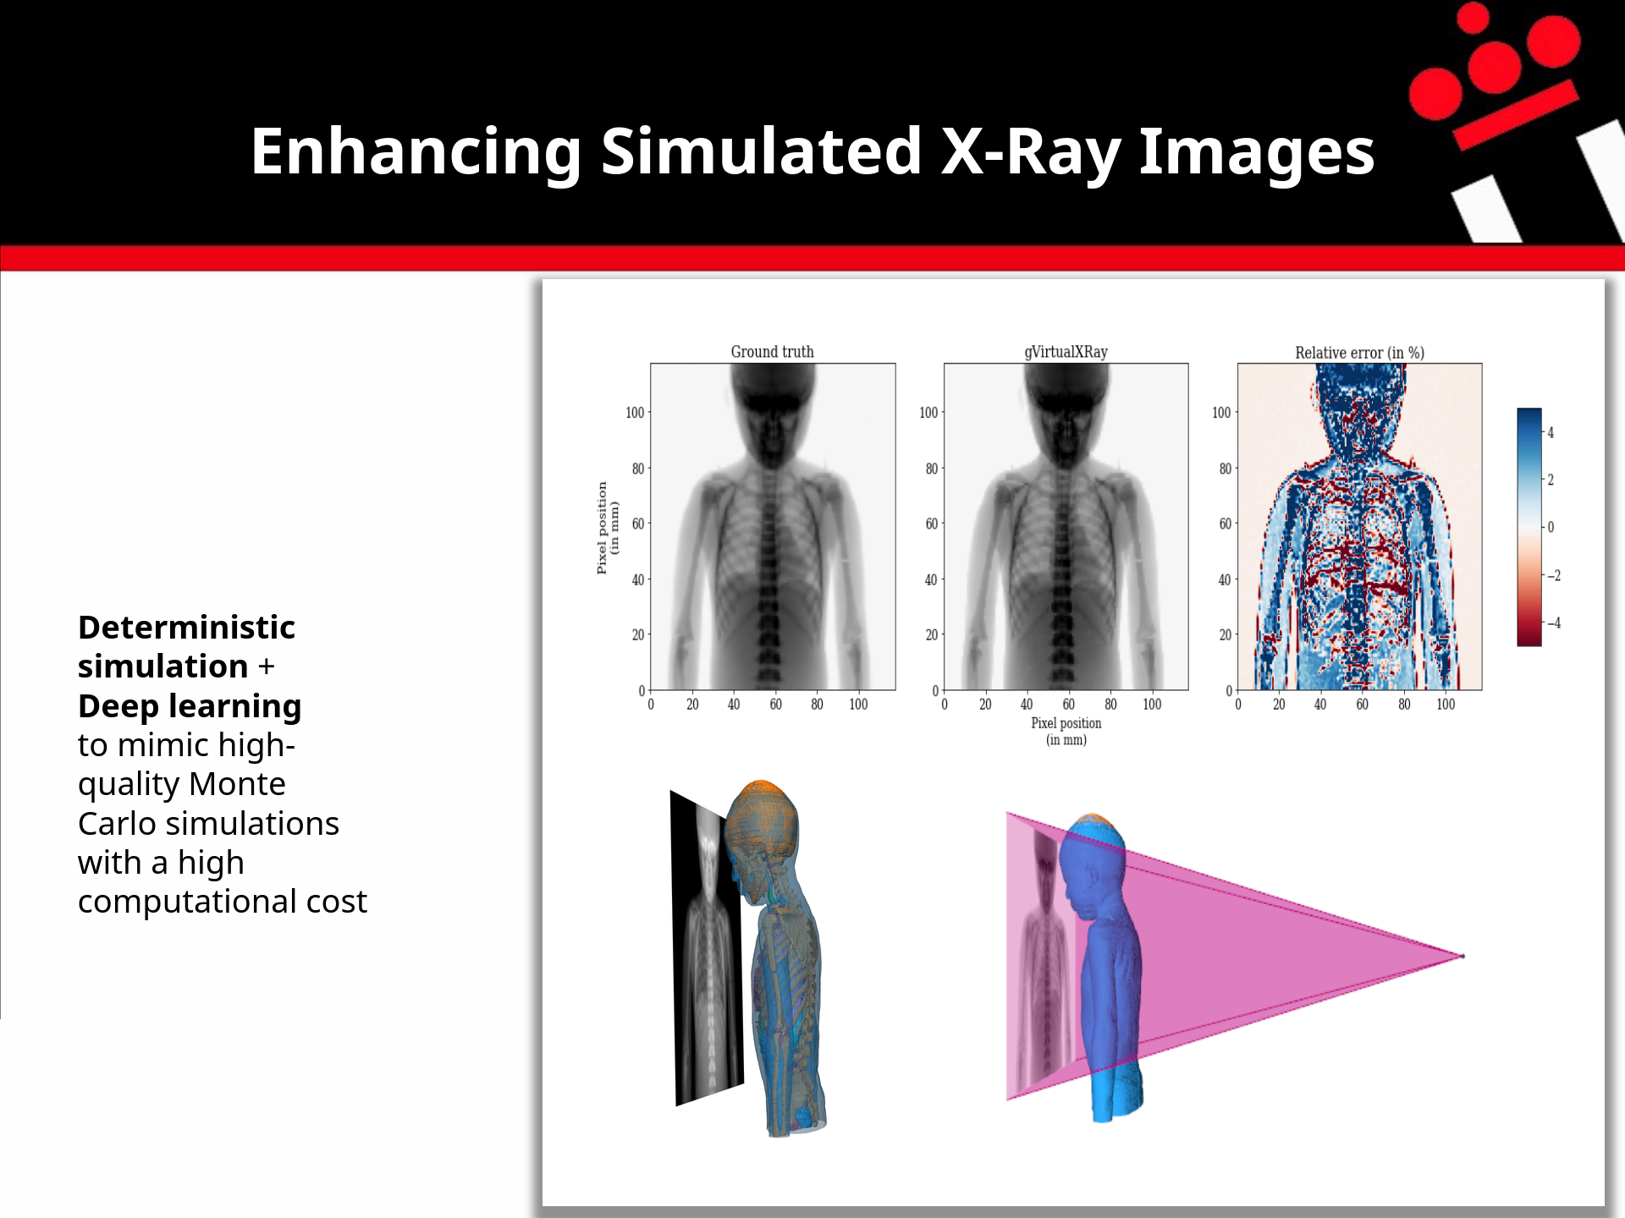
Notes:
Enhancing simulated X-ray images:
Monte Carlo methods accurately simulate how photons interact with different materials in the scene.
However, producing high-quality images takes a lot of computing time.
The top-left image was simulated using one billion photons. It took about 70 hours on a server running 20 threads in parallel.
The center image was simulated in less than one second on a desktop PC.
However, this deterministic simulation only accounts for the energy absorbed by tissues. It does not include scattering.
We aim to use deep learning to add scattering effects to the final image.

Slide 9
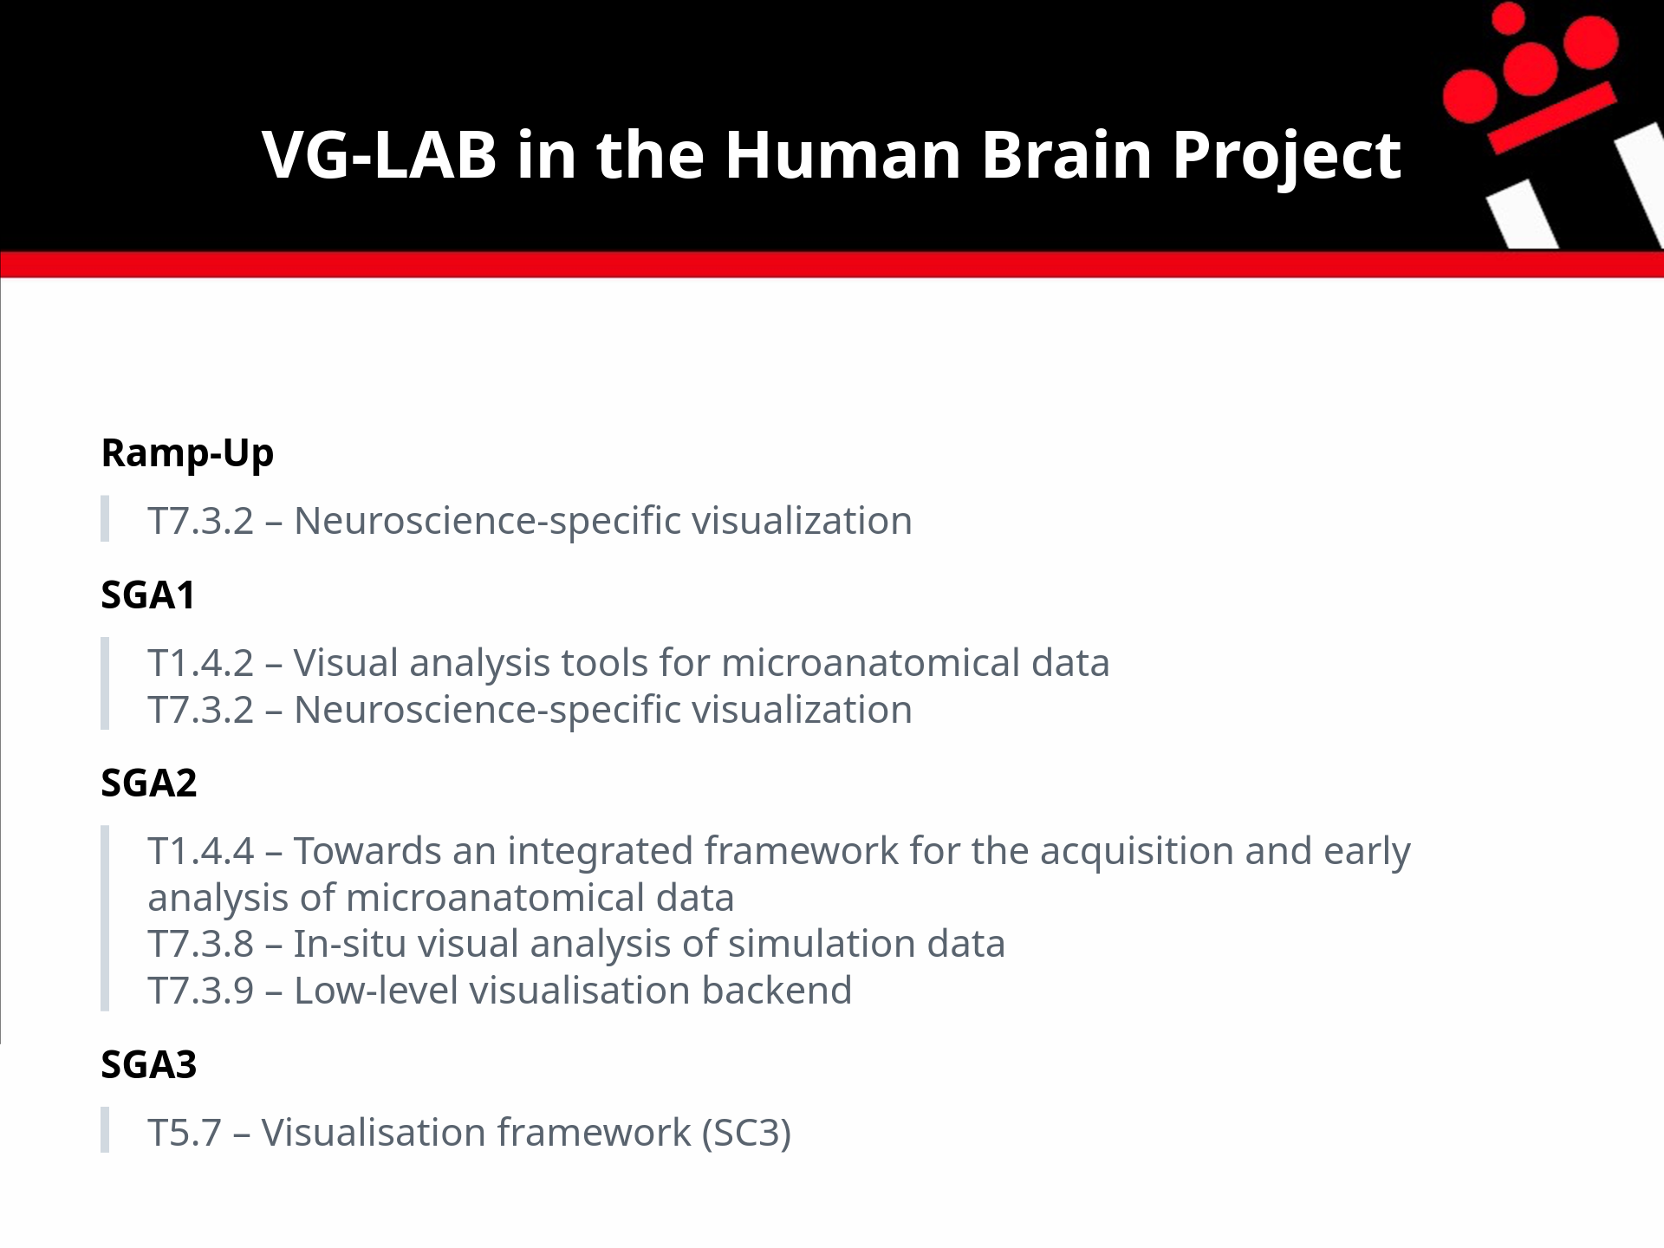
Notes:
The Human Brain Project, or HBP, was a European research project.
These were the tasks that VG-LAB contributed to during its different phases.

Slide 10
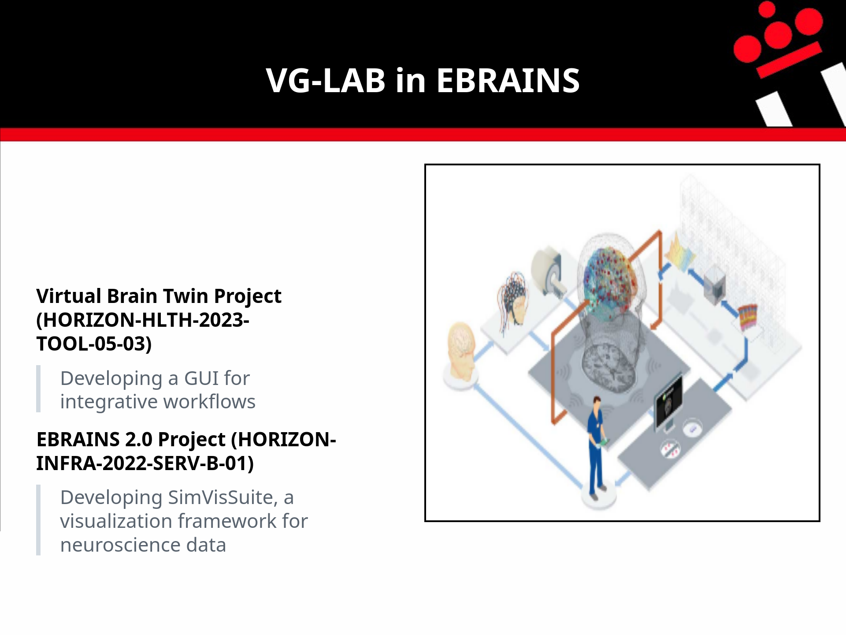
Notes:
EBRAINS is a European project.
Here are our contributions to EBRAINS 2.0 and the Virtual Brain Twin project.

Slide 11
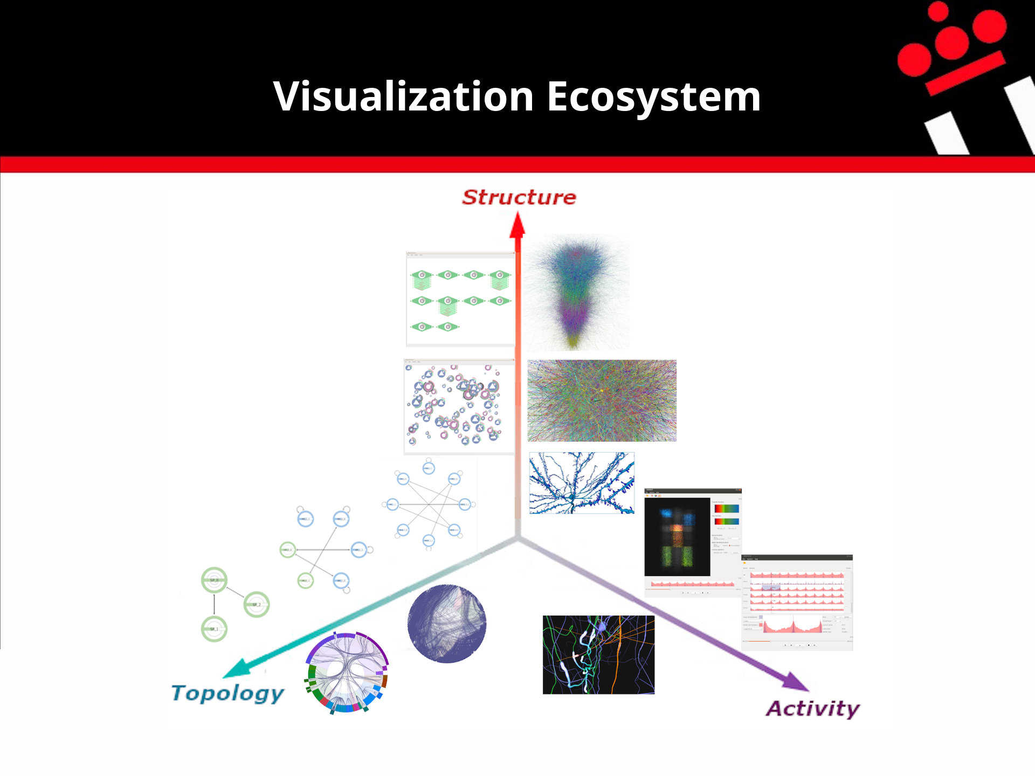

Slide 12
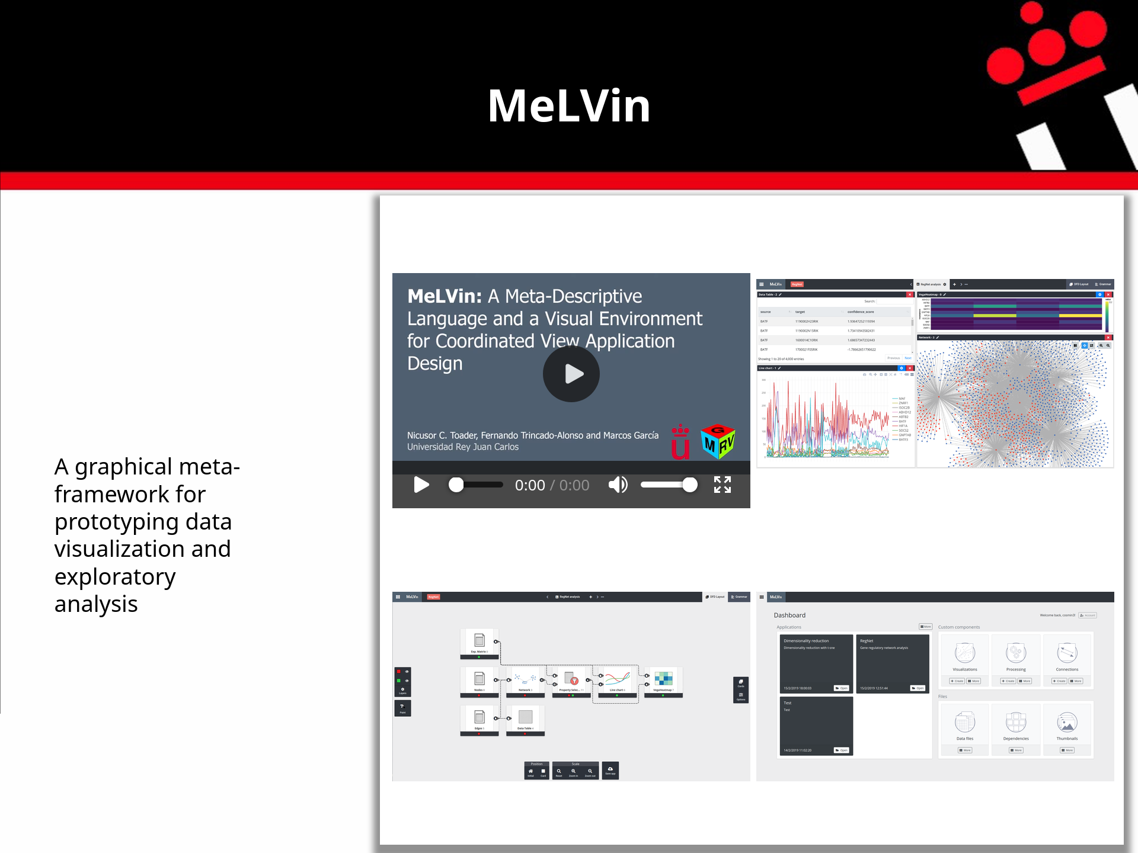
Notes:
MeLVin: https://vg-lab.es/melvin/
MeLVin is a web-based meta-framework for building visualization applications.
It is especially useful for rapid prototyping and interactive exploratory analysis.
It connects visualizations and data analysis tools built with different technologies, so they can work together.
It can be extended and adapted to different research areas.
Users can define the data analysis process with simple flowcharts.
Most flowchart-based data mining tools use visualizations only to show the final results.
MeLVin also lets users include visualizations and interactions between them as part of the analysis process.

Slide 13
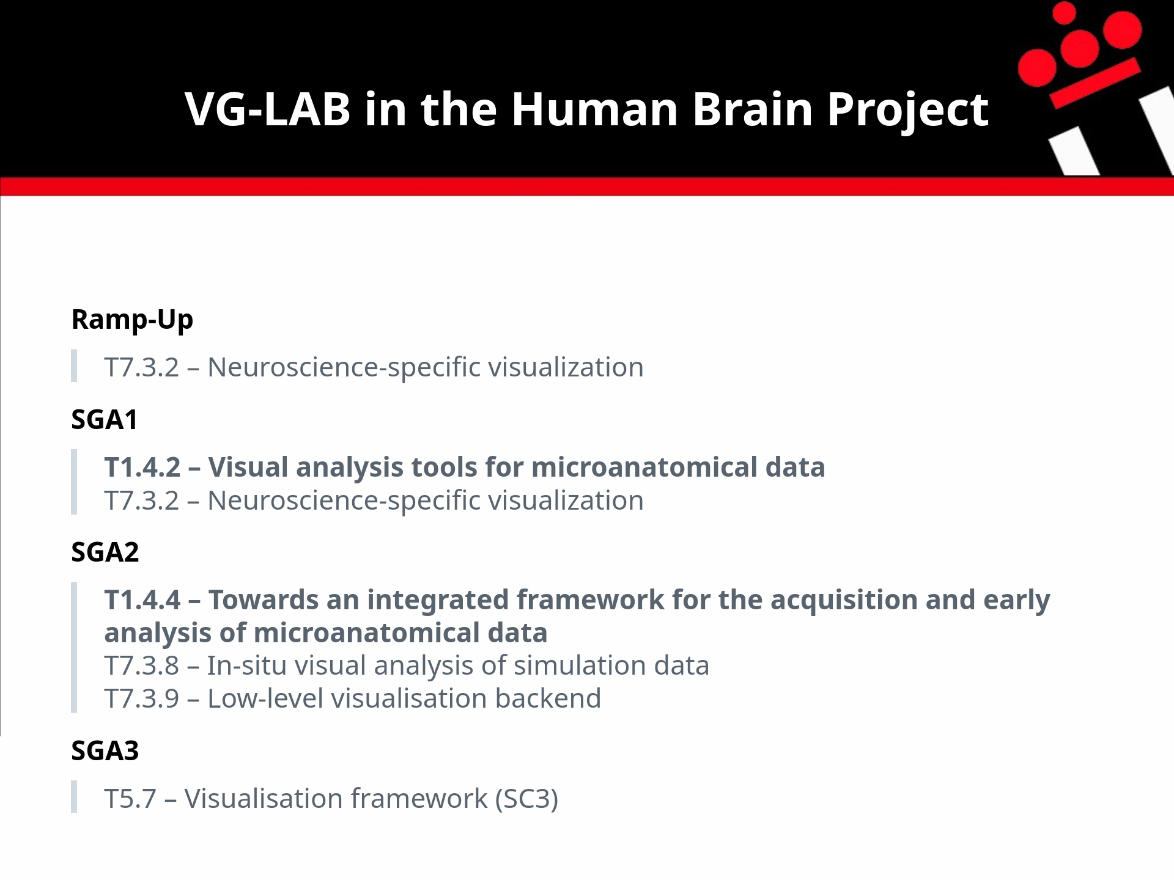
Notes:
The Human Brain Project, or HBP, was a European research project.
These were the tasks that VG-LAB contributed to during its different phases.

Slide 14
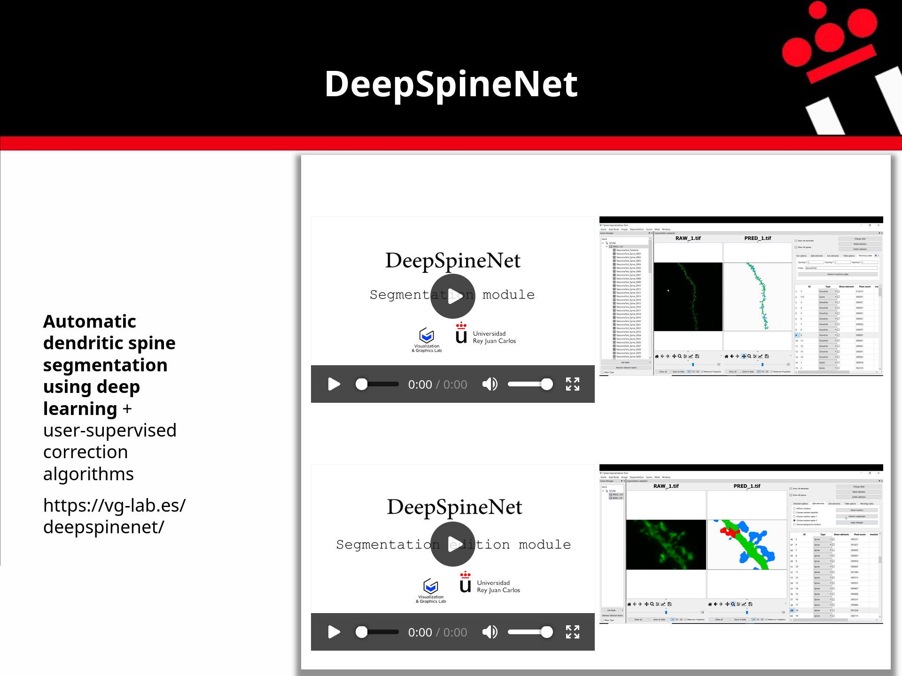
Notes:
Challenges:
Scientific datasets are often small, and their labels are incomplete or imprecise.
We propose three approaches:
- Automatic algorithms to improve the quality of the training data.
- Training techniques to reduce overfitting caused by poor-quality data.
- Correction algorithms to further improve the ground-truth labels.

Slide 15
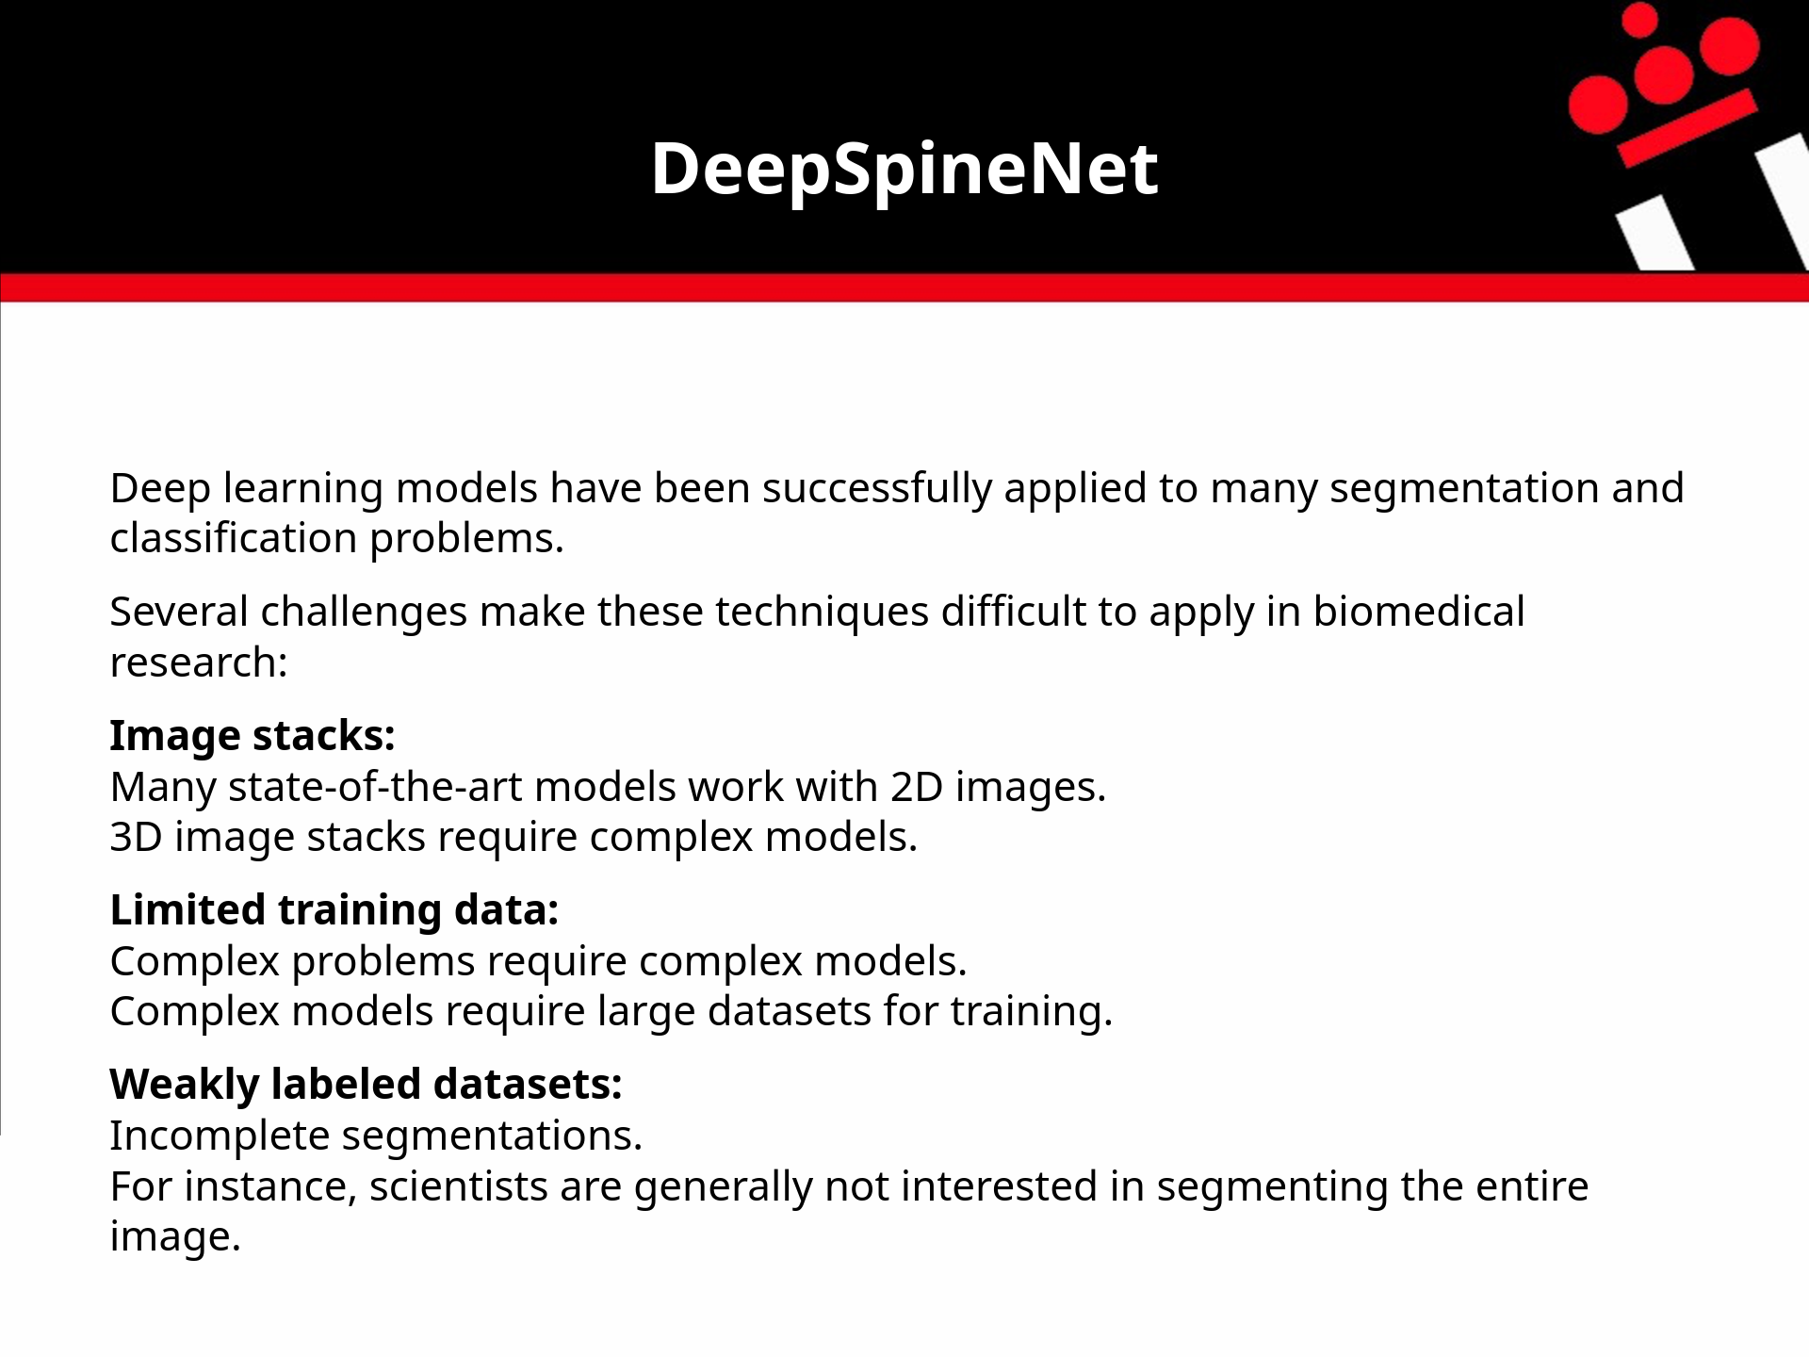
Notes:
As most of you already know, deep learning models work well for many segmentation and classification tasks.
However, applying them to biomedical images can be difficult.
First, we work with 3D image stacks.
Many state-of-the-art models mainly work with 2D images.
Processing 3D images requires more complex models, often with many parameters.
These models need large training datasets.
Labeling dendritic spines is difficult and takes a lot of time.
This makes it hard to obtain enough labeled data to train reliable models.
Finally, the labels in many datasets are incomplete.
Researchers are often interested in only one dendritic branch in the image stack.
As a result, other parts of the image remain unlabeled.

Slide 16
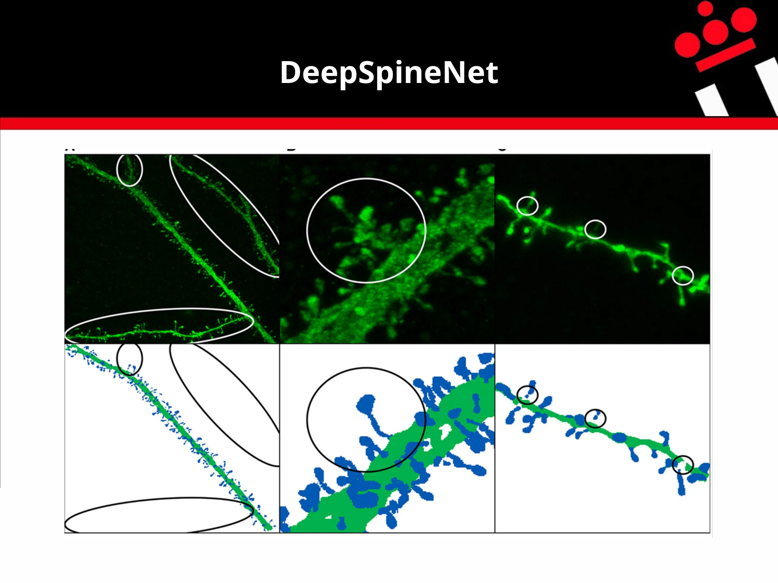

Slide 17
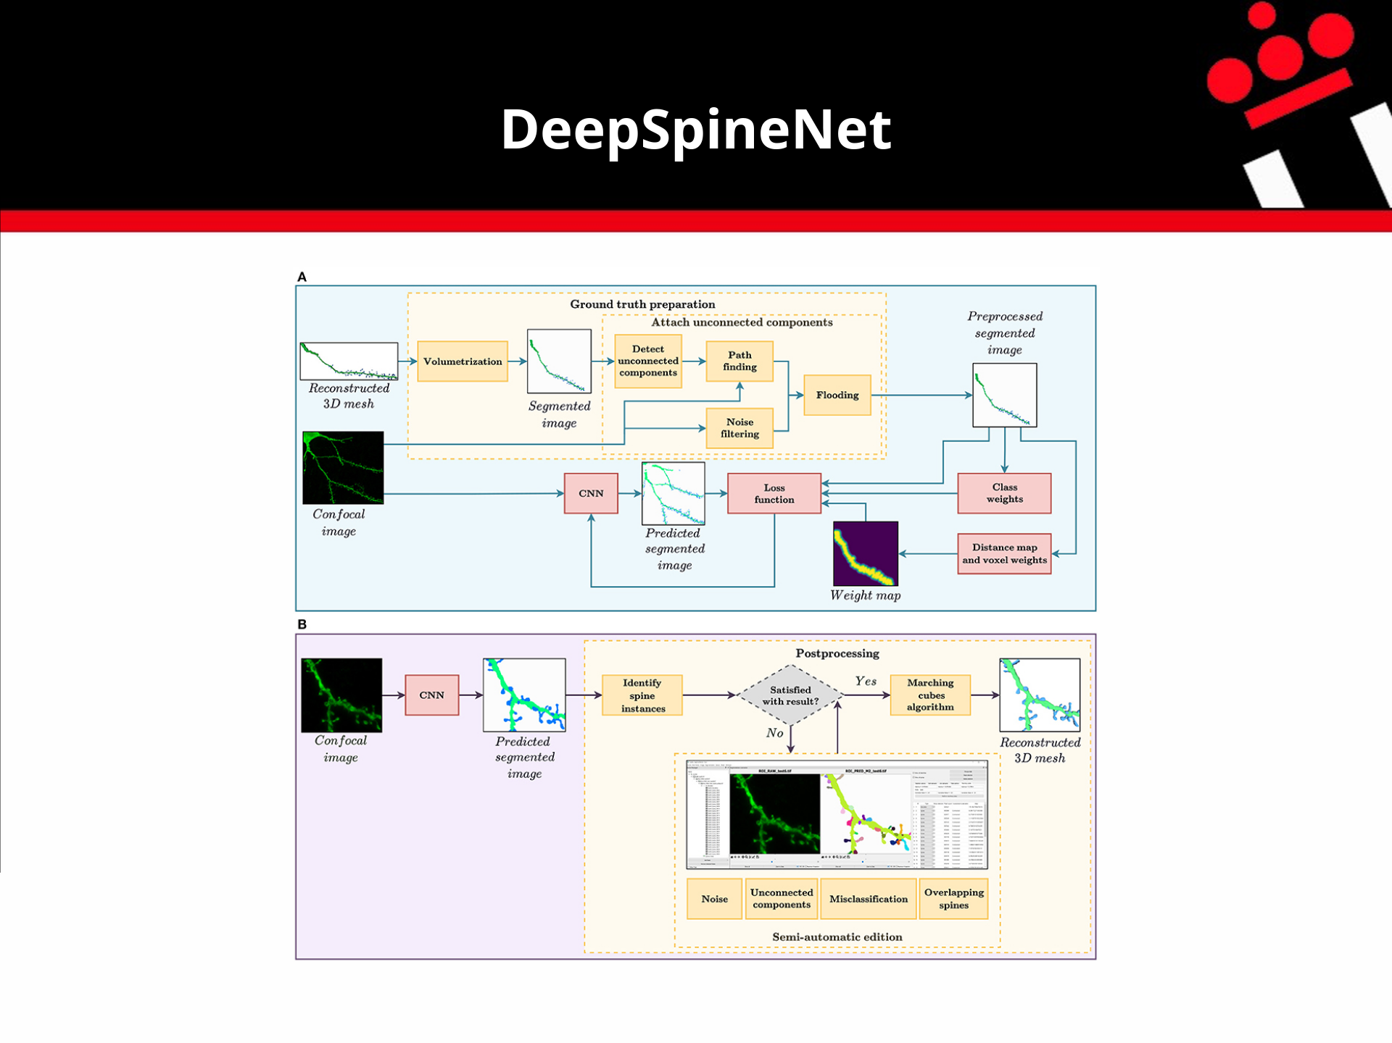
Notes:
Our approach has three components:
- A preprocessing module to prepare the data.
- A deep learning model designed for this task.
- A postprocessing module that lets users correct the model's errors.

Slide 18
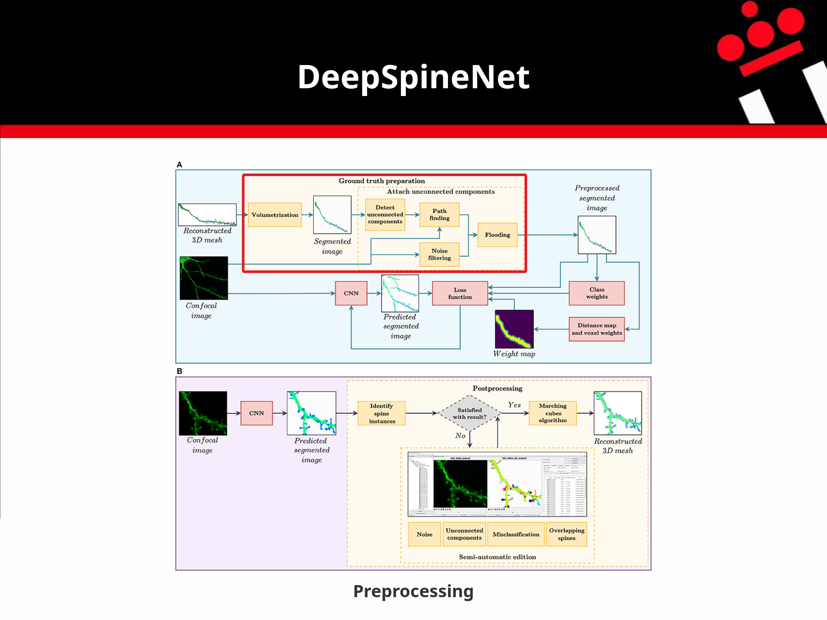
Notes:
Our approach has three components:
- A preprocessing module to prepare the data.
- A deep learning model designed for this task.
- A postprocessing module that lets users correct the model's errors.

Slide 19
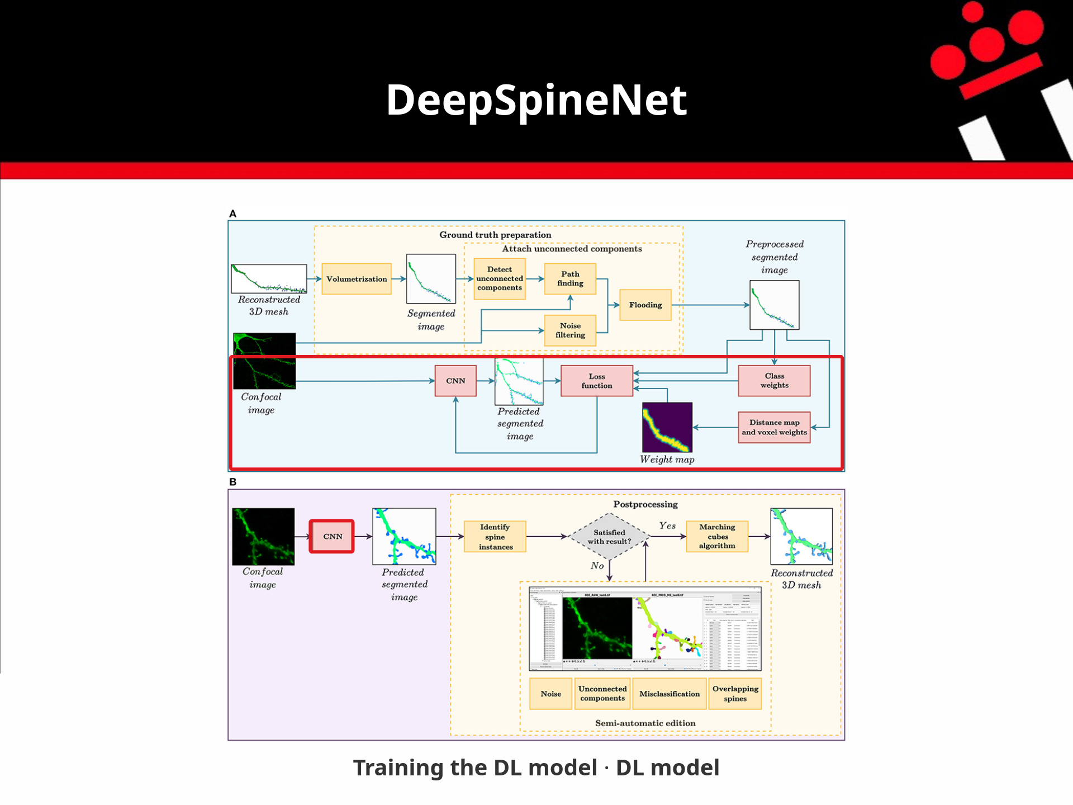
Notes:
Our approach has three components:
- A preprocessing module to prepare the data.
- A deep learning model designed for this task.
- A postprocessing module that lets users correct the model's errors.

Slide 20
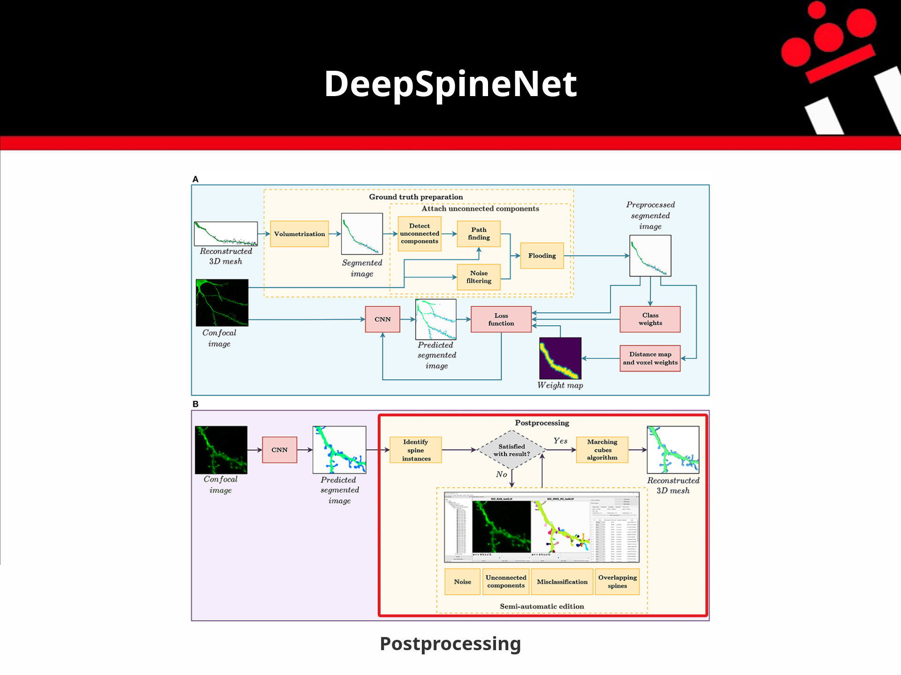
Notes:
Our approach has three components:
- A preprocessing module to prepare the data.
- A deep learning model designed for this task.
- A postprocessing module that lets users correct the model's errors.

Slide 21
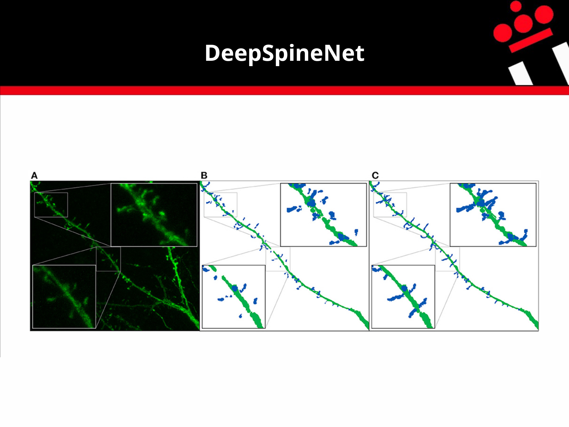
Notes:
The main goal of the preprocessing module is to create the training set and automatically reconstruct the necks of disconnected dendritic spines.

Slide 22
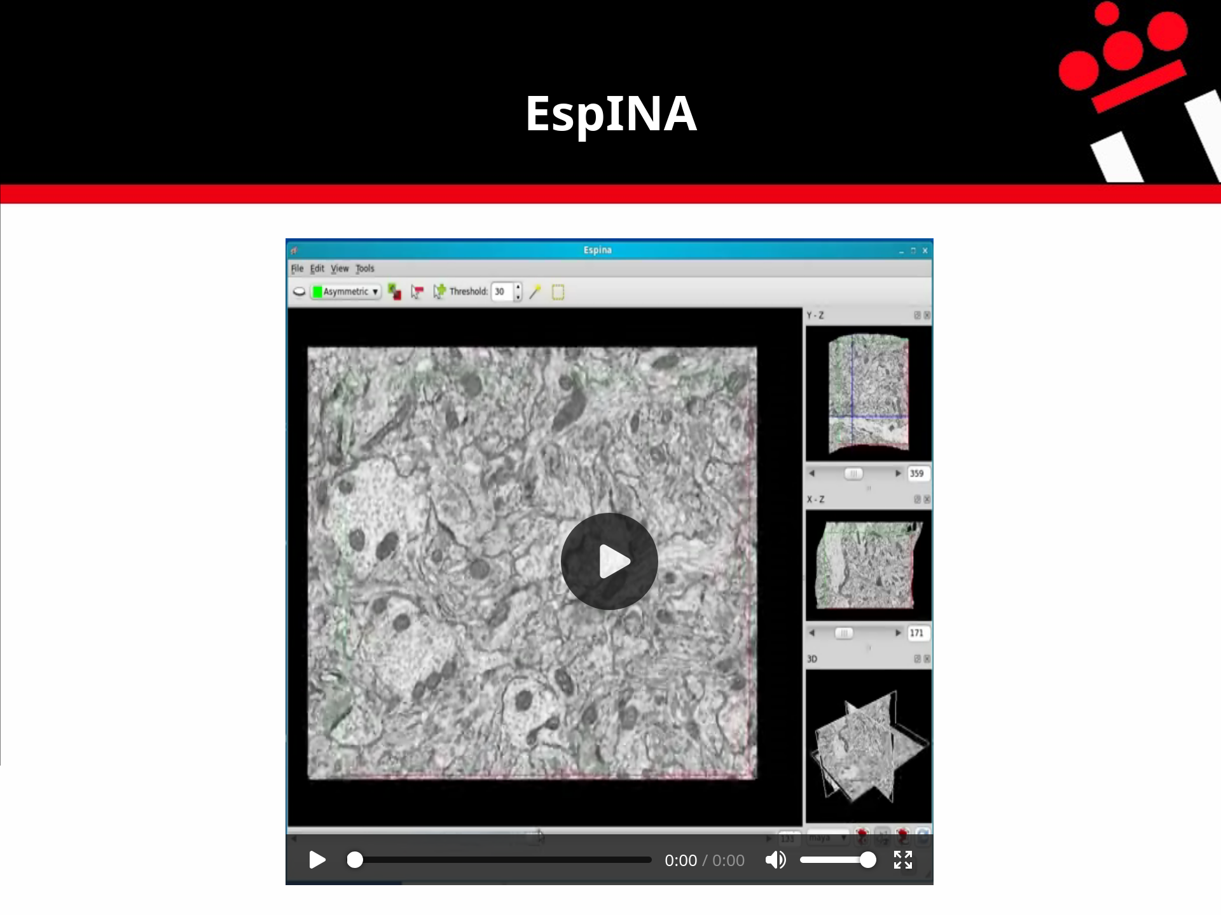

Slide 23
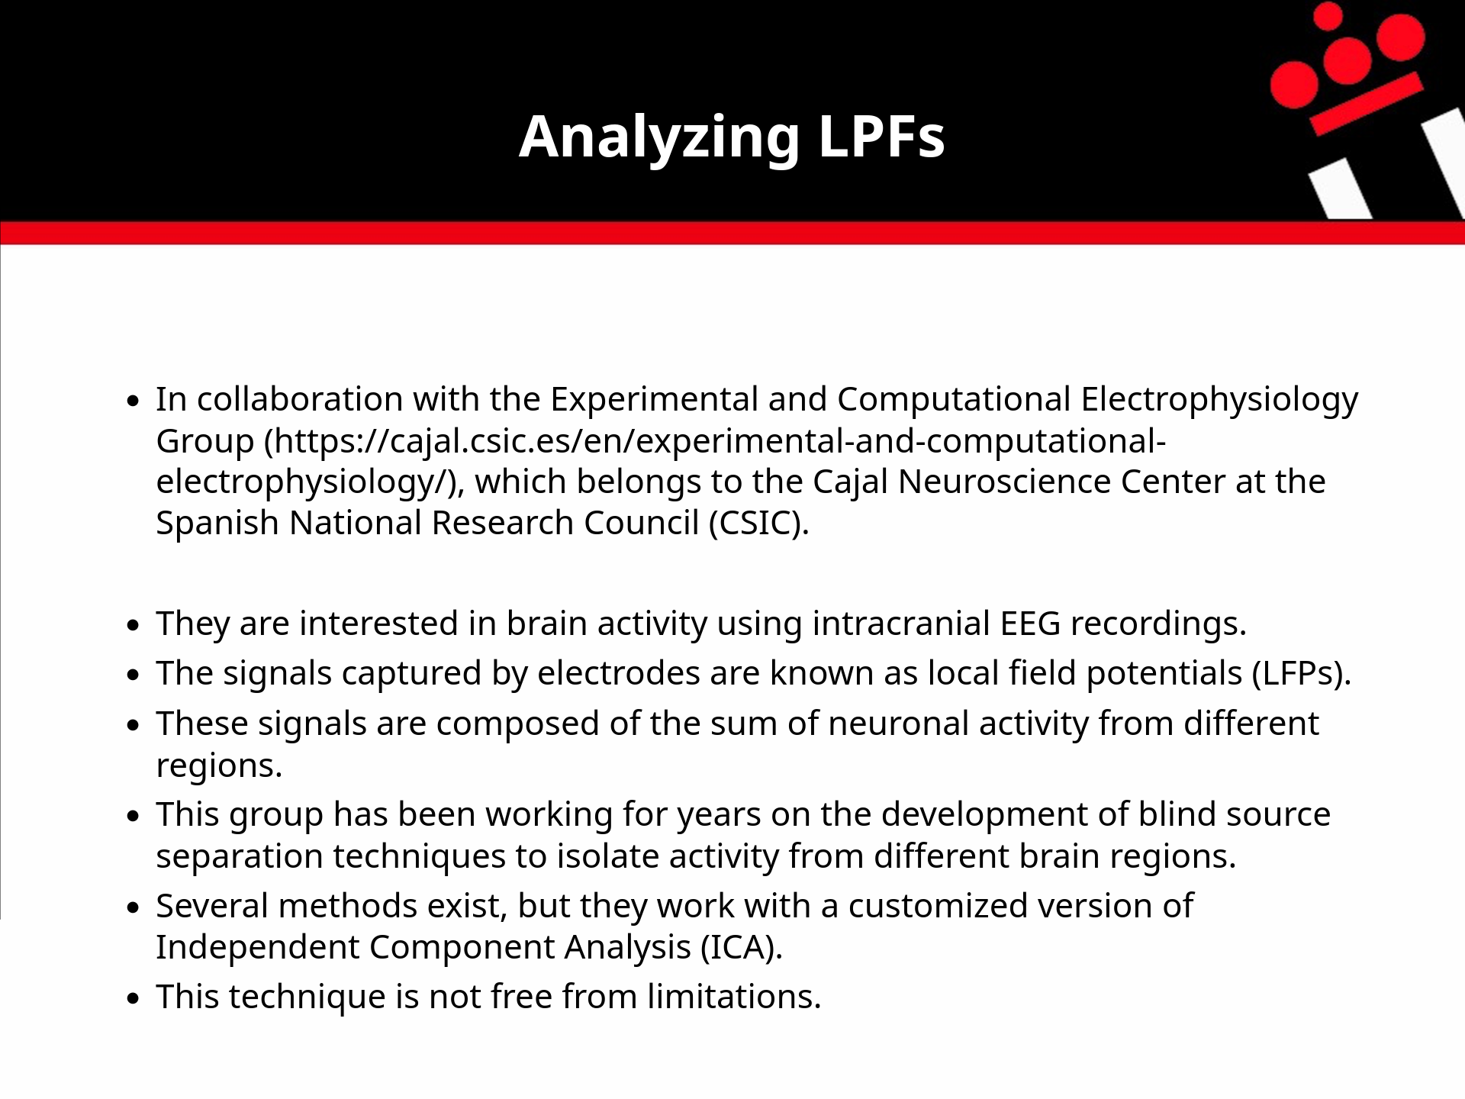
Notes:
* Esta es mi linea de trabajo mas reciente
* He estado trabajando en ella el ultimo año.

Slide 24


Slide 26
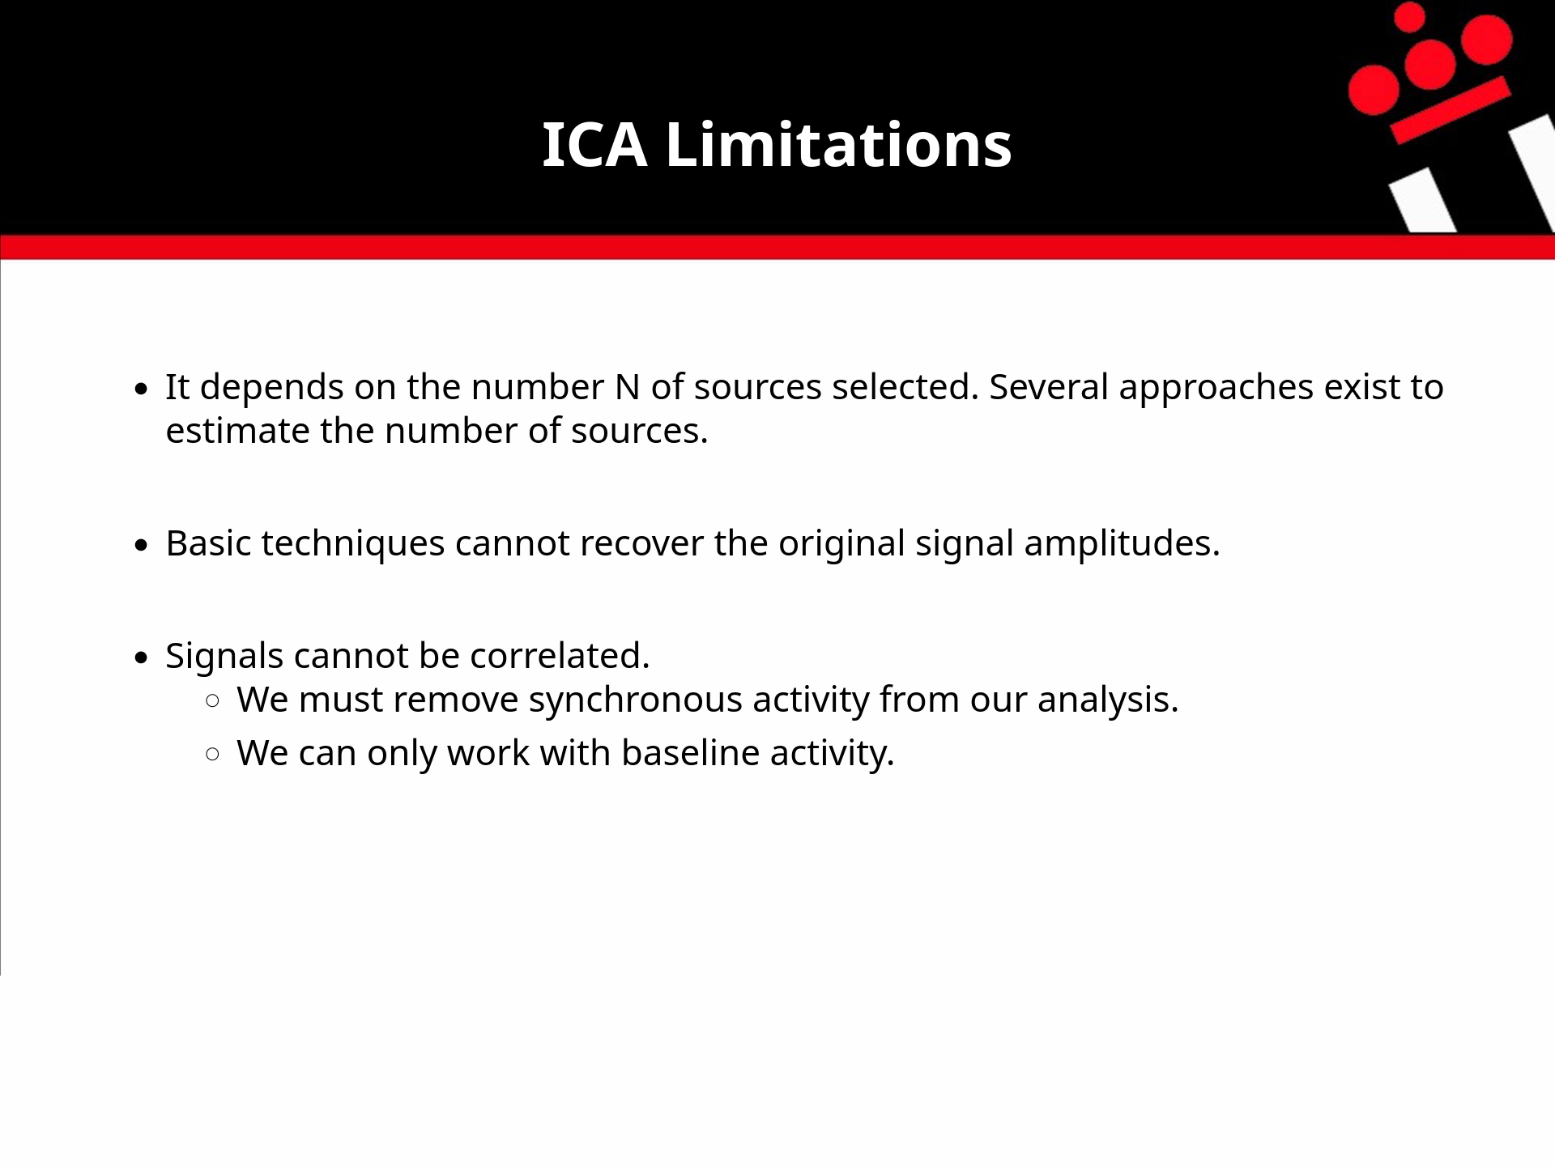

Slide 28
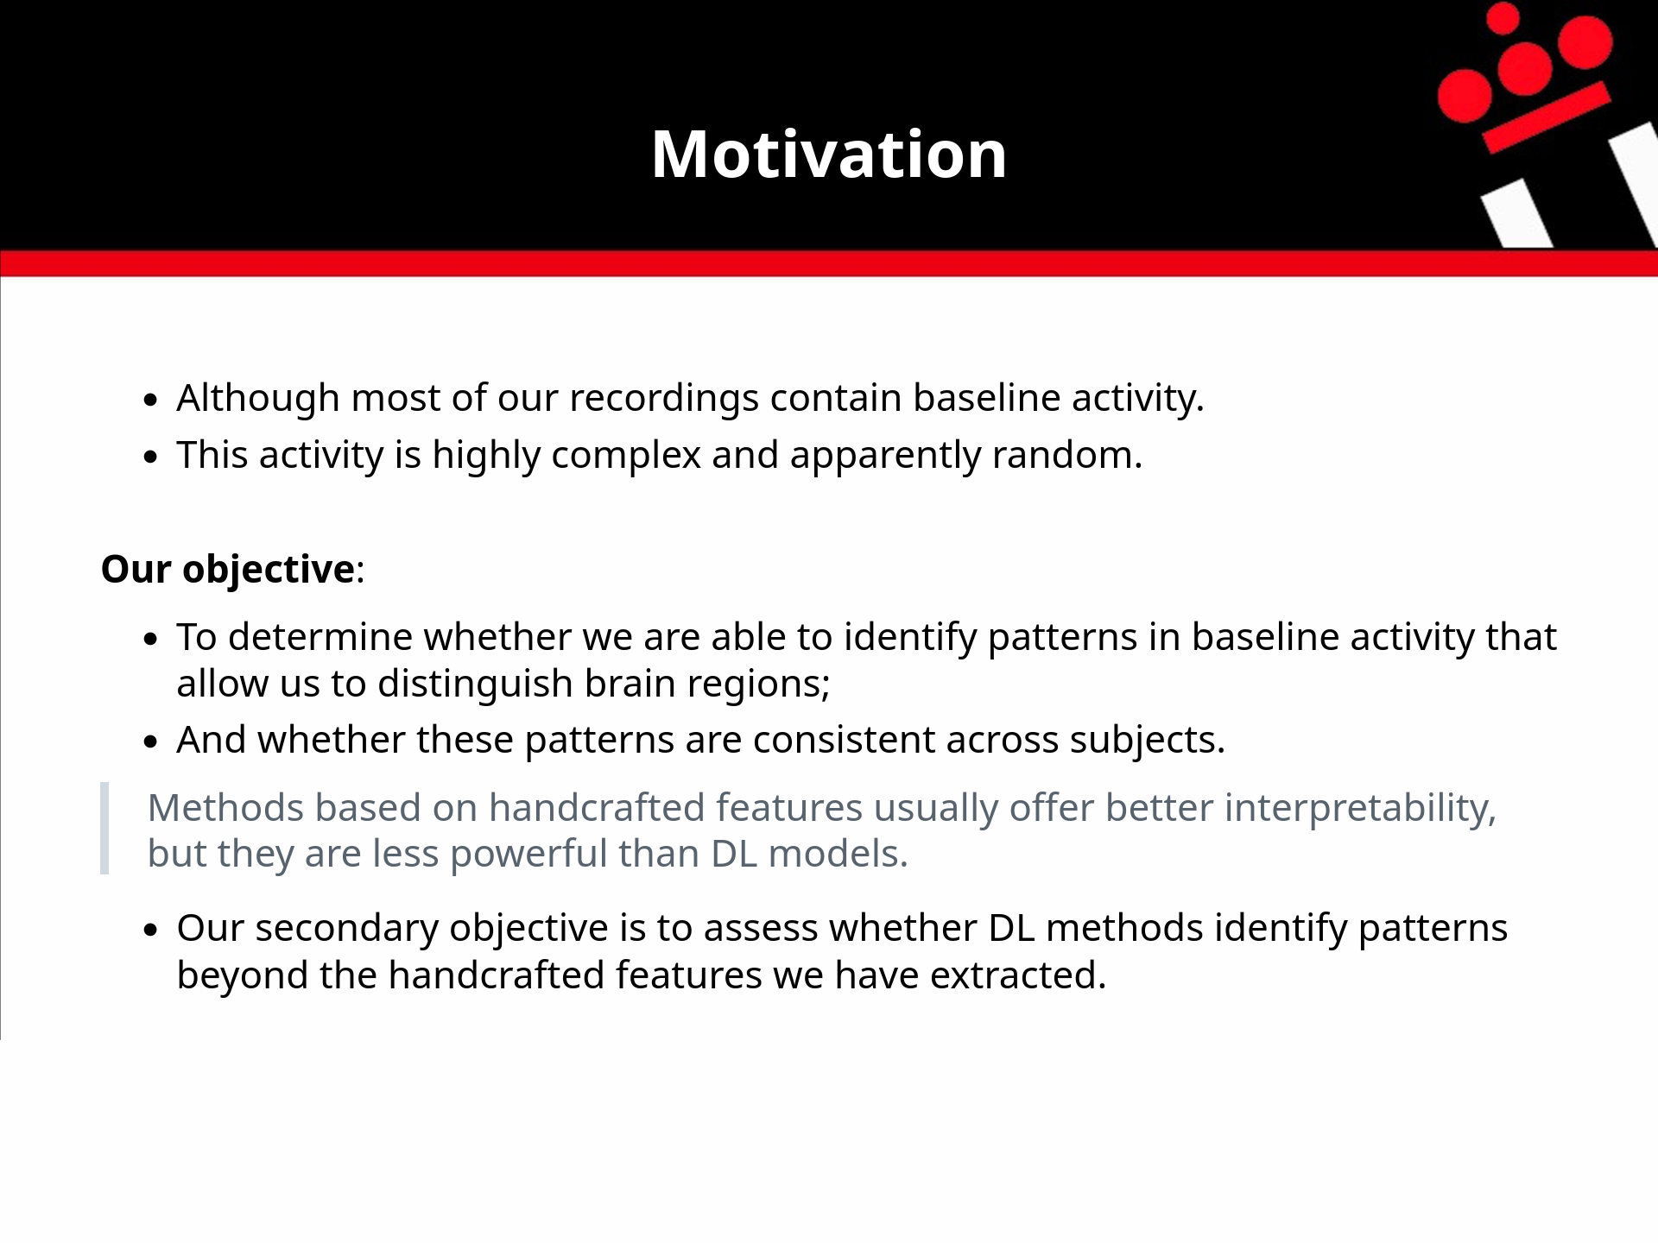

Slide 29
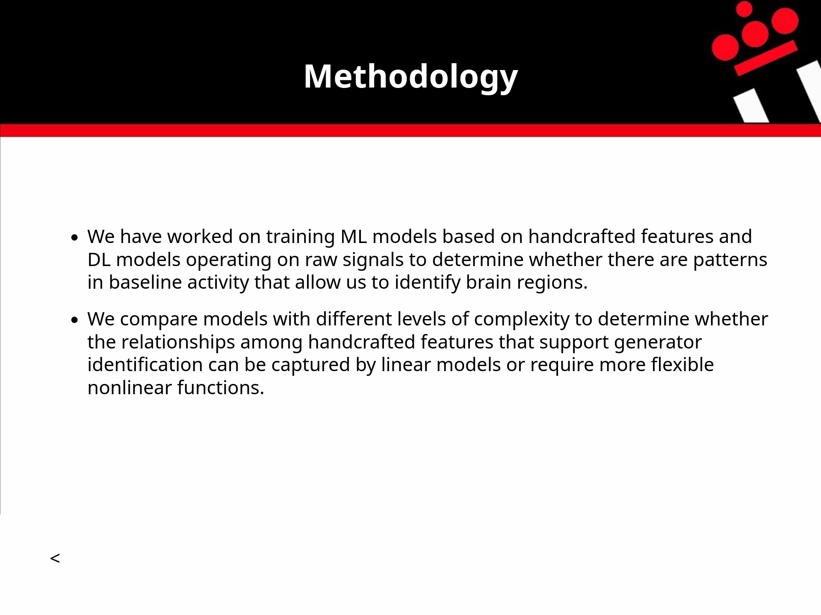

Slide 30
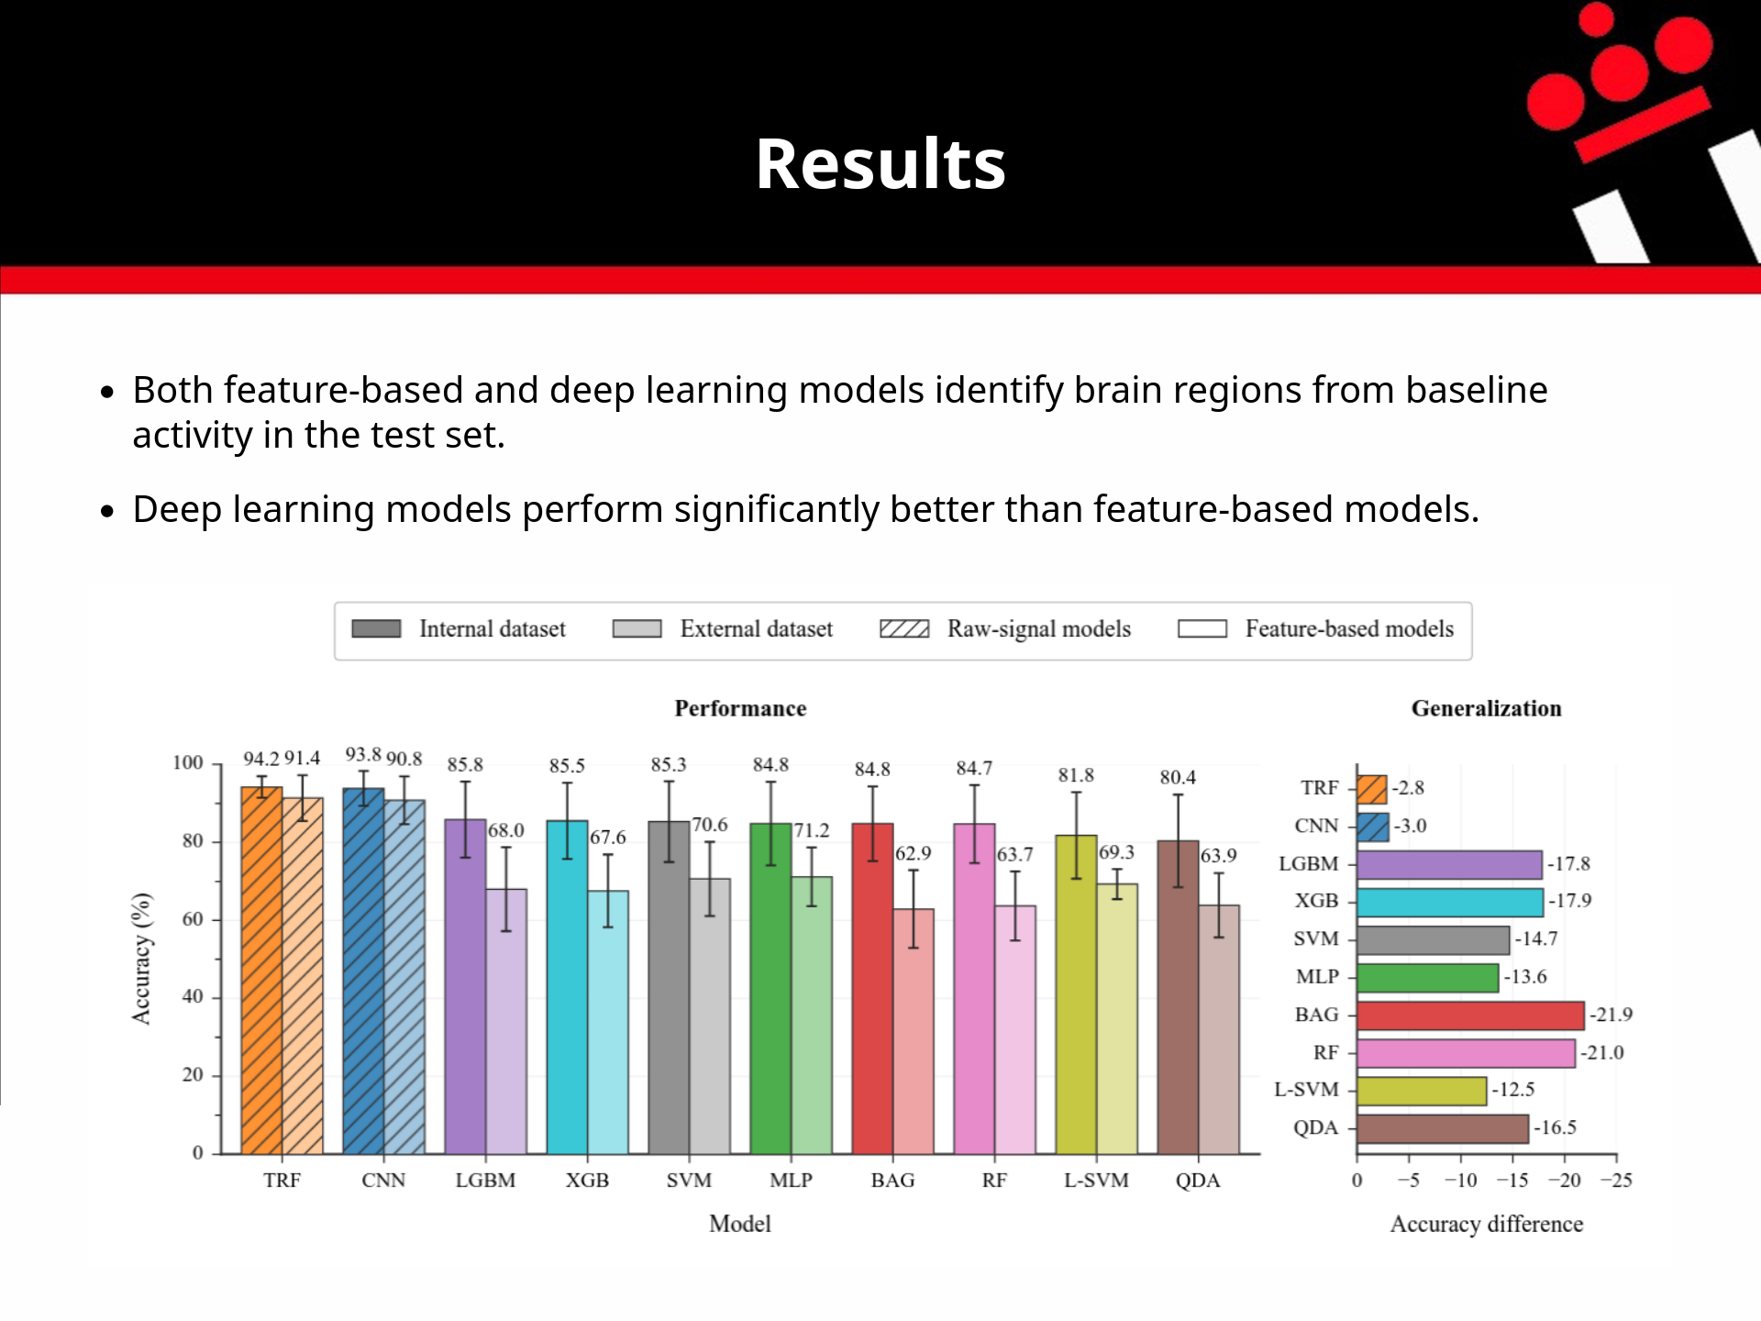

Slide 31
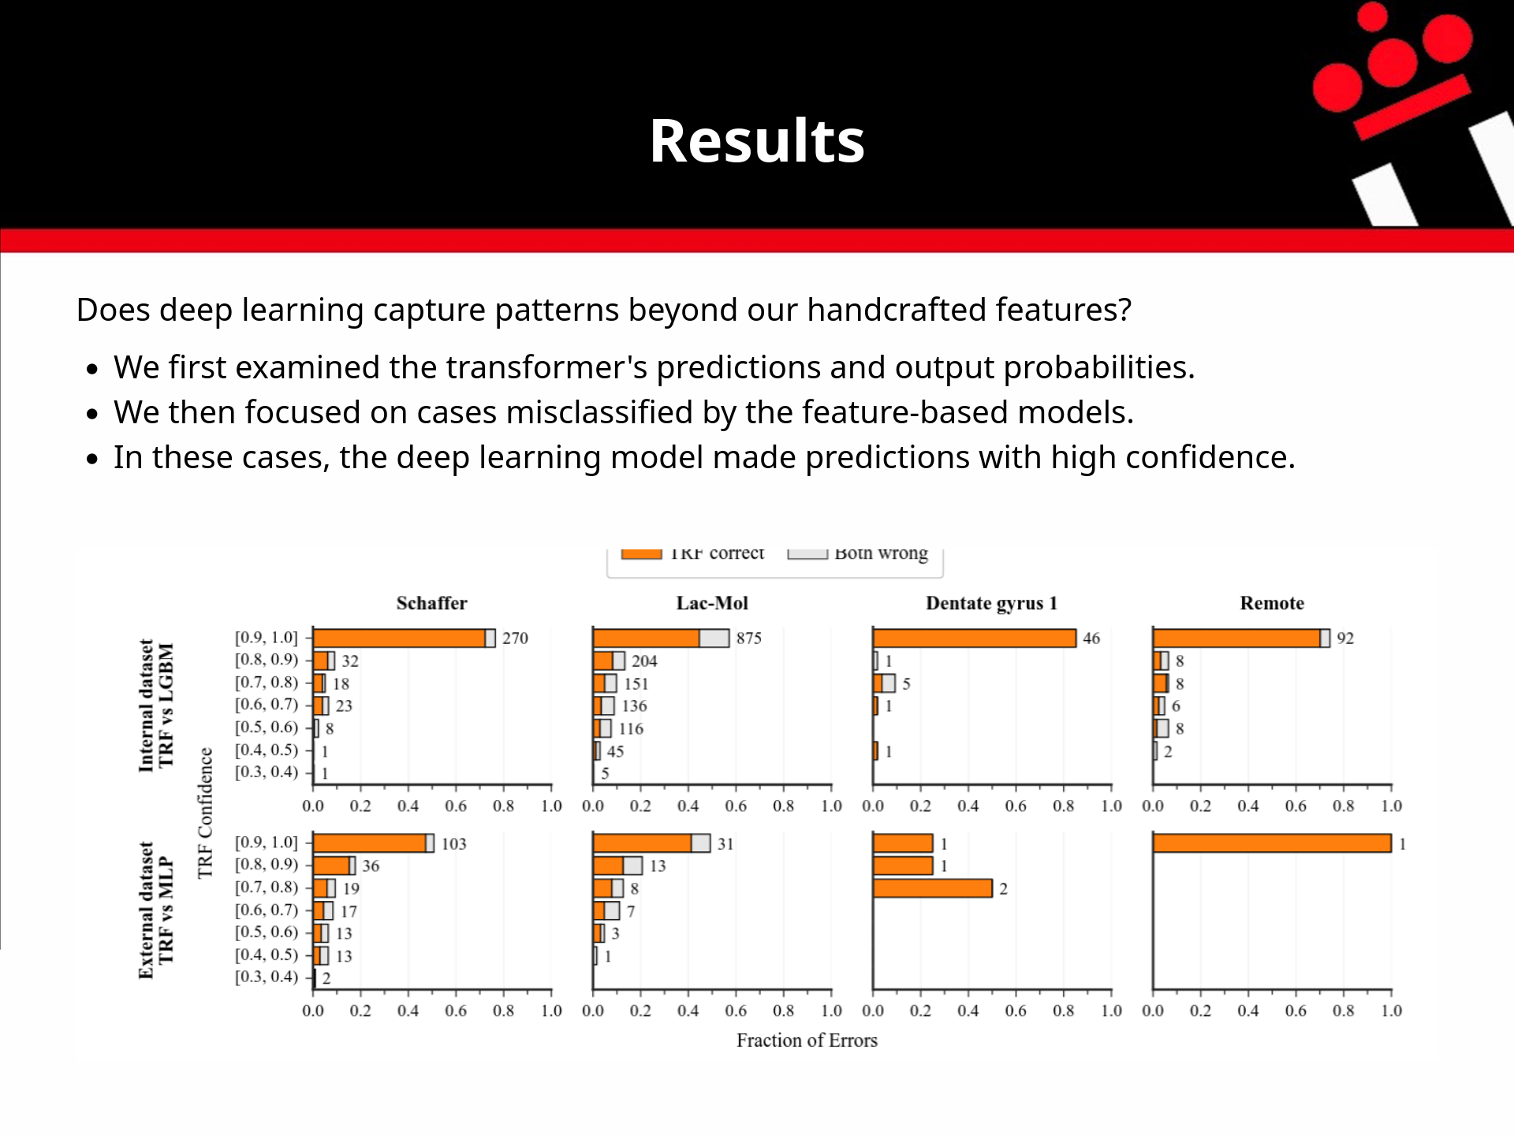

Slide 32
