Slide 1
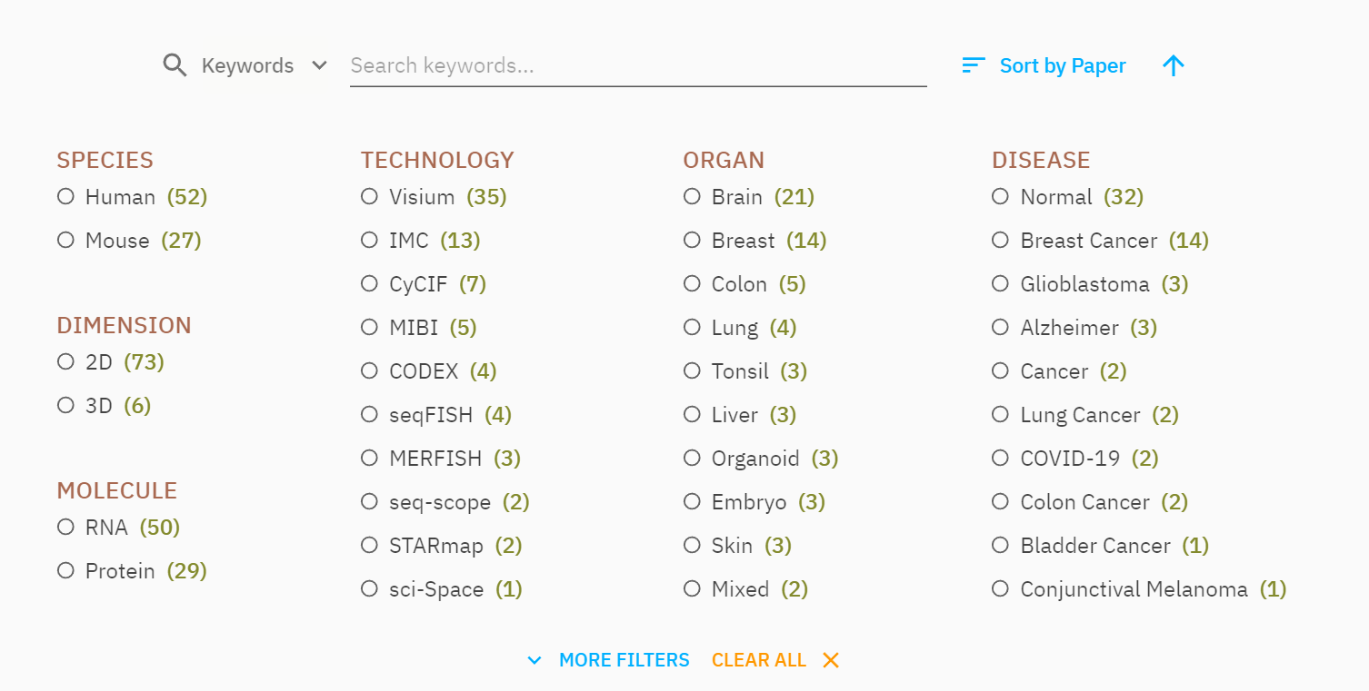
View All Datasets
View By Publications
Search
Sort
Filter

Slide 2
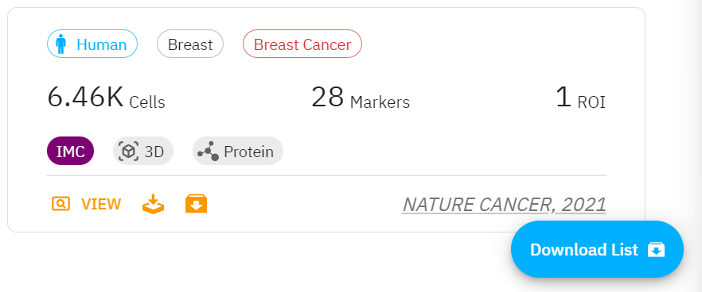
Species
Tissue
Disease
Technology
Molecule
Journal & Year
Click to view
Add to download list
Download
Directly
Click this to download all your selection

Slide 3
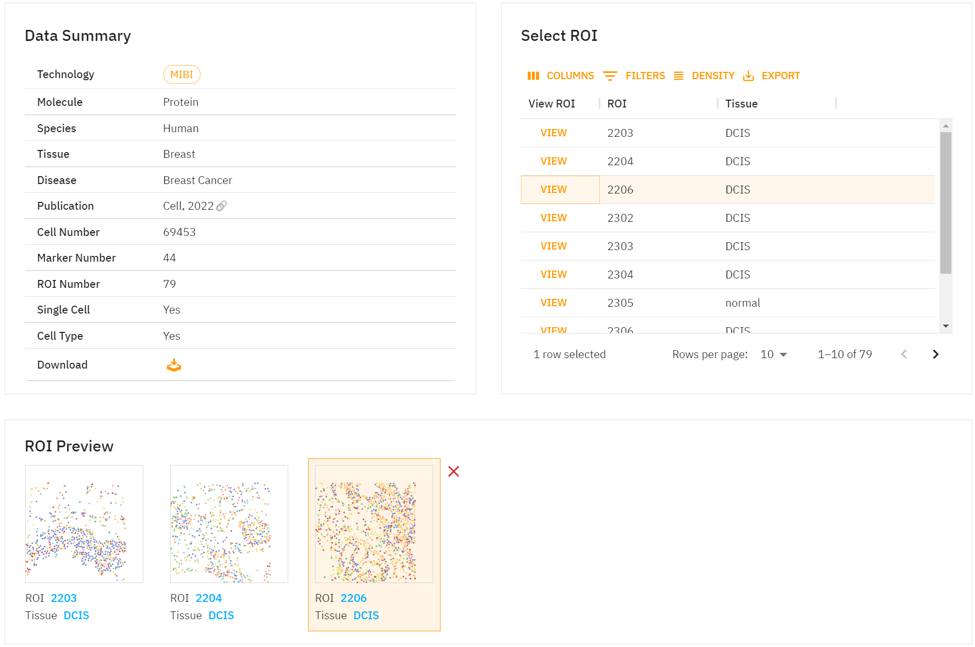
Click `View` will add the ROI to preview panel and show in following ROI visualization panel

Slide 4
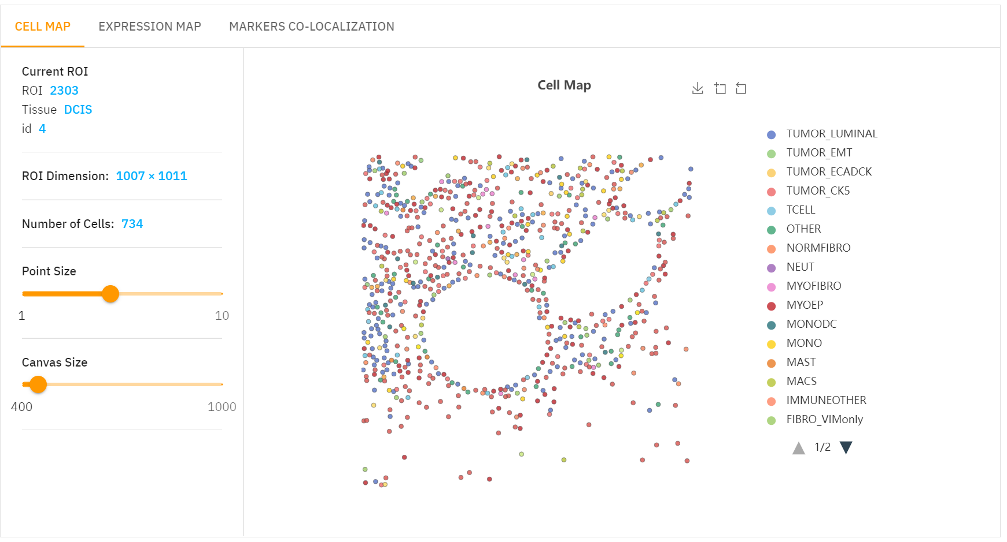

Slide 5
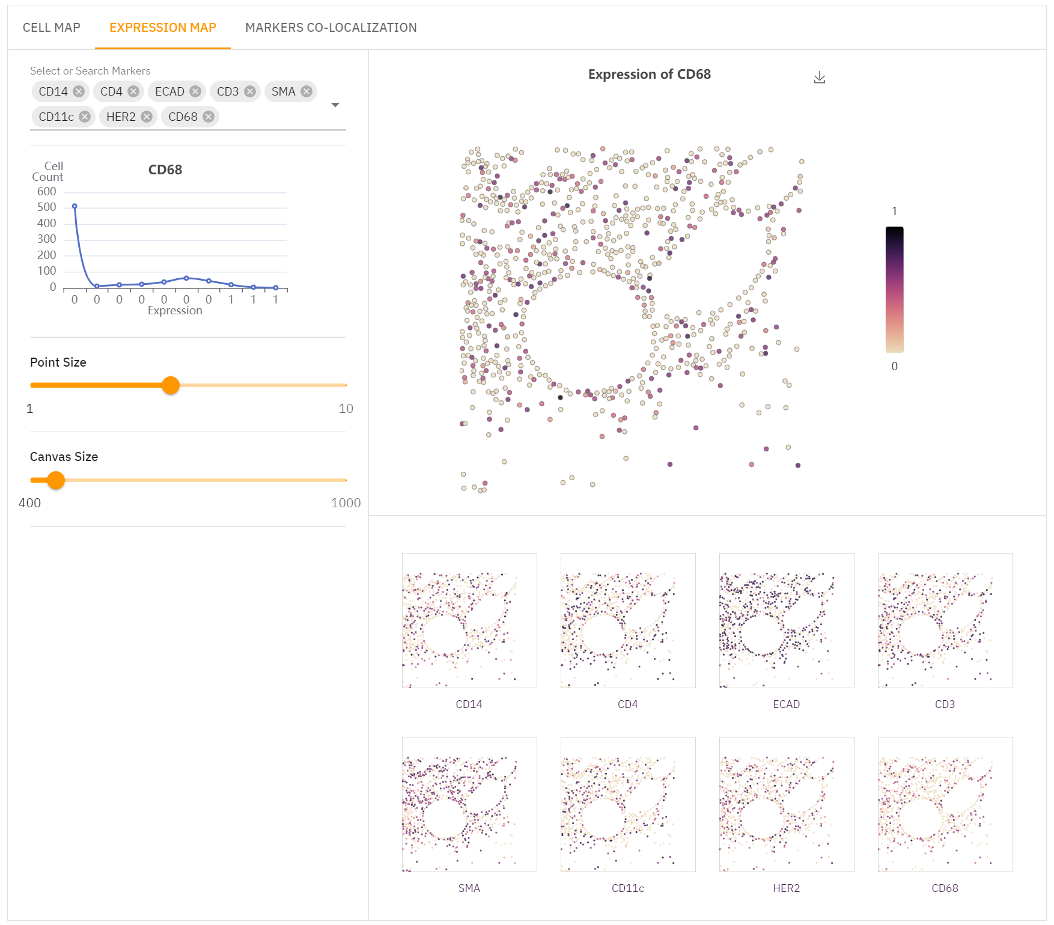

Slide 6
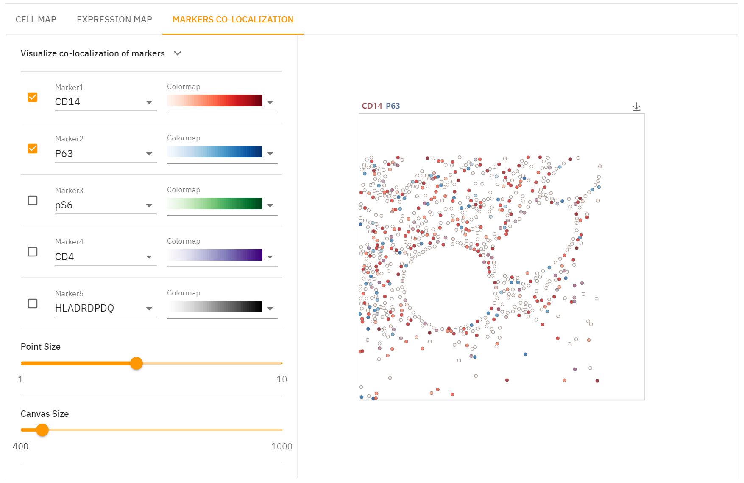

Slide 7
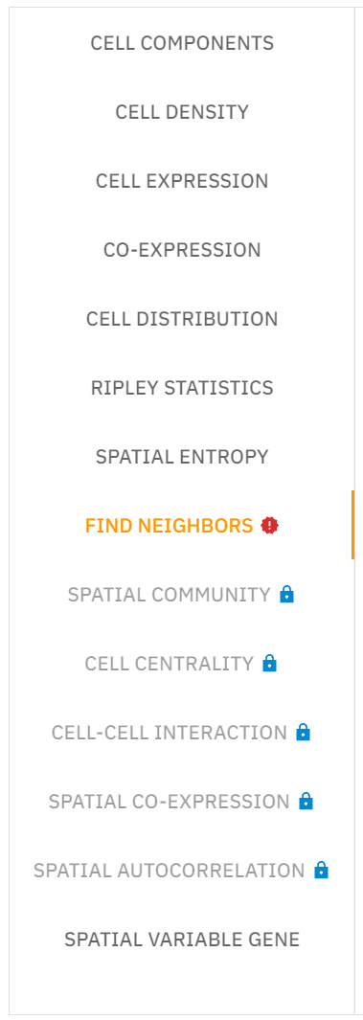
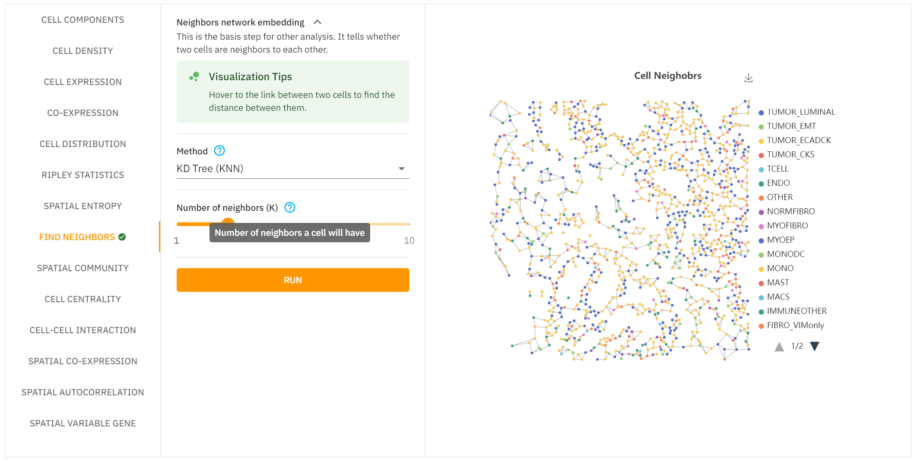

Slide 8


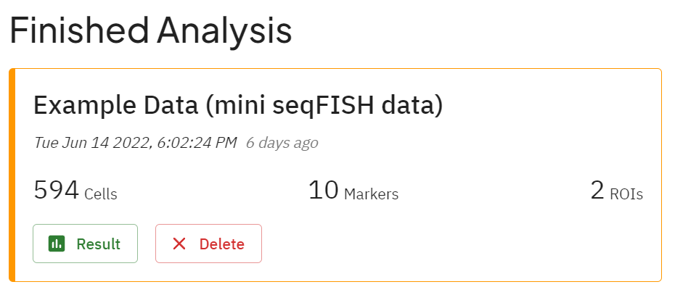
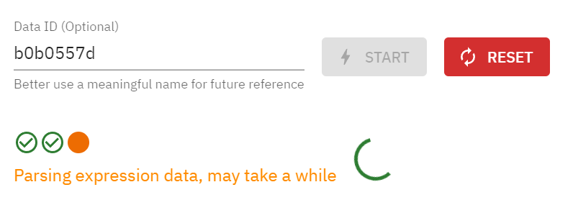
Click to view file specifications

