Slide 1

Software design and analysis
Names: Poli Ndiramiye Ninshuti
Module: Software engineering
On 05th, Oct, 2024

Slide 2
Agenda/Outline
Here is what we will focus on
Introduction to Software Design and Analysis
Conclusion
SDLC Overview
Tools and Examples
Key Design Concepts
Analysis Techniques
Design Patterns

Slide 3
Introduction to Software Design and Analysis
Software Design: Creating a blueprint for how software will be structured and built
Software Analysis: Evaluating the quality, performance, and structure of the software
Then who can define SDA

Slide 4
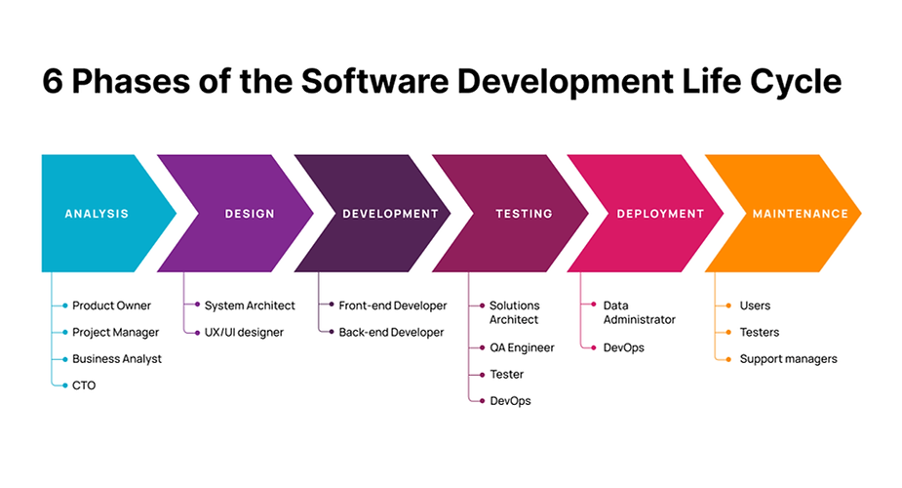
SDLC Overview
Software Development Life Cycle (SDLC)
Here are the steps of the phases: Requirement Analysis, Design, Implementation, Testing, Deployment, Maintenance
But we will emphasis on the Design and Analysis phases

Slide 5
Software Design Concept
Content:
Here are the steps of the phases: Requirement Analysis, Design, Implementation, Testing, Deployment, Maintenance
Modularity: Breaking systems into smaller parts
Abstraction: Hiding unnecessary complexity
Encapsulation: Grouping related data and methods
Cohesion and Coupling: Balance between how modules are divided and interact

Slide 6
Types of Software Design
Those includes:
Architectural design: here we defines the overall structure of the system, identifying major components and their interactions without delving into internal details.
Detailed design:This phase focuses on the intricate details of each software component, ensuring that developers have a clear blueprint for coding and testing.
Object Oriented Design: This approach enhances modularity, reusability, and maintainability in software development.
Functional design: This focuses on defining the functionalities of a system based on user requirements. It serves as a bridge between requirements analysis and detailed design, ensuring that the software meets the needs of its users.

Slide 7
Software Design Concept
Content:
Here are the steps of the phases: Requirement Analysis, Design, Implementation, Testing, Deployment, Maintenance
Modularity: Breaking systems into smaller parts
Abstraction: Hiding unnecessary complexity
Encapsulation: Grouping related data and methods
Cohesion and Coupling: Balance between how modules are divided and interact

