Slide 1

GROUP 2
COMPUTER NETWORKING ASSIGNMENT
Name | reg no
BYUKUSENGE Immacule | 222006273
NDIRAMIYE NINSHUTI Poli | 222002045
RUSHIMISHA Dieudone | 222013223
Niyodusenga Florence | 222010802
MINANI Regis | 222009959
NSENGIYUMVA Clement | 222005281
SUGIRA Herve | 222004590
UWINEZA Florence | 222005152
Cyeza Sangano Bruce Principle | 222010053

Slide 2
Definition: A modem is a device that allows computers to communicate over phone lines or cables by converting digital signals (from the computer) into analog signals (for transmission) and vice versa.
Types of Modems:
Dial-up Modems: Traditional, slower speeds.
DSL Modems(Digital Subscriber Line. ): High-speed connections using telephone lines.
Cable Modems: Utilize cable TV lines for broadband internet.
Fiber Optic Modems: High-speed data transmission using light signals.

Slide 3
Functions of Modems
Modulation:
Converts digital signals into analog for transmission.
Demodulation:
Converts incoming analog signals back into digital format.
Error Correction:
Ensures data integrity during transmission by detecting and correcting errors.
Protocols:
Supports various communication protocols (e.g., PPP, SLIP) for data exchange.
Modems play a crucial role in data communication by converting signals for transmission.

Slide 4
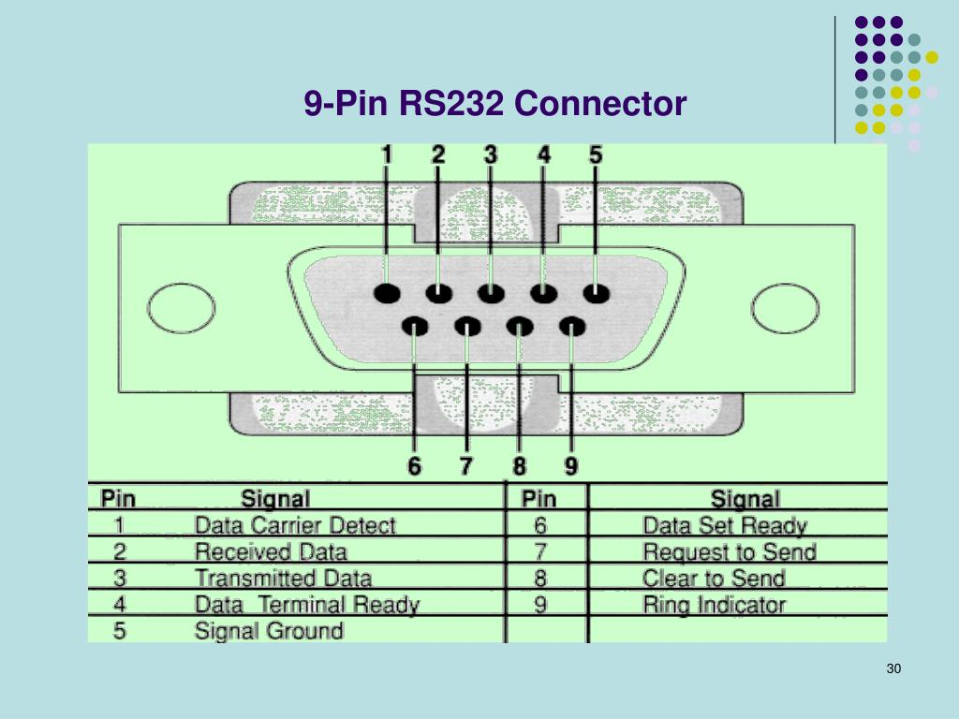
RS232 Connector

Slide 5
Definition: RS232 is a standard for serial communication between devices, typically used for computer and peripheral communication.
Pin Configuration:
Common pins include TX (Transmit), RX (Receive), GND (Ground), and others for control signals.
Communication Sequence:
Initialization: Devices establish communication settings (baud rate, data bits, etc.).
Data Transmission: Data is sent byte by byte over the serial connection.
Acknowledgment: Receiver sends acknowledgment signals to confirm receipt.
RS232 provides a reliable method for serial communication between devices, ensuring data integrity.

Slide 6
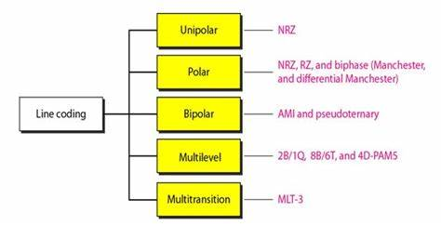
Line coding techniques

Slide 7
Definition: Line coding is the process in digital communication converting digital data into a digital signal.
Common Techniques:
Unipolar Encoding: Uses a single voltage level for binary data.
Polar Encoding: Uses two voltage levels, one for 0s and another for 1s.
Bipolar Encoding: Alternates between positive and negative voltages for consecutive 1s, providing error detection.
Line coding techniques are essential for efficient data transmission and play a significant role in digital communication systems.

Slide 8
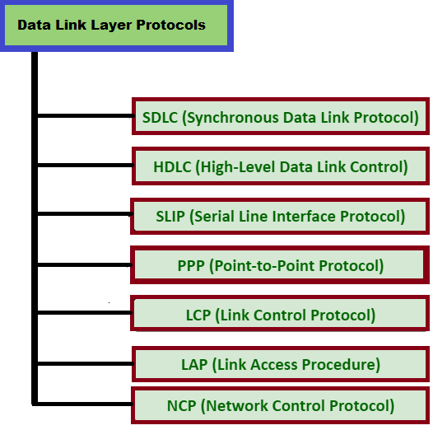
Data Link layers Protocols

Slide 9
Definition: The Data Link Layer is essential components of network architecture, facilitating communication between devices on the same local area network (LAN) or wide area network (WAN).
Functions:
Framing: Encapsulates packets into frames.
Addressing: Provides MAC addresses for network interface cards.
Error Detection and Correction: Ensures data integrity through checksums or CRCs.
Flow Control: Manages the rate of data transmission.
Data Link Layer protocols are crucial for reliable communication between devices.

Slide 10
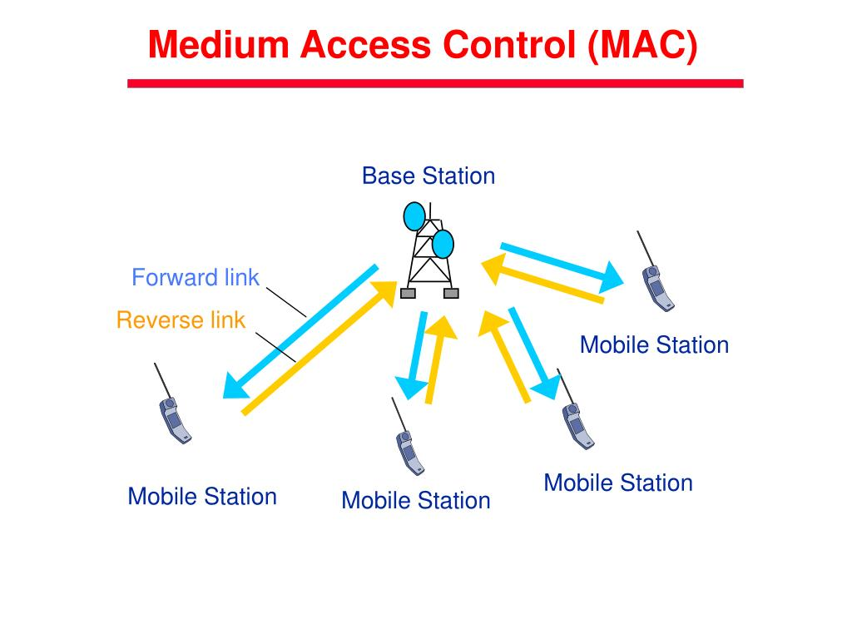
Medium Access Control (MAC)

Slide 11
Definition: MAC is is a physical unique identifier assigned to network interface controllers (NICs) for use in communications within a network segment.
Functions:
Addressing: Identifies devices on the network using MAC addresses.
Channel Access: Determines when devices can transmit data.
Protocols:
CSMA/CD (Carrier Sense Multiple Access with Collision Detection) for Ethernet.
CSMA/CA (Carrier Sense Multiple Access with Collision Avoidance) for Wi-Fi.

Slide 12
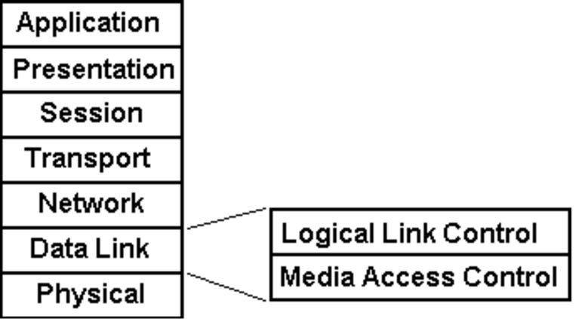
Logical Link Control (LLC)

Slide 13
Definition: LLC is the upper sublayer of the Data Link Layer, providing a way to identify the network layer protocols.
Functions:
Protocol Identification: Differentiates between multiple network layer protocols (e.g., IP, IPX).
Flow Control and Error Management: Ensures reliable data transfer.
Protocols: Commonly used in LANs and WANs, such as IEEE 802.2.

Slide 14
thank you.
the new super premium presentation

