Slide 1
第一、二章作业讲解
陈岭
lingchen@cs.zju.edu.cn

Slide 2
Chap. 1
6 Edition 1.3, 1.8, 1.9, 1.13

Slide 3
1.3 List six major steps that you would take in setting up a database for a particular
enterprise.

Slide 4
Steps of Database Design
Requirement analysis
  What data, applications, and operations needed
Conceptual database design
  A high-level description of data, constraints using E - R model or a similar high level data model
Logical database design:
  Convert the conceptual design into a DB schema
Schema refinement
  Normalization of relations: Check relational schema for redundancies and related anomalies.
Physical database design :
  Indexing, clustering and database tuning
Create and initialize the database & Security design
  Load initial data, testing
  Identify different user groups and their roles

Slide 5
1.8 List four significant differences between a file-processing system and a DBMS.

Slide 6
Database systems VS File Processing Systems
File processing system supported by a conventional OS:
  New application programs must be written when needed, and new data files are created as required.
  But over a long period of time, data files may be in different formats. Data files are independent of each other.
Drawbacks of using file systems to store data:
  Data redundancy and inconsistency
    Multiple file formats, duplication of information in different files.

Slide 7
Drawbacks of using file systems (cont.)
  Difficulty in accessing data
    Need to write a new program to carry out each new task.
  Data isolation - multiple files and multiple formats. (Difficult to retrieve, difficult to share)
  Integrity problems
    Integrity constraints (e.g. account balance > 0) become part of program code
    Hard to add new constraints or change existing ones

Slide 8
Drawbacks of using file systems (cont.)
  No atomicity of updates (consistent)
    Failures may leave database in an inconsistent state with partial updates carried out.
    E.g. transfer of funds from one account to another should either complete or not happen at all – atomicity.
  Difficult to concurrent access by multiple users
    Concurrent accessed needed for performance
    Uncontrolled concurrent accesses can lead to inconsistencies
      E.g. two people reading a balance and updating it at the same time
  Security problems (Right person use right data)
Database systems offer solutions to all the above problems!

Slide 9
1.9 Explain the concept of physical data independence, and its importance in database systems.

Slide 10
Physical data independence is the ability to modify the physical scheme without making it necessary to rewrite application programs.
Such modifications include changing from unblocked to blocked record storage, or from sequential to random access files. Such a modification might be adding a field to a record; an application program’s view hides this change from the program.

Slide 11
1.13 What are five main functions of a database administrator?

Slide 12
Database administrator's duties include:
  Schema definition
  Storage structure and access method definition
  Schema and physical organization modification
  Granting of authorization for data access
  Routing maintenance
    Monitoring performance and responding to changes in requirements
    Security for the database (e.g. periodically backup database, recovery when failure)

Slide 13
Chap. 2
6 Edition: 2.6; 2.7; 2.12; 2.13 ; 6.11 ; 6.13

Slide 14
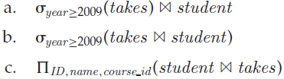
2.6 Consider the following expressions, which use the result of a relational algebra operation as the input to another operation. For each expression, explain in words what the expression does.

Slide 15
a. For each student who takes at least one course in 2009, display the students information along with the information about what courses the student took. The attributes in the result are:
ID, name, dept name, tot cred, course id, section id, semester, year, grade
b. Same as (a); selection can be done before the join operation.
c. Provide a list of consisting of all students who took any course in the university

Slide 16

2.7 Consider the relational database of Figure 2-14. Give an expression in the relational algebra to express each of the following queries:
a. Find the names of all employees who live in city “Miami”.
b. Find the names of all employees whose salary is greater than $100,000.
c. Find the names of all employees who live in “Miami” and whose salary is greater than $100,000.

Slide 17
a. ∏_{person_name} (σ_{city} _{= “Miami”} (employee))
b. ∏_{person_name} (σ_{salary} _{> 100 000} (works))
c. ∏ _{person_name} ((σ_{city} _{= “Miami”} (employee))
(σ_{salary} _{> 100 000} (works)))

Slide 18
2.12 Consider the relational database of Figure 2-14. Give an expression in the relational algebra to express each of the following queries:
a. Find the names of all employees who work for “First Bank Corporation”.
b. Find the names and cities of residence of all employees who work for “First Bank Corporation”.
c. Find the names, street address, and cities of residence of all employees who work for “First Bank Corporation” and earn more than $10,000.

Slide 19
a. Find the names of all employees who work for “First Bank Corporation”.

Slide 20

b. Find the names and cities of residence of all employees who work for “First Bank Corporation”.

Slide 21
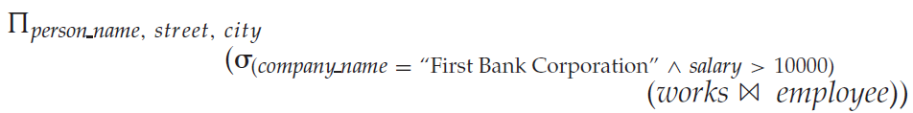
c. Find the names, street address, and cities of residence of all employees who work for “First Bank Corporation” and earn more than $10,000.

Slide 22
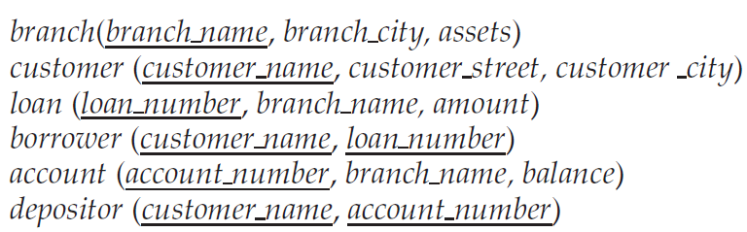
2.13 Consider the bank database of Figure 2.15. Give an expression in the relational algebra for each of the following queries:
a. Find all loan numbers with a loan value greater than $10,000.
b. Find the names of all depositors who have an account with a value greater than $6,000.
c. Find the names of all depositors who have an account with a value greater than $6,000 at the “Uptown” branch.

Slide 23

a. Find all loan numbers with a loan value greater than $10,000.

Slide 24
b. Find the names of all depositors who have an account with a value greater than $6,000.

Slide 25
c. Find the names of all depositors who have an account with a value greater than $6,000 at the “Uptown” branch.

Slide 26
6.11 Consider the relational database of Figure 6-22,where the primary keys are underlined. Give an expression in the relational algebra to express each of the following queries: d. Find the names of all employees in this database who live in the same city as the company for which they work.
e. Assume the companies may be located in several cities. Find all companies located in every city in which “Small Bank Corporation” is located.

Slide 27
d. Find the names of all employees in this database who live in the same city as the company for which they work.

Slide 28
e. Assume the companies may be located in several cities. Find all companies located in every city in which “Small Bank Corporation” is located.

Slide 29
6.13 Consider the relational database of Figure 6-22. Give a relational-algebra expression for each of the following queries:
a. Find the company with the most employees.
b. Find the company with the smallest payroll.
c. Find those companies whose employees earn a higher salary, on average, than the average salary at First Bank Corporation.

Slide 30

a. Find the company with the most employees.

Slide 31

b. Find the company with the smallest payroll.

Slide 32
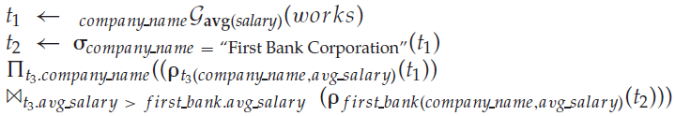
c. Find those companies whose employees earn a higher salary, on average, than the average salary at First Bank Corporation.

