Slide 1
第11章作业讲解
陈岭
lingchen@cs.zju.edu.cn

Slide 2
Chap. 11
Edition 6: 11.1, 11.16, 11.3(a, c), 11.4(c, e)

Slide 3
11.1 Since indices speed query processing, why might they not be kept on several search keys? List as many reasons as possible.

Slide 4
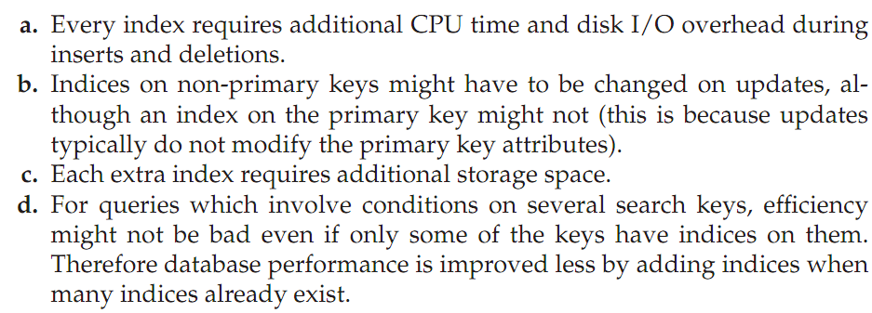

Slide 5
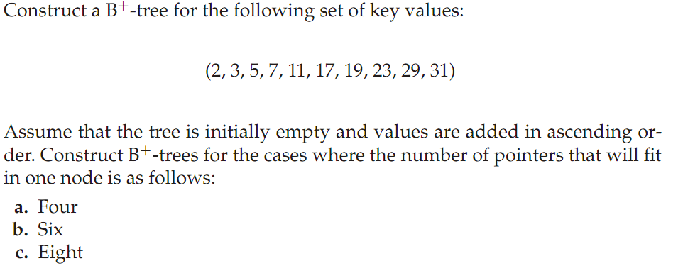
11.3

Slide 6
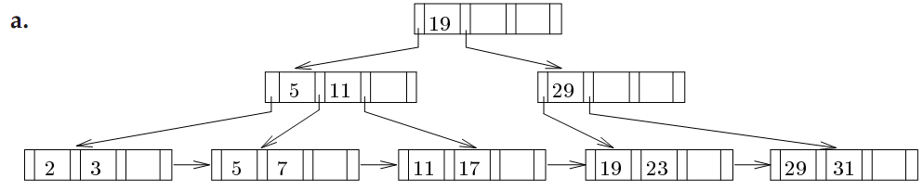

Slide 7
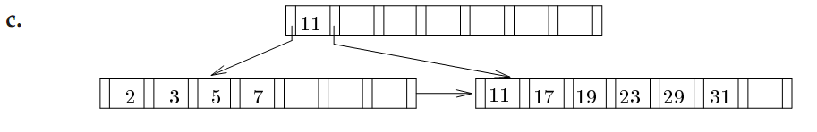

Slide 8
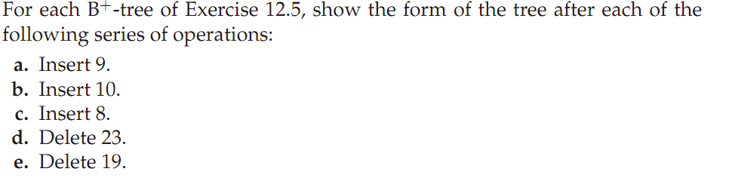
11.4
11.3

Slide 9
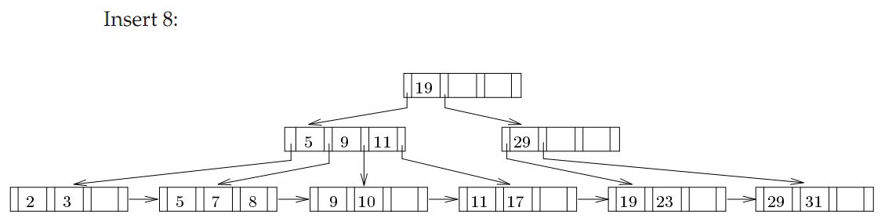
For c

Slide 10
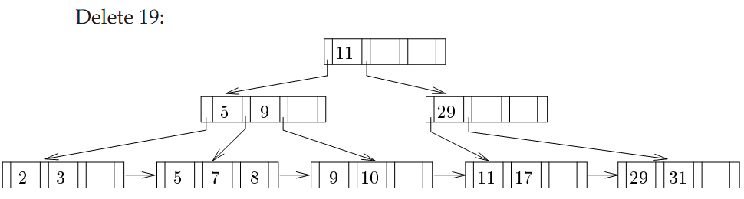
For e

Slide 11
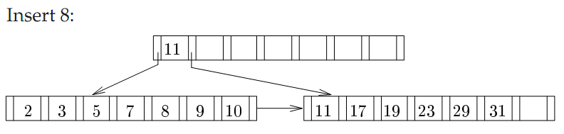
For c

Slide 12
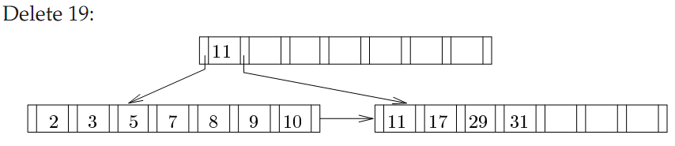
For e

Slide 13
11.16 What is the difference between a primary index and a secondary index?

Slide 14
The primary index is on the ﬁeld which speciﬁes the sequential order of the ﬁle. There can be only one primary index while there can be many secondary indices.

