Slide 1
第14章作业讲解
陈岭
lingchen@cs.zju.edu.cn

Slide 2
Chap. 14
Edition 6: 14.6,14.12,14.15

Slide 3
14.6Consider the precedence graph of Figure 14.16. Is the corresponding schedule conﬂict serializable? Explain your answer.

Slide 4
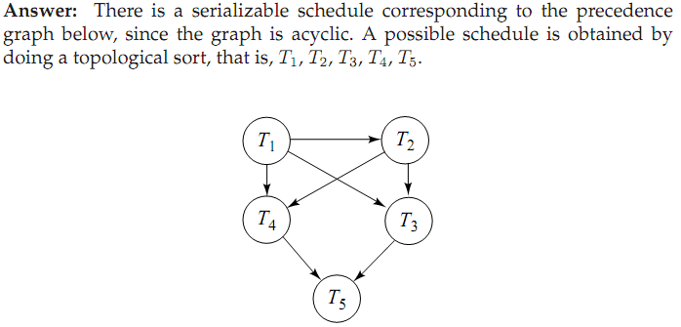

Slide 5
14.12List the ACID properties. Explain the usefulness of each.

Slide 6
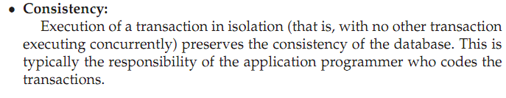


Slide 7
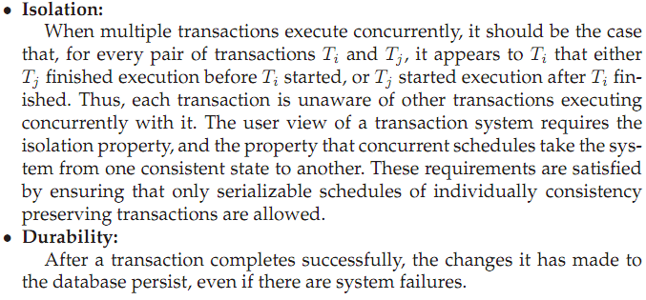

Slide 8
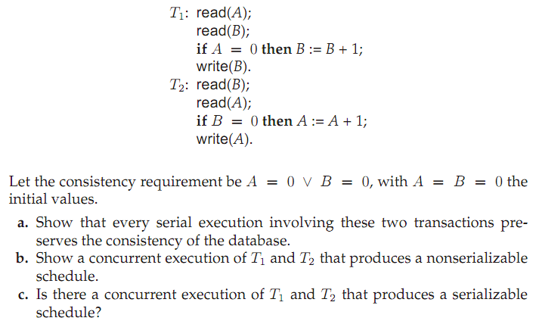
14.15

Slide 9
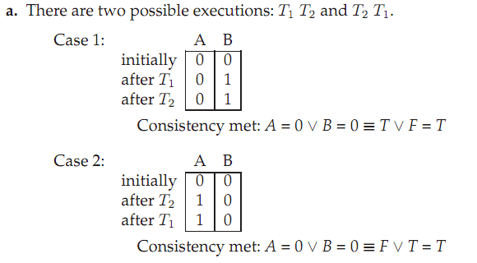

Slide 10
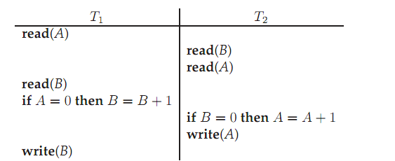

Slide 11
