Slide 1
第15章作业讲解
陈岭
lingchen@cs.zju.edu.cn

Slide 2
Chap. 15
Edition 6: 15.1, 15.2, 15.20

Slide 3
15.1 Show that the two-phase locking protocol ensures conﬂict serializability, and that transactions can be serialized according to their lock points.

Slide 4
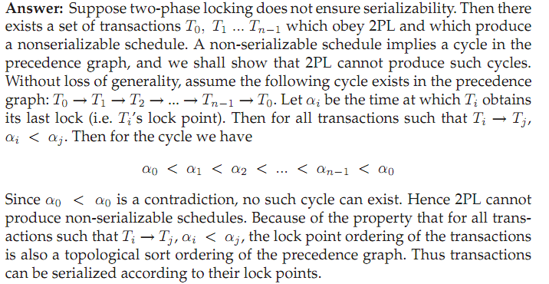

Slide 5
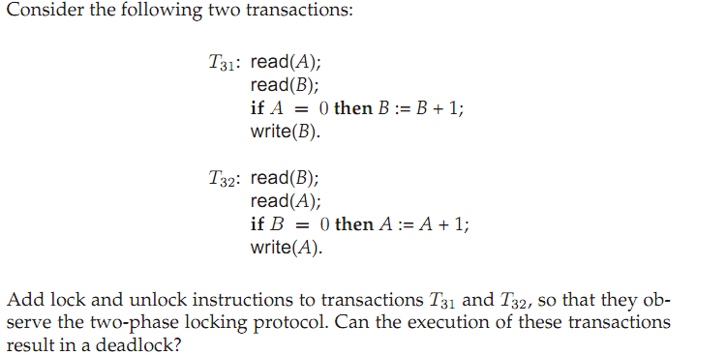
15.2

Slide 6
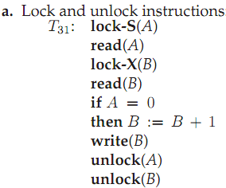
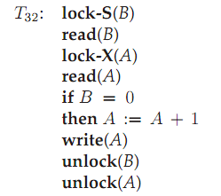

Slide 7
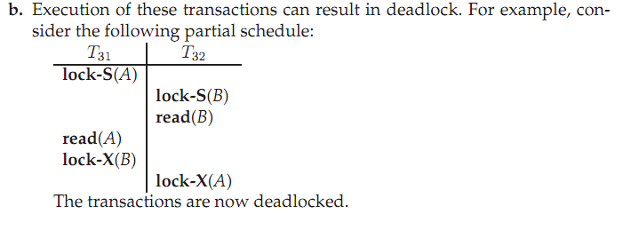

Slide 8
15.20What beneﬁt does strict two-phase locking provide? What disadvantages result?

Slide 9


