Slide 1
第十六章作业讲解
陈岭
lingchen@cs.zju.edu.cn

Slide 2
Chap. 16
6 Edition: Ex. 16.8, 16.18

Slide 3
16.8 Disk space allocated to a file as a result of a transaction should not be released even if the transaction is rolled back. Explain why, and explain how ARIES ensures that such actions are not rolled back.
Answer: If a transaction allocates a page to a relation, even if the transaction is rolled back, the page allocation should not be undone because other transactions may have stored records in the same page. Such operations that should not be undone are called nested top actions in ARIES. They can be modeled as operations whose undo action does nothing. In ARIES such operations are implemented by creating a dummy CLR whose UndoNextLSN is set such that the transaction rollback skips the log records generated by the operation.

Slide 4
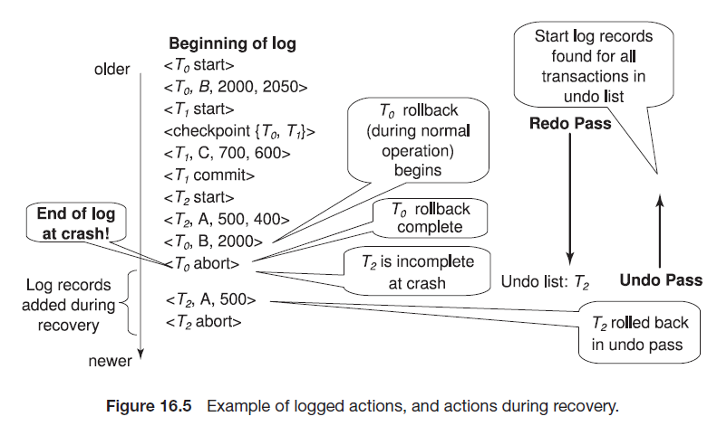
16.18 Consider the log in Figure 16.5. Suppose there is a crash just before the < T0 abort> log record is written out. Explain what would happen during recovery.

Slide 5
16.18 Consider the log in Figure 16.5. Suppose there is a crash just before the < T0 abort> log record is written out. Explain what would happen during recovery.
Answer: Recovery would happen as follows:
Redo phase:
Undo-List = T0, T1
b. Start from the checkpoint entry and perform the redo operation.
c. C = 600
d. T1 is removed from the Undo-list as there is a commit record.
e. T2 is added to the Undo list on encountering the < T2 start > record.
f. A = 400
g. B = 2000

Slide 6
Answer:
Undo phase:
a. Undo-List = T0, T2
b. Scan the log backwards from the end.
c. A = 500; output the redo-only record < T2, A, 500 >
d. output < T2 abort >
e. B = 2000; output the redo-only record < T0, B, 2000 >
f. output < T0 abort >
At the end of the recovery process, the state of the system is as follows:
A = 500
B = 2000
C = 600

Slide 7
Answer:
The log records added during recovery are:
< T2, A, 500 >
< T2 abort >
< T0, B, 2000 >
< T0 abort >
Observe that B is set to 2000 by two log records, one created during normal rollback of T0, and the other created during recovery, when the abort of T0 is completed. Clearly the second one is redundant, although not incorrect. Optimizations described in the ARIES algorithm(and equivalent optimizations described in Section 16.7 for the case of logical operations) can help avoid carrying out redundant operations, which create such redundant log records.

