Slide 1
第二十二章作业讲解
陈岭
lingchen@cs.zju.edu.cn

Slide 2
Chap. 22
6 Edition: Ex. 22.1 22.4

Slide 3
22.1 A car-rental company maintains a database for all vehicles in its current fleet. For all vehicles, it includes the vehicle identification number, license number, manufacturer, model, date of purchase, and color. Special data are included for certain types of vehicles:
Trucks: cargo capacity.
Sports cars: horsepower, renter age requirement.
Vans: number of passengers.
Off-road vehicles: ground clearance, drivetrain (four- or two-wheel drive).

Slide 4
Answers：
We use table inheritance and assume that MyDate, Color and DriveTrainType are pre-defined types.
  create type Vehicle
  (vehicle id integer,
  license number char(15),
  manufacturer char(30),
  model char(30),
  purchase date MyDate,
  color Color)
  create table vehicle of type Vehicle
  create table truck
  (cargo capacity integer)
  under vehicle

Slide 5
Answers：
We use table inheritance and assume that MyDate, Color and DriveTrainType are pre-defined types.
  create table sportsCar
  (horsepower integer
  renter age requirement integer)
  under vehicle
  create table van
  (num passengers integer)
  under vehicle
  create table offRoadVehicle
  (ground clearance real
  driveTrain DriveTrainType)
  under vehicle

Slide 6
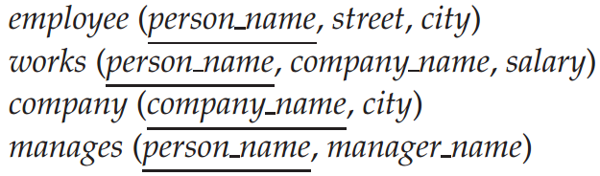
22.4 Consider the relational schema shown in Figure22-6
  a. Give a schema definition in SQLcorresponding to the relational schema, but using references to express foreign-key relationships.
  b. Write each of the queries given in Exercise 6.13 on the above schema, using SQL.
Find the company with the most employees.
Find the company with the smallest payroll.
Find those companies whose employees earn a higher salary, on average, than the average salary at First Bank Corporation.

Slide 7
Answers：
a. create type Employee
(person name varchar(30),
street varchar(15),
city varchar(15))
create type Company
(company name varchar(15),
(city varchar(15))
create table employee of Employee
create table company of Company

Slide 8
Answers：
create type Works
(person ref(Employee) scope employee,
comp ref(Company) scope company,
salary int)
create table works of Works
create type Manages
(person ref(Employee) scope employee,
(manager ref(Employee) scope employee)
create table manages of Manages

Slide 9
Answers：
b. i. Find the company with the most employees.
  select comp−>name
  from works
  group by comp
  having count(person) ≥ all(select count(person)
  from works
  group by comp)
ii. Find the company with the smallest payroll.
  select comp−>name
  from works
  group by comp
  having sum(salary) ≤ all(select sum(salary)
  from works
  group by comp)

Slide 10
Answers：
iii. Find those companies whose employees earn a higher salary, on average, than the average salary at First Bank Corporation.
  select comp−>name
  from works
  group by comp
  having avg(salary) > (select avg(salary)
  from works
  where comp−>company name="First Bank Corporation")

